Slide 1
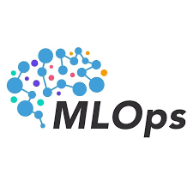
+
Machine Learning
Data gathering
Operations
Data cleaning
Delivery
EDA
Feature Engineering
Deployment
Model Training
Maintenance-Monitoring
Model Evaluation
ML Ops engineer will maintain the entire pipeline from data gathering to deployment
Testing
Containerize entire project using docker
QA

Slide 2
Continuous Integration/Continuous Delivery/Continuous Deployment/ Continuous Training
CI/CD/CD/CT Pipelines
CI(Continuous Integration): Automatically building and testing code changes frequently to detect issues early, using GitHub action we can set up workflows that trigger builds and tests whenever changes are pushed to the repository. This ensures that the codebase remains stable and that any integration issues are caught promptly, leading to higher quality software and more efficient collaboration.
CD (Continuous Delivery & Deployment) : As soon as testing is done successfully, deliver and deploy the project using docker
CT (Continuous Training): retraining models whenever new data is available or code changes occur, ensuring that the model remains up-to-date and accurate.
- DVC: Use DVC to track datasets. When new data is pushed to the repository, it can trigger the CI/CD pipeline.
- MLFlow: Log models and their parameters, metrics, and artifacts.
- Airflow: Schedule the retraining process.

Slide 3
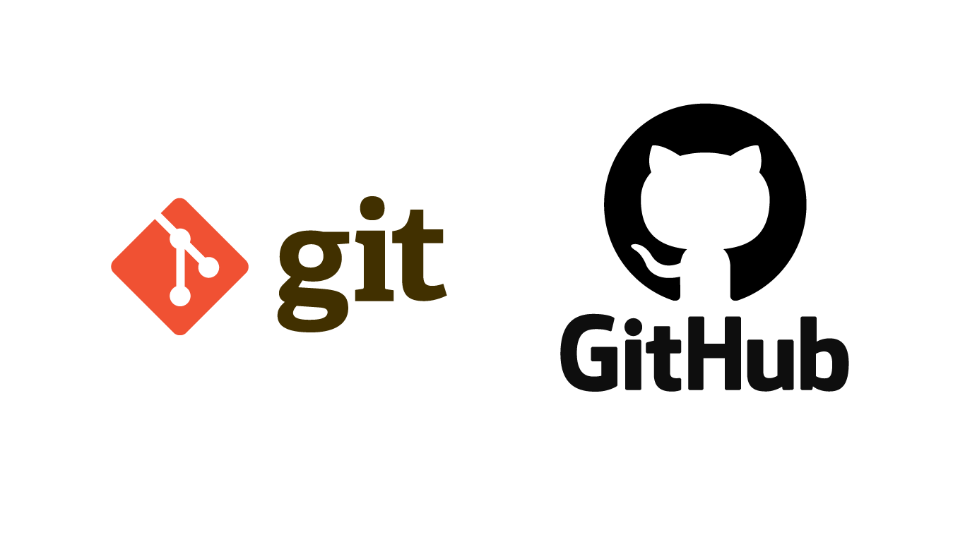
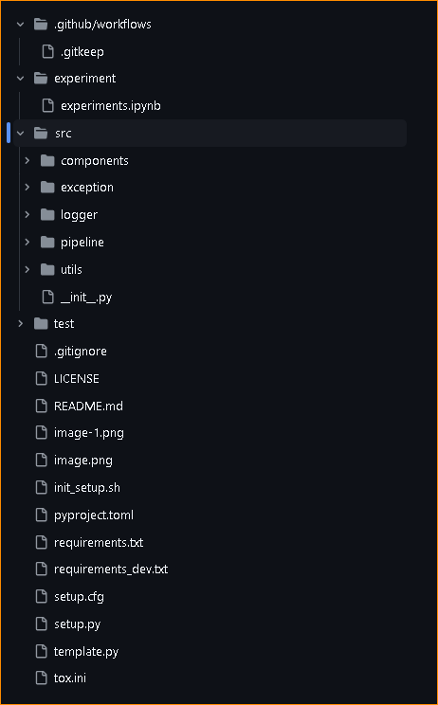
Create a GitHub repo & Clone it in local system: git clone <repo url>
Create file and folder structure using template.py
Above can be done by creating a github repo using template repo in github
CI/CD Configuration
ML Development/experiments
data ingestion, transformation, model trainer, model evaluation
Custom exception
logging
Training & prediction pipeline
Common utility functions
Unit/Integration testing
Ignore files/folders to be pushed in github repo

Slide 4
Micro Project: Deploy Python Package (CI Concepts)
We will create a unified python package to perform CRUD operations which will be hosted on github & released on
pypi repo so that people can pip install and use it in their code
Mongodb is a nosql dbs where we save data in dictionary format, we will also include cassandra, mysql etc
This package will be able to perform crud operations & connecter for all major dbs
Create folder structure using template.py
Create ci.yaml & python-publish.yaml
Generate pypi api token & add in github under setting > security > actions > new repository secret and save
it inside github secret variables
“Continuous Integration (CI) is a software development practice where developers frequently integrate their
code into a shared repository multiple times a day. Each integration (or "commit") is automatically tested to detect
issues early, enabling teams to identify and address bugs as soon as they arise. The goal of CI is to improve software
quality and reduce the time it takes to deliver updates”

Slide 5
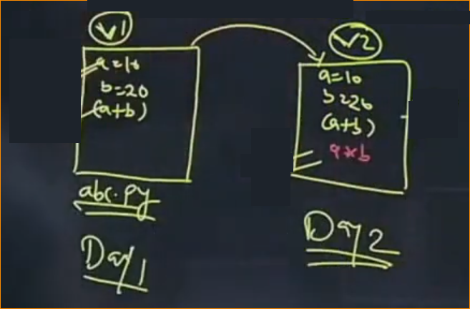
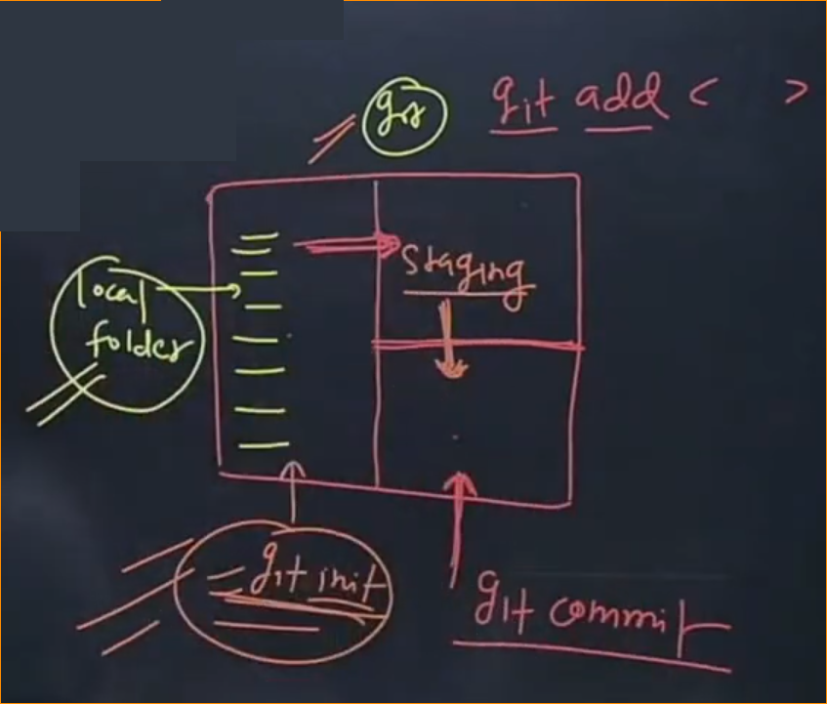
GIT is a Source Code Management Tool. What is SCM and Version Control?
Source code is the code that we write for any program
Lets say we write some code on day1 & write more code
On day 2, so day 1 file is v1 & day 2 file is v2, even though
It’s the same file, but it has 2 versions
By using “git” we can manage different versions of the code, It’s a SCM tool.
Git is a Open Source tool
“git init” in local folder to local repo, git add <file_name> to add the file in
Staging area & finally we can commit to take a snapshot of the code
git cimmit –m “<comment>”
- <skipped>

Slide 6
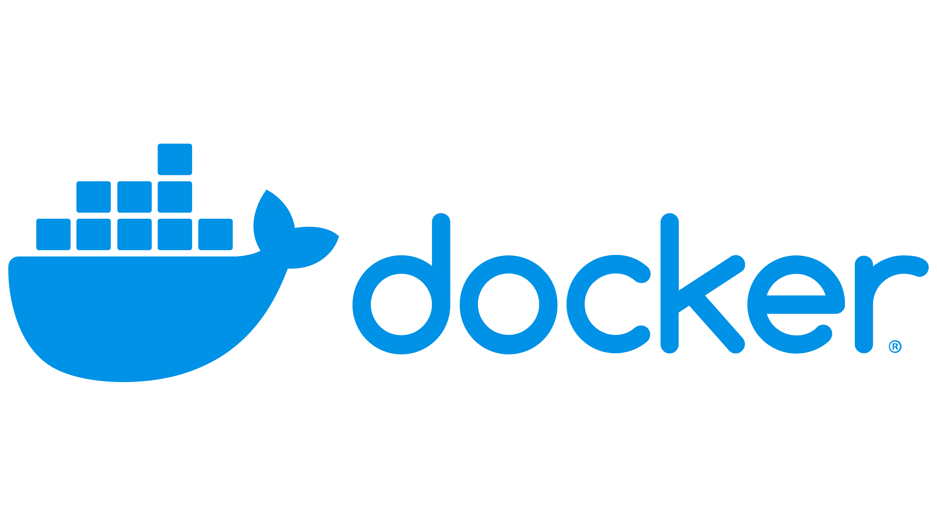
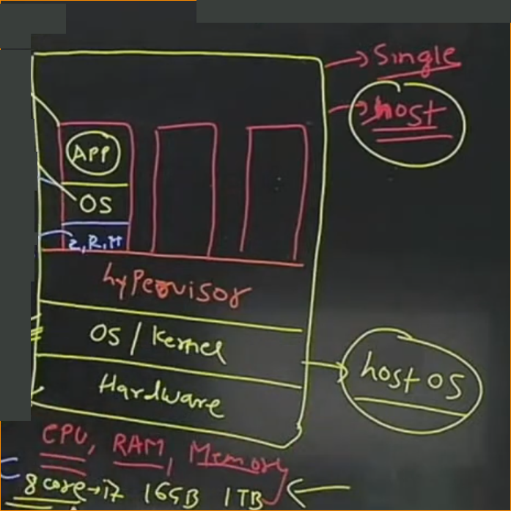
What is docker?
Docker was developed in 2013 developed by Solomon Hikes. It’s open-source tool.
Actual virtualization is done by “docker engine”
Written using “Go” language of google.
There are 3 services: IAAS, PAAS, SAAS. Docker is a PAAS since its providing a platform to run application
We can build, run & deploy application using docker
What was the problem before?
Lets say we have a development, testing and deployment team. When development team creates a program and send it to
Testing team to test, Its doesn’t work on their system due to development environment or dependencies not available.
Or when we write code in our local system, It works flawlessly but when we deploy it on aws or cloud then it fails, it gives
“internal server error”
Solution was “Virtualization” and actual program which is responsible for virtualization called
“hypervisor”
We can create multiple VMs by sharing resources using hypervisor and we can create a template
Of it and share that template to Testing team and it will work on their system also but the issue
with this is that we cant create unlimited VMs since its sharing the resources of the host pc since
Resources are fixed and will not be free until VM are shut down.
We are installing separate OS in virtualization which takes more memory. Solution to this is
“Containerization”, we can use Docker Engine for containerization. In containerization we share
Host OS & resources and they are not fixed. Its not directly interacting with hardware.
Port Mapping: Lets say we’re running flask on docker which uses 5000 port but we cant access it on host os
unless its mapped, 5000(host port): 5000(container app port)

Slide 7
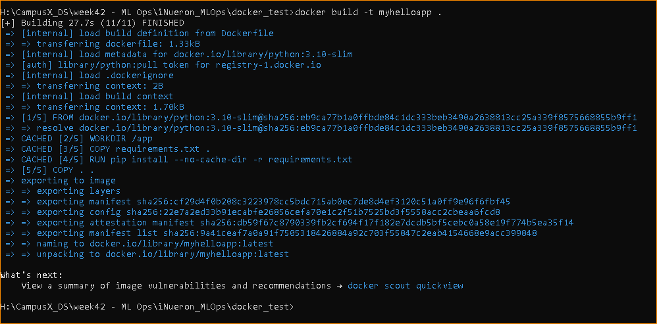
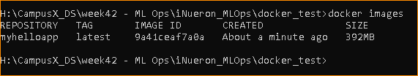
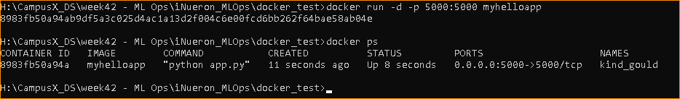
TASK: Create flask app and run it on docker container inside docker image
Inside docker hub there are images of almost all technologies like os, web servers like nginx, dbs like sql etc
There are 3 ways to create a image:
We can write a docker file and create image
We can create image directly from container
Run “docker images” to check all images
Run “docker ps” to check all running containers
Create app.py file for flask and run it on local system
Now we can containerize this app, there 3 ways to create a image
Write a docker file for this app and create a docker image
Run this docker image inside container
By default, Flask runs on 5000 port
To access the flask app on local system which is running inside the container we need to perform port mapping
“host port : container port”
In summary, we need to create a docker file to create a docker image of flask app & run that image inside docker
Container, to access the flask app in local system, we need to perform port mapping
In order to create image we have 2 ways:
1. Create a docker file which contains instructions
2. Create an image directly using docker commands
Write docker file : FROM, COPY, WORKDIR, RUN, CMD
Create docker image using this docker file: “docker build -t <image name> <.>”
Image name = image name we want to keep & “.” means file is available in the same folder
Once image is created, check it : “docker images” (This is the 1st way to create an image, 2nd way is we can convert container to image & share it to next team)
Now we can run this image in container: docker run -d -p <host_port>:<container_port> <image_name>
docker run –d –p 5000:5000 myhelloapp
Now check in local browser: http://localhost:5000/ this app is running from container
To stop this container and free resources: docker stop <containerid>
Container is an isolated process

Slide 8
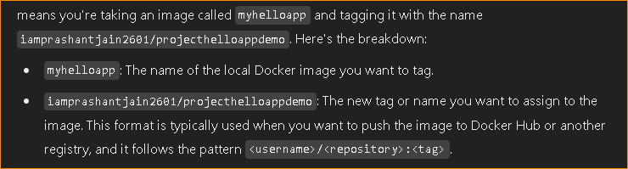
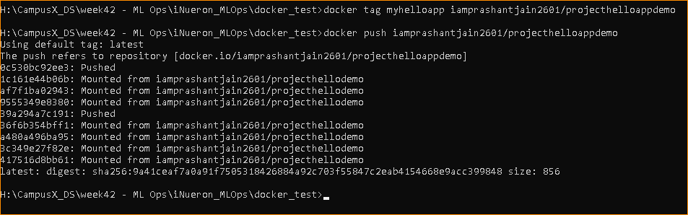
How to push the image we created previously to docker hub?
Docker is same as github where we push our repo
Login to docker inside terminal: “docker login”
Push the image: “docker tag myhelloapp iamprashantjain2601/projecthelloappdemo”
To push: “docker push <username>/<repo_name>”

Slide 9
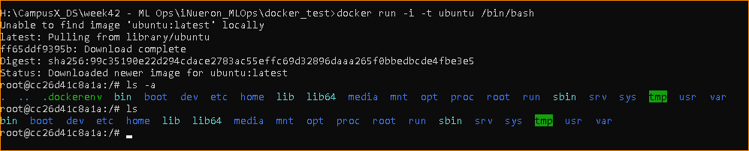
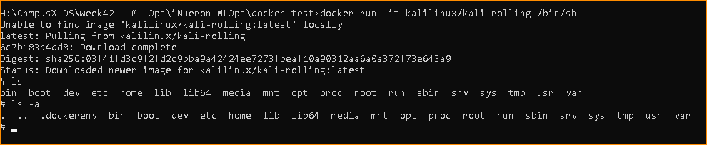
After it pushed to docker hub, anyone can use it by pulling it same as we push & pull in github
“docker pull iamprashantjain2601/projecthelloappdemo”
We have various ways to create docker images
1. docker file
2. pull image from docker hub & run inside container
3. create image from docker container
- How to pull the image and run inside container?
- There is a component inside docker “docker engine”
If we run the image 1st time, it will find that image in local system, if its not found then it will fetch from dockerhub
Pull: “docker pull redis”
Run: ”docker run –i –t ubuntu /bin/bash”
When we are pulling os like ubuntu, its not going to pull entire OS, only some utility files and rest will be used from host os
How to Run any image directly inside the container?
docker run -it kalilinux/kali-rolling /bin/sh (“kalilinux/kali-rolling “ is the new image name)

Slide 10
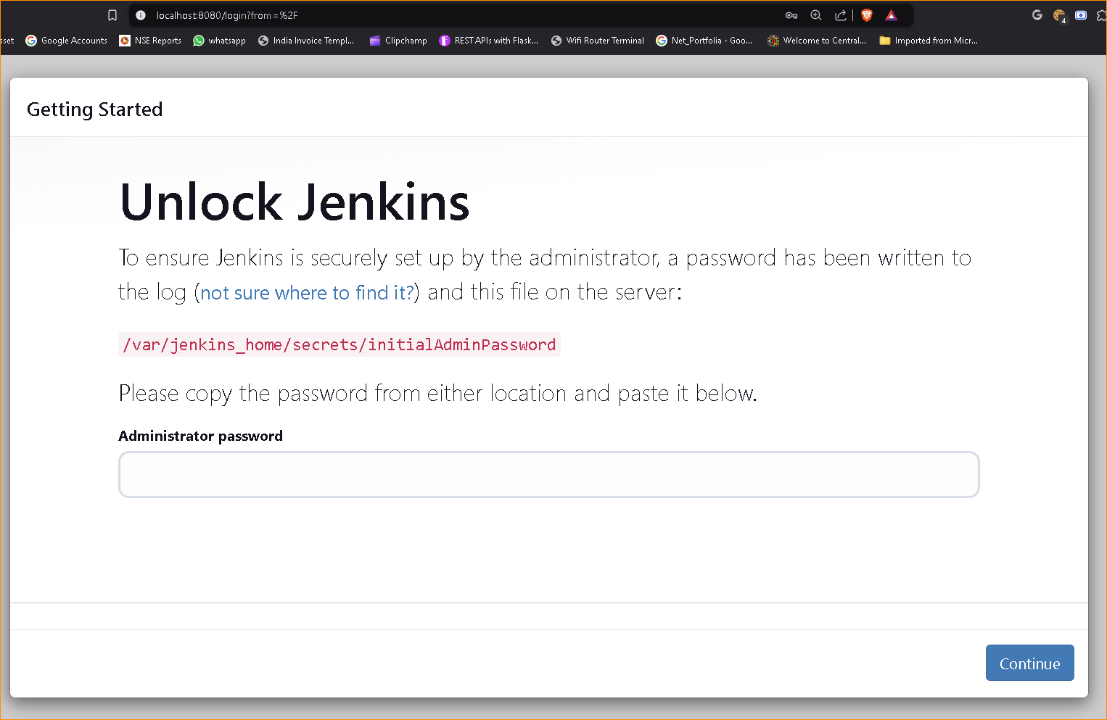
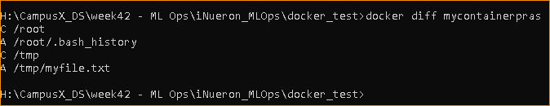
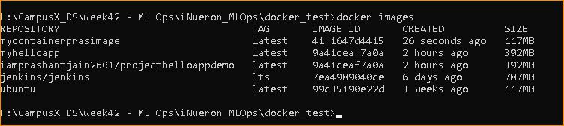
There are 2 ways to execute container: detach mode “-d” and interactive mode “-i”
To delete docker image: docker rmi –f Jenkins/Jenkins:lts or docker rmi redis
To run the image & run it directly like Jenkins.. Which is not installed in our system but we can still run it using docker
docker run -p 8080:8080 jenkins/jenkins:lts
How to create an image from container itself like we’re running an image inside container, how to share the image to next team?
We can ship these containers from 1 place to another that’s why we use docker.. To share containers b/w teams from development to testing to deployment teams
Run ubuntu container & make some changes to it and share it
docker run --name mycontainerpras -it ubuntu /bin/bash
cd tmp & touch myfile.txt to create new file (as developer we write app file)
To check what changes we have made:
docker diff <container name>
Now we can share this directly to my testing team, we can create image from this container .
docker commit <container name> <updated image name>
docker commit mycontainerpras mycontainerprasimage
Now we can push this image to docker hub, which anybody can pull & use

Slide 11

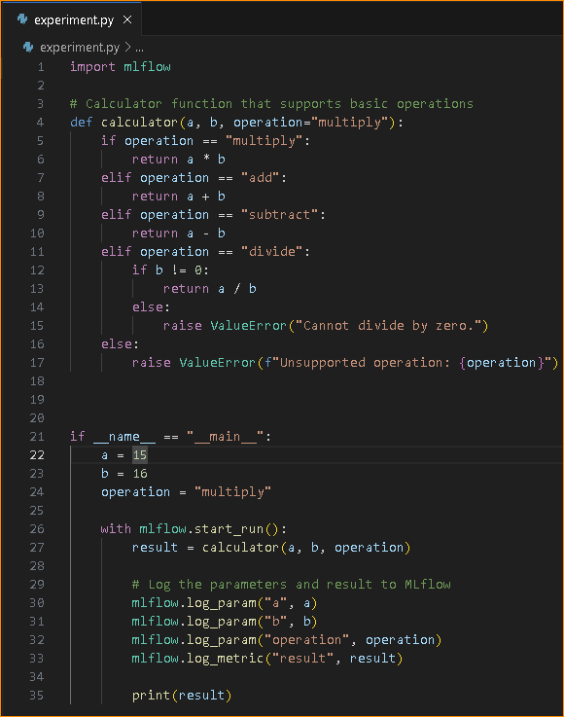
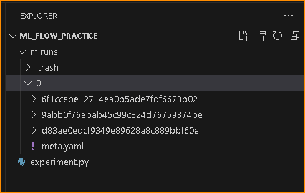
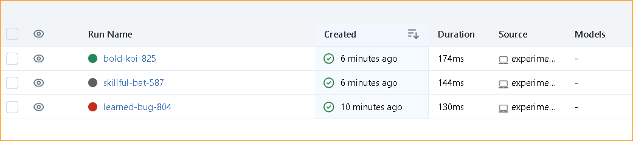
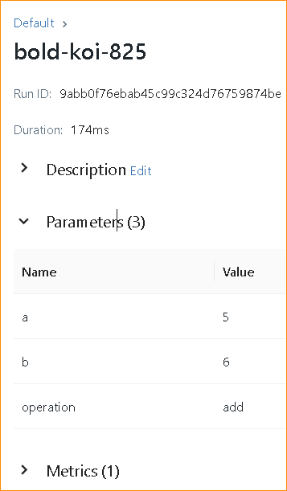
Why Use MLFlow?
We use MLFlow for experiment tracking inside pipelines, we can manage various stages of model using Dagshub.
To practice, we can create a sample program and try to track the experiments performed inside it.
If I run the same code multiple times, Each execution is called an Experiment, same as
In Machine learning, We’ll be executing training pipeline multiple times with different
Parameters, Transformation techniques and data. Each of those executions are also called
“Experiments”
- We can track all those experiments using MLFlow.
- To track, We need to start the MLFlow server using command: `with mlflow.start_run():`
- This will start the server.
- After logging everything, We can run the pipeline (or the sample calculator code)
- As soon we run the code, It will create a folder `mlruns` which contains all details like params &
Results
- We can run the same experiment again for different params and everything will be logged
Inside the same folder.
- This Experiment tracking can also be seen in the UI using command: `mlflow ui`

Slide 12

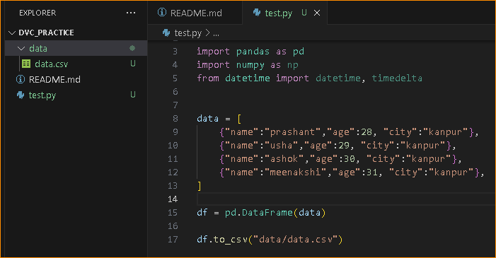
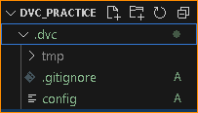
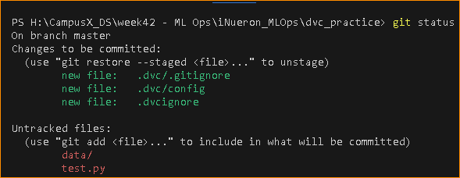
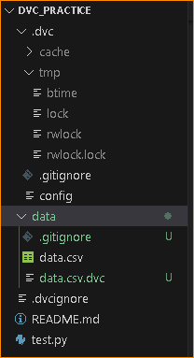
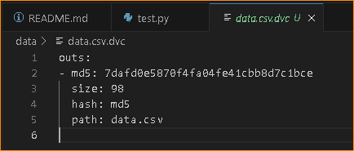
(Data Version Control)
- DVC(data version control) works on Git so Git must be initialized.
- To test, we can create a python with dummy dictionary & creating data frame from that dict
- We can commit this and create different versions of the code, That’s why git is for : “Source code management”
- Now we can run the code to generate dummy data
- Create .gitignore file & mention venv, data folders
- Also, we can initialize “DVC” using command: `dvc init` which will create a folder .dvc similar to .gitignore in git
- Whatever we don’t track, we can mention inside .dvcignore file inside the folder
- When we run git status, we will see that dvc folders which got create after dvc init are already added to staging area of git, we don’t need to add them, we can directly commit them.
- Now run “dvc add data/data.csv”, this will create a “data.csv.dvc” file, Now the “data management” comes into picture
- We never use git & github for data management and data version, We use it for SCM & we track data using git bcoz of data size as git doesn’t support large file, conflict resolution is easy with different version of code but will be very difficult with different version of data and solve conflicts bcoz we can check few line manually but not millions of rows to resolve conflict. Performance also hapmers bcoz it slows down.
- That’s why in data folder there will be 2 files: .gitignore (which will mention “data” to not track data since git isn’t for data management) and data.csv.dvc which contains metadata about data folder

Slide 13
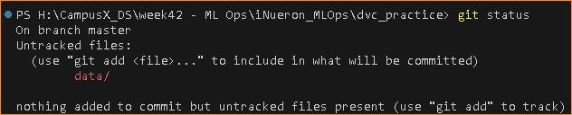
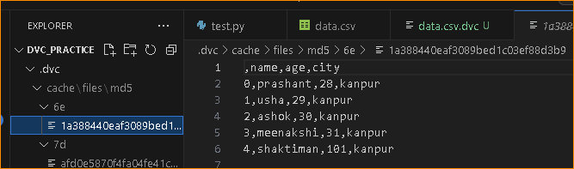
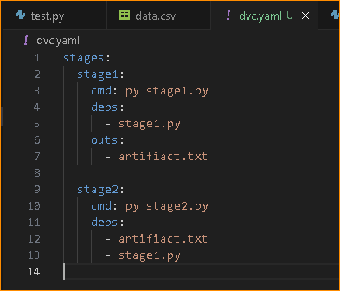
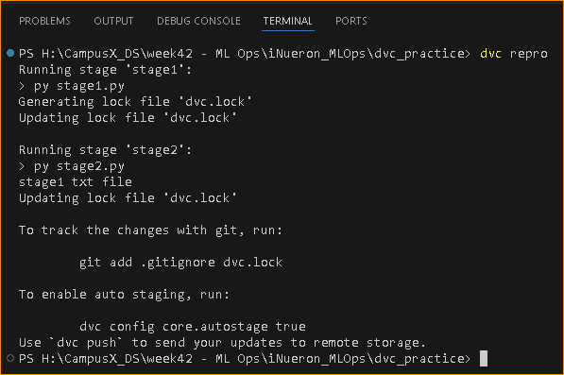
- Currently data has 4 rows, run ‘git status’ It says git is not tracking “data folder”
- Commit the changes: git commit –m “data file added”
- Now add 1 row to data and run “dvc add data/data.csv” which will update “md5” in data.csv.dvc file also
“cache” folder in .dvc folder contains all the version of data
- In order to get to the previous version of data, We are not tracking actual data since its mentioned in .gitignore
file but we are tracking “data.csv.dvc” file which contains metadata about the data
- We can run: “git checkout <1st 6 letters of commit key> & dvc checkout → It will restore that data
- That’s how we can manage different version of data by using single file : “data.csv.dvc”
- We can configure AWS S3 to save the data versions, and we can manage them using data.csv.dvc file
- For dvc reproducibility (to reproduce my pipeline), we can create dvc.yaml file in the workspace to track all the
changes in the data, model, params etc
In order to practice dvc reproducibility, create 2 files stage1.py & stage2.py in workspace. In 1st file I will
Create a text file & in 2nd file I will read that txt file.
- Stage2 depends on stage1
- dvc.yaml file is for writing configurations in key & value pai, we have 2 stages: stage1
& stage2
- Now run “dvc repro” which will create dvc.lock file
H:\CampusX_DS\week42 - ML Ops\iNueron_MLOps\dvc_practice>git checkout 1bc3e9
Note: switching to '1bc3e9'.
You are in 'detached HEAD' state. You can look around, make experimental
changes and commit them, and you can discard any commits you make in this
state without impacting any branches by switching back to a branch.
If you want to create a new branch to retain commits you create, you may
do so (now or later) by using -c with the switch command. Example:
git switch -c <new-branch-name>
Or undo this operation with:
git switch -
Turn off this advice by setting config variable advice.detachedHead to false
HEAD is now at 1bc3e95 data updated
H:\CampusX_DS\week42 - ML Ops\iNueron_MLOps\dvc_practice>dvc checkout
Building workspace index |2.00 [00:00, 38.3entry/s]
Comparing indexes |3.00 [00:00, ?entry/s]
Applying changes |1.00 [00:00, 53.3file/s]
M data\data.csv

Slide 14
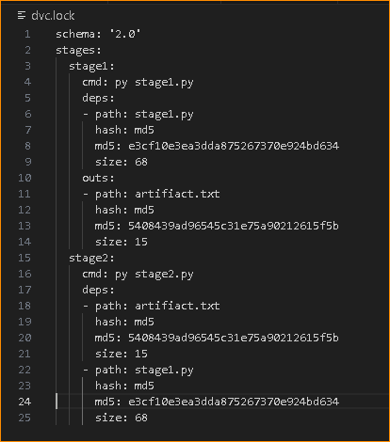
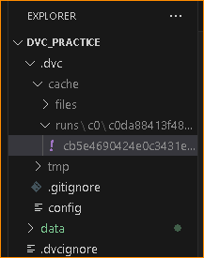
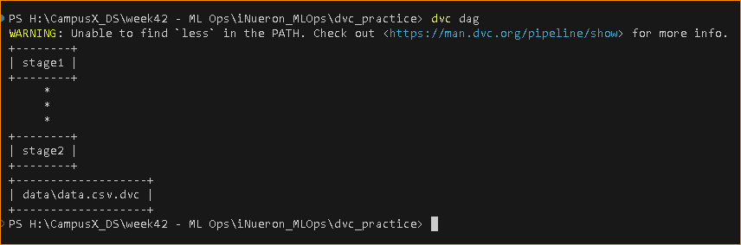
- Before we were tracking data using data.csv.dvc file which only has current file version data
And remaining will be saved inside the cache folder
- Git is only tracking “data.csv.dvc” file, and using git checkout & dvc checkout we can get the previous
version of the data
We can also do pipeline versioning along with data versioning using dvc.
- In pipeline we have various components like data ingestion, transformation, model training, evaluation,
We will write some code inside each component & we will have some output like we had in our
Components like data ingestion had raw, train & test data as output, data transformation had
Preprocessor.pkl as output, model trainer had model.pkl as output and so on
- Each output is input for next component where each component is dependent on previous component
Same as we have seen in practice code where stage is dependent on stage 1.
- Everything about pipeline versioning can be defined inside dvc.yaml file & all changes are tracked under run folder
- Run “dvc dag” to check dependencies where it shows stage 2 dependent on stage 1, DAG means direct acyclic graph and this concept will also be
In “Airflow”

Slide 15


Airflow for Continuous Training (CT)
- Airflow works smooth on linux since it was built on linux, so we can use docker container for that.
- Create a folder inside the project workspace: airflow\dags & create 2 files inside the folder: batch_prediction.py & training_pipeline.py
- After that, create a docker file with complete instruction to create docker image, another file “docker-compose.yaml” & “Dockerfile” and “start.sh” file regarding airflow,
How to activate & run the scheduler. Also update dvc.yaml file for pipeline tracking.
- Similar to docker-compose.yaml, we can deploy the application using docker.
- Run “docker-compose up” to run the docker file to create the image, up the container automatically

Slide 16
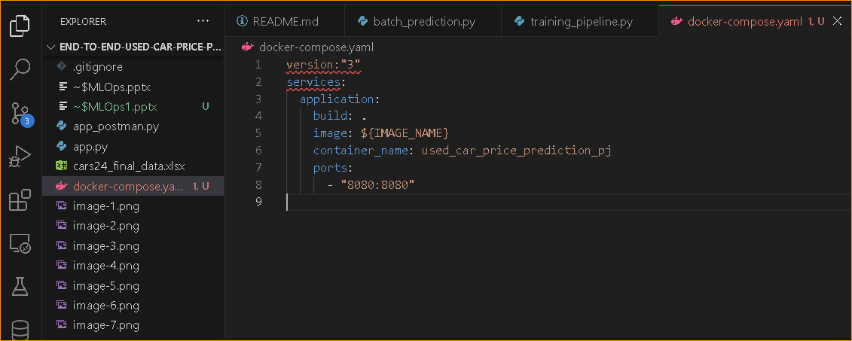
This is a **Docker Compose** configuration file for a single service:
- **version: "3"**: Specifies Docker Compose file format version 3.
- **services**:
- **application**: Defines a containerized application with the following options:
- **build: .**: Builds the Docker image from the current directory (using the `Dockerfile` there).
- **image: ${IMAGE_NAME}**: Names the image dynamically using the environment variable `IMAGE_NAME`.
- **container_name: used_car_price_prediction_pj**: Assigns a custom name to the container.
- **ports**: Maps port 8080 on the host to port 8080 in the container.
It builds and runs a containerized application, naming it `used_car_price_prediction_pj`, and exposes it on port 8080.

Slide 17
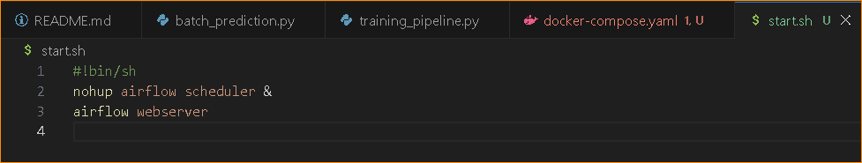
- shell script used to start Apache Airflow services.
- nohup: Stands for "no hang-up". It allows the command to keep running even if the user logs out or the terminal is closed.
- airflow scheduler: Starts the Apache Airflow scheduler, which is responsible for executing scheduled tasks (DAGs). The scheduler continuously monitors for new tasks to run.
- &: Runs the command in the background, so the script doesn’t block further execution.
- “airflow webserver”: Starts the Airflow web server, which serves the Airflow UI (User Interface) so you can monitor and manage workflows through a web browser. By default, it runs on port
8080.
- Summary: Starts the Airflow scheduler in the background (nohup and & ensure it runs even after the terminal is closed).
Then, it starts the Airflow web server, allowing you to access the Airflow UI to monitor workflows.

Slide 18
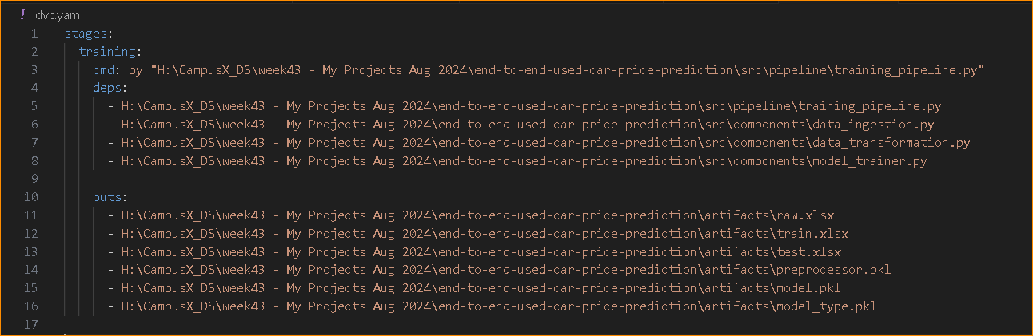
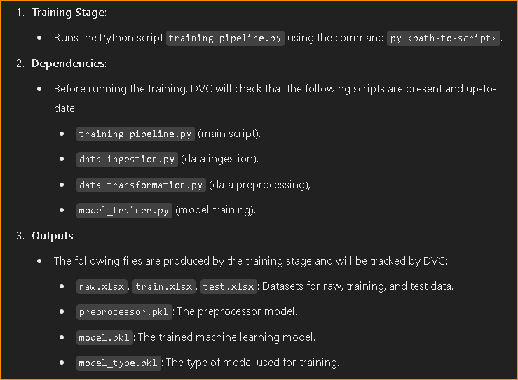
DVC (Data Version Control) pipeline definition for the training stage of an end-to-end machine learning project. DVC is used to manage data, models, and workflows.
This DVC pipeline defines a training stage where the model is trained. It runs the training_pipeline.py script and depends on other files (data ingestion, transformation, model training). It generates various output files, including the datasets (train.xlsx, test.xlsx) and model artifacts (model.pkl, preprocessor.pkl), all of which are tracked by DVC for versioning and reproducibility.

Slide 19

- Suppose we build an app “facebook” & deployed, Its working fine and now we want to add more features to it. Lets say
we have written a code of a function “upload pictures” and tested in our local pc means development server & now we
want to add that function to facebook app which is live Means we want to deploy it to production but when we deployed
In production server, It stopped working !! Now we can’t afford to have downtime of a website like facebook so we use
CI/CD pipeline (Continous integration/Continous deployment pipeline) using which we can push our code of that function
To central repo, which will first build complete facebook app integrating the additional function & test it, If working then
Only it will be pushed to production to avoid downtime.

