Slide 1
Student Name Guru Prathosh S 211521243057 AIDS - B
Final Project
3/21/2024 Annual Review

Slide 2
PROJECT TITLE
Building an Image-to-Recipe Pipeline with Python
3/21/2024 Annual Review

Slide 3


AGENDA
This Python project leverages computer vision and natural language processing to create a system that analyzes an uploaded dish image and retrieves a corresponding recipe. The emphasis lies on building a robust proof-of-concept with potential for future expansion into a mobile application.
3/21/2024 Annual Review

Slide 4

PROBLEM STATEMENT
Accurately translating visual food representations into the structured text of a recipe poses a significant challenge in computer vision and natural language processing. Existing image-to-recipe solutions often lack either accuracy or a wide range of recognized dishes
3/21/2024 Annual Review

Slide 5

PROJECT OVERVIEW
Problem: Finding recipes based on images is time-consuming and often inaccurate.
Solution: An AI system that identifies dishes from photos and retrieves corresponding recipes.
How it Works:
Image Classification (trained deep learning model)
Recipe Source (database or web scraping)
Smart Recipe Matching (NLP)
3/21/2024 Annual Review

Slide 6

WHO ARE THE END USERS?
Novice Cooks: Individuals who want to learn how to cook but lack experience
Foodies & Adventurous Eaters: People interested in expanding their culinary horizons.
People with Dietary Restrictions: Those with allergies, intolerances, or following specific diets.
Visual Learners: Individuals who prefer visual information over traditional text-based recipe searches.
Anyone Looking for Convenience: People who want a quick and easy way to find recipes.
3/21/2024 Annual Review

Slide 7
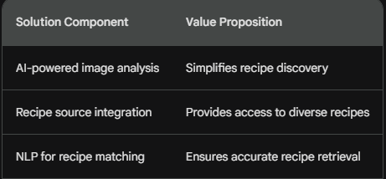
YOUR SOLUTION AND ITS VALUE PROPOSITION
3/21/2024 Annual Review

Slide 8
THE WOW IN YOUR SOLUTION
Effortless Recipe Discovery: Instead of text searches, users simply snap a picture of a dish to instantly find the recipe
Accessibility for Everyone: Empowers beginner cooks to explore recipes and makes cooking less intimidating.
Unlocks Culinary Inspiration: Turns any image of food into a potential recipe, encouraging users to try new things.
3/21/2024 Annual Review
8

Slide 9
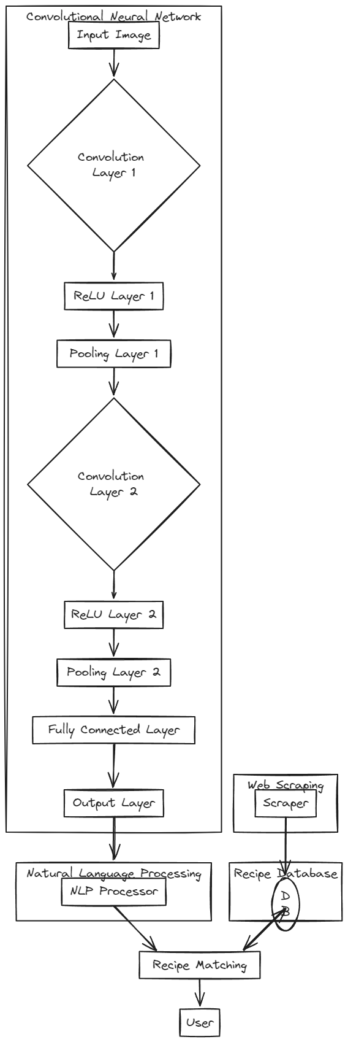
MODELLING
3/21/2024 Annual Review
9

Slide 10
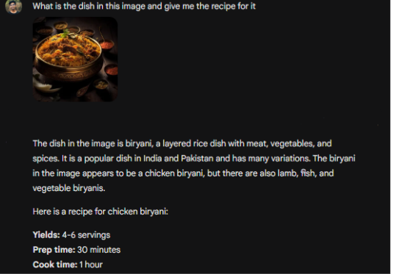
RESULTS
Demo Link
3/21/2024 Annual Review
10

