Slide 1
Retrieval of Images using Data Mining Techniques
By-
Pratiksha Samal (B118039)
Priyabrat Mahapatro (B118043)
GROUP -23

Slide 2
Data mining is an emerging research area, because of the generation of large volume of data. The image mining is new branch of data mining, which deals with the analysis of image data. There are several methods for retrieving images from a large dataset
In this project we are implementing:
Bag of Visual Words (BOVW) model.
for image classification

Slide 3
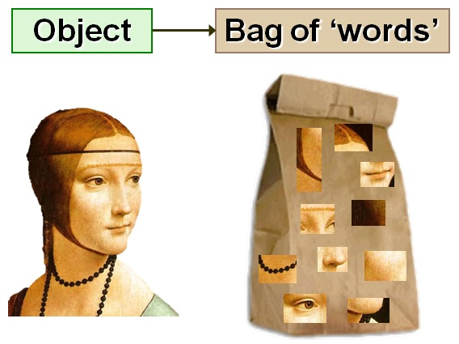
Bag of Visual Words(BoVW)
BoVW is a commonly used technique in image classification. The idea behind this technique, is similar to the bag of words in NLP but in this technique we use image features as words. Image features are unique pattern that we can find in an image.

Slide 4
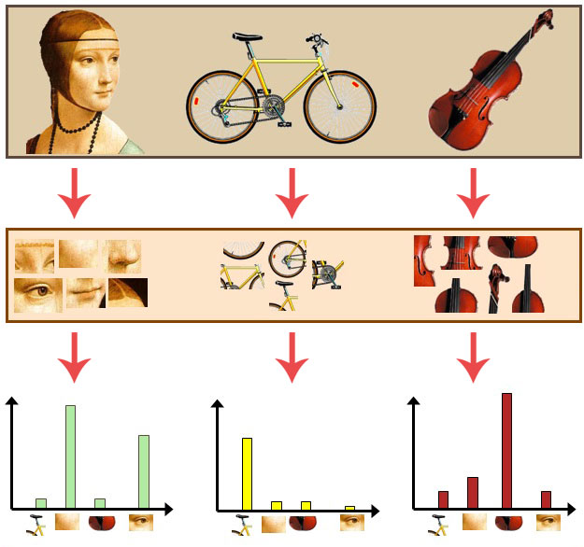
The general idea of bag of visual words (BOVW) is to represent an image as a set of features. Features consists of keypoints and descriptors. Keypoints are the “stand out” points in an image, so no matter the image is rotated, shrink, or expand, its keypoints will always be the same. And descriptor is the description of the keypoint. We use the keypoints and descriptors to construct vocabularies and represent each image as a frequency histogram of features that are in the image. From the frequency histogram, later, we can find another similar images or predict the category of the image.
Taking three input images (top), extracting image patches from each of them (middle), and then counting the number of times each visual word appears in the respective images (bottom).

Slide 5
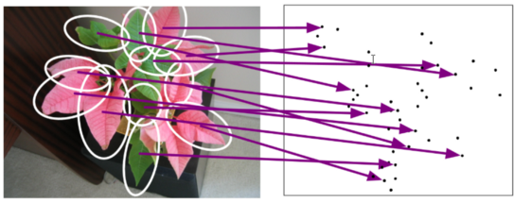
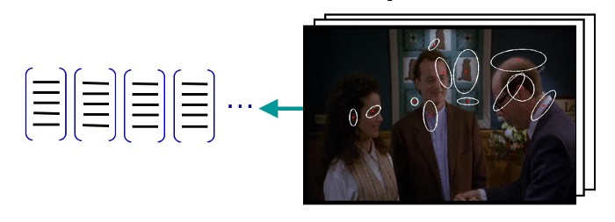
Building a bag of visual words
Local features are extracted by detecting keypoints and their corresponding descriptors are computed. We extracted local features from several images using SIFT.

Slide 6
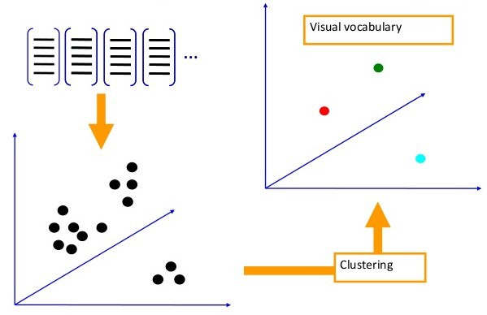
2. Quantize the feature space. Make this operation via clustering algorithms such as K-means. The center points, that we get from the clustering algorithm, are our visual words.

Slide 7
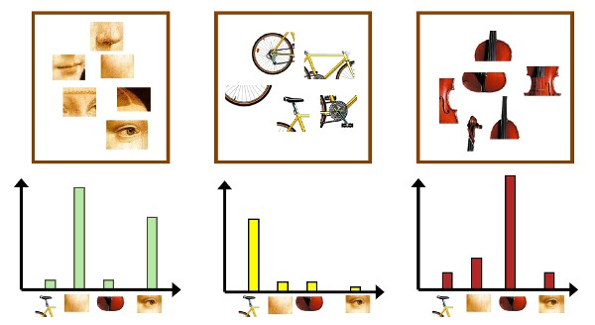
3. Extract local features and compare these features with visual words to create histograms for each image both for the test and train dataset.
4.Predict the class of test images comparing with each histogram of train images. We will use 1-NN to predict the class of each test image.

Slide 8
Implementation of BOVWs

Slide 9
We used : Opencv (3.x), sklearn (0.17), Caltech101 dataset( trimmed version)
Load train and test images into dictionaries.
Extracts local features from images using SIFT. The function returns an array whose first index holds a list that holds all local features from all images without an order. This is our visual dictionary. And the second index holds the sift vectors dictionary which holds the descriptors but this is separated class by class.
Send the visual dictionary to the k-means clustering algorithm and find the visual words which are center points.
Create histograms for both test and train images.
Predict classes of the test images with k-NN function. “k” is 1 in this case.
Calculate the accuracy.

Slide 10
Scale Invariant Feature Transform (SIFT)
SIFT helps locate the local features in an image, commonly known as the ‘keypoints‘ of the image. These keypoints are scale & rotation invariant that can be used for various computer vision applications, like image matching, object detection, scene detection, etc.
We can also use the keypoints generated using SIFT as features for the image during model training. The major advantage of SIFT features, over edge features or hog features, is that they are not affected by the size or orientation of the image.

Slide 11
KMeans Clustering
K-means clustering algorithm is an unsupervised classification procedure which
classifies or groups the objects automatically into K number of group where each group contain points that have minimum distance between them.
The algorithm works as follows:
First we initialize k points, called means, randomly.
We categorize each item to its closest mean and we update the mean’s coordinates, which are the averages of the items categorized in that mean so far.
We repeat the process for a given number of iterations and at the end, we have our clusters.

Slide 12
K-Nearest Neighbours
kNN is often used in search applications where you are looking for similar items, like find items similar to this one.
The k-nearest neighbors algorithm uses a very simple approach to perform classification. When tested with a new example, it looks through the training data and finds the k training examples that are closest to the new example. It then assigns the most common class label (among those k-training examples) to the test example.

Slide 13
Training Algorithm
Testing Algorithm
Input (collection of image)
Output (k - clusters, k - visual word)
Step 1: Collect set of images for each class of interest (in this paper the experimental class of interest are pizza, stop_sign, sunflower and water_lilly).
Step 2: Apply BoVW on collected images. BoVW consists of three main steps:
1. Extract keypoints from images using SIFT feature detection and description algorithm.
2. Create descriptor for each extracted keypoints.
3. Clustering features using k-means clustering algorithm (Create visual vocabulary using vector quantization of descriptor space) and save the resulting “visual words”
Input (k - visual word)
Output (labeled image)
Step 1: Open unlabeled new image.
Step 2: Extract and describe features of unlabeled image using SIFT.
Step 3: Extract visual word (centroid) for testing image.
Step 4: Calculate the nearest neighbor using Euclidean distance between visual word of tested image and visual words of training images.
Step 5: Take the decision: compare extracted features of unlabeled image with visual words extracted in training stage.

Slide 14
Using 1-NN:
Average accuracy: %84.21052631578947
Class based accuracies:
water_lilly : %75.0
pizza : %100.0
stop_sign : %100.0
sunflower : %60.0

Slide 15
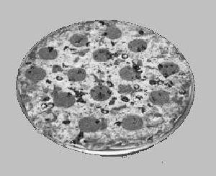
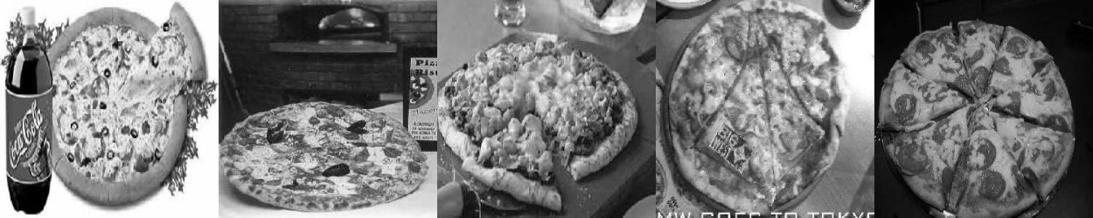
pizza
Closest images

Slide 16

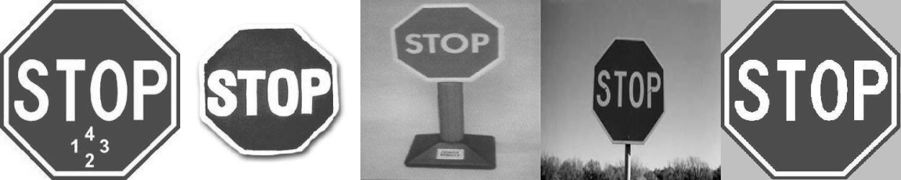
stop_sign
Closest images

Slide 17
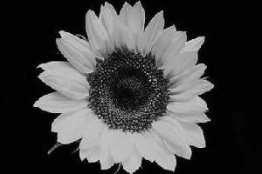
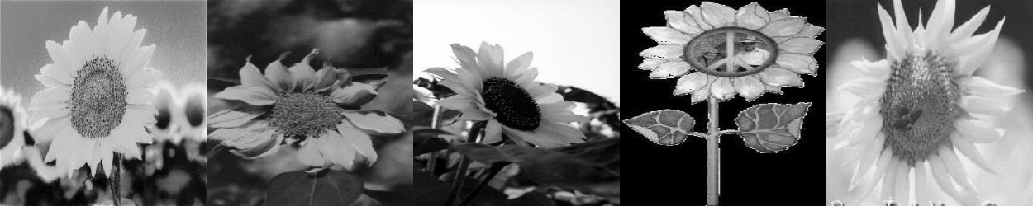
sunflower
Closest images

Slide 18
References
https://www.irjet.net/archives/V5/i3/IRJET-V5I3598.pdf
http://www.vision.caltech.edu/Image_Datasets/Caltech101/
https://www.researchgate.net/publication/338891482_Image_Classification_Using_Bag_of_Visual_Words_BoVW

