Slide 1

Final Assignment: AI methods
Group 8: Lars Keupe, Priyam Singh, Yoawen Zhang & Rajiv Chhatta ​
Lecturers : Debarati Bhaumik

Slide 2
Contents
Car auction dataset
- EDA
- Feature engineering
- Dataset generation
-Model fitting
-Model evaluation
-Model selection
- Conclusion
Bank transaction dataset
- EDA
- Feature engineering
-PCA
- Clustering
- Conclusion

Slide 3
Car auction dataset
In this project, we delve into the complex world of used car data, leveraging the prowess of machine learning to unearth pivotal insights. The heart of our analysis lies in two sophisticated models: Random Forest and Neural Network, each chosen for their unique strengths in handling diverse and intricate data landscapes like those found in the used car market.
Primary business question
"What factors most significantly impact the resale value of used cars in auctions, and how can car dealerships leverage this information to maximize their profits?"
Sub question
How does the make and body of a car affect its resale value in auctions?
How does the age of a car impact its selling price?
How do the condition and mileage (odometer reading) of a car correlate with its selling price in auctions?
Are there any geographical trends in the resale value of cars, based on the state where the auction is held?

Slide 4
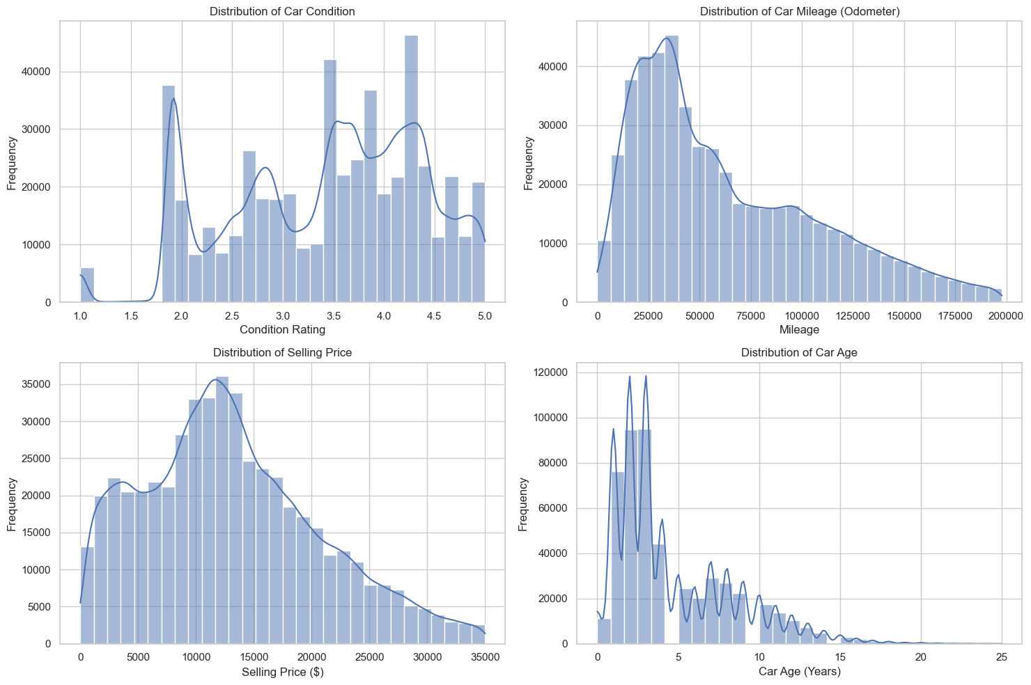
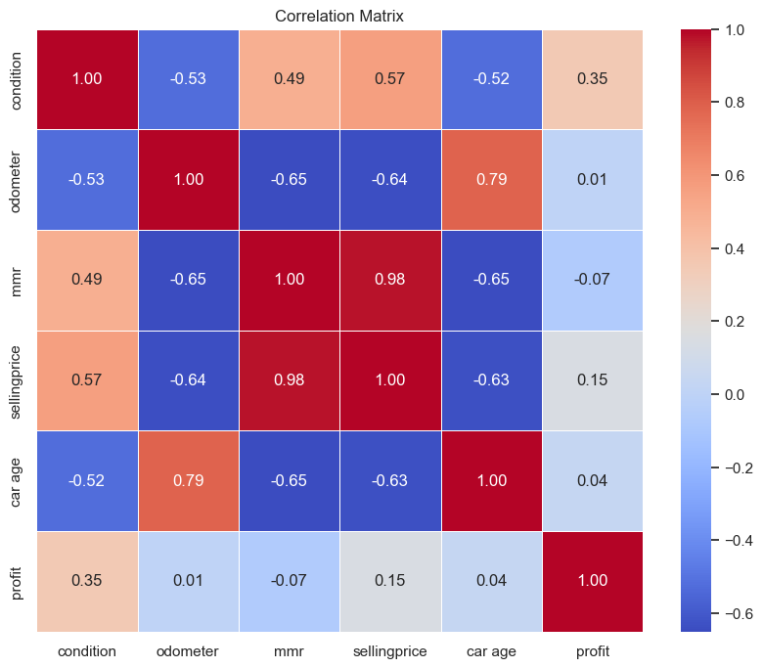
Data Cleaning and EDA analysis
Missing values removal
Outliers removal with different methods
Checking the sale date and manufacture year

Slide 5
Feature engineering and Dataset generation
Creation of Combined Features
New Feature for Price Difference
Transformation of Skewed Data
Numerical and Categorical Pipeline
Preprocessor and Data Transformation
Training and Test Split
Training and Validation Split

Slide 6
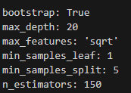
Model fitting
Hyperparameter Tuning with GridSearchCV
Cross-Validation for Model Evaluation
Results and Best Parameters

Slide 7
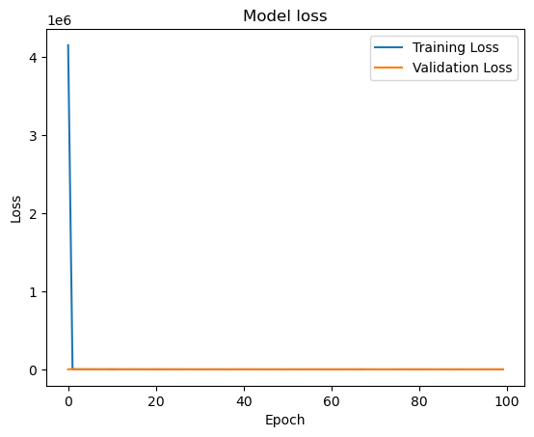
Model fitting
Model Architecture
Callbacks for Early Stopping and Model Checkpointing
Plotting the Loss Curve
Observations
Modifications
Rationale for Changes

Slide 8
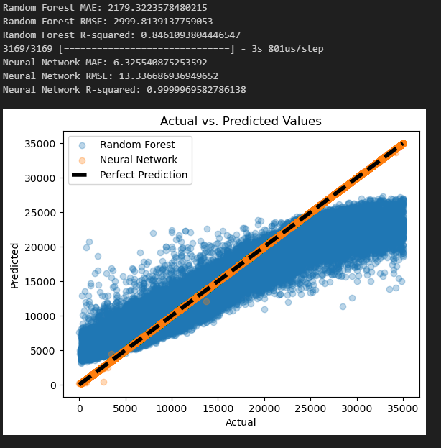
Model evaluation and selection
Performance Metrics
Comparing Random Forest and Neural Network

Slide 9
Conclusion
Make and Model
Car Age
Condition
Mileage
Geographic Location
Utilizing the Insights

Slide 10
Bank transaction dataset
In this project, we employed exploratory data analysis and machine learning techniques, specifically PCA for dimensionality reduction and K-means clustering, to identify distinct behavioural patterns in bank transaction data. This enables us to provide actionable insights for banks to tailor customer engagement and enhance profitability.
Primary business question:
"How can a bank optimize its customer engagement and marketing strategies to enhance customer satisfaction and profitability based on transactional behaviours?“
Sub questions:
1. What patterns and anomalies in transaction volumes and amounts across different demographics and time periods can be identified to tailor customer engagement?
2. How can new features be engineered from the dataset to better understand customer behaviors?
3. what distinct customer segments can be identified using K-means clustering, and how do these segments differ in their transactional behavior?
4. Based on the interpretation of the transactional behaviour of each customer cluster, what targeted strategies can be developed to enhance customer satisfaction and profitability?

Slide 11
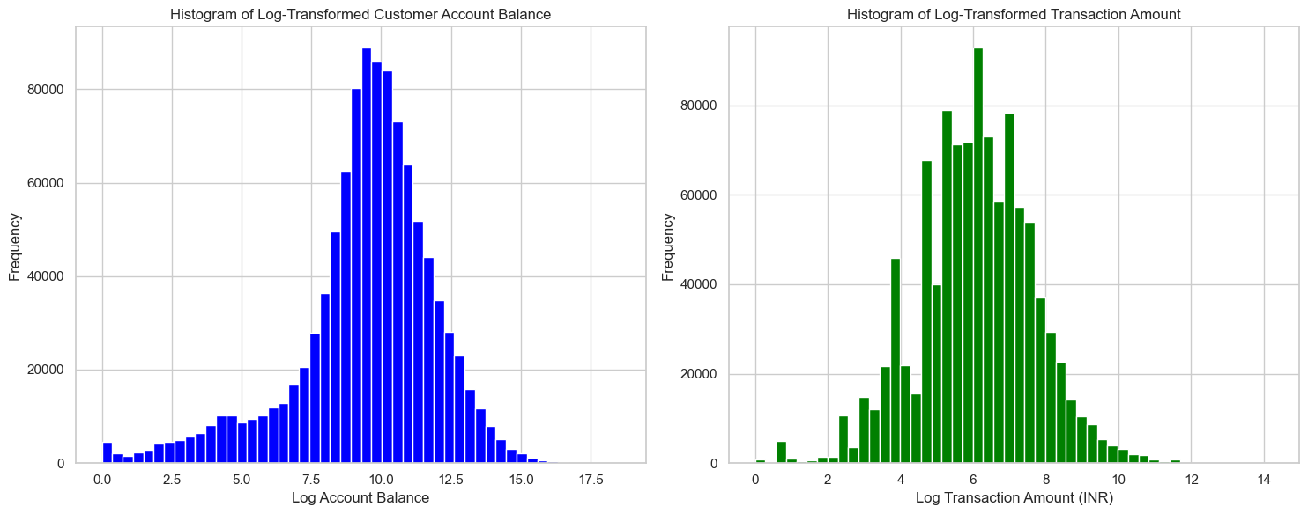
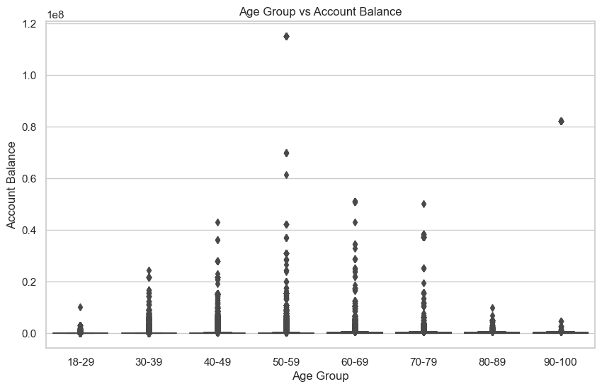
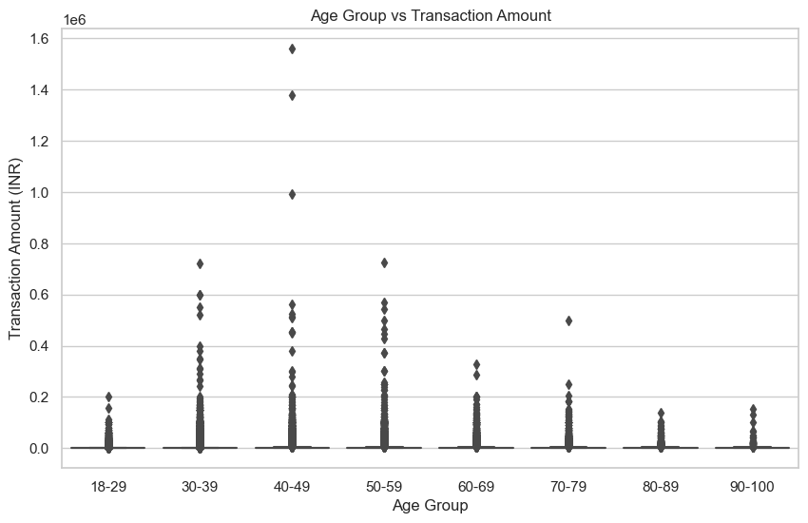
Data cleaning and EDA
Cleaning missing values
Removal “T” in GustGender
Convert variables to date time
EDA:
-Daily transaction variation
-Transaction peak in July
Figure 1: Customer account balance & transaction amount
Figure 2: Age Group vs Account Balance and Age group vs Transaction Amount
Notes:
- Convert 'CustomerDOB', 'TransactionDate', and 'TransactionTime' to datetime
- Log transformation has normalized the right-skewed distribution of both account balances and transaction amounts, enhancing the validity of statistical analysis.
-The boxplot shows steady median account balances across age groups with notable variation within; those aged 50-69 have larger balances, while younger groups make more high-value transactions
-The 2016 data shows daily transaction volumes and amounts varied greatly, with a significant surge in July indicating an unusual event disrupting the regular financial activity pattern.

Slide 12
Feature engineering
Transformation of skewed data
Age Group: Categorize customers into different age groups.
Transaction Volume: Count the number of transactions per customer.
Average Transaction Amount: Calculate the average transaction amount per customer.
Transaction Frequency: Determine the frequency of transactions (e.g., average number of transactions per month).
Day of Week Analysis: Create features to analyze transaction patterns by day of the week.

Slide 13
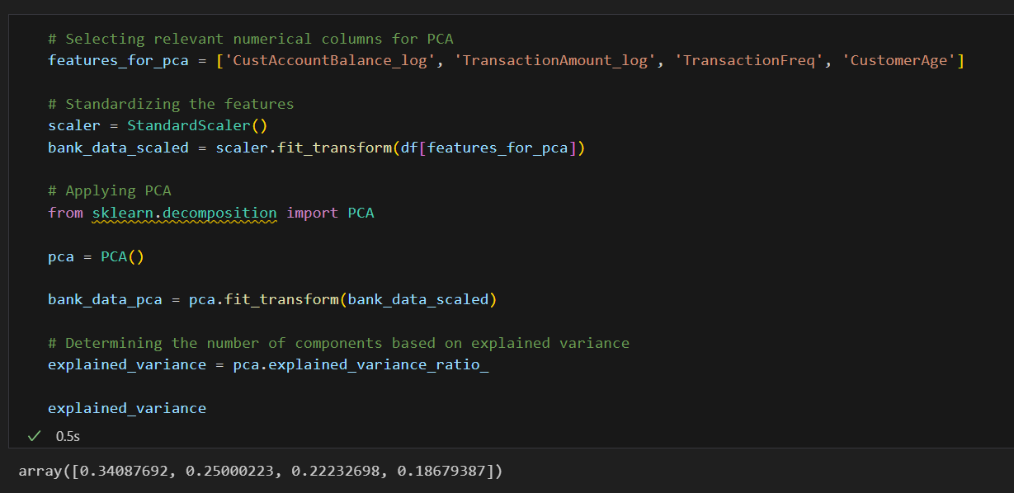
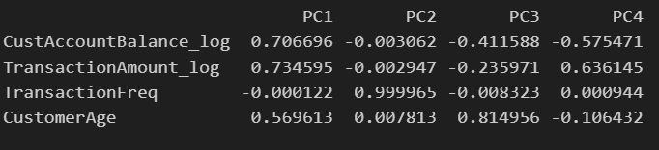
PCA

Slide 14
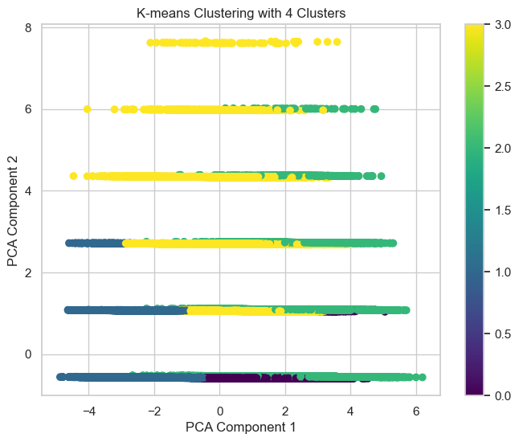
K-means clustering

Slide 15
Conclusion
Targeted Strategies for different identified customer segments (clusters):
For the first cluster, banks can offer savings programs or micro-investment products to help them grow their wealth.
For the second, diverse cluster, personalized financial advice and a range of product offerings could cater to their varied needs.
The third cluster could benefit from loyalty programs and regular engagement strategies to encourage consistent transaction behaviors.
The fourth cluster may be targeted with premium services, high-value investment options, and exclusive benefits to enhance satisfaction and retain their business.

