Slide 1

Database Design for Recommender Systems ( Master’s Thesis)
Supervisor: Diptish Dey
Student: Priyam Singh (500926036)

Slide 2
Summary
Introduction and Background
Problem Statement and Research Objective
Literature Review
Research Methodology
Results and Analysis
Discussion and Insights
Conclusion, Limitations and Future Work
Q&A

Slide 3
Introduction
The rapid growth of data in online platforms has led to the widespread use of Recommender Systems (RS).
This research focuses on evaluating the performance of different databases in supporting RS.
The goal is to determine the most suitable database for AI Systems BV's requirements.

Slide 4
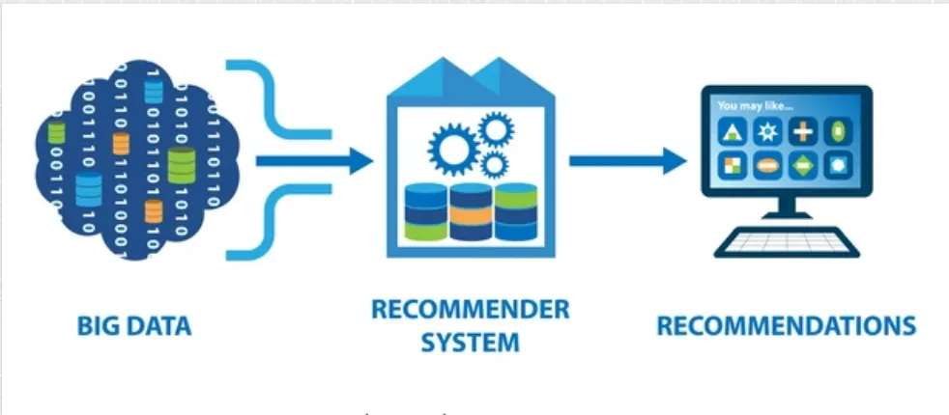
Background Information
Recommender Systems (RS): a subclass of information filtering system that provides suggestions for items that are most relevant to a user based on user data (Lex et al., 2021).
Importance: Enhances user experience and boosts engagement (Vaidya & Khachane, 2017).
DBMS Role: Critical in storing and retrieving large datasets efficiently (Truică et al., 2015).
Figure 1: Recommender System

Slide 5
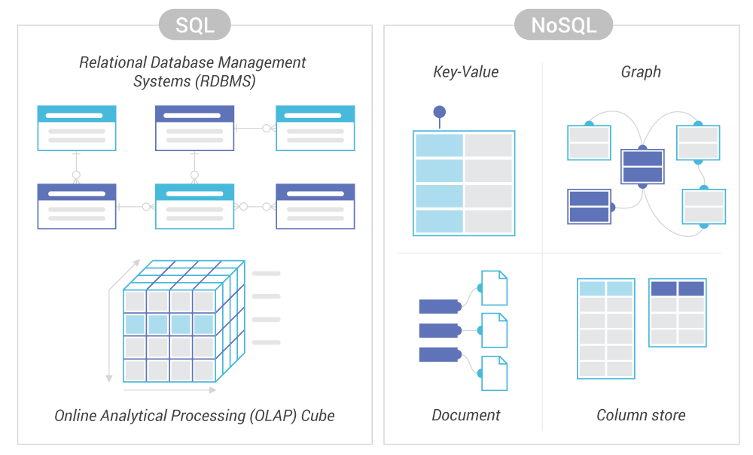
SQL and NoSQL Databases
Figure 2: Database Types

Slide 6
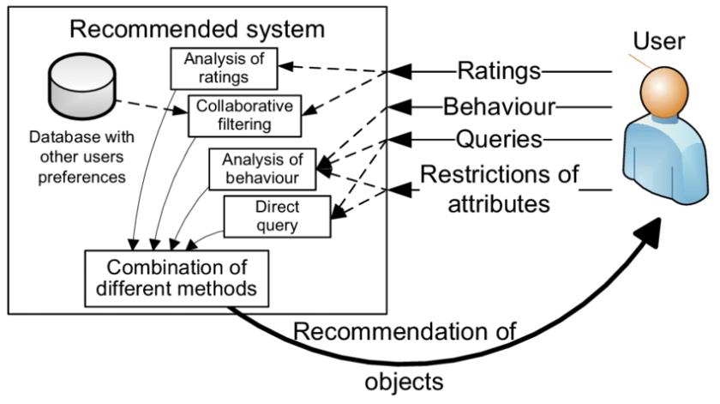
Figure 3: Recommender System Explanation (Eckhardt et al., 2009)

Slide 7
Problem Statement
AI Systems BV, an AI Based Recommender System (RS) start-up is experiencing “performance limitations with their current relational database management system (DBMS)” in supporting their Recommender System (RS) (Osadchiy et al., 2019). The existing system based on PostgreSQL needs to be compared with other DBMSs based on handling large-scale data efficiently, latency and memory usage issues (Biswas & Liu, 2022b). With the rise of diverse database technologies, there is a need to evaluate whether these alternatives could offer superior performance for RS tasks. This research aims to rigorously compare the performance of different databases to identify the most suitable database architecture that can enhance the scalability, efficiency, and overall effectiveness of AI Systems BV’s Recommender System (Abramova et al., 2014).

Slide 8
Research Objectives
Conduct
Conduct a comprehensive literature review on databases. Recognizing various design possibilities.
Evaluate
Evaluate the performance of these databases on key metrics to identify Database that is optimized for RS performance.
Develop
Develop a demonstrator to test the performance of graph database setup.

Slide 9
Research Questions
Main Question: How does the selection of database architecture impact the performance of a Recommender System?
Sub-questions:
1. What types of databases are typically used in Recommender Systems and how do they compare with each other?
2. Which metrics could be used to compare their performance considering different types of RS algorithms?
3. How could their performance be demonstrated by developing a tool?
4. Which insights could be drawn about the suitability and performance of these different combinations of databases and algorithms?

Slide 10
Literature Review
Key Findings:
Latency, Memory Usage, Scalability and Availability Metrics are essential for evaluating and optimizing database performance in RS (Filip & Čegan, 2020).
For Latency measurement, CRUD (Create, Read, Update, Delete) operations are essential performance metrics for evaluating database efficiency in RS. NoSQL databases often outperform SQL databases in read and write operations, especially at scale (Truică et al., 2015).
SQL databases have traditionally been used in RS, but they face challenges with scalability and flexibility when dealing with large, diverse datasets (Goldberg et al., 1992).
NoSQL databases have gained popularity in RS due to their ability to handle unstructured data and scale horizontally. MongoDB, Cassandra, and Redis are among the commonly used NoSQL databases for RS (Filip & Čegan, 2020).
Graph databases, particularly Neo4j, have shown promise in RS due to their ability to represent complex relationships between users and items efficiently (Angles & Gutiérrez, 2018).
Hybrid database approaches, combining SQL and NoSQL technologies, are emerging as a solution to leverage the strengths of both types for RS (Bjeladinović, 2018).
The Jaccard Similarity measure is an effective method for calculating similarity in graph-based RS, particularly when using Neo4j (Bag et al., n.d.).
Knowledge graph-based recommender systems have shown improved performance in capturing complex relationships and context in recommendations (Guo et al., 2022).

Slide 11

System Specification
Ubuntu 24.04 LTS was used to minimizing downtime and enhancing research productivity (Awan, 2022).
Partitioning Scheme:
Operating System – 55GB SSD
Hard Drive – 77GB SSD
Miscellaneous – 15GB SSD
RAM – 16GB (15.8 GB useable)
Architecture – 64-bit
Other operating systems considered:
Windows 11, macOS Ventura, Fedora 38, CentOS Stream

Slide 12
Databases Used
CRUD Operations and Memory Usage:
Retail Rocket Dataset (events.csv) - timestamp, visitorid, event, itemid, transactionid
Diginetica Dataset (train-clicks.csv) – queryid, timeframe, itemid
Neo4j Based Recommender System:
Movielens Dataset (users.dat, ratings.dat and movies.dat)
Other Databases Considered:
Amazon Reviews Dataset, Yelp Dataset, Netflix Prize Dataset, IMDB Dataset, etc.

Slide 13





Database Technologies Evaluated

Slide 14
Key Performance Metrices
Latency: Time taken to complete a request.
Memory Usage: Amount of memory consumed by the database.
Scalability: Ability to handle growth in data volume.
Availability: Database uptime and fault tolerance.

Slide 15
Latency
Creating Databases
Inserting Data into the Databases
Bulk Insertion
Batch Insertion
Reading Databases
Updating Databases
Deleting Databases

Slide 16
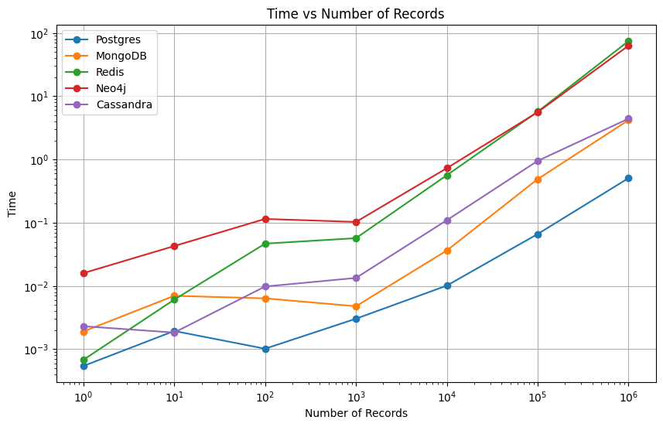
Types of Plots used in the Analysis:
Figure 4: Diginetica Read Time vs Number of records

Slide 17
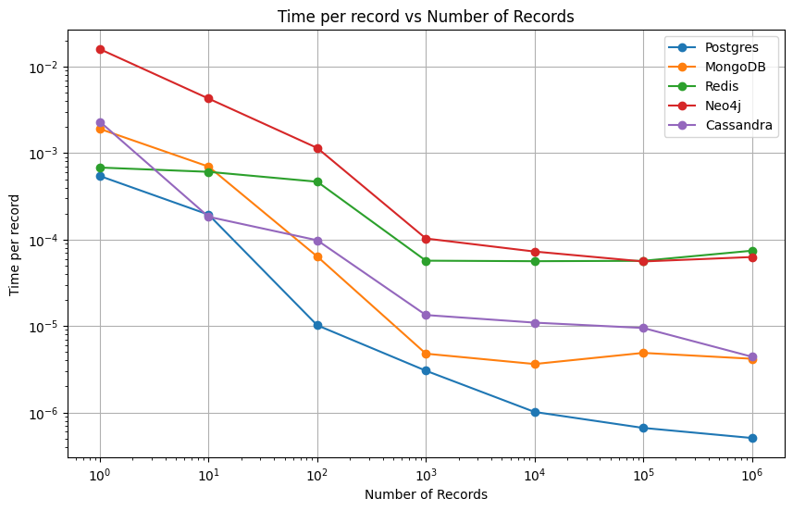
Figure 5: Diginetica Dataset Time per record vs Number of Records

Slide 18
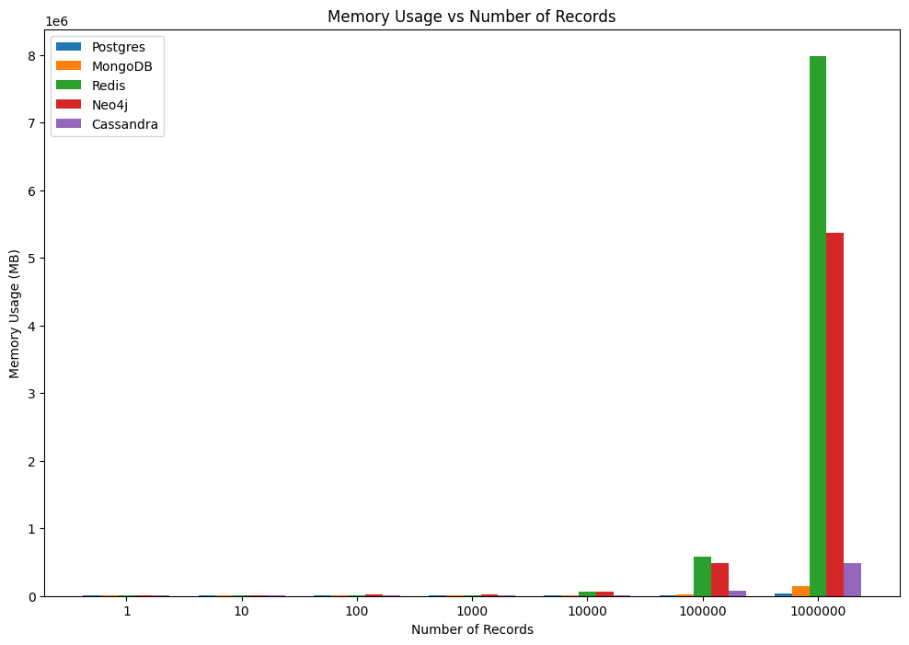
Figure 6: Diginetica Read Memory usage vs number of records

Slide 19
Retail Rocket Database (1000000 records)
Database | Creation | Bulk Insertion | Batch Insertion | Reading | Updating | Deleting | Memory Usage
PostgreSQL | 0.012551546096801758 | 134.21906113624573 | 142.22567677497864 | 0.780382 | 79.9573431 | 49.88350654 | Low
MongoDB | 0.001479 | 11.60965609550476 | 21.756386041641235 | 6.087698 | 293.8425362 | 231.6255879 | Low
Cassandra | 0.6377148628234863 | 404.3991868495941 | 407.1113646030426 | 7921.88 | 405.7728195 | 254.4858463 | High
Redis | 0.000598 | 153.00538063049316 | 140.5859775543213 | 7745.732 | 51.24177146 | 37.08331776 | Low
Neo4j | 0.1566786766052246 | 3695.816222667694 | 4728.145860671997 | 65.02913 | 3732.317911 | 3663.466218 | Extremely High
Figure 7: Retail Rocket Parameters

Slide 20
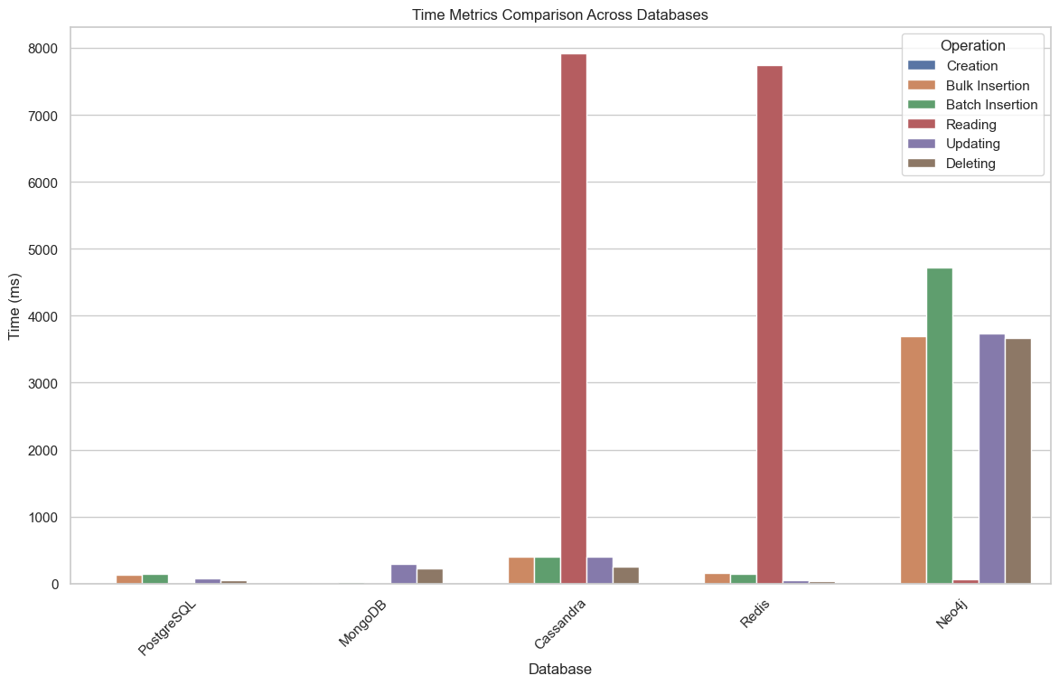
Retail Rocket Dataset
Figure 8: Retail Rocket Visualization

Slide 21
Diginetica Database (1000000 records)
Database | Creation | Bulk Insertion | Batch Insertion | Reading | Updating | Deleting | Memory Usage
PostgreSQL | 0.00390577316284179 | 96.43332052230835 | 79.75668096542358 | 0.5059597492218018 | 4.061434745788574 | 2.1787874698638916 | Low
MongoDB | 0.00238466262817382 | 8.519765 | 7.503891468048096 | 4.176774024963379 | 296.36906599998474 | 229.18407583236694 | Low
Cassandra | 0.5540585517883301 | 370.7326889038086 | 339.251 | 4.4117560386657715 | 636.1679861545563 | 263.9174118041992 | High
Redis | 0.00111079216003417 | 103.7646234035492 | 103.49634742736816 | 74.31328344345093 | 182.59218525886536 | 37.49143052101135 | Low
Neo4j | 0.0639102458953857 | 3459.440174102783 | 3601.1960093975067 | 62.81365513801575 | 33.763957262039185 | 3355.340473175049 | Extremely High
Figure 9: Diginetica Dataset Parameters

Slide 22
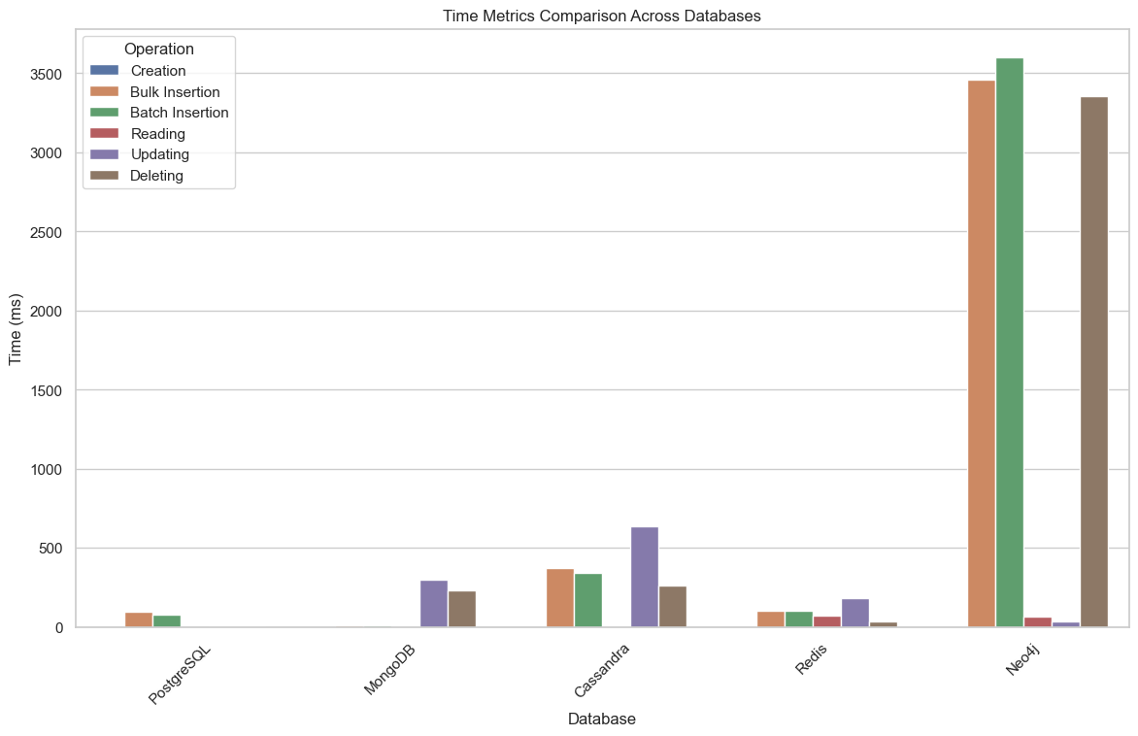
Diginetica Dataset
Figure 10: Diginetica Visualization

Slide 23
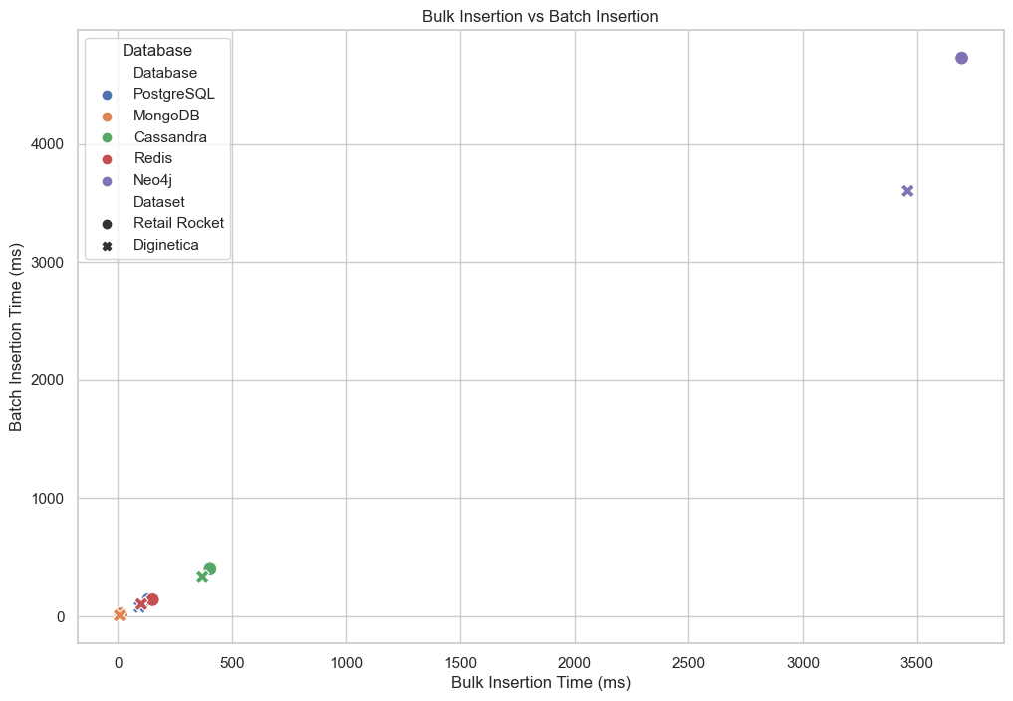
Batch Insertion vs Bulk Insertion
Figure 11: Bulk Insertion vs Batch Insertion

Slide 24

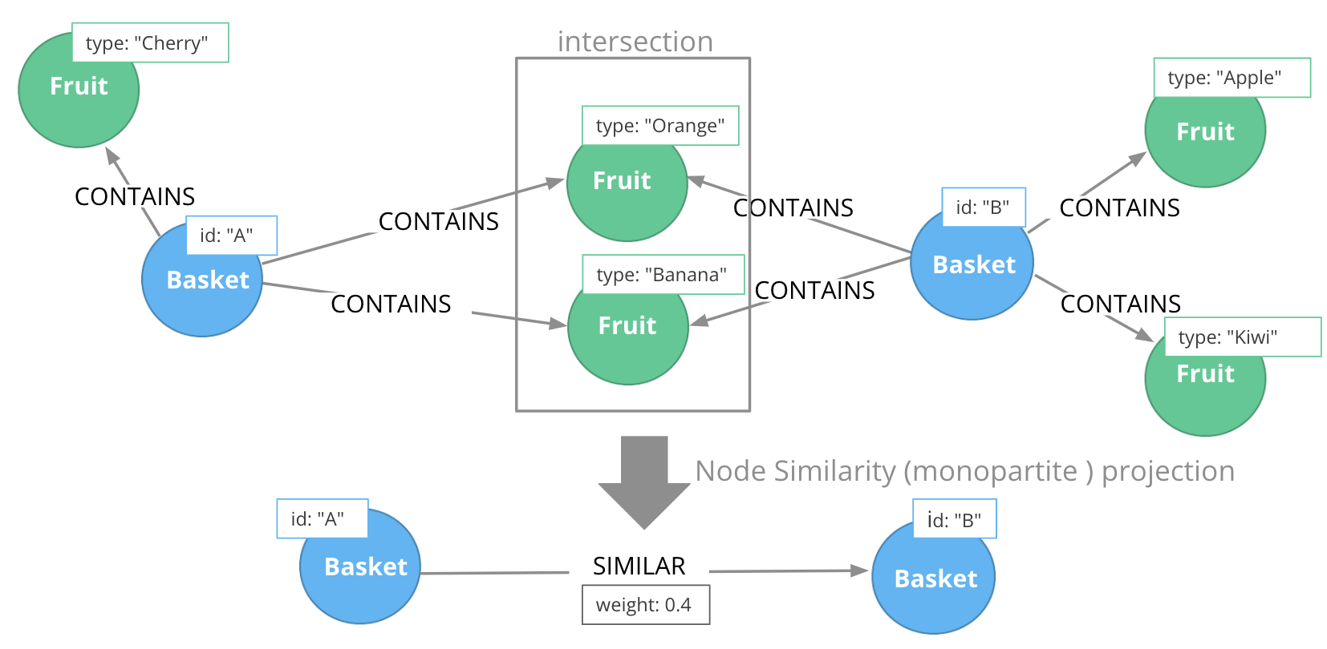
Graph Databases in RS
Jaccard Similarity:
Figure 12: Jaccard Similarity (Neo4j, 2024)

Slide 25
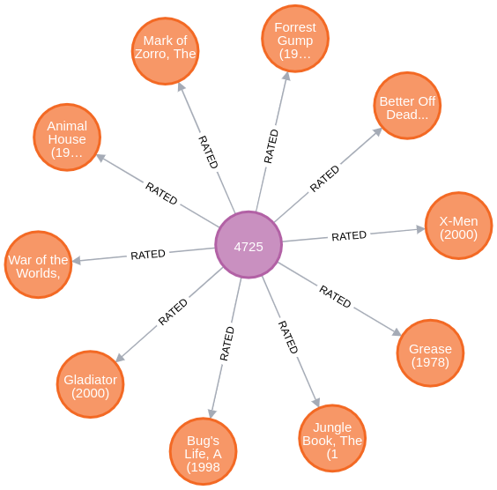
Nodes and Relationships
Creating Nodes
And Relationship
Figure 13: Nodes and Relationships

Slide 26
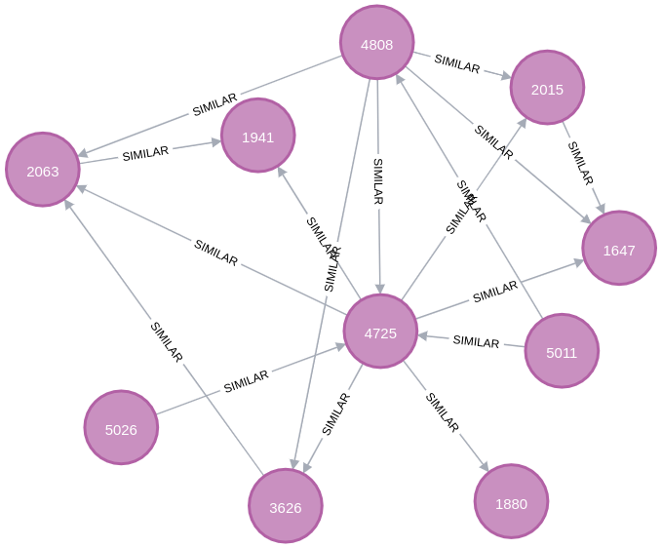
Jaccard Similarity for Movielens
Creating Similarity
Between Users
Index | UserID1 | UserID2 | similarity
0 | 4725 | 4808 | 0.755415
1 | 4808 | 4725 | 0.755415
2 | 1122 | 2126 | 0.632000
3 | 2126 | 1122 | 0.632000
4 | 1272 | 2837 | 0.601852
Figure 14: Jaccard Similarity (Movielens Dataset)

Slide 27

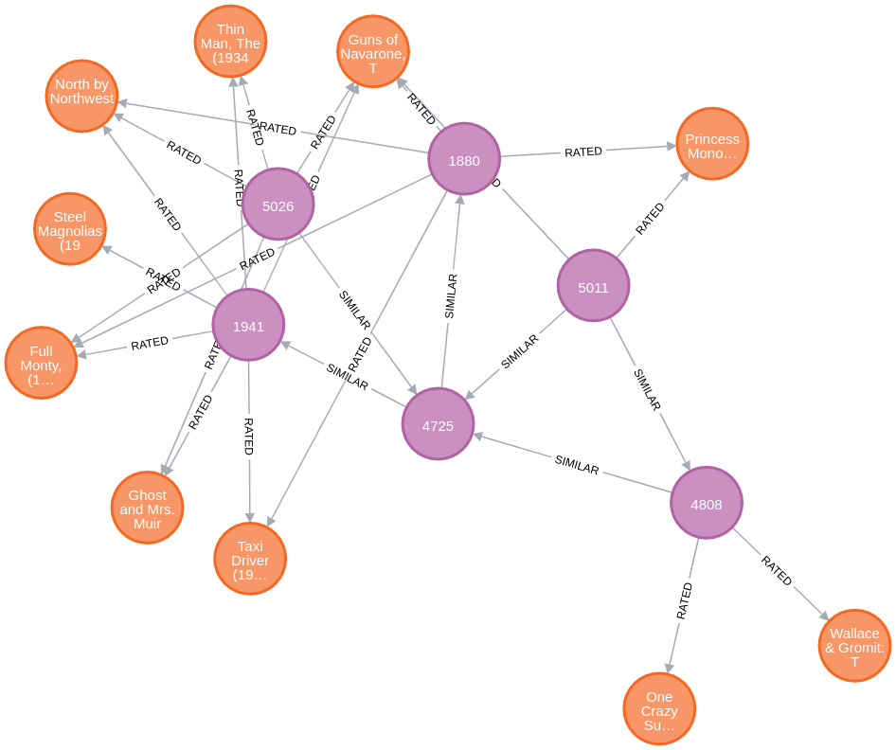
Recommending Movies to Users:
Using Jaccard Similarity and Movie Ratings by user to recommend movies.
For each movie
Calculating expected
Rating by user.
Figure 15: Movie Recommendations

Slide 28
Recommending Movies to Users:
Using Jaccard Similarity and Movie Ratings by user to recommend movies.
For UserID 4725:
Index | m.Title | m.Genres | score
0 | Schindler's List (1993) | Drama|War | 6.864803
1 | Toy Story (1995) | Animation|Children's|Comedy | 6.497486
2 | October Sky (1999) | Drama | 6.390129
3 | Almost Famous (2000) | Comedy|Drama | 6.389066
4 | Bulworth (1998) | Comedy | 6.283263
Figure 16: Movie Recommendations Scores

Slide 29




Insights on Database Suitability:
Database | Latency | Memory Usage | Scalability | Availability
PostgreSQL | Efficient for read and delete operations, but latency can increase with complex queries (Truică et al., 2015) | Efficient memory management, but may consume more during peak loads (Nakhare, 2021) | Traditionally scales vertically, which can limit handling of massive datasets (Filip & Čegan, 2020) | High availability through replication and failover mechanisms (Lourenço et al., 2015)
MongoDB | Low latency for create and insert operations, in high-throughput environments (Truică et al., 2015) | Efficient in memory consumption (Filip & Čegan, 2020) | Built for horizontal scalability (Györödi et al., 2022) | High availability through distributed architecture and replication (Wang et al., 2022)
Redis | Very low latency, ideal for real-time recommendations (Gupta et al., 2017) | Efficient memory usage (Gupta et al., 2017) | Scales horizontally (Györödi et al., 2022) | High availability through replication (Györödi et al., 2022)
Cassandra | Superior for update operations (Truică et al., 2015) | Higher memory usage compared to some others (Kabakuş & Kara, 2017) | Excellent horizontal scalability (Bjeladinović, 2018) | High availability through distributed architecture (Györödi et al., 2022)
Neo4j | Low latency for complex relationship queries (Yi et al., 2017). Database should be representable in the form of nodes and relationship. | Extremely High memory consumption, especially during bulk insertions (Yi et al., 2017) | Can scale both horizontally and vertically, but limited by graph complexity (Wu et al., 2022) | High availability through replication and clustering (Wu et al., 2022)
Figure 17: Database Insights

Slide 30
Research Question:
“How does database architecture selection impact RS performance, considering varying algorithms and application context?”
Key Findings:
1. SQL (PostgreSQL): Excels in structured data, complex queries, read/delete operations (Nakhare, 2021)
2. NoSQL:
MongoDB: Best for bulk insertions, large-scale unstructured data (Truică et al., 2015)
Cassandra: Superior in update operations, distributed architecture (Bjeladinović, 2018)
Redis: Low latency, ideal for real-time recommendations (Gupta et al., 2017)
3. Graph (Neo4j): Efficient for complex relationships, high memory usage (Yi et al., 2017)
Insights:
1. Database choice depends on specific RS requirements.
2. Consider trade-offs between performance, scalability, and resource utilization.
3. Hybrid approaches is optimal for complex RS applications.

Slide 31
Sub-Questions:
1. What types of databases are typically used in Recommender Systems and how do they compare with each other?
SQL (e.g., PostgreSQL), NoSQL (e.g., MongoDB, Cassandra, Redis), and graph databases (e.g., Neo4j) are commonly used. SQL excels in structured data and complex queries, NoSQL offers flexibility and scalability, and graph databases are optimal for complex relationships.
2. Which metrics could be used to compare their performance considering different types of RS algorithms?
Key metrics include latency, memory usage, scalability, and availability. Performance varies by operation: PostgreSQL for read/delete, MongoDB for bulk insertions, Cassandra for updates, Redis for real-time operations, and Neo4j for complex relationship queries.
3. How could their performance be demonstrated by developing a tool?
A tool was developed to measure CRUD operations and memory usage. For Neo4j, it assessed efficiency in handling complex relationship queries and traversals, measuring query response time, memory consumption during data import, and traversal speed.
4. Which insights could be drawn about the suitability and performance of these different combinations of databases and algorithms?
Each database type offers unique advantages depending on the RS application context. The choice depends on specific requirements such as data structure, scalability needs, and query patterns. Hybrid approaches may be optimal for complex RS applications.

Slide 32
Recommendations for AI Systems BV
Short Term (1 to 3 months):
Integrate MongoDB for Large-Scale Data Management
Consider using MongoDB alongside PostgreSQL for low latency in high-throughput environments and excellent horizontal scalability (Truică et al., 2015).
Medium Term (3 to 6 months):
Implement Performance Optimization Techniques
Utilize in-memory databases like Redis for cache memory to reduce load times (Gupta et al., 2017).
Long Term (6 months to more):
Enhance Scalability with NoSQL Databases
Deploying NoSQL databases like MongoDB or Cassandra can manage expanding data volumes efficiently (Györödi et al., 2022).
Utilize Graph Databases for User-Item Interactions
For enhancing personalization capabilities of RS, implementing graph databases like Neo4j is recommended (Yi et al., 2017).

Slide 33
Limitations of Research
Limited Scope of Performance Metrics and Applications (Cold-start problem and Prioritizing certain customers)
Evolving Database Technologies (like NewSQL, Cloud Storage)
Specific Sample Size and Test Environment (1000000 records and Dual Bootable)
System Configuration Discrepancies (Real World Scenarios)
Future Directions and Best Practices
Integration of Advanced Algorithms (Collaborative Filter, Content Based, etc.)
Implement Real-Time Data Processing with different databases
Efficient Data Partitioning and Indexing (Understanding how database indexing and feature datatypes impacts performance)
Comparing Graph Database RS with conventional RS

Slide 34

Q&A

Slide 35
References:
Abramova, V., Bernardino, J., & Furtado, P. (2014). Which NoSQL database? A performance overview. Open Journal of Databases (OJDB) Volume 1, Issue 2, 2014, 1(2), 17–24. https://estudogeral.sib.uc.pt/bitstream/10316/27748/1/Which%20NoSQL%20Database.pdf
Angles, R., & Gutiérrez, C. (2018, January 1). An Introduction to Graph Data Management. Springer International Publishing, 1-32. https://doi.org/10.1007/978-3-319-96193-4_1
Awan, M. T. (2022). Linux vs. Windows: A Comparison of Two Widely Used Platforms. Journal of Computer Science and Technology Studies, 4(1), 41–53. https://doi.org/10.32996/jcsts.2022.4.1.4
Bag, S., Kumar, S K., & Tiwari, M K. (n.d). An eﬃcient recommendation generation using relevant Jaccard similarity
Biswas, P., & Liu, S. (2022b). A hybrid recommender system for recommending smartphones to prospective customers. Expert Systems With Applications, 208, 118058. https://doi.org/10.1016/j.eswa.2022.118058
Bjeladinović, S. (2018b). A fresh approach for hybrid SQL/NoSQL database design based on data structuredness. Enterprise Information Systems, 12(8–9), 1202–1220. https://doi.org/10.1080/17517575.2018.1446102
Bjeladinović, S. (2018b). A fresh approach for hybrid SQL/NoSQL database design based on data structuredness. Enterprise Information Systems, 12(8–9), 1202–1220. https://doi.org/10.1080/17517575.2018.1446102
Eckhardt, Alan. (2009). Various aspects of user preference learning and recommender systems. CEUR Workshop Proceedings. 471. 56-67.
Filip, P., & Čegan, L. (2020). Comparison of MySQL and MongoDB with focus on performance. International Conference on Informatics, Multimedia, Cyber and Information System (ICIMCIS). https://doi.org/10.1109/icimcis51567.2020.9354307
Goldberg, D., Nichols, D., Oki, B M., & 7~rry, D. (1992, December 1). Tapestry: An Experimental Mail System for Filtering Information
Guo, Q., Zhuang, F., Qin, C., Zhu, H., Xie, X., Xiong, H., & He, Q. (2022). A survey on Knowledge Graph-Based Recommender Systems. IEEE Transactions on Knowledge and Data Engineering, 34(8), 3549–3568. https://doi.org/10.1109/tkde.2020.3028705
Gupta, A., Tyagi, S., Panwar, N., Sachdeva, S., & Saxena, U. (2017, October 1). NoSQL databases: Critical analysis and comparison. https://doi.org/10.1109/ic3tsn.2017.8284494
Győrödi, C., Dumşe-Burescu, D. V., Zmaranda, D., & Győrödi, R. (2022). A comparative study of MongoDB and Document-Based MySQL for big data application data management. Big Data and Cognitive Computing, 6(2), 49. https://doi.org/10.3390/bdcc6020049
Kabakuş, A T., & Kara, R. (2017, October 1). A performance evaluation of in-memory databases. Elsevier BV, 29(4), 520-525. https://doi.org/10.1016/j.jksuci.2016.06.007*(Q2)
Lex, E., Kowald, D., Seitlinger, P., Tran, T N T., Felfernig, A., & Schedl, M. (2021, January 1). Psychology-informed Recommender Systems. Now Publishers, 15(2), 134-242. https://doi.org/10.1561/1500000090
Lourenço, J. R., Cabral, B., Bernardino, J., & Vieira, M. (2015). Comparing NoSQL Databases with a Relational Database: Performance and Space. International Journal of Big Data (Print), 2(1), 1–14. https://doi.org/10.29268/stbd.2015.2.1.1

Slide 36
References:
Nakhare, D. (2021). A Comparative study of SQL Databases and NoSQL Databases for E-Commerce. International Journal for Research in Applied Science and Engineering Technology, 9(12), 409–412. https://doi.org/10.22214/ijraset.2021.39263
Osadchiy, T., Poliakov, I., Olivier, P., Rowland, M., & Foster, E. (2019). Recommender system based on pairwise association rules. Expert Systems With Applications, 115, 535–542. https://doi.org/10.1016/j.eswa.2018.07.077
Truică, C., Rădulescu, F., Boicea, A., & Bucur, I. (2015). Performance evaluation for CRUD operations in asynchronously replicated document oriented database. Department of Computer Science, Faculty of Automatic Control and Computers, University Politehnica of Bucharest, Bucharest, Romania. https://doi.org/10.1109/cscs.2015.32
Vaidya, N., & Khachane, A R. (2017, July 1). Recommender systems-the need of the ecommerce ERA. https://doi.org/10.1109/iccmc.2017.8282616
Wang, S., Zhang, X., Wang, Y., Liu, H., & Ricci, F. (2022, January 1). Trustworthy Recommender Systems. Cornell University. https://doi.org/10.48550/arxiv.2208.06265
Wu, S., Sun, F., Zhang, W., Xie, X H., & Cui, B. (2022, December 3). Graph Neural Networks in Recommender Systems: A Survey. Association for Computing Machinery, 55(5), 1-37. https://doi.org/10.1145/3535101
Yi, N., Li, C., Feng, X., & Shi, M. (2017). Design and implementation of Movie Recommender system based on Graph Database. University of Beijing. https://doi.org/10.1109/wisa.2017.34

