Slide 1
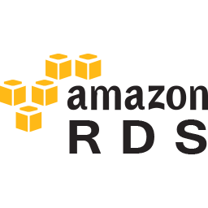
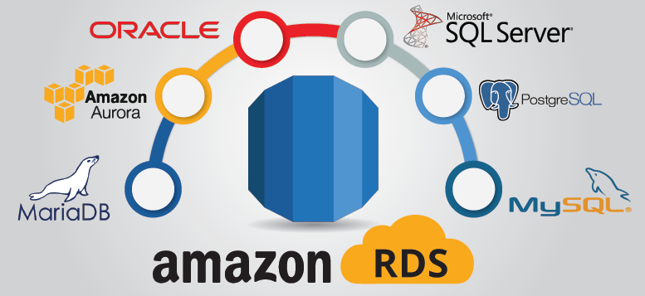
Relational Database Service and DynamoDB

Slide 2

Agenda for Today
RDS and DynamoDB
Introduction to RDS
Database Basics
  RDS
  DynamoDB
Launching an RDS Database

Slide 3
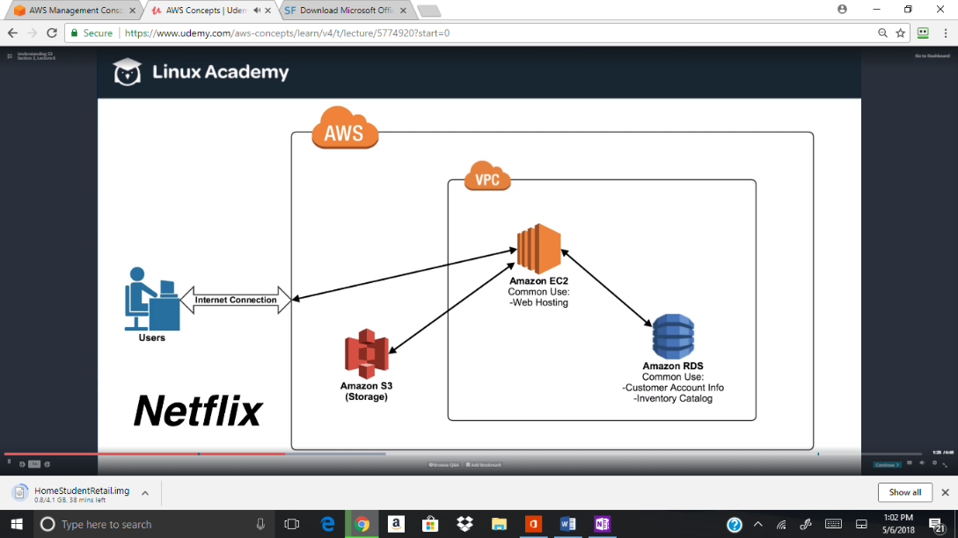
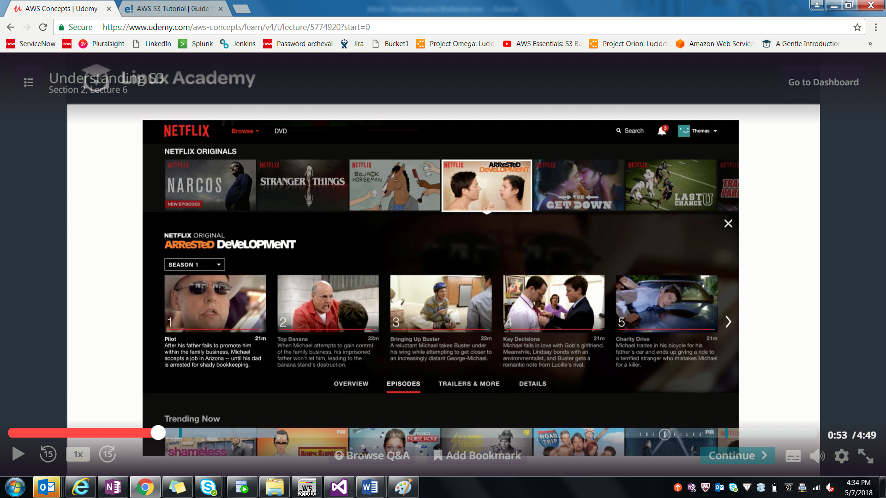
Introduction to RDS
Lets Understand Now Netflix works

Slide 4
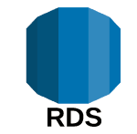
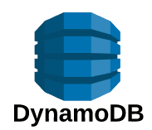
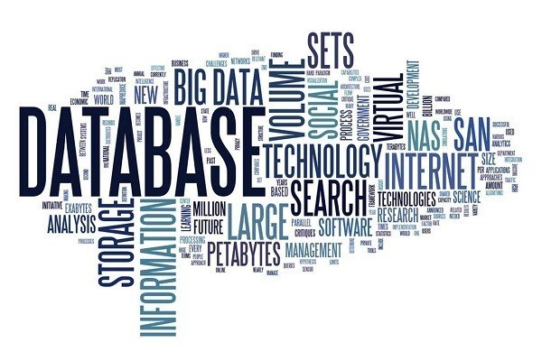
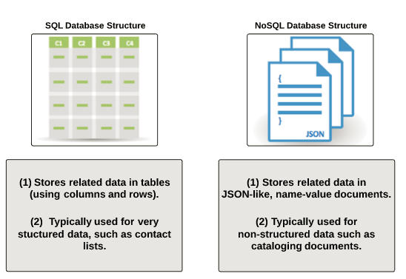
Database Basics
There are two types of databases:
Relational Databases : “SQL” (RDS)
Non-Relational Databases :“NoSQL” (DynamoDB)

Slide 5
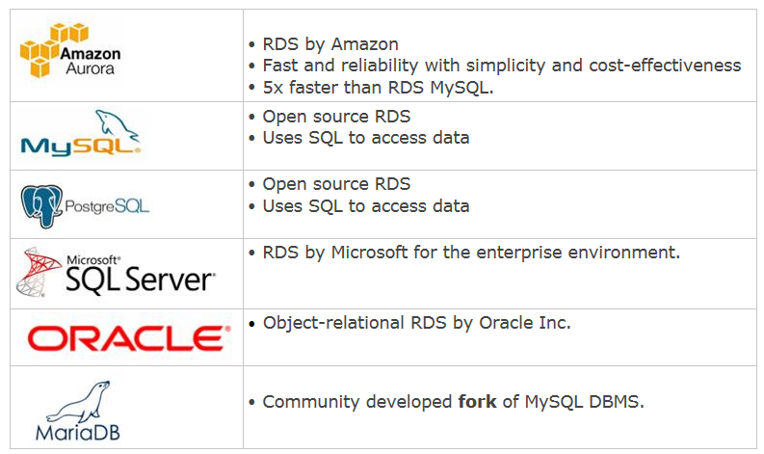
Relational Database Service (RDS)
Fully managed, SQL database
Store data in tables and have defined Relationship
Connectivity from outside world
Hardware is Scalable
Multi-AZ available for High Availability
Read Replica Available
Notes:
Organize data in tables.
Associated tables have a defined relationships between them.
Fully managed - does not allows access to underlying OS
You can connect to RDS database server in the same way you would connect to a traditional on-premise database instance (i.e. MYSQL command line)
You have the ability to provision/resize hardware OnDemand for scaling
You can enable multi-AZ deployments for backup and high available solution.
Utilize Read Replica (MySQL/PostgreSQL/Aurora)to help offload hots on your primary database.

Slide 6
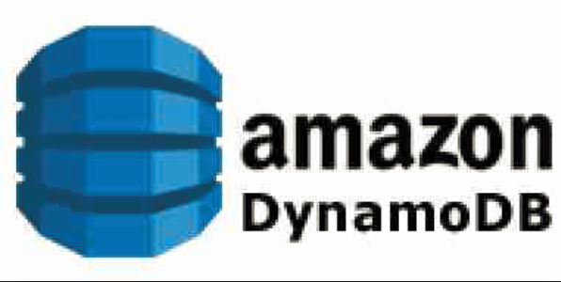
DynamoDB
Fully managed, NoSQL database
Similar to MongoDB
Schema less and uses Key-Value store
Popular use includes
IOT
Gaming
Mobile
Notes:
Fully managed means :
DynamoDB is a fully managed noSQL database service provided by AWS.
Similar to MongoDB, but it is Home Grown AWS solution
You just need to tell throughput capacity and rest will be taken care by the DynamoDB
Popular use includes
IOT(storing meta data)
Gaming (session information, leaderboard)
Mobile(Storing Profiles, personalization)

Slide 7
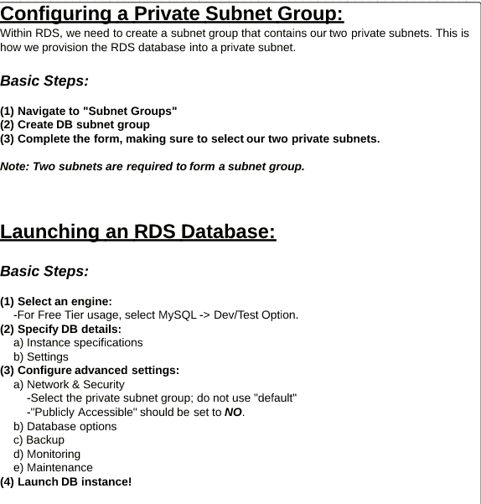

Launching an RDS Database
Notes:
Show then how to create RDS Free Tier.

Slide 8

Questions
© Allstate Insurance Company Proprietary and Confidential

