Slide 1

Simple Storage Service

Slide 2

Agenda for Today
Simple Storage Service
Introduction to S3
S3 Components and Structure
  S3 Buckets
  S3 Objects and Folders
S3 Storage Class
S3 Permissions
S3 Versioning
S3 Lifecycle
S3 Static Web Hosting

Slide 3
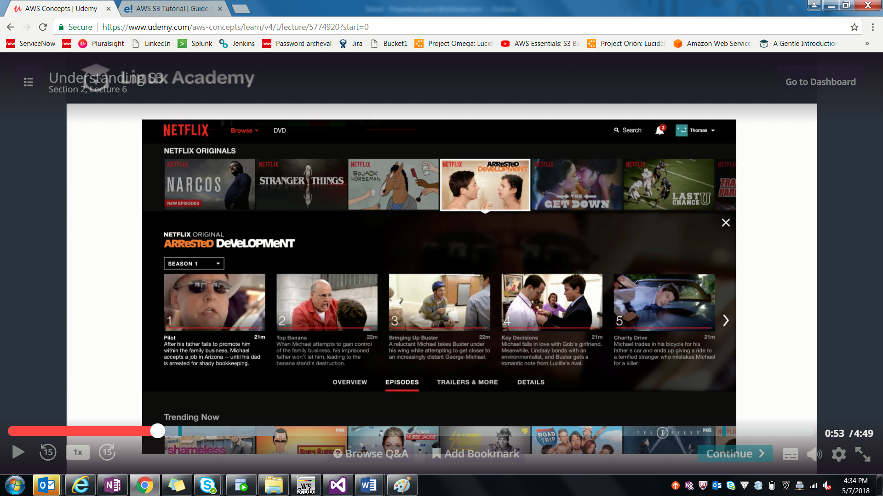
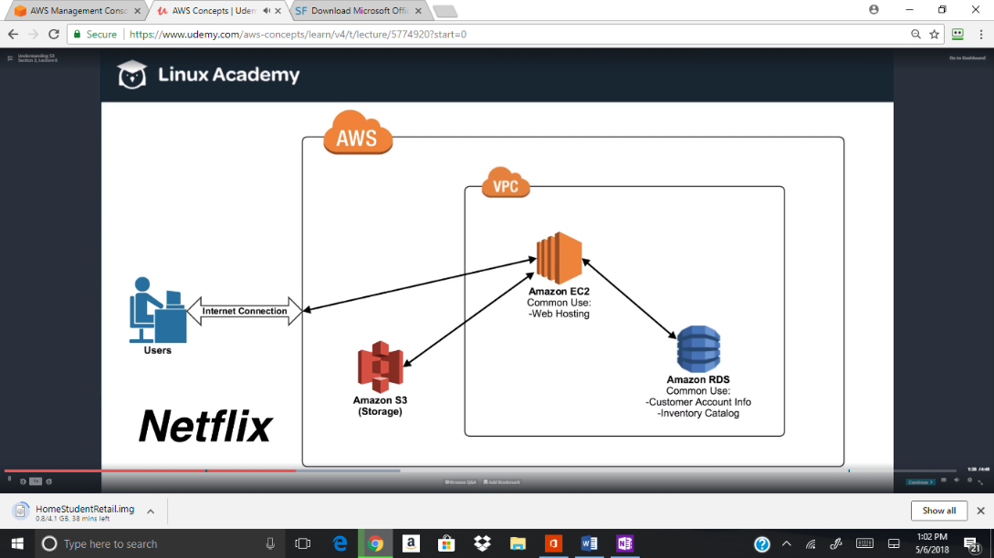
Introduction to S3

Slide 4
Simple Storage Service (S3)
Provides Highly Available, Fault Tolerant and Secure Application architecture
Bulk static object storage
Storage classes
Object Versioning
Access Restriction
Object management
Hosting static files and websites
File sharing and Backup
Notes:
Provides Highly Available, Fault Tolerant and Secure Application architecture
Bulk static object storage – basically unlimited
Storage classes – to optimize cost vs needed availability/durability
Access restriction via s3 bucket policies/permissions.
Object management via lifecycle policies
Hosting static files and websites
Origin for CloudFront CDN
File sharing and backup/achieving for hybrid networks(via Storage gateway)

Slide 5

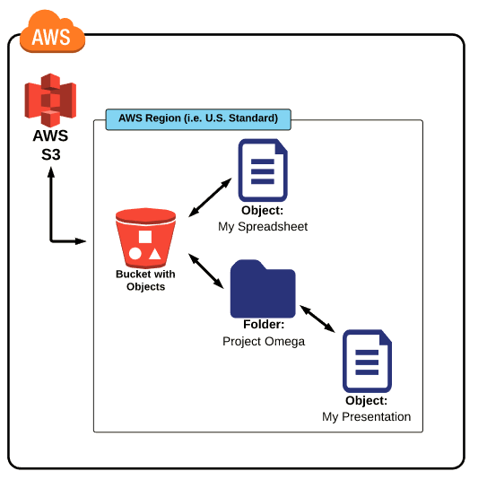


Components and Structure
Buckets:
Root level Folders
Objects
Files Stored in Buckets
Folders
Subfolders within a bucket
Notes:
When you create a Bucket, you must choose

Slide 6


S3 Buckets
Main Storage Container containing grouping of information.
Tags can be used to organize buckets.
Each bucket must have a unique name across ALL of AWS.
Bucket Limitations
With Buckets
Notes:
Buckets are the main storage container of s3 and contains a grouping of information and have a surname space that are similar to folders.
Bucket Limitation:
Only 100 buckets can be created in an AWS account at a time
Bucket ownership cannot be transferred once a bucket is created.
Hands on:
Creating a Bucket
Bucket Overview
Bucket Properties
Bucket Permissions
Bucket Management

Slide 7


S3 Objects and Folders
S3 Objects
Static files, contains metadata information
Have Storage class
By default, ALL objects are Private
Size can be from 0 Byte to 5TB
Can have Multi Versions
Publicly available via a URL
Automatically switch storage class or deleted
Encrypted
Organize into sub names
S3 Folders
Only a mean for grouping objects.
Uses Key-pair prefixes for Objects
Notes:
S3 Objects
Static files, contains metadata info
Set of name-key pairs
Contain information specified by the user and aws information such as storage type
Each object must be assigned a storage type, which determined the objevt availability , durability and cost
By default, ALL objects are Private
Object Encryption
SSE(Server Side Encryption)
Client side Encryption
Creating Folder and Objects

Slide 8
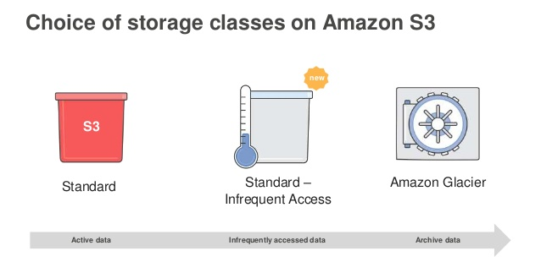
S3 Storage Class
Represents “Classification” assigned to each Object in S3.
Each Storage class has different attributes
  Storage cost
  Object Availability
  Object durability
  Frequency of access
Notes:
Show the Team how default objects are created with Standard
And show them that how they can switch from one storage Class to another.

Slide 9
S3 Storage Class
Characteristics | Standard | RRS | S3-IA | Glacier
Durability | 99.999999999% | 99.99% | 99.999999999% | 99.99%
Availability | 99.99% | 99.99% | 99.90% | N/A
Min Storage Duration | No Min Duration |  | 30 days | 90 days
First Byte latency | Milliseconds | Milliseconds | Milliseconds | 4 hours
Retrieval Fee | No Fee |  | Per GB retrieved | Per GB retrieved
Uses | General, all purpose storage | Non-critical, reproducible objects | Infrequently used objects | Archival storage
Cost Effective | Most Expensive | Less expensive than Standard | Less Expensive than Storage/RRS | Cheapest

Slide 10



S3 Permissions
All Buckets and Objects are private by default.
Resource owner can grant access
  Bucket Policies
  IAM User Policies
  ACL
Notes:
Resource owner can grant access to the resource through S3 resource based policies OR Access can be granted through a traditional IAM policiy
Show each one of them
How access can be given through IAM
Access through Bucket policy
Access through ACL

Slide 11


S3 Versioning
Manage and store all old/new/deleted versions of an object.
Once enabled, it can only be suspended
Can be set up only at bucket level.
Notes:
By default, versioning is disabled on all buckets/objects.
Its cann
Show them how versioning is enabled. Upload a new file and how it can de suspended,

Slide 12
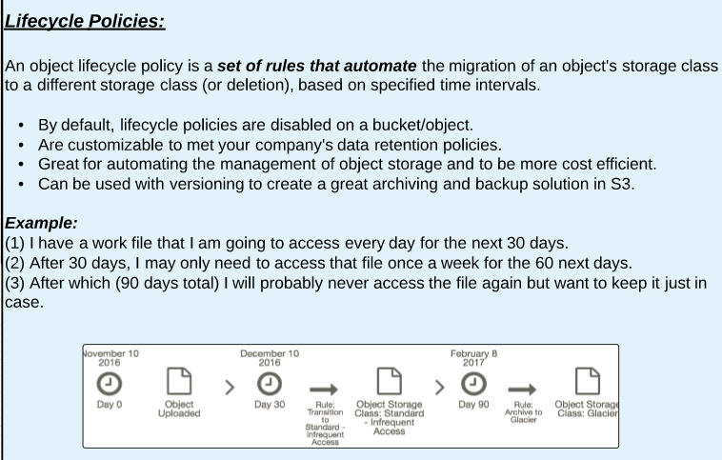

S3 LifeCycle
Lifecycle is a set of rules that automate the migration of a object’s storage class, based on specified time intervals
  By default its is disabled on buckets/objects.
  Its customizable
  Can be used with versioning.

Slide 13
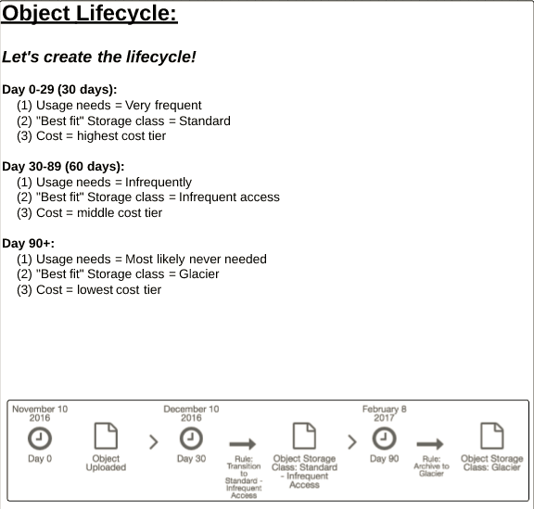
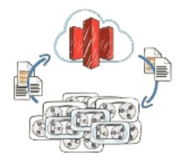
Let’s Create a LifeCycle

Slide 14



S3 Static Web Hosting
AWS allow us low cost, highly reliable static web hosting
It provides with an unique endpoint which can be pointed.
Supported formats included:
  HTML
  CSS
  JavaScript
Notes:
Give a Demo of static webhosting
Route 53 can also map human readable domain names to static web hosting buckets, which are ideal for DNS failover solutions.

Slide 15

Questions
© Allstate Insurance Company Proprietary and Confidential

