Slide 1

WatchX-ai🧑‍💻 & AutoWatchX-ai🤖
Author
VIKAS PANDEY

Slide 2

Table of Content
📌 Why I choose this ?
📌 Solution
📌 Technology Stack
📌 Architecture
📌 Workflow
📌 E R diagram
📌 Use Case Diagram
📌 Features
📌 For more and Thank you

Slide 3
📌 Why I choose this ?
I developed two web app -> watchX-ai and AutoWatchX-ai
AutoWatchX.ai is under Development
The project aims to provide a safe and user-friendly environment to take exams online to various locations for those who don't have access to campus.
Due to Covid 19, remote learning has been a constant and so have been online examinations. But proctoring has always been a task and cheating and unfair practices have always been a problem.
The project employs various machine learning models to reduce the burden on the admin to detect malpractice by the students on a large scale.

Slide 4
📌Solution
⚡ To provide a safe and user-friendly environment to take exams online to various locations for those who don't have access to campus
⚡ Teacher can conduct their examination in proctored Environment.
⚡ Realtime Monitoring
⚡ Share Exam Link coded with Exam code .
⚡ You can conduct examination without Proctor with help of AutoWatchX.ai and get real time dashboard in WatchX.ai
⚡Deter Detect and Prevent .

Slide 5
📌 Technology Stack
👉 Tensorflow Implementation of CocoSSD Object Detection Model and JavaScript
👉 Database ➼ MongoDB Atlas and Mongoose
👉 Frontend ➼ Bootstrap, React.js, Materialise.css , Material-UI
👉 Backend ➼ JWT , Node.js, Passport.js, Express.js.

Slide 6
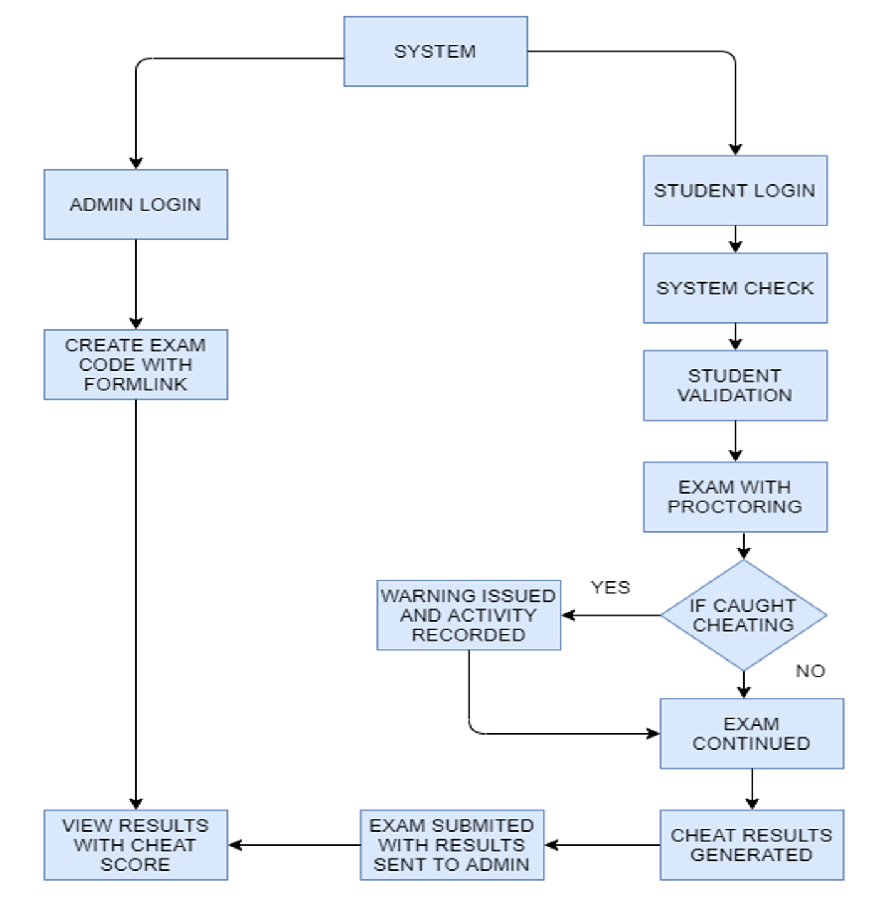

📌Architecture

Slide 7
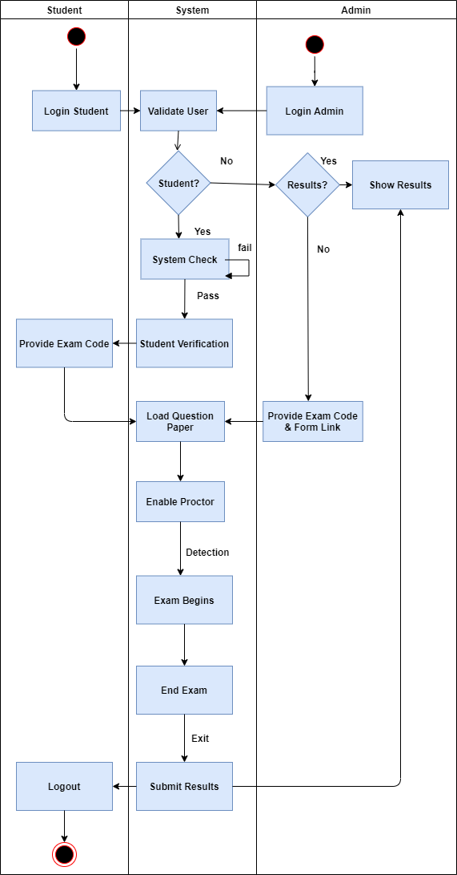

📌 WorkFlow

Slide 8
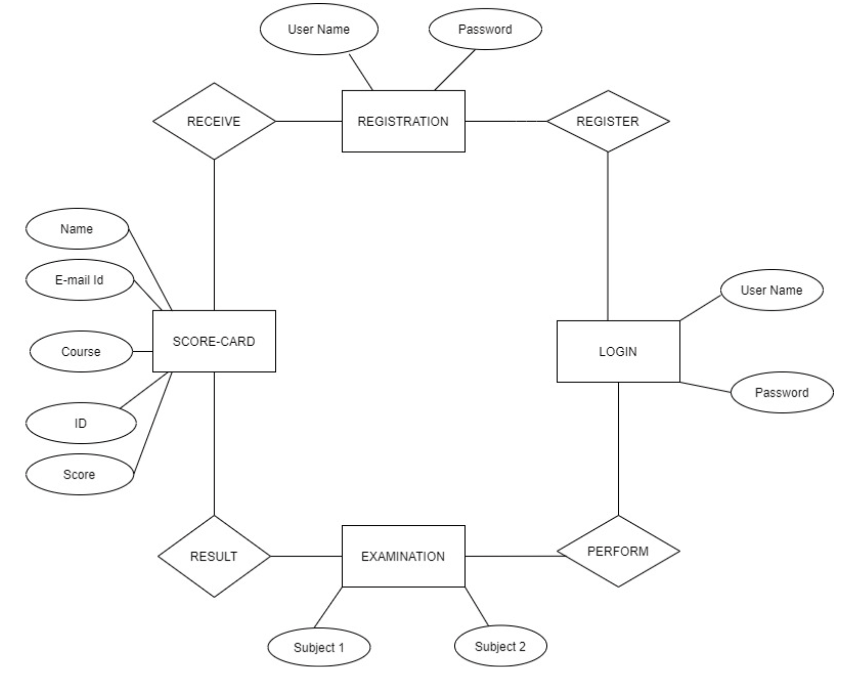
📌 ER diagram

Slide 9
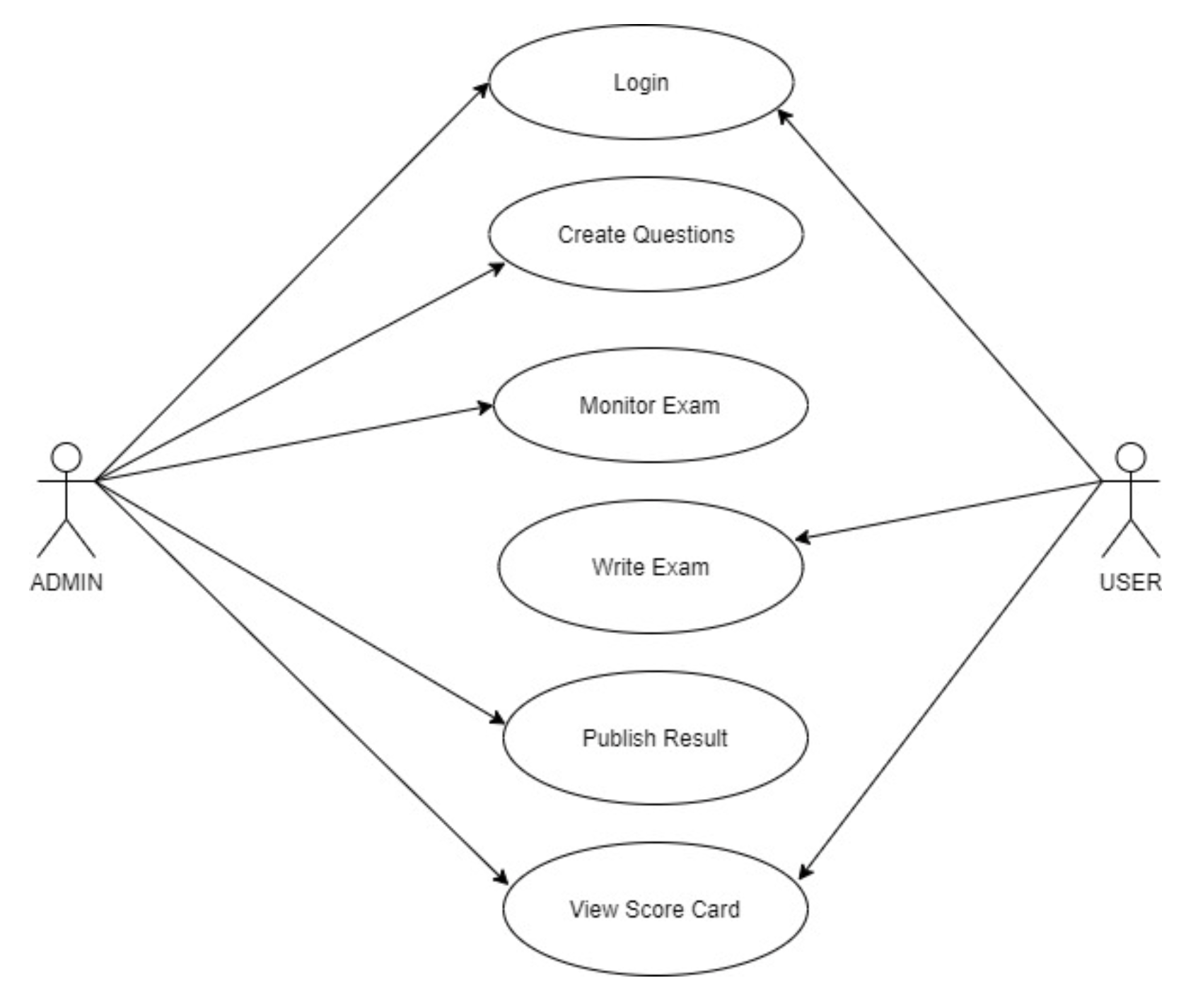
📌 Use Case Diagram

Slide 10

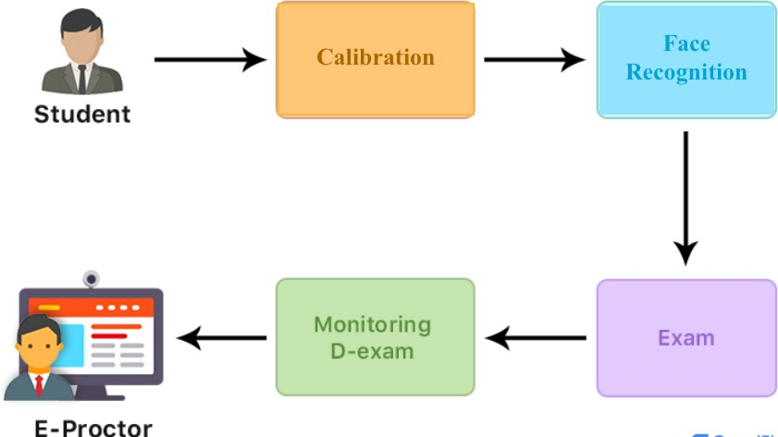

Slide 11

📌 Features
🚀Tab Capture🚀Face capture
🚀Face invisible
🚀Prohibited Keys press
🚀 Face not Visible
🚀Multiple Face detected
🚀Prohibited Object found
🚀Capture Mobile Phone

Slide 12

📌 More Features
🚀 Exam Code feature (using Random Function generator)
🚀Books , Copy Detector
🚀Easy to Use
🚀Handle Large number of Students
🚀 Supported Any type of Exam Link
🚀 Schedule Examination
🚀 Fixed Time Slot / Duration
🚀 Browser Supported .
🚀 Organised Result in the form of Tables.
🚀 Real time Monitoring.

Slide 13
For Professor 👨🏼‍🏫 and Managements🧑‍🏫
✍️ Take test using exam code
✍️ Proper dashboard to see the status of students in real time
✍️ Simple to use.
✍️ Uses AI
✍️ Take test using using any Exam link.
✍️ Schedule the examination
✍️ Real time Monitoring
✍️ Time limit / Duration .
✍️ Result in organised format
✍️ Take printout of Result
✍️ Unique Exam Code (uses Random function gernerator )
✍️ Safe And Secure .
✍️ Cheating impossible .

Slide 14

📌 For more
Please visit the app website
To utilize your time.
https://watchx-ai.herokuapp.com/
https://autowatchx-ai.herokuapp.com/

Slide 15

📌Thank you
For more ,
Click here
Regards ,
Vikas Pandey

