Slide 1
Docker
Pranjal Srivastava

Slide 2
What is Container?

Slide 3
What is Container?
A container is a lightweight, standalone, and executable software package that includes everything needed to run a piece of software, including the code, runtime, system tools, system libraries, and settings

Slide 4
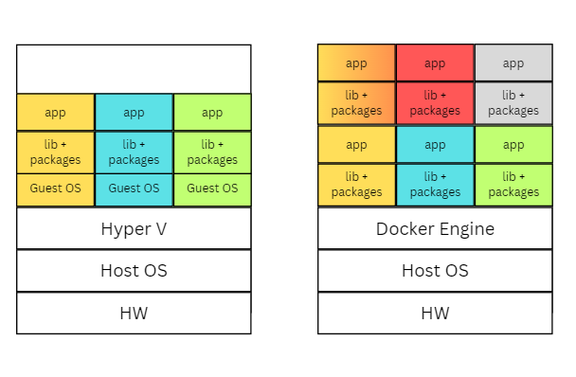
VM
Container
Resource Utilization
Speed
Scalability
Isolation
Portability

Slide 5
What is Docker?
Docker is an open-source platform used to develop, ship, and run applications inside containers.
Docker allows applications to be packaged along with their dependencies into isolated units called containers

Slide 6
Docker Image, Dockerfile, Docker Container, Docker Hub
Docker images is a read-only template used to create Docker containers.
Docker images are built from a set of instructions defined in a text file called a Dockerfile. The Dockerfile contains the configuration and dependencies required for the application.
Images are stored in a repository, and one of the most popular repositories for Docker images is Docker Hub.
A Docker container is a runnable instance of a Docker image.

Slide 7
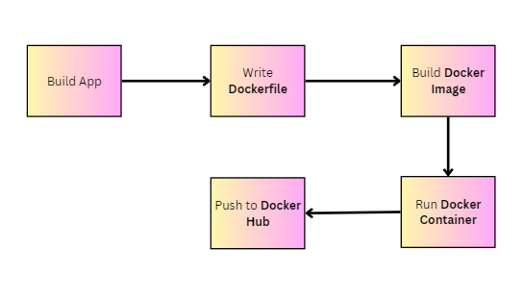
Docker Workflow

Slide 8
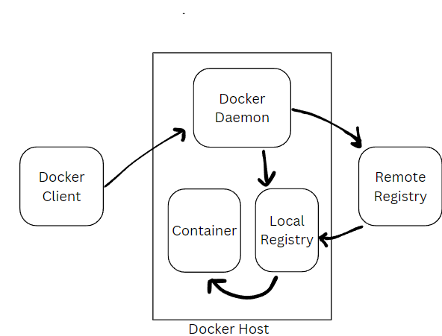
How Docker works?
docker run hello-world

Slide 9
