Slide 1
Mastering AWS: Sharpen Your Skills | PCCOE x GeeksforGeeks
Pranjal Srivastava

Slide 2

Pranjal Srivastava
Content Creator | Edupreneur | Freelance Devops Consultant
7 years experience as Online Instructor
Taught more than 200,000 students/professionals Globally.
Worked at TCS
Passion to teach, Love to travel, Foodie
Skilled in Devops, Cloud, Machine learning and Data Science
https://www.linkedin.com/in/srivastavapranjal/
https://github.com/iampsrv

Slide 3
Three 90 Challenge
Learn, Complete, and Get Rewarded!

Slide 4
What is Three 90 Challenge?
A special program by GeeksforGeeks to encourage course completion.
Challenge Structure:
Complete 90% of a course
Within 90 days
Get 90% refund on the course fee!
Designed for self-paced & live courses
www.geeksforgeeks.org

Slide 5
Why Should You Join?
✅ Financial Incentive: Get 90% of your money back
✅ Motivation Boost: Stay consistent & disciplined
✅ Skill Development: Learn and apply knowledge
✅ Career Growth: Strengthen your resume & job prospects
www.geeksforgeeks.org

Slide 6
Who Can Participate?
Open to all learners interested in upskilling
Ideal for students, working professionals, and career changers
Choose from a variety of tech courses:
Programming & DSA
Machine Learning & AI
Web Development & More
www.geeksforgeeks.org

Slide 7
Introduction to AWS
A Beginner's Guide to Amazon Web Services
Presented by:Pranjal Srivastava

Slide 8
What is AWS?
Amazon Web Services (AWS) is a cloud computing platform by Amazon.
Provides on-demand cloud services such as computing, storage, and databases.
Helps businesses scale and innovate efficiently.
Offers pay-as-you-go pricing model.

Slide 9
Benefits of AWS
Scalability: Easily scale up or down as needed.
Security: Industry-leading security measures.
Cost-Effective: Pay only for what you use.
Global Reach: Data centers across the world.
Flexibility: Supports various programming languages and frameworks.

Slide 10
AWS Services Categories
Compute: EC2, Lambda, Elastic Beanstalk
Storage: S3, EBS, Glacier
Database: RDS, DynamoDB, Redshift
Networking: VPC, Route 53, CloudFront
Security: IAM, AWS Shield, WAF
Machine Learning: SageMaker, Rekognition, Lex

Slide 11
Popular AWS Services
Amazon EC2: Virtual servers in the cloud.
Amazon S3: Scalable object storage service.
AWS Lambda: Serverless computing platform.
Amazon RDS: Managed relational databases.
Amazon CloudFront: Content delivery network.
AWS IAM: Secure access management.

Slide 12
AWS Pricing Model
Pay-as-you-go: Pay only for what you use.
Reserved Instances: Discounted pricing for long-term usage.
Spot Instances: Lower-cost compute capacity.
Free Tier: Limited free access to AWS services for new users.

Slide 13
Getting Started with AWS
Create an AWS account at aws.amazon.com
Explore AWS Free Tier services.
Use AWS Management Console or CLI.
Start with basic services like EC2, S3, and RDS.
Learn through AWS documentation and training.

Slide 14
AWS Core Services
Understanding the Key Services of Amazon Web Services
Presented by:Pranjal Srivastava

Slide 15
Introduction to AWS Core Services
AWS Core Services include essential cloud computing resources.
These services cover computing, storage, networking, and databases.
They are the building blocks for cloud-based applications.
AWS provides fully managed, scalable, and cost-effective solutions.

Slide 16
AWS Compute Services
Amazon EC2: Virtual servers in the cloud.
AWS Lambda: Serverless computing for running code.
AWS Elastic Beanstalk: Managed platform for web apps.
Amazon ECS & EKS: Container orchestration services.
AWS Fargate: Serverless container management.

Slide 17
AWS Storage Services
Amazon S3: Scalable object storage.
Amazon EBS: Persistent block storage for EC2.
Amazon EFS: Scalable file storage for EC2.
AWS Glacier: Low-cost archival storage.
AWS Storage Gateway: Hybrid cloud storage solution.

Slide 18
AWS Networking Services
Amazon VPC: Virtual private cloud for networking.
AWS Route 53: Scalable domain name system (DNS).
AWS CloudFront: Global content delivery network (CDN).
AWS Direct Connect: Dedicated network connection to AWS.
AWS Elastic Load Balancing: Distributes traffic across instances.

Slide 19
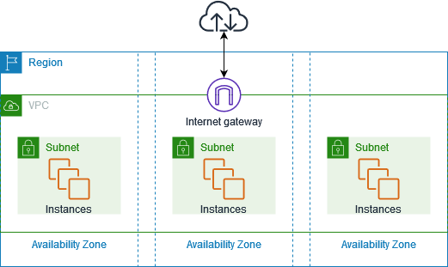
Source: AWS Documentation

Slide 20
AWS Database Services
Amazon RDS: Managed relational database service.
Amazon DynamoDB: NoSQL database with high performance.
Amazon Redshift: Data warehousing solution.
Amazon Aurora: High-performance relational database.
AWS Database Migration Service (DMS): Database migration tool.

Slide 21
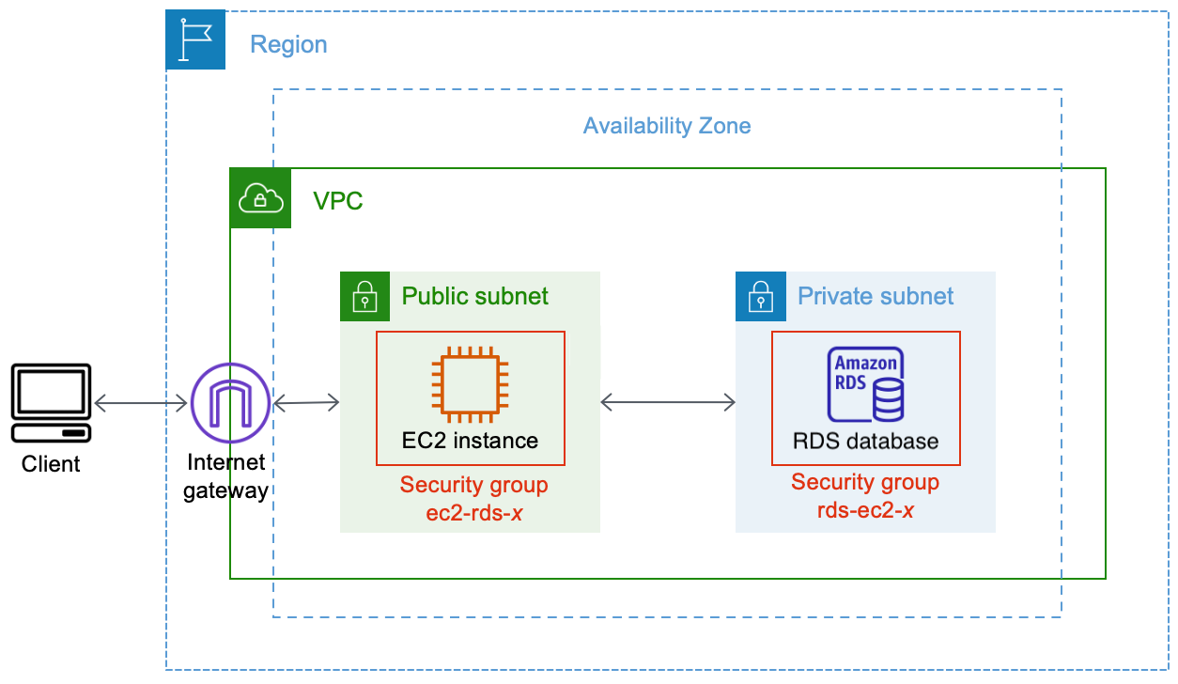
Source: AWS Documentation

Slide 22
AWS Security
AWS IAM: Identity and access management.
AWS Shield: Protection against DDoS attacks.
AWS WAF: Web application firewall.
AWS KMS: Key management service for encryption.
AWS Security Hub: Unified security analysis.

Slide 23
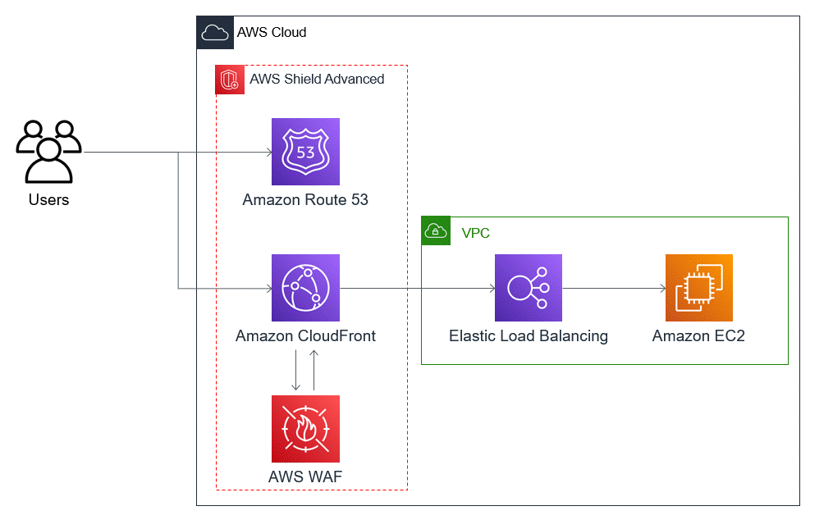
Source: AWS Documentation

Slide 24
AWS Management & Monitoring Services
AWS CloudWatch: Monitoring and logging service.
AWS CloudTrail: Tracks API activity and logs.
AWS Config: Compliance auditing and security checks.
AWS Auto Scaling: Dynamically scales resources.
AWS Systems Manager: Centralized resource management.

Slide 25
AWS Application Integration Services
Amazon SQS: Message queuing service.
Amazon SNS: Pub/Sub messaging system.
AWS Step Functions: Workflow automation.
Amazon API Gateway: API management tool.
AWS EventBridge: Event-driven application integration.

Slide 26
AWS Networking & Load Balancing
Understanding AWS Networking and Traffic Distribution
Presented by:Pranjal Srivastava

Slide 27
Introduction to AWS Networking & Load Balancing
AWS provides scalable and secure networking solutions.
Networking services connect cloud resources and manage traffic.
Load balancing distributes incoming traffic across multiple resources.
Key services include VPC, Route 53, ELB, and CloudFront.

Slide 28
AWS Virtual Private Cloud (VPC)
Amazon VPC allows users to create isolated cloud environments.
Users can define IP ranges, subnets, and security settings.
Internet Gateway (IGW) enables internet access for instances.
NAT Gateway allows private instances to access the internet securely.
VPC Peering & Transit Gateway facilitate communication between VPCs.

Slide 29
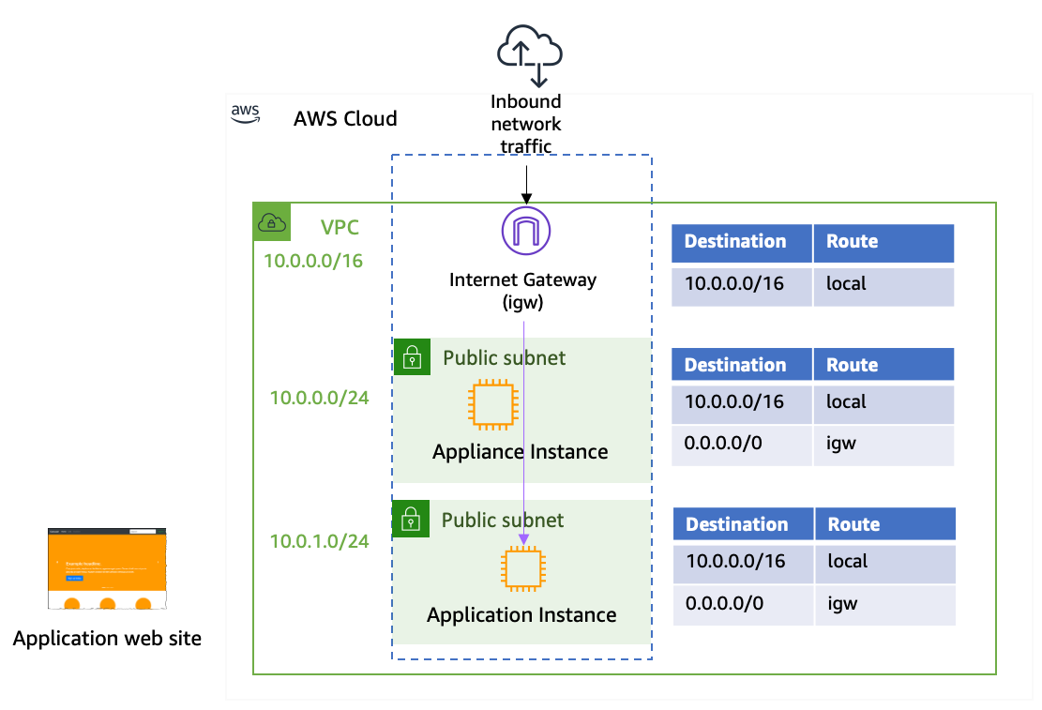
Source: AWS Documentation

Slide 30
AWS Route 53 – Domain Name System (DNS)
Route 53 is a scalable and highly available DNS service.
Supports domain registration, routing, and health checks.
Provides Traffic Routing Policies:
Simple Routing
Weighted Routing
Latency-based Routing
Geolocation Routing
Failover Routing
Integrates with AWS services for global application delivery.

Slide 31
AWS Elastic Load Balancing (ELB)
ELB distributes incoming traffic across multiple targets.
Ensures high availability, fault tolerance, and scalability.
Three types of load balancers:
Application Load Balancer (ALB): Operates at Layer 7 (HTTP/HTTPS).
Network Load Balancer (NLB): Operates at Layer 4 (TCP/UDP).
Gateway Load Balancer (GLB): Routes and filters network traffic.
Integrates with Auto Scaling, AWS WAF, and CloudWatch.

Slide 32
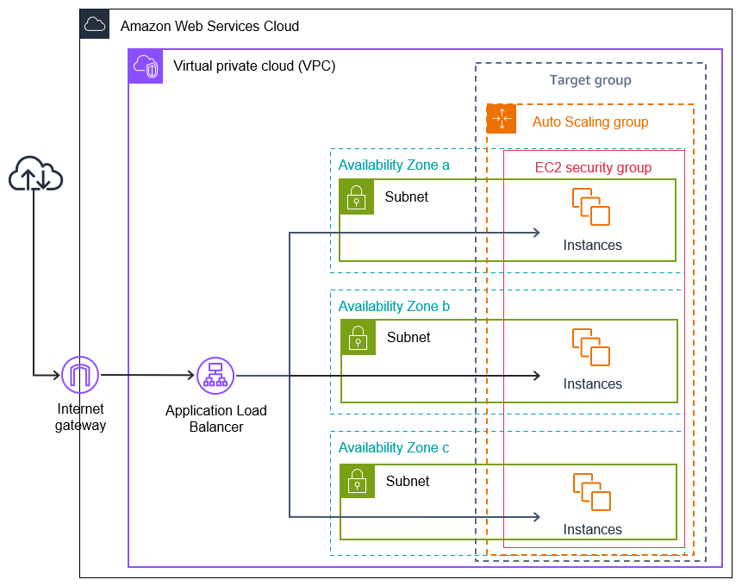
Source: AWS Documentation

Slide 33
Amazon CloudFront – Content Delivery Network (CDN)
Amazon CloudFront delivers content with low latency.
Uses a network of Edge Locations for global distribution.
Supports static and dynamic content caching.
Works with S3, EC2, Route 53, and Lambda@Edge.
Enhances security with AWS Shield and AWS WAF integration.

Slide 34
AWS Direct Connect – Dedicated Network Connection
AWS Direct Connect provides a private, high-speed connection to AWS.
Bypasses the public internet for low latency and secure communication.
Supports hybrid cloud architectures.
Reduces network congestion and enhances performance.
Works with VPC and on-premises data centers.

Slide 35
Security in AWS Networking
Security Groups: Acts as a virtual firewall for instances.
Network ACLs (NACLs): Controls traffic at the subnet level.
AWS WAF (Web Application Firewall): Protects against common web attacks.
AWS Shield: Provides DDoS protection.
AWS PrivateLink: Secures communication between services.

Slide 36
Best Practices for AWS Networking & Load Balancing
Design VPC architectures with multiple subnets and security layers.
Use Auto Scaling with ELB to handle dynamic workloads.
Leverage CloudFront and Route 53 for global application distribution.
Implement private networking for sensitive workloads.
Monitor traffic and logs with AWS CloudWatch and VPC Flow Logs.

Slide 37
AWS Security & Compliance
Ensuring Security and Compliance in the Cloud
Presented by:Pranjal Srivastava

Slide 38
Introduction to AWS Security & Compliance
AWS provides a secure and compliant cloud environment.
Security and compliance are shared responsibilities between AWS and customers.
AWS follows best practices for security, data protection, and governance.
Compliance ensures adherence to industry regulations and standards.

Slide 39
AWS Shared Responsibility Model
AWS is responsible for the security of the cloud (infrastructure, hardware, software).
Customers are responsible for security in the cloud (data, applications, identity management).
Security responsibilities vary depending on the AWS service used (IaaS, PaaS, SaaS).
AWS provides tools and services to enhance security and compliance.

Slide 40
AWS Identity and Access Management (IAM)
Controls user access to AWS services and resources.
Uses roles, policies, and permissions for secure access control.
Supports multi-factor authentication (MFA) for enhanced security.
Integrates with AWS Organizations for centralized management.

Slide 41
AWS Security Services
AWS Shield: DDoS protection service.
AWS WAF: Web application firewall.
AWS KMS: Key management service for encryption.
AWS Secrets Manager: Manages sensitive information securely.
Amazon GuardDuty: Threat detection and monitoring.

Slide 42
Data Protection & Encryption in AWS
AWS encrypts data at rest and in transit.
Amazon S3 Encryption: Protects stored data.
AWS Certificate Manager: Manages SSL/TLS certificates.
AWS CloudHSM: Hardware security module for encryption keys.
AWS KMS: Centralized key management for AWS services.

Slide 43
AWS Monitoring & Logging Tools
Amazon CloudWatch: Monitors AWS resources and applications.
AWS CloudTrail: Logs API activities and user actions.
AWS Config: Audits AWS resource configurations.
AWS Security Hub: Centralized security and compliance insights.
AWS Inspector: Assesses security vulnerabilities.

Slide 44
Best Practices for AWS Security & Compliance
Use IAM Roles and Policies to enforce least privilege access.
Enable Multi-Factor Authentication (MFA) for user accounts.
Encrypt data at rest and in transit.
Monitor logs and use AWS security services.
Regularly audit compliance using AWS security tools.

Slide 45
Deployment & Automation in AWS
Efficiently Deploying and Managing Applications in AWS
Presented by:Pranjal Srivastava

Slide 46
Introduction to Deployment & Automation in AWS
AWS provides various tools for automated deployment and infrastructure management.
Automation helps reduce errors, improve efficiency, and ensure consistency.
Popular AWS services for deployment include AWS Elastic Beanstalk, CodeDeploy, and Lambda.
Infrastructure as Code (IaC) enables repeatable and scalable infrastructure deployment.

Slide 47
AWS Deployment Services
AWS Elastic Beanstalk: Deploys and manages web applications.
AWS CodeDeploy: Automates application deployment.
AWS CodePipeline: CI/CD service for automated workflows.
AWS Lambda: Serverless deployment of functions.
Amazon ECS & EKS: Containerized deployment for applications.

Slide 48
Infrastructure as Code (IaC) in AWS
Infrastructure as Code (IaC) automates infrastructure provisioning.
AWS CloudFormation: Templates for defining AWS infrastructure.
Terraform: Open-source IaC tool compatible with AWS.
AWS CDK (Cloud Development Kit): Code-based infrastructure definition.
Benefits include consistency, scalability, and version control.

Slide 49
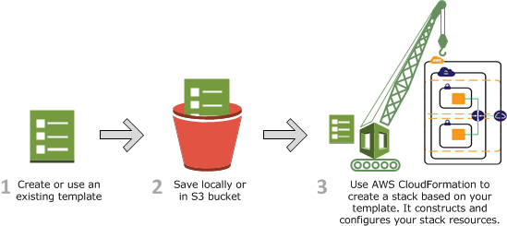
Source: AWS Documentation

Slide 50
AWS Continuous Integration & Continuous Deployment (CI/CD)
CI/CD automates software development and deployment.
AWS CodePipeline: Automates the build, test, and deployment process.
AWS CodeBuild: Builds and tests source code.
AWS CodeDeploy: Deploys applications to EC2, Fargate, and Lambda.
AWS CodeCommit: Managed source control service.

Slide 51
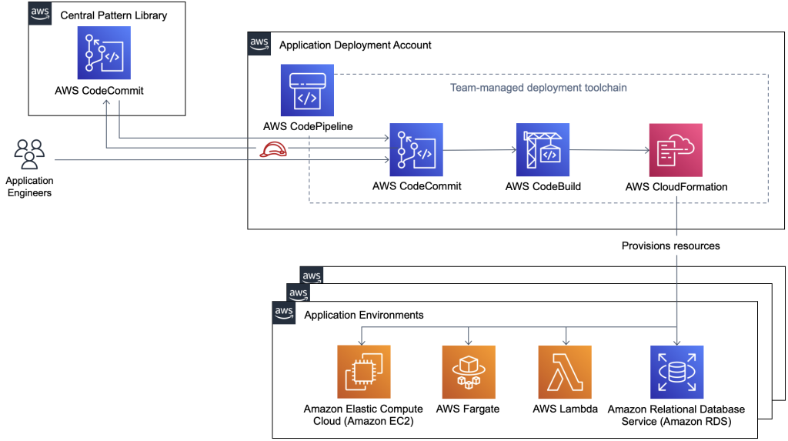
Source: AWS Documentation

Slide 52
AWS Serverless Deployment
Serverless deployment eliminates the need for managing infrastructure.
AWS Lambda: Executes code in response to events.
Amazon API Gateway: Manages APIs for serverless applications.
AWS Step Functions: Orchestrates serverless workflows.
AWS SAM (Serverless Application Model): Simplifies serverless deployment.

Slide 53
AWS Auto Scaling & Load Balancing
Auto Scaling: Adjusts capacity based on demand.
Amazon EC2 Auto Scaling: Ensures high availability and cost optimization.
Elastic Load Balancing (ELB): Distributes traffic across multiple instances.
AWS Fargate: Scales containerized applications dynamically.
Improves application performance and reliability.

Slide 54
Best Practices for AWS Deployment & Automation
Use Infrastructure as Code (IaC) for consistent deployments.
Implement CI/CD pipelines to streamline software releases.
Enable Auto Scaling to optimize resource utilization.
Utilize Monitoring & Logging for troubleshooting and performance tracking.
Follow AWS Well-Architected Framework guidelines.

Slide 55
AWS Certification
A Guide to AWS Certification Paths & Benefits
Presented by:Pranjal Srivastava

Slide 56
Introduction to AWS Certification
AWS Certification validates expertise in cloud technologies.
Recognized globally and enhances career opportunities.
Certifications are available for different roles and skill levels.
Covers key domains like cloud computing, security, and networking.

Slide 57
Benefits of AWS Certification
Validates expertise in AWS cloud computing.
Increases job opportunities and earning potential.
Provides access to the AWS Certified Community.
Helps organizations ensure cloud proficiency.
Keeps professionals updated with AWS advancements.

Slide 58
AWS Certification Levels
Foundational Level: Entry-level certification (Cloud Practitioner).
Associate Level: For professionals with AWS experience (Solutions Architect, Developer, SysOps Administrator).
Professional Level: Advanced certification (Solutions Architect, DevOps Engineer).
Specialty Level: Focuses on specific domains (Security, Machine Learning, Networking, Data Analytics).

Slide 59
AWS Foundational Certification
AWS Certified Cloud Practitioner
Covers basic AWS concepts and services.
Best for beginners and non-technical roles.
Exam duration: 90 minutes.
No prior experience required.

Slide 60
AWS Associate Certifications
AWS Certified Solutions Architect – Associate
Covers designing distributed systems on AWS.
AWS Certified Developer – Associate
Focuses on AWS application development.
AWS Certified SysOps Administrator – Associate
Covers deployment, management, and operations.

Slide 61
AWS Professional Certifications
AWS Certified Solutions Architect – Professional
Advanced cloud architecture and best practices.
AWS Certified DevOps Engineer – Professional
Covers automation, monitoring, and security.
Requires in-depth AWS experience and knowledge.

Slide 62
AWS Specialty Certifications
AWS Certified Advanced Networking – Specialty
AWS Certified Security – Specialty
AWS Certified Machine Learning – Specialty
AWS Certified Data Analytics – Specialty
AWS Certified Database – Specialty
Focused on specialized AWS domains.

