Slide 1
Modern Data Visualization and Research tools
Erik Hambardzumyan
hambardzumyanerik@gmail.com

Slide 2
Tufte’s sound visualization principles
Tell a story with your plots (use of titles, labels)
Keep minimalist
Overview first, then details on demand
Make use of color and keep formatting

Slide 3
Layered grammar of graphics
The idea that you can build every graph from the same
few components: a data set, a set of geoms and a coordinate
system.

Slide 4
Layers and Aesthetics
Aesthetics describe visual characteristics that represent data – e.g., position, size, color, shape, transparency, fill
Layers are responsible for creating the objects that we perceive on the plot

Slide 5
A layer is composed of four parts:
data and aesthetic mapping,
a statistical transformation (stat),
a geometric object (geom)
and a position adjustment.

Slide 6
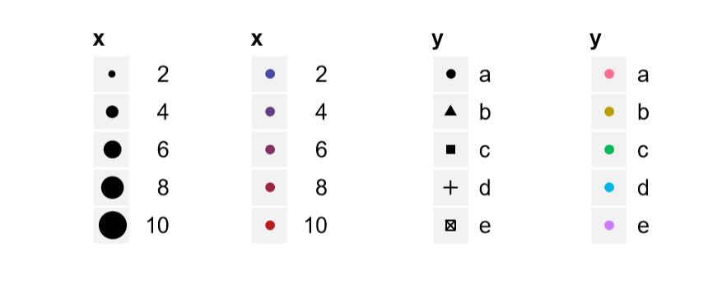
Scales
A scale controls the mapping from data to aesthetic attributes, and we need a scale for every aesthetic used on a plot

Slide 7
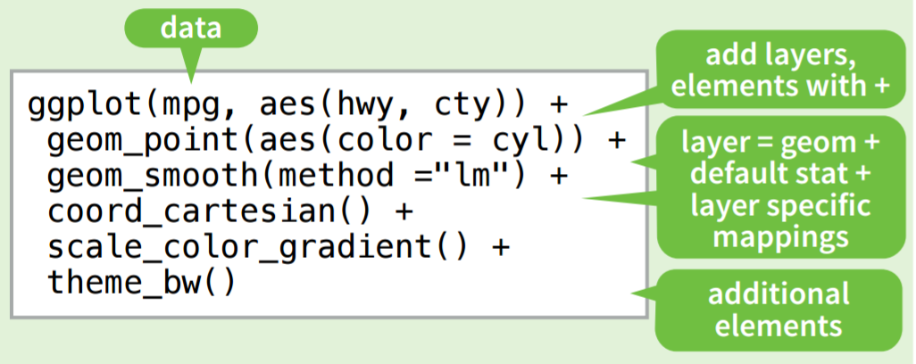
Code structure

Slide 8
Let’s do some coding!

