Slide 1
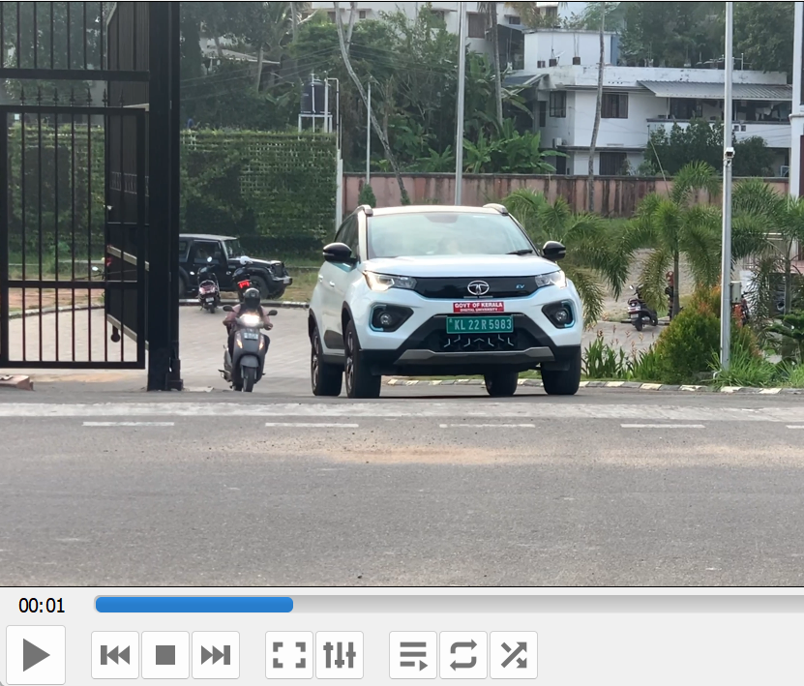
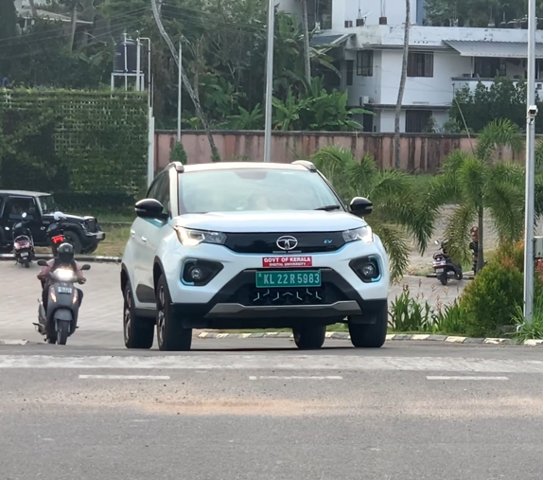


Object Detection
> = Confidence: 80%
Easy OCR
YOLO V8
Frame Slicing
Filtering
Capturing Video ( input)
Frames
Model
Object
Model For Character Detection
. , K L 22 |R 5983\
> = Confidence: 80%
Regex
K L 22 R 5983
car_records = {
"KL22R5983": {
"Entry": <entry_timestamp>,
"Exit": <exit_timestamp>,
"OCR Confidence": <entry_ocr_confidence>,
"Exit OCR Confidence": <exit_ocr_confidence>
}
}
One angle Exit Entry Logic
Filtering Repetition
Creating
Storing In DB
Creating Dictionary
Output
Dictionary Structure
Storage

