Slide 1

Weather & Climate Data Analytics Dashboard
Using Power BI for Big Data Visualization
Student: Rahul Bisht · Enrollment Number: 992509260002
Course: Big Data & Data Visualization
Institute: Jaypee Institute of Information Technology, Noida ·
Academic Year: 2025–2026

Slide 2
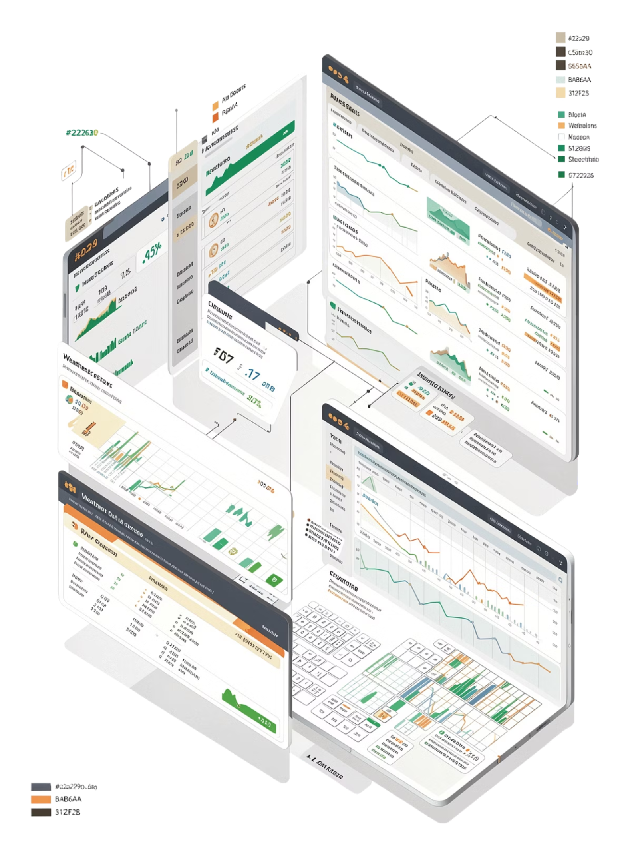
Problem Statement & Objectives
Weather data is vast, complex, and difficult to interpret in its raw form — it demands structured transformation into meaningful, actionable insights.
ETL Pipeline
Build a robust Python-based pipeline to extract, transform, and load large-scale weather data
Data Analysis
Analyze multi-year, multi-city weather datasets to uncover hidden patterns and anomalies
Power BI Dashboard
Create an interactive, visual dashboard for intuitive exploration and reporting
Trend Identification
Detect seasonal trends, extreme events, and regional climate differences

Slide 3
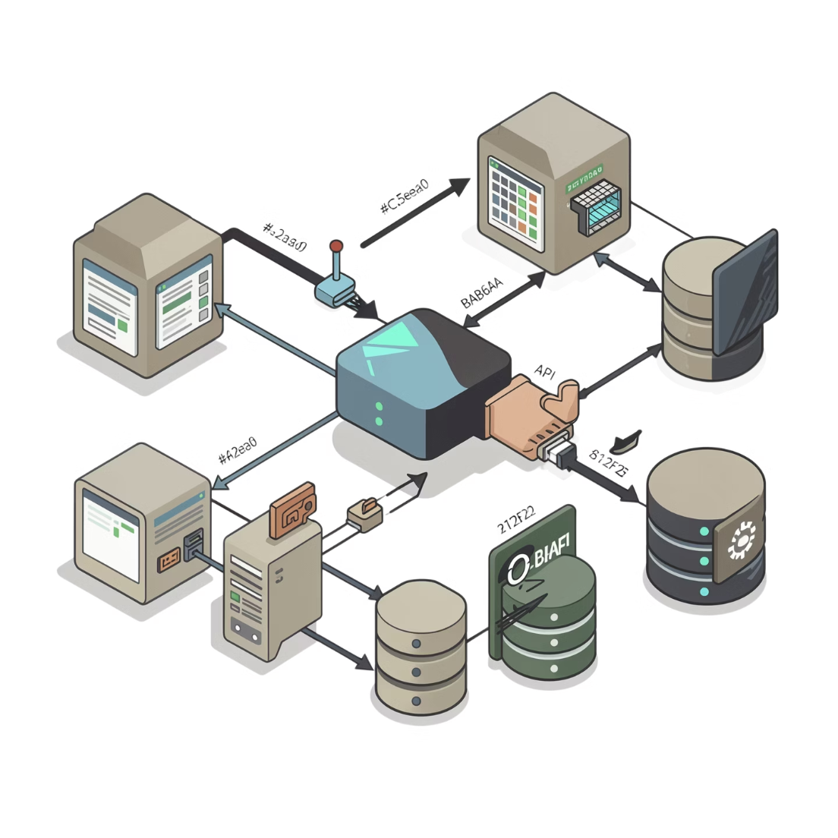
Data Pipeline & Methodology
Data Source
Open-Meteo API · 2015–2024 · 50 global cities
Big Data Characteristics
Volume · Velocity · Variety
ETL Process
Data Model
Star Schema with Fact and Dimension tables for optimized querying
Extract: Automated API data collection
Transform: Data cleaning + feature engineering
Load: CSV export → Power BI import

Slide 4
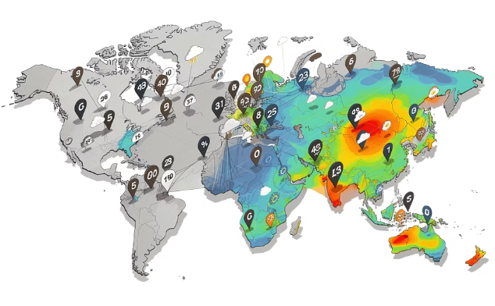
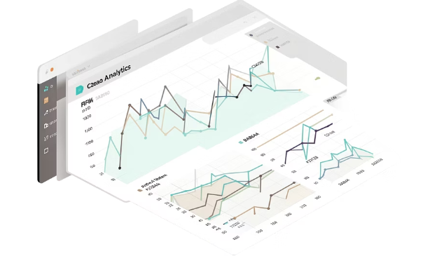
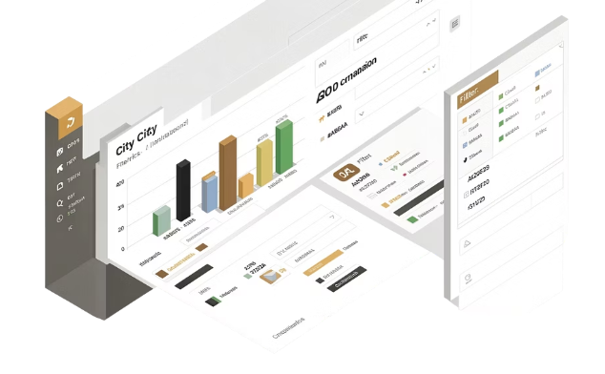
Dashboard Design
Three interactive pages enable layered exploration — from global KPIs down to city-level comparisons.
Global Overview
Weather Deep Dive
City Insights
KPIs, world map view, and temperature trend charts at a glance
Detailed seasonal patterns, daily variation, and anomaly analysis
Cross-city comparisons with slicers, filters, and drill-through navigation
Slicers & Filters
Cross-Filtering
Drill-Through Navigation

Slide 5
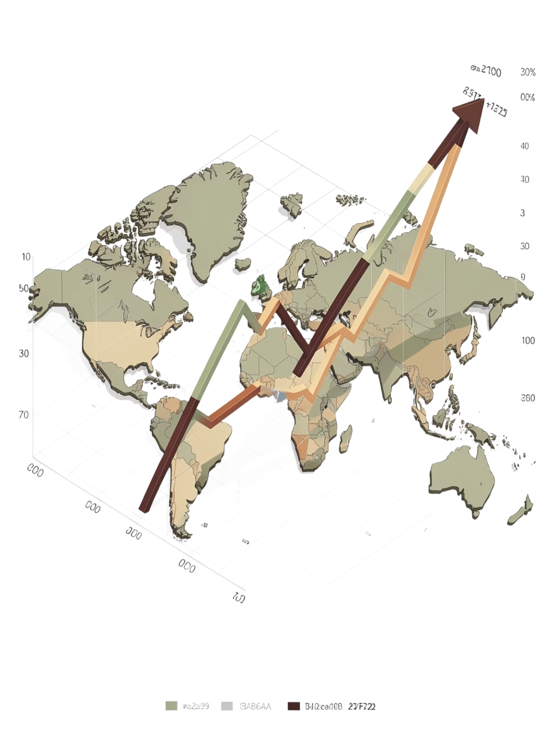
Results & Insights
+0.18°C
Global Warming Trend
Observed temperature increase across the decade
~1.1%
Extreme Events
Of records flagged as extreme weather anomalies
50
Cities Analyzed
Spanning diverse climate zones worldwide
10
Years of Data
Continuous records from 2015 to 2024
Strong seasonal and daily temperature variation detected across mid-latitude cities
Tropical cities exhibit stable temperature patterns with minimal fluctuation
Clear climate differences visible across geographic regions and zones

Slide 6
Conclusion & Future Scope
What We Achieved
Future Enhancements
1
Built an end-to-end Big Data pipeline using Python ETL
Real-Time Integration
Live API feeds for up-to-the-minute weather monitoring
2
Transformed raw weather data into actionable insights
ML Predictions
3
Demonstrated Power BI for real-world climate analytics
Forecast models for temperature and extreme event prediction
Cloud Deployment
Scalable hosting on Azure or AWS for broader access
City Expansion
Scale coverage to hundreds of cities globally

