Slide 1
E-Commerce Application Clone
Report
RK

Slide 2
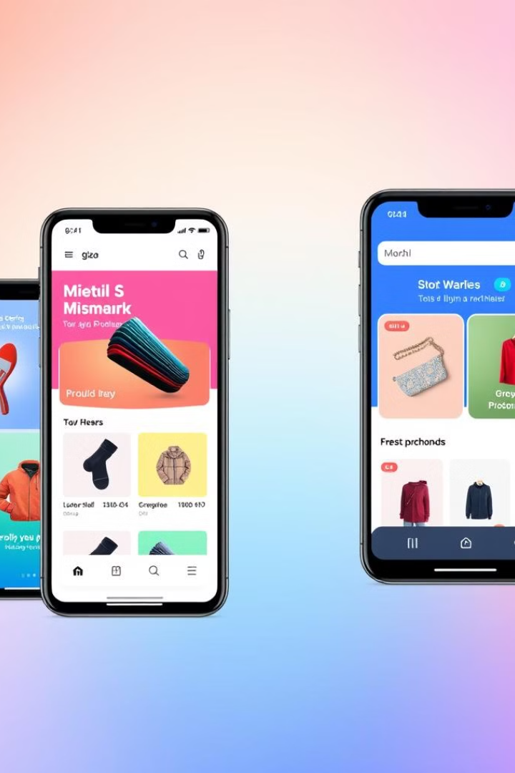
E-Commerce Application Clone
Discover a seamless shopping experience with our E-Commerce Application Clone. Browse, buy, and manage your purchases effortlessly. From curated collections to secure checkouts, we've got you covered.
RK

Slide 3

Introduction to E-Commerce Application Clone
1
User-Friendly Interface
2
Extensive Product Range
Intuitive navigation ensures a smooth shopping journey for all users.
Diverse categories cater to various customer needs and preferences.
3
Secure Transactions
Advanced encryption protects user data and financial information during checkout.

Slide 4
Homepage: Displaying Available Products
Featured Products
Search Functionality
Navigation Menu
Showcase popular items and new arrivals to catch user attention.
Enable quick product discovery with an efficient search bar.
Organize product categories for easy browsing and exploration.

Slide 5
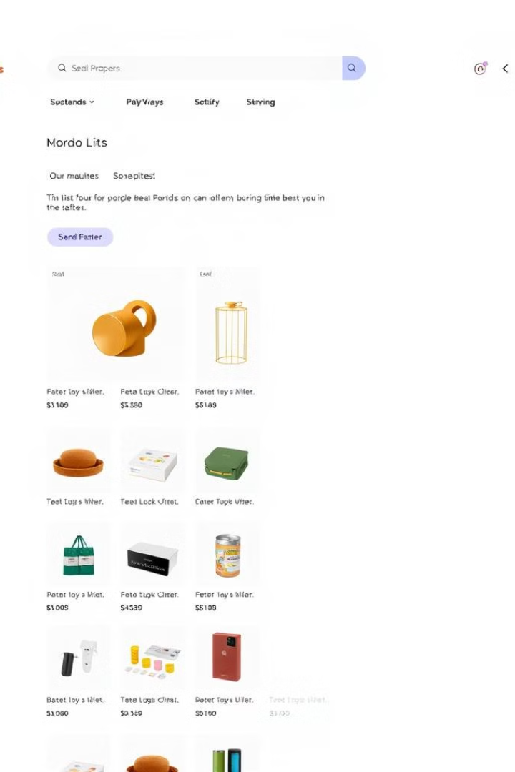



Category/Collection Page: Showcasing Product Types
Filter Options
Allow users to refine their search based on size, color, and price.
Sort Functionality
Enable sorting by price, popularity, or newest arrivals for user convenience.
Product Grid
Display items in an organized grid with essential information and images.

Slide 6
Cart Page: Viewing Added Items
Product Image
Product Name
Quantity
Price
Total
Thumbnail
Item Description
Adjustable
Unit Price
Subtotal

Slide 7
Checkout Page: Order Placement
1
Shipping Information
Collect user's delivery details through a streamlined form.
2
Payment Options
Offer multiple secure payment methods for user convenience.
3
Order Review
Display a final summary of items, costs, and shipping details.

Slide 8
User Authentication: Secure Login and Registration
User Registration
Secure Login
Simple sign-up process with email verification for account security.
Implement multi-factor authentication for enhanced account protection.
Password Recovery
Offer a straightforward process for resetting forgotten passwords.

Slide 9

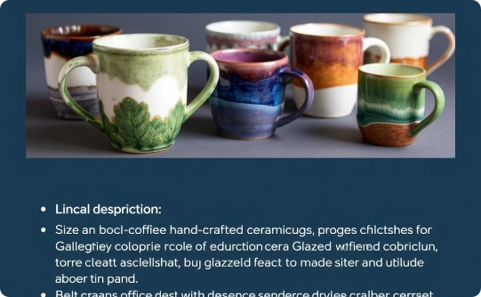
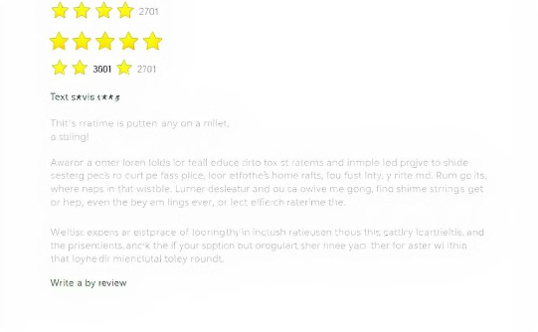
Product Details Page: Exploring Individual Products
Product Images
Detailed Description
Customer Reviews
High-resolution photos with zoom capability for detailed viewing.
Comprehensive information about product features, materials, and care instructions.
Authentic user feedback and ratings to aid in purchase decisions.

Slide 10



Shopping Cart Functionalities: Adding, Removing, and Updating Items
Add to Cart
Seamlessly add products with a single click from any page.
Remove Items
Easily remove unwanted items from the cart with one action.
Update Quantities
Adjust product quantities and see real-time total cost updates.

Slide 11
Responsive Design: Optimizing for Mobile and Desktop
Mobile-First Approach
Adaptive Layouts
Performance Optimization
Prioritize mobile users with a touch-friendly, streamlined interface.
Automatically adjust content and navigation for optimal viewing on all devices.
Ensure fast loading times and smooth interactions across all platforms.

Slide 12
Thank You

