Slide 1
Real-Time Operating Systems
RTOS
For Embedded systems

Slide 2
Real-Time Systems
Result in severe consequences if logical and timing correctness are not met
Two types exist
  Soft real-time
    Tasks are performed as fast as possible
    Late completion of jobs is undesirable but not fatal.
    System performance degrades as more & more jobs miss deadlines

Slide 3
Real-Time Systems (cont.)
  Hard real-time
    Tasks have to be performed on time
    Failure to meet deadlines is fatal
    Example :
      Flight Control System

Slide 4
Hard and Soft Real Time Systems
(Operational Definition)
Hard Real Time System
  Validation by provably correct procedures or extensive simulation that the system always meets the timings constraints
Soft Real Time System
  Demonstration of jobs meeting some statistical constraints suffices.
Example – Multimedia System
  25 frames per second on an average

Slide 5
Most Real-Time Systems are embedded
An embedded system is a computer built into a system but not seen by users as being a computer
Examples
  FAX machines
  Copiers
  Printers
  Scanners
  Routers
  Robots

Slide 6
Role of an OS in Real Time Systems
Standalone Applications
  Often no OS involved
  Micro controller based Embedded Systems
Some Real Time Applications are huge & complex
  Multiple threads
  Complicated Synchronization Requirements
  File system / Network / Windowing support
  OS primitives reduce the software design time

Slide 7
Features of Real Time OS (RTOS)
Scheduling.
Resource Allocation.
Interrupt Handling.
Other issues like kernel size.

Slide 8
Scheduling in RTOS
More information about the tasks are known
  Number of tasks
  Resource Requirements
  Execution time
  Deadlines
Being a more deterministic system better scheduling algorithms can be devised.

Slide 9
Scheduling Algorithms in RTOS
Clock Driven Scheduling
Weighted Round Robin Scheduling
Priority Scheduling

Slide 10
Scheduling Algorithms in RTOS (cont.)
Clock Driven
  All parameters about jobs (execution time/deadline) known in advance.
  Schedule can be computed offline or at some regular time instances.
  Minimal runtime overhead.
  Not suitable for many applications.

Slide 11
Scheduling Algorithms in RTOS (cont.)
Weighted Round Robin
  Jobs scheduled in FIFO manner
  Time quantum given to jobs is proportional to it’s weight

Slide 12
Scheduling Algorithms in RTOS (cont.)
Priority Scheduling
  Processor never left idle when there are ready tasks
  Processor allocated to processes according to priorities
  Priorities
    Static - at design time
    Dynamic - at runtime

Slide 13
Priority Scheduling
Earliest Deadline First (EDF)
  Process with earliest deadline given highest priority
Least Slack Time First (LSF)
  slack = relative deadline – execution left
Rate Monotonic Scheduling (RMS)
  For periodic tasks
  Tasks priority inversely proportional to it’s period

Slide 14
Schedulers
Also called “dispatchers”
Schedulers are parts of the kernel responsible for determining which task runs next
Most real-time kernels use priority-based scheduling
  Each task is assigned a priority based on its importance
  The priority is application-specific

Slide 15
Preemptive Kernels
The highest-priority task ready to run is always given control of the CPU
  If an ISR makes a higher-priority task ready, the higher-priority task is resumed (instead of the interrupted task)
Most commercial real-time kernels are preemptive

Slide 16
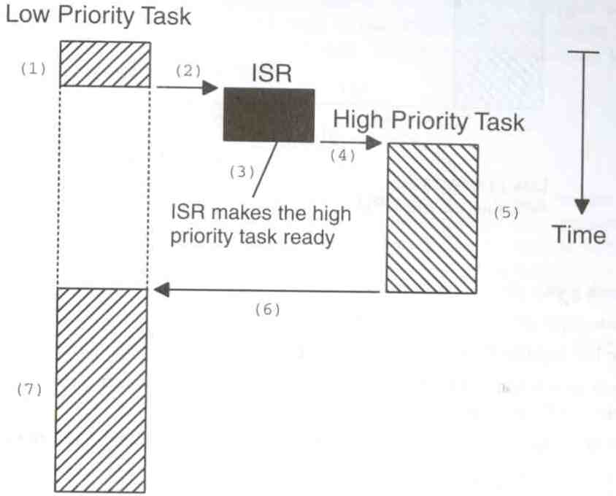
Preemptive Kernels (cont.)

Slide 17
Advantages of Preemptive Kernels
Execution of the highest-priority task is deterministic

Slide 18
Resource Allocation in RTOS
Resource Allocation
  The issues with scheduling applicable here.
  Resources can be allocated in
    Weighted Round Robin
    Priority Based
Priority inversion problem may occur if priority scheduling is used

Slide 19
Assigning Task Priorities
Not trivial
In most systems, not all tasks are critical
  Non-critical tasks are obviously low-priorities
Most real-time systems have a combination of soft and hard requirements

Slide 20
A Technique for Assigning Task Priorities
Rate Monotonic Scheduling (RMS)
  Priorities are based on how often tasks execute

Slide 21
Other RTOS issues
Interrupt Latency should be very small
  Kernel has to respond to real time events
  Interrupts should be disabled for minimum possible time
For embedded applications Kernel Size should be small
  Should fit in ROM
Sophisticated features can be removed
  No Virtual Memory
  No Protection

Slide 22
Linux for Real Time Applications
Scheduling
  Priority Driven Approach
    Optimize average case response time
  Interactive Processes Given Highest Priority
    Aim to reduce response times of processes
  Real Time Processes
    Processes with high priority
    There was no notion of deadlines

Slide 23
Interrupt Handling in Linux
Interrupts were disabled in ISR/critical sections of the kernel
There was no worst case bound on interrupt latency avaliable
  eg: Disk Drivers might disable interrupt for few hundred milliseconds

Slide 24
Interrupt Handling in Linux (cont.)
Linux was not suitable for Real Time Applications
  Interrupts may be missed

Slide 25
Other Problems with Linux
Processes were not preemtible in Kernel Mode
  System calls like fork take a lot of time
  High priority thread might wait for a low priority thread to complete it’s system call
Processes are heavy weight
  Context switch takes several hundred microseconds

