Slide 1
Real-Time Operating Systems
RTOS
For Embedded systems
For Embedded systems
- Rajendra Singh

Slide 2
Real-Time Systems
A system is said to be Real Time if it is required to complete it’s work & deliver it’s services on time.
Result in severe consequences if logical and timing correctness are not met
Example
    Flight Control System
    controlling traffic signal
    nuclear reactor
Non Example – PC system

Slide 3
What a RTOS is not
Real time computing is equivalent to fast computing.
Real time systems operate in a static environment
Real time programming involves assembly coding, writing device drivers.

Slide 4
Real-Time Systems (cont.)
  Two types exist
    Soft real-time
      Tasks are performed as fast as possible
      Late completion of jobs is undesirable but not fatal.
      System performance degrades as more & more jobs miss deadlines
      Also known as “best effort” systems
      Example :
        multimedia transmission and reception
        networking, telecom (cellular) networks
        web sites and services, Online Databases
        computer games

Slide 5
Real-Time Systems (cont.)
    Hard real-time
      Tasks have to be performed on time
      Failure to meet deadlines is fatal
      Requires formal verification/guarantees of being to always meet its hard deadlines (except for fatal errors).
      Example :
        Flight Control System, air traffic control
        vehicle subsystems control
        Nuclear power plant control

Slide 6
Most Real-Time Systems are embedded
An embedded system is a computer built into a system but not seen by users as being a computer
Examples
  FAX machines
  Copiers
  Printers
  Scanners
  Routers
  Robots

Slide 7
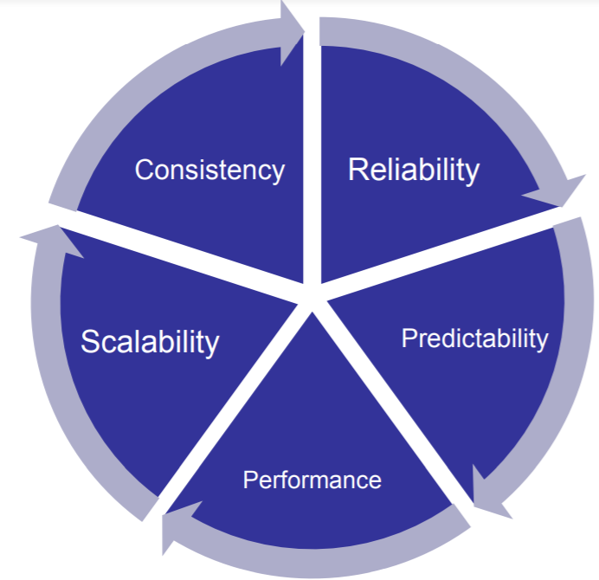
CHARACTERISTICS OF RTOS

Slide 8
Role of an OS in Real Time Systems
Standalone Applications
  Often no OS involved
  Micro controller based Embedded Systems
Some Real Time Applications are huge & complex
  Multiple threads
  Complicated Synchronization Requirements
  File system / Network / Windowing support
  OS primitives reduce the software design time

Slide 9
Role of an OS in Real Time Systems
Standalone Applications
  Often no OS involved
  Micro controller based Embedded Systems
Some Real Time Applications are huge & complex
  Multiple threads
  Complicated Synchronization Requirements
  File system / Network / Windowing support
  OS primitives reduce the software design time

Slide 10
FUNCTIONS OF RTOS
Task management
Scheduling.
Resource Allocation.
Interrupt Handling.

Slide 11
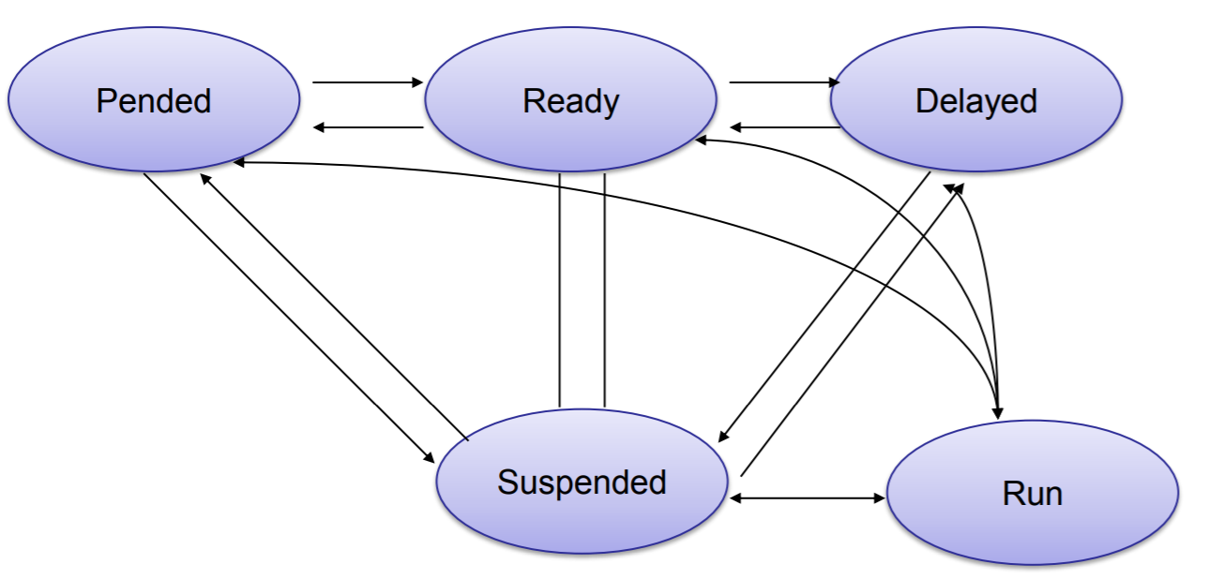
Task management
In Real Time Applications the Process is called as Task which takes execution time and occupies memory.
Task management is the process of managing tasks through its life cycle.

Slide 12
Scheduling in RTOS
More information about the tasks are known
  Number of tasks
  Resource Requirements
  Execution time
  Deadlines
Being a more deterministic system better scheduling algorithms can be devised.

Slide 13
Scheduling Algorithms in RTOS
Clock Driven Scheduling
Weighted Round Robin Scheduling
Priority Scheduling(Greedy / List / Event Driven)

Slide 14
Scheduling Algorithms in RTOS (cont.)
Clock Driven
  All parameters about jobs (execution time/deadline) known in advance.
  Schedule can be computed offline or at some regular time instances.
  Minimal runtime overhead.
  Not suitable for many applications.

Slide 15
Scheduling Algorithms in RTOS (cont.)
Weighted Round Robin
  Jobs scheduled in Round Robin manner
  Time quantum given to jobs is proportional to it’s weight
  Example use : High speed switching network
  Not suitable for precedence constrained jobs.
  • Job A can run only after Job B. No point in giving time quantum to Job B before Job A.

Slide 16
Scheduling Algorithms in RTOS (cont.)
Priority Scheduling
  Processor never left idle when there are ready tasks
  Processor allocated to processes according to priorities
  Priorities
    Static - at design time
    Dynamic - at runtime

Slide 17
Priority Scheduling
Earliest Deadline First (EDF)
  Process with earliest deadline given highest priority
Least Slack Time First (LSF)
  slack = (relative deadline – execution left)
Rate Monotonic Scheduling (RMS)
  For periodic tasks
  Tasks priority inversely proportional to it’s period

Slide 18
Resource Allocation in RTOS
Resource Allocation
  Resources can be allocated in
    Weighted Round Robin
    Priority Based
Some resources are non preemptible
  Example : semaphores

Slide 19
Assigning Task Priorities
In most systems, not all tasks are critical
  Non-critical tasks are obviously low-priorities
Most real-time systems have a combination of soft and hard requirements

Slide 20
Other RTOS issues
Interrupt Latency should be very small
  Kernel has to respond to real time events
  Interrupts should be disabled for minimum possible time
For embedded applications Kernel Size should be small
  Should fit in ROM
Sophisticated features can be removed
  No Virtual Memory

Slide 21
CONCLUSION.
RTOS have been the heroes in most of the technological areas, right from fuel injection system to nuclear reactor control, satellite control, global positioning systems(gps), and fully equipped high-tech warfare aircrafts.
    And the best is yet to come!

Slide 22
Thank you!

