Slide 1

CUSTOMER INSIGHTS & PRODUCT TRENDS FOR STRATEGIC CROSS-SELLING
Prepared by: DataVision Team
Contributors: RAJ PAWAR, NAGA PAVITHRA JAJALA
WEEK 11 | 14TH JUNE 2025

Slide 2

AGENDA
PROBLEM STATEMENT
PROJECT OBJECTIVE
DATASET OVERVIEW
EDA APPROACH
KEY INSIGHTS
BUSINESS IMPLICATIONS
GRAPHS AND VISUALISATIONS

Slide 3

PROBLEM STATEMENT
Customers are typically subscribed to a single product with XYZ Credit Union. This presents a challenge in unlocking revenue through cross-selling.
Current state: Limited customer-product engagement
Business Goal: Enhance multi-product adoption via targeted strategies

Slide 4
PROJECT OBJECTIVE
Analyse customer behavior and product ownership trends to:
Understand usage patterns
Detect churn risk and opportunity areas
Segment customer base for marketing actions
Final Outcome: Insights to drive data-backed cross-selling strategies.

Slide 5
DATASET OVERVIEW
Source: XYZ Credit Union (train.csv)
Size: ~2.1 GB | 13M+ records | 48 columns
Time Range: Jan 2015 – May 2016
Fields Include:
Demographics (age, gender, country, etc.)
Account info (seniority, income, relationship)
24 binary product ownership flags

Slide 6
EDA APPROACH
Data Cleaning
Removed nulls/outliers
Standardized column names
Converted dtypes appropriately
Exploratory Analysis
Univariate & bivariate stats
Time-series patterns
Churn and loyalty metrics
Tooling:
Python
Dask
Pandas
Matplotlib

Slide 7
CUSTOMER PROFILE INSIGHTS
Gender Split: Female (54.5%) vs Male (45.5%)
Age: Avg = 40.2 years (18–100 range)
Segments:
60% Particulares
36% Universitarios
4% Top-tier customers
Country: 99.7% based in Spain
Seniority: Highly skewed; median = 105 months

Slide 8
PRODUCT OWNERSHIP PATTERNS
Top 3 Products:
Current Account (65%)
Particular Account (13%)
Direct Debit (13%)
Cross-Product Usage:
52.5% of customers own only 1 product
<10% customers have >5 products

Slide 9
TIME-BASED TRENDS AND CHURN & LOYALTY INDICATORS
Time-Based Trends
Monthly engagement stable with seasonal variation
Direct Debit, Pension, Salary products increase steadily
Some fixed deposits (short-term/medium-term) show churn over time
Churn & Loyalty Indicators
High churn: Salary (65K), Pension (76K), Credit Card (70K)
High addition: Direct Debit (153K), Pension (84K), Salary (73K)
Implication: High engagement products need retention strategies

Slide 10
FEATURE INTERACTIONS & CORRELATION
Product ownership moderately correlated across:
Pension ↔ Salary ↔ Direct Debit
Loans ↔ Mortgage
Age and Segment influence multi-product behavior
Feature synergy potential for product bundling

Slide 11
BUSINESS IMPLICATIONS
Define customer personas based on behavior
Segment by life stage and financial needs
Tailor campaigns (e.g., university grads → Credit Card + e-Account)
Proactive churn prevention for high-risk segments
Bundle promotions for complementary products

Slide 12
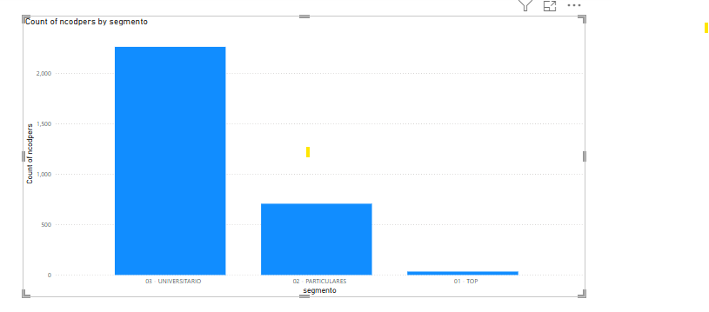
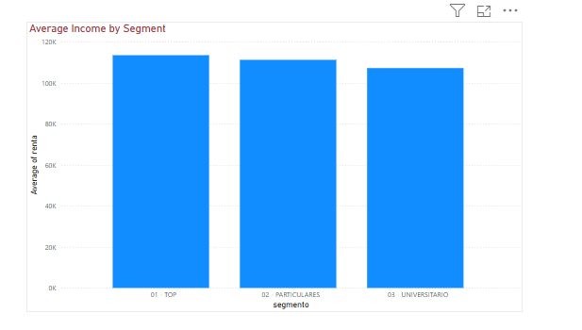
GRAPHS AND VISUALISATIONS
Customer Distribution by Segment
Income Comparison by Segment
The 'Universitario' segment has the highest number of customers, showing strong engagement from younger users.
The 'Top' segment has the highest average income, making them strong candidates for premium product cross-sell opportunities.
Note: All the visualisations from here on are from the subset (10k rows) of original cleaned dataset (Final_cleaned.csv), due to system hardware not able to process the bigger 3GB dataset. With that being said, we do understand, in real world usage, it is common to expect huge datasets and as data analysts, we should be able to work on these large datasets. These visualisations are here to demonstrate our capability to use visualisation software. However, all the EDA insights (mentioned earlier in this presentation) required to solve the business problem are extracted by working on the original cleaned dataset (Final_cleaned.csv – 3GB). Thank you.
Notes:
All the visualisations are from the subset (10k rows) of original cleaned dataset (Final_cleaned.csv), due to system hardware not able to process the bigger 3GB dataset. With that being said, we do understand in real world usage, it is common to expect huge datasets and as data analysts, we should be able to work on these large datasets. These visualisations are here to demonstrate our capability to use visualisation software. However, all the EDA insights required to solve the business problem are extracted by working on the original cleaned dataset (Final_cleaned.csv – 3GB). Thank you.

Slide 13
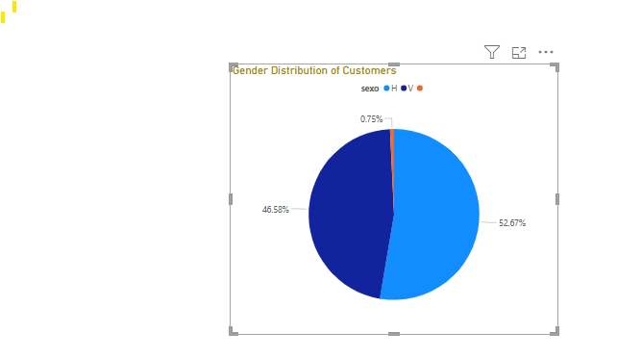
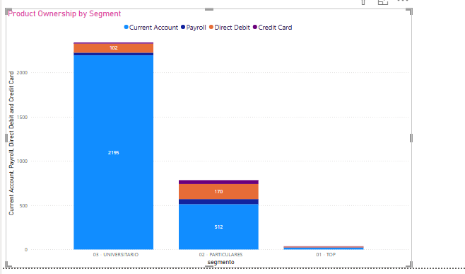
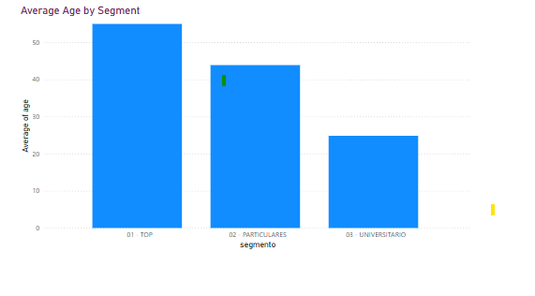
GRAPHS AND VISUALISATIONS
Average Age by Segment
Ownership of Key Products
Customer Gender Distribution
The 'Universitario' segment is the youngest, ideal for promoting student banking and first-time saver products.
Current accounts are widely adopted across all segments. Credit card and payroll product usage is lower especially among Universitario customers, suggesting opportunities for cross-selling.
The gender distribution is nearly balanced, allowing for inclusive and gender-neutral product marketing.

Slide 14
FINAL RECOMMENDATIONS
1. Encourage Multi-Product Usage Over 50% of customers only use one product. This indicates a big opportunity to introduce them to other services like savings accounts, credit cards, or investment products.
2. Promote High-Value Product Bundles Products such as salary, pension, and direct debit are often used together. Marketing these as a bundle could increase uptake and customer convenience.
3. Focus on Retention of High-Churn Products Products like salary accounts, pensions, and credit cards show high churn. Focus on improving user experience and offering loyalty benefits to retain these customers.
4. Targeted Campaigns for Different Customer Segments
University students (Segment: Universitario) can be targeted with simple digital banking products like e-accounts or junior accounts.
Top-tier customers (Segment: Top) should be engaged with premium services like mortgages, investments, or long-term deposits.
5. Use Customer Age and Seniority for Personalized Offers Younger customers might prefer digital and flexible options, while older, long-term customers can be pitched retirement planning products.
6. Churn Prediction Opportunity Now that we know which products are prone to churn, we can build a churn prediction model to take early action before a customer leaves.
7. Time-Based Marketing Some product ownerships fluctuate by month. Use seasonal insights (e.g., January drop-offs, April upticks) to time campaigns effectively.

Slide 15
THANK
YOU

