Slide 1


Green University of Bangladesh
Project Name: Blood Heros
Presented by:
Presented to:
MD Rakib Sarder
[221902377]
Md. Parvez Hossain
Lecturer
Department of CSE
Green University of Bangladesh

Slide 2
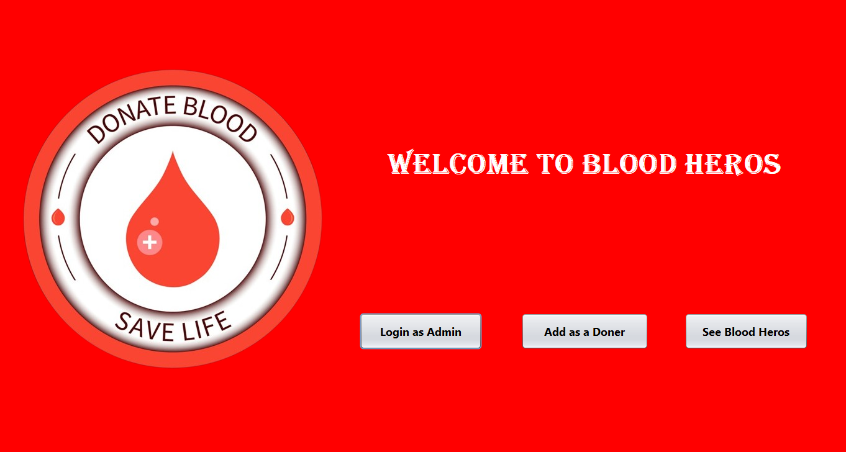
02
BLOOD HEROS
SAVE LIFE

Slide 3

03
Topic Outlines
Introduction
Conclusion
Used
Technologies
Limitations & Future Works
Project Outcomes
Working process

Slide 4
04
Introduction
“Blood Donation Is A Small Act Of Kindness That Does Great And Big Wonders.

Slide 5

05
Used Technologies
Java
MySQL
NetBeans IDE
Document
Document

Slide 6
06
Project Outcomes
Admin can add, remove, update any data.
Any user can add them as a donor
Anyone can see the Donor List and download the list.
Storing and getting data from the Database (MySQL).
Document
Document

Slide 7
07
Working Processes
01.
02.
Admin Login
Add Donor
Welcome
Page
04.
03.
Donor List

Slide 8
08
Working Processes
01.
02.
Add Donor & Update Donor
Search for Donor
Admin Dashboard
By Blood Group
By Location
04.
03.
Remove Donor

Slide 9
09
Welcome Page

Slide 10
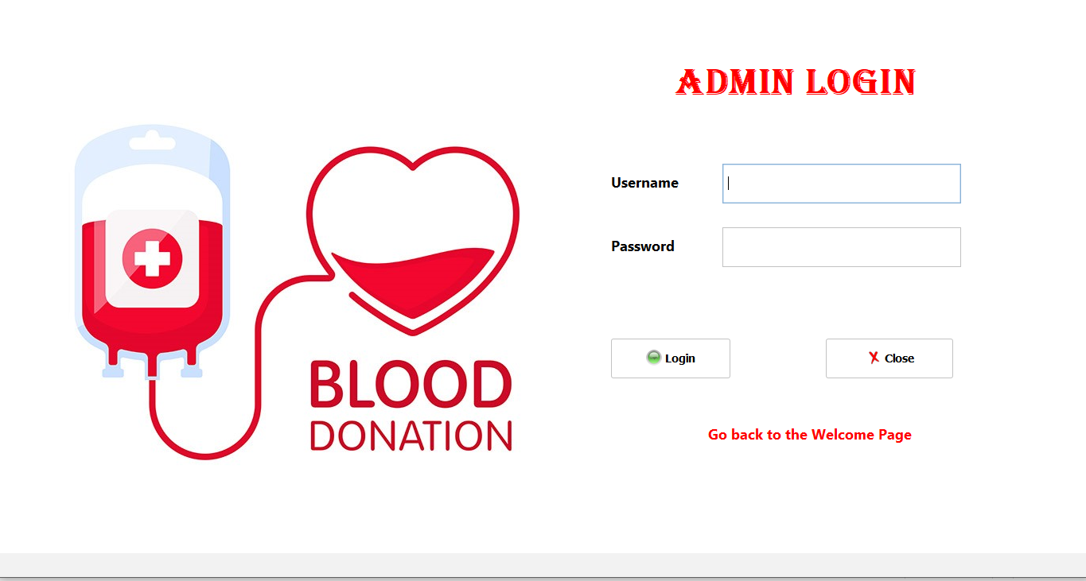
10
Login Page

Slide 11
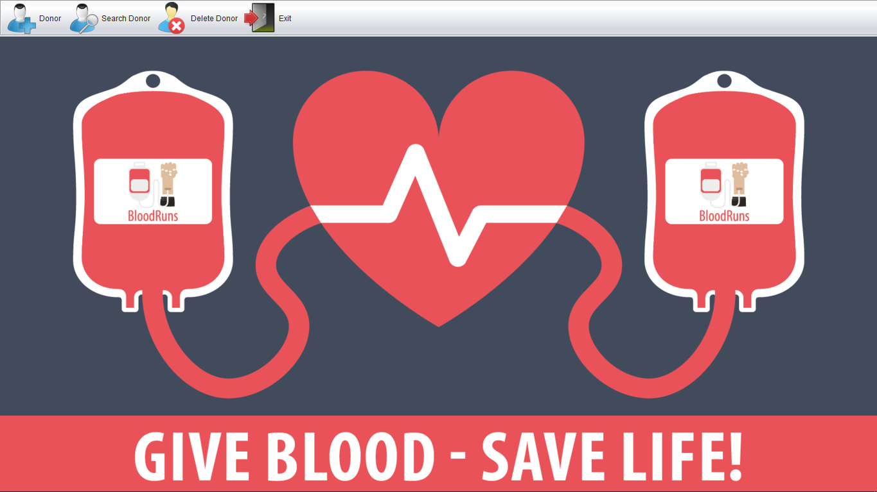
11
Dashboard Page

Slide 12
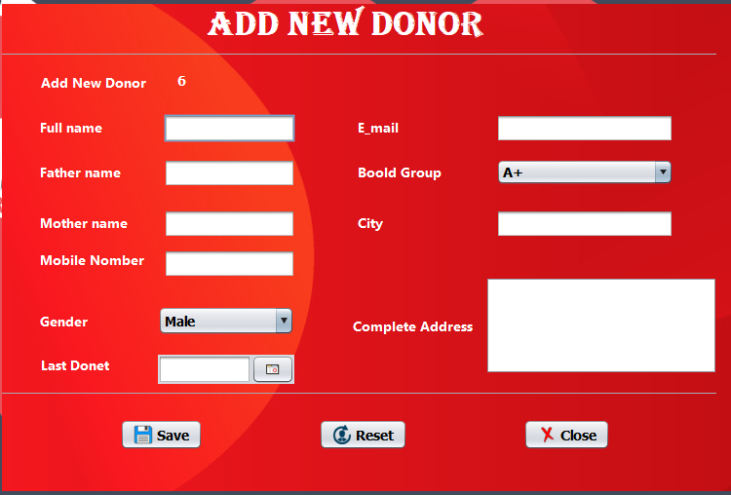
12
Add Donor Page

Slide 13
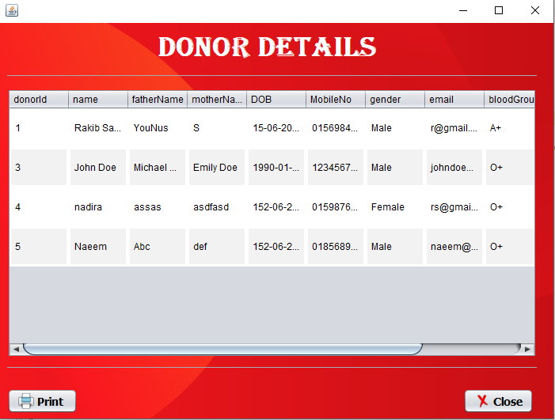
13
Donor Details Page

Slide 14
14
Limitations
“Donate Blood Today So That No One Ever Has To Suffer From A Lack Of Blood.
”
01.
No one can edit details without Admin.
02.
Deleted serial can’t be replaced.
03.
Invalid Data’s are also accepted for some fields
04.
Not responsive.

Slide 15
15
Future Works
“Donate Blood So That You Can Say That You Have Served Mankind.”
01.
Add Login, Signup for the Users
02.
Data Validations functionality
03.
Launch a Real Time App
04.
Make it responsive.

Slide 16
16
Conclusion
By incorporating user feedback and conducting regular updates, the blood donor Java app can continually improve its functionality and user experience. Collaborating with blood banks, hospitals, and healthcare organizations can also help in expanding the app's reach and impact.

Slide 17
17
2020 - 2021
THANK YOU
Any Question?
Red Presentation Design

