Slide 1
Department of Electronics & Communication Engineering
NACHIMUTHU POLYTECHNIC COLLEGE
A TRIVIAL SCHEME FOR HIGHWAY TOLL GATE FEE COLLECTION SYSTEM USING LI-FI TECNOLOGY

Slide 2
A TRIVIAL SCHEME FOR HIGHWAY TOLL GATE FEE COLLECTION SYSTEM USING LI-FI TECNOLOGY
OBJECTIVE
To implement a LiFi-based toll gate system for seamless and secure vehicle passage.
To enhance the efficiency of toll collection and reduce traffic congestion by integrating LiFi technology in toll gate operations.

Slide 3
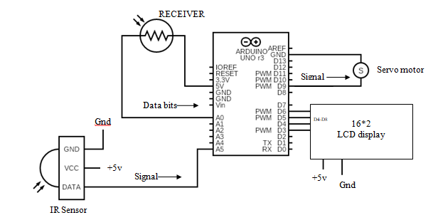
A TRIVIAL SCHEME FOR HIGHWAY TOLL GATE FEE COLLECTION SYSTEM USING LI-FI TECNOLOGY
CIRCUIT DIAGRAM

Slide 4
A TRIVIAL SCHEME FOR HIGHWAY TOLL GATE FEE COLLECTION SYSTEM USING LI-FI TECNOLOGY
WORKING
The transmitter sends a unique ID to the receiver using lifi communication. The data is transmitted as bytes of information. The ON OFF KEYING modulation technique is used to transmit the bytes.
The receiver detects the lifi signal and reads the transmitted data. The signal is amplified by the amplifier in the module and filter circuit is used to filter the received signal.
If the transmitted data contains an authorized ID, the gate is opened by activating a servo motor and turning on a green LED.
If the transmitted data does not contain an authorized ID, the gate remains closed by activating a buzzer and turning on a red LED.
The lifi communication is a secure and fast method of transmitting data and allows for reliable gate control.

Slide 5
A TRIVIAL SCHEME FOR HIGHWAY TOLL GATE FEE COLLECTION SYSTEM USING LI-FI TECNOLOGY
ADVANTAGES
Faster Data Transfer
More Secure
Lower Interference
Greater Coverage
Inexpensive

Slide 6
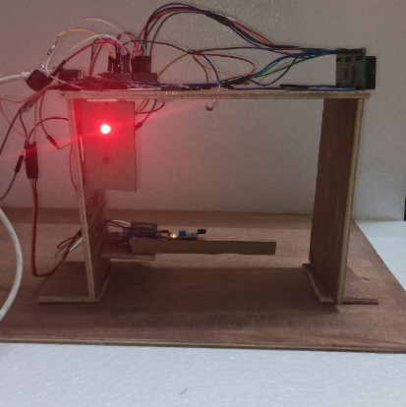
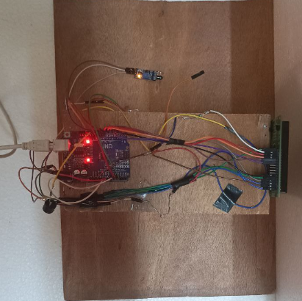
A TRIVIAL SCHEME FOR HIGHWAY TOLL GATE FEE COLLECTION SYSTEM USING LI-FI TECNOLOGY

Slide 7
A TRIVIAL SCHEME FOR HIGHWAY TOLL GATE FEE COLLECTION SYSTEM USING LI-FI TECNOLOGY
CONCLUSION:
Our proposed system is to reduce human intervention, vehicle congestion and High secure toll collection in right direction as it helps increase mobility and improve the overall user experience for drivers.

Slide 8


