Slide 1



The Transformer Architecture & Decoding
Niloy Ganguly
Professor
IIT Kharagpur

Slide 2
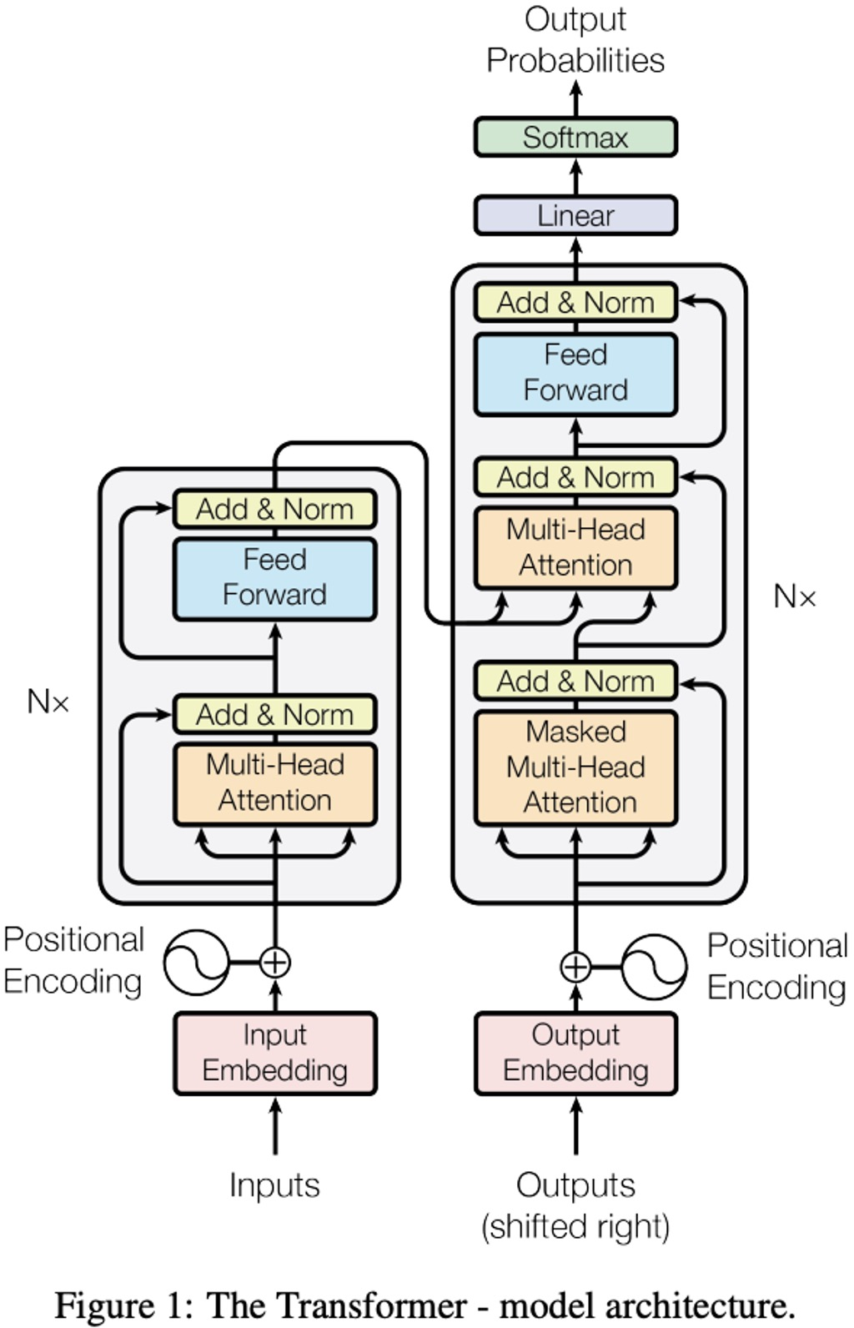
Attention Based Model: Transformer

Slide 3
What is Self-Attention?
Each element looks at all others and decides how much to focus on each.
"The animal didn't cross the street because it was too tired."
👉 What does "it" refer to?
1
Compare
2
Weight
3
Understand
Compare it with every other word
Assign higher weight to animal
Use weights to build
contextual meaning
Key Property
Every token can directly interact with every other token — no sequential propagation needed (unlike RNNs).
Long-range dependencies
Parallel computation
Dynamic context understanding

Slide 4
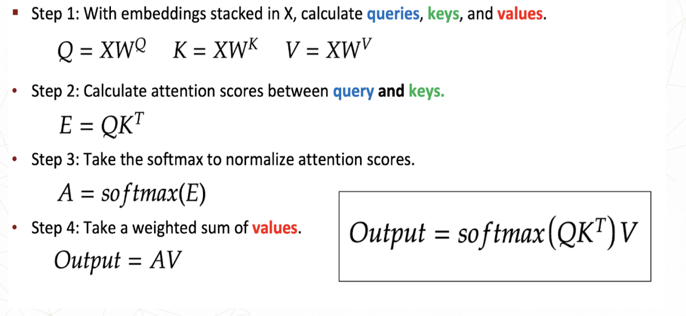
What is Self-Attention?
Each element looks at all others and decides how much to focus on each.
"The animal didn't cross the street because it was too tired."
👉 What does "it" refer to?
1
Compare
2
Weight
3
Understand
Compare it with every other word
Assign higher weight to animal
Use weights to build
contextual meaning
Key Property
Every token can directly interact with every other token — no sequential propagation needed (unlike RNNs).
Long-range dependencies
Parallel computation
Dynamic context understanding
Notes:
Q is what each token is currently looking for — a query vector encoding the kind of information that token needs from the rest of the sequence. K is what each token offers to be found by — a key vector describing that token's content in terms other tokens can match against, and the QKᵀ dot product is what turns "what I want" and "what I offer" into an attention score. V is what actually gets passed along once a match is found — the content vector that gets blended into the output, weighted by how well each key matched the query.

Slide 5
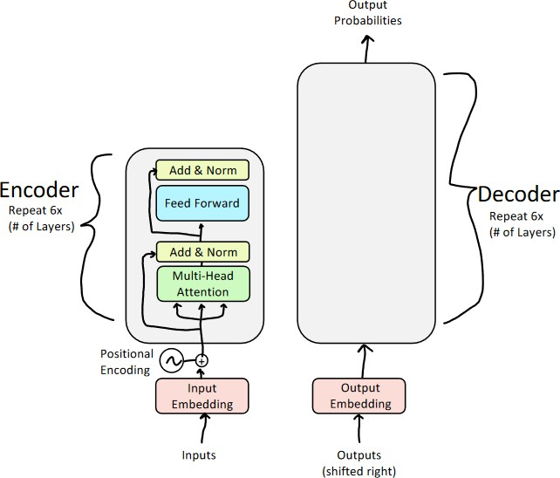
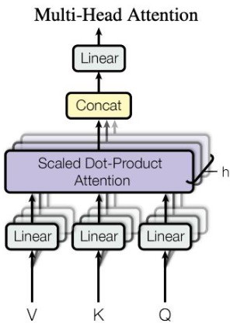
Multi-Head Attention

Slide 6
"The animal didn't cross the street because it was too tired."
Why Multiple Heads?
One attention head captures one type of relationship. Language has many.
Single Attention Head
Multi-Head Attention
→
One Q,K,V → captures only one type of relationship
h independent heads → captures h different relationship types
Coreference
Verb–Object
H1
H2
Example: "it" → "animal"
Example: "cross" → "street"
Semantic sim.
Positional
H3
H4
Example: "tired" → "animal"
Example: nearby tokens
MultiHead(X) = Concat( head₁ … headₕ ) · Wᴼ headᵢ = softmax( QᵢKᵢᵀ / √dₖ ) Vᵢ
Notes:
In the multi-head attention formula, W^o is the output projection matrix.
Here's what it does:
When you concatenate the outputs of all the heads — Concat(head₁ ... headₕ) — you get one big vector (combining the separate "views" from H1, H2, H3, H4 in your slide: coreference, verb-object, semantic similarity, positional). This concatenated vector is just heads stitched side-by-side; the model hasn't yet learned how to combine/blend the information across those heads.

Slide 7
2-Head Attention — Concrete Calculation
x₁="animal" x₂="it" · X = [[1,0],[0,1]] · Each head dim = 1
HEAD 1
HEAD 2
→ focuses on "animal" (coreference)
→ focuses on self / context
W_{Q}=[[1,1]ᵀ] W_{K}=[[1,0]ᵀ] W_{V}=[[2,0]ᵀ]
W_{Q}=[[0,1]ᵀ] W_{K}=[[0,1]ᵀ] W_{V}=[[0,3]ᵀ]
Q=[1,1]ᵀ K=[1,0]ᵀ V=[2,0]ᵀ
Q=[0,1]ᵀ K=[0,1]ᵀ V=[0,3]ᵀ
QKᵀ = [[1,0],[1,0]]
QKᵀ = [[0,0],[0,1]]
A = softmax → [[0.73,0.27],[0.73,0.27]]
A = softmax → [[0.5,0.5],[0.27,0.73]]
Output: animal=[1.46] it=[1.46]
Output: animal=[1.5] it=[2.19]
Concat → "animal":[1.46, 1.5] | "it":[1.46, 2.19] → multiply by Wᴼ for final output

Slide 8
Head 1 vs Head 2 — Side-by-Side Comparison
Same input X, different projection matrices → different attention patterns → complementary information
HEAD 1 (Coreference)
HEAD 2 (Self/Context)
W_{Q}
[1,1]ᵀ — both dims equally
[0,1]ᵀ — 2nd dim only
W_{K}
[1,0]ᵀ — 1st dim only
[0,1]ᵀ — 2nd dim only
W_{V}
[2,0]ᵀ — amplify 1st dim
[0,3]ᵀ — amplify 2nd dim
Scores
QKᵀ = [[1,0],[1,0]] (both rows same)
QKᵀ = [[0,0],[0,1]] (rows differ)
Attn A
[[0.73,0.27],[0.73,0.27]] (rows identical)
[[0.50,0.50],[0.27,0.73]] (rows differ)
Output
animal=[1.46] it=[1.46] (same!)
animal=[1.50] it=[2.19] (differ)
Learns
Coreference: it → animal
Self-awareness: it → itself
Identical Attention (Head 1)
Differential Attention (Head 2)
Why Both Together Are Powerful
When projection matrices create equal scores for all tokens, every token attends with the same pattern → enforces group-level coreference.
When projection matrices separate tokens, each attends differently → preserves individual identity while tracking context.
Head 1 links 'it' to 'animal' (coreference). Head 2 preserves 'it' as a separate entity. Together: 'it' = 'animal' + distinct context.

Slide 9
2-Head Attention — Full Walkthrough
x₁ = "animal" · x₂ = "it" · Embedding dim d = 2 · 2 heads, each dim = 1
HEAD 1 (coreference: it → animal)
O⁽¹⁾
INPUT X
[ 1 0 ]
[ 0 1 ]
Concat
× Wᴼ
Final
Output
HEAD 2 (self/context: it → itself)
O⁽²⁾
x₁="animal" → [1,0]
x₂="it" → [0,1]
H1
What Head 1 learns
H2
What Head 2 learns
WQ projects both tokens to same space [1,1]ᵀ
WQ focuses on second dimension [0,1]ᵀ
WK focuses only on first dimension [1,0]ᵀ
WK same projection [0,1]ᵀ
→ animal gets score 1, it gets score 1
→ animal gets score 0, it gets score 1
→ Both attend to animal (coreference)
→ it attends to itself (context-aware)

Slide 10

Quiz 1
You're designing a sequence model from scratch and need to choose between an RNN-based architecture and a self-attention-based one. Your training corpus is enormous (billions of tokens) and you have access to large GPU clusters, but your sequences are relatively short (under 100 tokens). Which architecture should you pick, and why?
A) RNN — short sequences don't need attention's long-range modeling strength, so it's a better fit
B) Self-attention — because it captures long-range dependencies RNNs structurally cannot
C) Self-attention — because it parallelizes across the GPU cluster, letting you actually use the compute you have
D) Either works equally well; the real bottleneck will be model size, not architecture

Slide 11
Quiz 1
You're designing a sequence model from scratch and need to choose between an RNN-based architecture and a self-attention-based one. Your training corpus is enormous (billions of tokens) and you have access to large GPU clusters, but your sequences are relatively short (under 100 tokens). Which architecture should you pick, and why?
A) RNN — short sequences don't need attention's long-range modeling strength, so it's a better fit
B) Self-attention — because it captures long-range dependencies RNNs structurally cannot
C) Self-attention — because it parallelizes across the GPU cluster, letting you actually use the compute you have
D) Either works equally well; the real bottleneck will be model size, not architecture
✔️

Slide 12
Quiz 1 — Solution
Which architecture should you pick, and why?
A
RNN — short sequences don't need attention's long-range modeling strength, so it's a better fit — Incorrect.
Reasonable instinct, but it optimizes for the wrong constraint. With a huge corpus and idle GPU clusters, training speed — not modeling capacity — is what determines whether the project finishes on time.
B
Self-attention — because it captures long-range dependencies RNNs structurally cannot — Incorrect.
This is true of self-attention in general, but it's not the deciding factor here. Sequences are under 100 tokens, so an RNN's long-range weaknesses barely come into play in this scenario.
C
Self-attention — because it parallelizes across the GPU cluster, letting you actually use the compute you have — Correct.
With billions of tokens and large GPU clusters, an RNN's sequential, step-by-step processing leaves most of that compute idle. Self-attention processes the whole sequence in parallel, turning available hardware into actual training speed.
D
Either works equally well; the real bottleneck will be model size, not architecture — Incorrect.
Architecture choice still matters a great deal here — at this data and compute scale, an RNN's sequential bottleneck would dominate training time regardless of model size.
Key Insight
Self-attention's headline advantage is usually framed as 'long-range dependencies' — but in this scenario that strength is irrelevant, since sequences are short. The advantage that actually decides the outcome is parallelization: with massive data and GPU clusters, the architecture that can use the hardware wins. Attention's real-world edge is often about hardware utilization, not just modeling capacity.

Slide 13
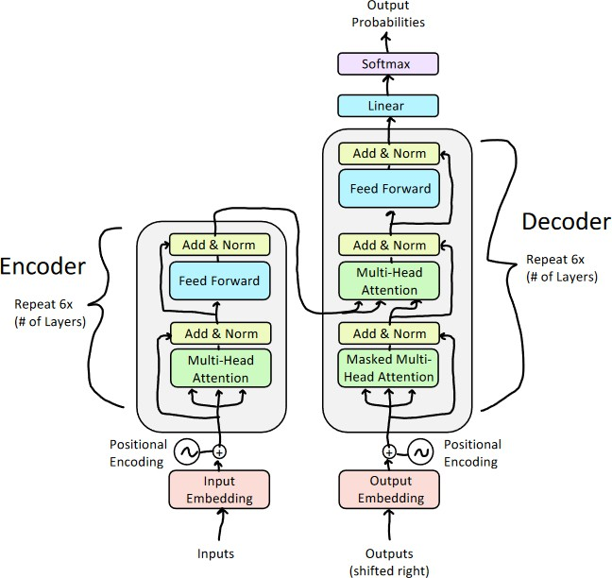
The Transformer (Decoder)

Slide 14
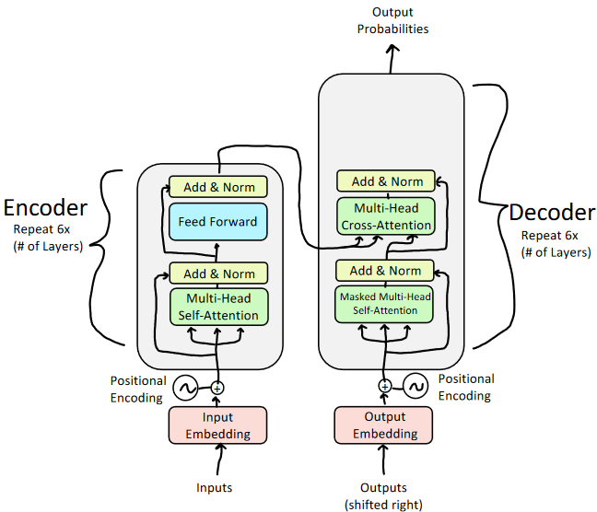
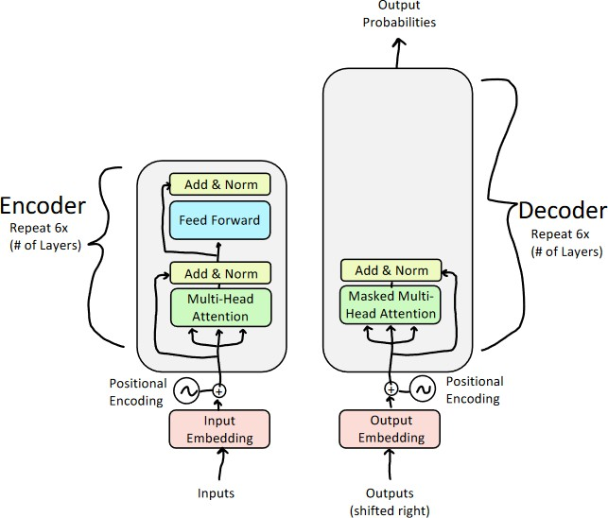
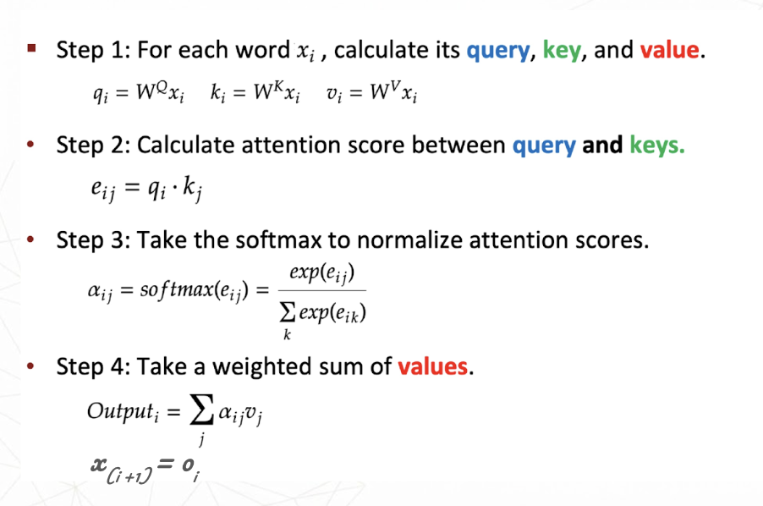
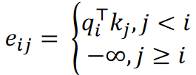
Decoder Design
𝑉, 𝐾
𝑄
Masked Multi-head Attention
Encoder-Decoder Multi-head Attention

Slide 15
Decoder Design
Attention Mask Matrix
KEY →
QUERY ↓
<start>
Je
t'aime
<EOS>
<start>
attend
masked
masked
masked
✓
✕
✕
✕
Je
attend
attend
masked
masked
✓
✓
✕
✕
t'aime
attend
attend
attend
masked
✓
✓
✓
✕
<EOS>
attend
attend
attend
attend
✓
✓
✓
✓
✓ Can attend (past + self)
Score computed normally
Masked Multi-head Attention

Slide 16
Decoder Design
Cross-Attention: Q, K, V
Q
K
V
𝑉, 𝐾
Query
(Decoder)
Key
(Encoder)
Value
(Encoder)
𝑄
softmax(Q·Kᵀ / √dₖ) · V
Encoder-Decoder Multi-head Attention

Slide 17
What is Cross-Attention?
The decoder looks at encoder outputs to decide what source information to use.
EN: "The cat sat on the mat." → FR: "Le chat s'est assis sur le tapis."
👉 Which English words should "chat" attend to?
1
Query
2
Match
3
Aggregate
Decoder token asks: what source info do I need?
Score query against each encoder key
Weighted sum of encoder
values for the decoder
Key Difference from Self-Attention
Q comes from the DECODER, while K and V come from the ENCODER — two different sequences interact, unlike self-attention where all three come from the same sequence.
Two-sequence bridging
Encoder-decoder alignment
Used in translation & generation

Slide 18
Cross-Attention as Matrix Operations
Decoder queries attend over all encoder positions in parallel.
Cross-Attention Matrix A (t × s)
Decoder (French, target — rows) → attends over → Encoder (English, source — columns)
1
Two Input Matrices
X_{enc} ∈ ℝ^{s×d}, X_{dec} ∈ ℝ^{t×d}
s = src length, t = tgt length, d = embedding dim
cat
sat
on
the
mat
Project Q (decoder), K, V (encoder)
Q=X_{dec}·W_{Q}, K=X_{enc}·W_{K}, V=X_{enc}·W_{V}
chat
0.60
0.10
0.10
0.10
0.10
2
Q from decoder; K, V from encoder
assis
0.10
0.70
0.05
0.05
0.10
3
Cross-Score Matrix
Scores = QK^{T} shape: t×s
sur
0.10
0.10
0.60
0.10
0.10
Entry (i,j): how much decoder token i attends to encoder token j
le
0.05
0.05
0.10
0.65
0.15
4
Scale + Softmax
A = softmax( QK^{T} / √d_{k} )
Each row: distribution over ALL encoder positions
tapis
0.05
0.20
0.05
0.05
0.65
5
Output
Output = A · V_{enc}
"chat" row → high attention on "cat" (source noun)
Each decoder token: weighted blend of encoder values

Slide 19
Cross-Attention as Matrix Operations
Decoder queries attend over all encoder positions in parallel.
Cross-Attention Matrix A (t × s)
Decoder (French, target — rows) → attends over → Encoder (English, source — columns)
1
Two Input Matrices
X_{enc} ∈ ℝ^{s×d}, X_{dec} ∈ ℝ^{t×d}
s = src length, t = tgt length, d = embedding dim
cat
sat
on
the
mat
Project Q (decoder), K, V (encoder)
Q=X_{dec}·W_{Q}, K=X_{enc}·W_{K}, V=X_{enc}·W_{V}
chat
0.60
0.10
0.10
0.10
0.10
2
Q from decoder; K, V from encoder
assis
0.10
0.70
0.05
0.05
0.10
3
Cross-Score Matrix
Scores = QK^{T} shape: t×s
sur
0.10
0.10
0.60
0.10
0.10
Entry (i,j): how much decoder token i attends to encoder token j
le
0.05
0.05
0.10
0.65
0.15
4
Scale + Softmax
A = softmax( QK^{T} / √d_{k} )
Each row: distribution over ALL encoder positions
tapis
0.05
0.20
0.05
0.05
0.65
5
Output
Output = A · V_{enc}
"chat" row → high attention on "cat" (source noun)
Each decoder token: weighted blend of encoder values

Slide 20
Quiz 2
In a Transformer model, what is the primary difference between Self-Attention and Cross-Attention in terms of where the "Queries" (Q), "Keys" (K), and "Values" (V) come from?
A) In Self-Attention, Q, K and V all come from the same input sequence, whereas in Cross-Attention, Q comes from the decoder and K and V come from the encoder.
B) In Self-Attention, Q and K come from the encoder, while in Cross-Attention, they come from the decoder.
C) There is no difference; both mechanisms use the same sources for Q, K and V.
D) Self-Attention is only used in the decoder, while Cross-Attention is only used in the encoder.

Slide 21
Quiz 2
In a Transformer model, what is the primary difference between Self-Attention and Cross-Attention in terms of where the "Queries" (Q), "Keys" (K), and "Values" (V) come from?
A) In Self-Attention, Q, K and V all come from the same input sequence, whereas in Cross-Attention, Q comes from the decoder and K and V come from the encoder.
B) In Self-Attention, Q and K come from the encoder, while in Cross-Attention, they come from the decoder.
C) There is no difference; both mechanisms use the same sources for Q, K and V.
D) Self-Attention is only used in the decoder, while Cross-Attention is only used in the encoder.
Explanation : Self-Attention allows a sequence to look at itself to find correlations between its own tokens. Cross-Attention is the "bridge" that allows the decoder to focus on relevant parts of the original input sequence (the encoder's output).
✔️

Slide 22


Quiz 2 (Explanation )
In Self-Attention, Q, K, and V all come from the same sequence. In Cross-Attention, Q comes from the decoder while K and V come from the encoder.
Correct. Self-Attention lets a sequence attend to itself. Cross-Attention is the bridge: the decoder forms queries, but looks up keys and values from the encoder output.
A
In Self-Attention, Q and K come from the encoder; in Cross-Attention, Q and K come from the decoder.
Wrong source assignment. In Self-Attention, Q, K, and V all come from the same sequence — not just Q and K from the encoder.
B
There is no difference — both Self-Attention and Cross-Attention use the same sources for Q, K, and V.
Incorrect. The defining distinction is exactly where Q, K, V originate. Cross-Attention deliberately mixes sources — decoder for Q, encoder for K and V.
C
Self-Attention is only used in the decoder, while Cross-Attention is only used in the encoder.
Reversed and wrong. Self-Attention appears in both encoder and decoder. Cross-Attention appears only in the decoder, bridging it to encoder outputs.
D
Self-Attention
Cross-Attention
Q ← same sequence K ← same sequence V ← same sequence
Q ← decoder K ← encoder V ← encoder
Key insight — Cross-Attention is the bridge between encoder and decoder: the decoder asks questions (Q) about what to generate next, and the encoder provides the context (K, V) from the source sequence.

Slide 23
Quiz 3
You're building a translation system. A colleague suggests reusing the same self-attention block for both "the decoder looking at its own partial output" and "the decoder looking at the source sentence" — just feed it different inputs. Will this design work?
A) Yes — self-attention is generic, so as long as you feed it the right inputs, one block can do both jobs
B) No — the decoder needs a causal mask for its own output, but full access to the encoder's output, so these need different mechanisms
C) No — self-attention can only ever look at one sequence at a time, full stop, regardless of masking
D) Yes — both cases are just softmax(QKᵀ/√d)·V, masking is an optional add-on that doesn't fundamentally change anything

Slide 24
Quiz 3
You're building a translation system. A colleague suggests reusing the same self-attention block for both "the decoder looking at its own partial output" and "the decoder looking at the source sentence" — just feed it different inputs. Will this design work?
A) Yes — self-attention is generic, so as long as you feed it the right inputs, one block can do both jobs
B) No — the decoder needs a causal mask for its own output, but full access to the encoder's output, so these need different mechanisms
C) No — self-attention can only ever look at one sequence at a time, full stop, regardless of masking
D) Yes — both cases are just softmax(QKᵀ/√d)·V, masking is an optional add-on that doesn't fundamentally change anything
✔️

Slide 25
Quiz 3 — Solution
Will this design work?
A
Yes — self-attention is generic, so as long as you feed it the right inputs, one block can do both jobs — Incorrect.
Underselling how much the details matter. The formula being generic doesn't mean the masking behavior and the source of Q, K, V are interchangeable — they define two genuinely different jobs.
B
No — the decoder needs a causal mask for its own output, but full access to the encoder's output, so these need different mechanisms (masked self-attention vs. cross-attention) — Correct.
The decoder's own output needs a causal mask (can't see the future), while reading the encoder's output needs full, unmasked access to a separate sequence entirely. One mechanism can't satisfy both requirements at once.
C
No — self-attention can only ever look at one sequence at a time, full stop, regardless of masking — Incorrect.
This overcorrects. Self-attention itself is single-sequence, but cross-attention solves exactly this limitation by design — Q from one sequence, K/V from another — so 'never' is too strong a claim.
D
Yes — both cases are just softmax(QKᵀ/√d)·V, masking is an optional add-on that doesn't fundamentally change anything — Incorrect.
Masking isn't a cosmetic add-on here — it's the mechanism that determines whether the model can cheat by seeing future tokens during training. Treating it as optional misses why two separate blocks exist.
Key Insight
Same formula, two different jobs. Masked self-attention prevents the decoder from peeking at its own future tokens; cross-attention deliberately reads a different sequence (the encoder's output) in full. The architecture needs both because masking and the source of K/V are doing fundamentally different work, even though the underlying math looks identical.

Slide 26
Attention Based Model: Transformer
Non-Linearity

Slide 27
Where Is The Non-Linearity In A Transformer?
Most of the architecture is linear (matrix multiplies) — only a few spots actually bend the function
Input
x
Q,K,V
Projection
Softmax
(QKᵀ/√d)
Weighted
Sum ·V
Output
Proj. Wₒ
Add &
Norm
FFN
W₁→ReLU→W₂
Add &
Norm
linear (matrix multiply only)
contains a non-linearity
1. Softmax
2. ReLU (inside FFN)
3. LayerNorm
αᵢⱼ = exp(eᵢⱼ) / Σₖ exp(eᵢₖ)
FFN(x) = ReLU(xW₁+b₁)W₂+b₂
LN(x) = γ·(x−μ)/σ + β
Converts raw attention scores into a probability distribution. Without it, attention would just be a linear weighted combination — softmax is what lets the model sharply focus on a few tokens instead of averaging all of them equally.
The only true elementwise non-linearity in the whole block. Fires independently on each of the 4d hidden units — this is what lets the FFN act as a pattern detector / feature recombiner, not just a linear remap.
Technically non-linear (division by a data-dependent σ), though its job is normalization, not feature transformation. It stabilizes scale rather than adding expressive power — included here for completeness.
Inside every attention head, before multiplying by V
Inside the feed-forward sublayer, between W₁ and W₂
After every attention and FFN sublayer (Add & Norm)
Key takeaway: Everything else — Q/K/V projections, the weighted sum by V, output projections, residual adds — is purely linear. Only softmax and ReLU give the model genuine non-linear expressive power; LayerNorm mainly stabilizes scale.

Slide 28
Making Deep Transformers Work
Three training tricks that enable stable, deep attention networks
Architecture: Feed-forward block repeated × 6
#1
#2
#3
Residual
Connections
Layer
Normalization
Scaled Dot
Product Attention
Skip connections that add the input directly to the output, preventing vanishing gradients in deep stacks.
Normalises activations across the feature dimension, stabilising training and enabling faster convergence.
Scales attention scores down to prevent extreme softmax saturation in high-dimensional spaces.
Source: Stanford CS224N / DeepMind Deep Learning Series
Notes:
That sentence packs three separate facts together — let's unpack them in order: why scores grow with dimension, why that causes saturation, and why saturation is a problem worth preventing.
Start with why the raw dot product QKᵀ grows with dimension in the first place. Say each component of a query vector q and a key vector k is roughly independent, with mean 0 and variance 1 — a reasonable assumption right after initialization or with normalized activations. The dot product is q·k = Σᵢ qᵢkᵢ, a sum of d_k such terms. Each individual term qᵢkᵢ has mean 0 and variance 1, and since the terms are independent, variances add rather than staying flat — so the variance of the whole sum is d_k, meaning its standard deviation is √d_k. In plain terms: even for two vectors with no special relationship, just summing over more dimensions makes the dot product swing further from zero, purely as an artifact of dimensionality, not because the vectors are more "aligned" or semantically relevant to each other.
Now trace what that does to softmax. Softmax's sharpness depends on how far apart its input scores are (as I mentioned last message — the gaps between scores get exponentially amplified). If d_k is large — say 64 or 128, as in real transformer heads — the scores QKᵀ can end up spread across a wide range purely from that √d_k growth, well before any of it reflects genuine semantic similarity. Feed a wide spread into softmax and it saturates hard: one score dominates, its probability shoots toward 1, and all the others get crushed toward 0 — regardless of whether that dominance was semantically warranted or just noise amplified by dimensionality.
That saturation is the actual problem, and it bites in two ways. First, representationally: attention becomes an almost all-or-nothing pick of a single token rather than a genuine weighted blend, even in cases where several tokens are legitimately relevant. Second, and more damaging for training: deep in the saturated region, softmax's gradient (which involves terms like pᵢ(1−pᵢ)) goes to nearly zero. So the model gets stuck with an attention pattern that's both premature and hard to correct, because the gradient signal needed to correct it has vanished.
Dividing by √d_k is the fix, and it directly cancels the growth you just derived: since the score's standard deviation scales as √d_k, dividing by that same √d_k brings the variance back down to roughly 1 regardless of how large d_k is. So a 64-dimensional head and a 128-dimensional head end up with scores of comparable, well-behaved spread — softmax stays in that sensitive middle region where it can meaningfully discriminate between tokens without collapsing to a hard argmax, and gradients keep flowing. It's not preventing softmax from ever sharpening on a genuinely dominant match — it's preventing sharpening that happens purely as a side effect of dimensionality rather than actual relevance.

Slide 29
The Three Training Tricks — In Detail
Trick #1 — Residual Connections
→
The input is added directly to the output of each sub-layer, creating a shortcut path.
This allows gradients to flow unimpeded through the entire depth of the network.
Each sub-layer (attention and feed-forward) is wrapped with its own residual connection.
Trick #2 — Layer Normalization
≡
Normalises the mean and variance of activations across the feature dimension for each token.
Applied after the residual addition at every sub-layer, keeping activations well-scaled.
Stabilises training and allows the network to converge reliably regardless of depth.
Trick #3 — Scaled Dot Product Attention
÷
Attention scores are scaled down before the softmax step, based on the size of the key vectors.
Without scaling, large dimensions push scores into saturation regions with near-zero gradients.
Scaling keeps score variance in a healthy range, maintaining stable gradient flow.

Slide 30
Attention Based Model: Transformer
Positional Encoding

Slide 31
Positional Encoding: Why & How
The Problem — Self-Attention Has No Sense Of Order
"cat sat on mat" and "mat on sat cat" → produce identical attention scores without positional info
The Fix — Add A Unique Position Vector To Each Token
xᵢ = word_embedding(tokenᵢ) + pᵢ
PE(pos,2j) = sin(pos / 10000^(2j/d))
PE(pos,2j+1) = cos(pos / 10000^(2j/d))
pos = position in sequence, j = dimension pair index, d = embedding size
Intuition — Each Dimension Pair Is A Clock Hand At A Different Speed
dim 0-1
fast — tells apart nearby positions
dim 100-101
medium — mid-range positions
dim 510-511
slow — far-apart positions
Fast-oscillating dims tell apart nearby positions; slow ones preserve coarse long-range order.
Unique per position
Bounded in [-1, 1]
Relative offsets are linear

Slide 32
Worked Example — "bank" at Position 3 vs Position 7
word_embedding("bank") = [0.8, 0.9, 0.2, 0.4, 0.6] (using d = 5 for clarity)
Position 3
Position 7
p =
0.1411
-0.9900
0.0753
0.9972
0.0019
p =
0.6570
0.7539
0.1749
0.9846
0.0044
+ word embedding [0.8, 0.9, 0.2, 0.4, 0.6]
+ word embedding [0.8, 0.9, 0.2, 0.4, 0.6]
x =
0.9411
-0.0900
0.2753
1.3972
0.6019
x =
1.4570
1.6539
0.3749
1.3846
0.6044
fast
fast
med
med
slow
fast
fast
med
med
slow
Final vector for "bank" at position 3
Final vector for "bank" at position 7
d = 5 dims shown (real models use d = 512)
d = 5 dims shown (real models use d = 512)
Same word, same embedding — but two completely different final vectors
Dim 1 swings from -0.09 → 1.65 (huge change) while dim 4 barely moves (0.602 → 0.604). Fast dimensions encode fine position; slow dimensions stay nearly constant across nearby positions.
Key takeaway: Attention now sees where each token sits — the position signal is baked directly into the vector before Q, K, V are even computed.

Slide 33
Why Relative Offsets Are Linear
PE(pos+k) is a fixed rotation of PE(pos) — independent of pos itself
PE(pos + k) = M(k) · PE(pos) where M(k) depends ONLY on offset k, never on pos
Derivation — angle addition formulas
Result — a 2D rotation matrix
sin(A+B) = sin(A)cos(B) + cos(A)sin(B)
cos(A+B) = cos(A)cos(B) − sin(A)sin(B)
Let A = pos·ω, B = k·ω
Substituting PE(pos,2j)=sin(A), PE(pos,2j+1)=cos(A) gives a clean linear system in k only.
M(k) = [ cos(kω) sin(kω)]
[-sin(kω) cos(kω)]
Geometric picture: each dimension pair is a point on a circle. Moving forward k positions = rotating that point by a fixed angle k·ω — like a clock hand advancing the same amount no matter what time it currently shows.
Verified numerically — same M(4) works at completely different positions
M(4) · PE(3) = PE(7) and M(4) · PE(50) = PE(54)
Same offset (k=4) → same rotation matrix, regardless of starting position
Why it matters: an attention head can learn "look 4 tokens back" once — that single learned rule works at every position in the sequence.

Slide 34
Beyond Sin/Cos — Competing Positional Schemes
Different ways to inject position — and who inherits the linear-offset property
RoPE — Rotary Position Embedding
ALiBi — Attention with Linear Biases
LLaMA, Mistral, Qwen, Gemma
BLOOM, MPT
q'ᵢ = R(i·θ)·qᵢ k'ⱼ = R(j·θ)·kⱼ
q'ᵢ·k'ⱼ depends only on (i−j)
score(i,j) = qᵢ·kⱼ − m·|i−j|
Same rotation idea as sin/cos, but applied directly to Q,K inside attention. Relative position is baked straight into the dot product.
No rotation, no sin/cos at all. Just subtracts a distance penalty straight from the attention score. Simple, but loses frequency structure.
Strongest inheritance
Linear, but not rotational
Learned Positional Embeddings
Complex Exponential (Euler form)
Original BERT, GPT-2
Mathematically = sin/cos
PE(pos) = lookup_table[pos]
PE(pos) = e^(i·pos·ω)
= cos(posω) + i·sin(posω)
A trainable vector per position slot, no formula. No built-in linearity — model must learn relative patterns from scratch, per position.
Just notation — identical math to sin/cos, expressed as complex rotation. Same linear-offset guarantee, different symbol set.
No linear-offset property
Identical to sin/cos
Property comparison
Property
sin/cos
ALiBi
Learned
RoPE
Bounded
✓
✓
✗
✓
Unique per position
✓
✓
✓
✓
Relative offset linear
✓
~
✗
✓✓
Extrapolates beyond train len
✓
✓
✗
✓

Slide 35
Quiz 4
You're designing a retrieval-style attention head for long-document QA. Requirement: V vectors must stay pure, position-untouched semantic content — position should only decide which tokens get attended to (via Q·K), never what gets copied (via V).
Recall how each scheme injects position:
sin/cos & Learned PE: position is added directly to the token embedding (x = word_emb + PE(pos)) before Q, K, and V are all computed from that same blended vector.
RoPE: embedding and V untouched; only Q and K get rotated before the dot product.
ALiBi: Q, K, V all computed normally; only the final attention score gets a distance penalty subtracted, before softmax.
Which scheme(s) satisfy the requirement above?
A) sin/cos and Learned PE
B) RoPE only
C) ALiBi only
D) Both RoPE and ALiBi

Slide 36
Quiz 4
You're designing a retrieval-style attention head for long-document QA. Requirement: V vectors must stay pure, position-untouched semantic content — position should only decide which tokens get attended to (via Q·K), never what gets copied (via V).
Recall how each scheme injects position:
sin/cos & Learned PE: position is added directly to the token embedding (x = word_emb + PE(pos)) before Q, K, and V are all computed from that same blended vector.
RoPE: embedding and V untouched; only Q and K get rotated before the dot product.
ALiBi: Q, K, V all computed normally; only the final attention score gets a distance penalty subtracted, before softmax.
Which scheme(s) satisfy the requirement above?
A) sin/cos and Learned PE
B) RoPE only
C) ALiBi only
D) Both RoPE and ALiBi
✔️

Slide 37



Quiz 4 — Solution
Which scheme should you pick, and why?
A sin/cos and Learned PE
Incorrect
Position is added to the embedding before Q, K, and V are all computed from it — so V is derived from an already position-blended vector, never pure content.
B RoPE only
Incorrect
True that RoPE leaves V untouched — but stopping here misses that ALiBi satisfies the same requirement, just through a different mechanism.
C ALiBi only
Incorrect
True that ALiBi leaves V untouched — but stopping here misses that RoPE satisfies the same requirement too, via rotating Q/K instead.
D Both RoPE and ALiBi
Correct
RoPE rotates Q/K before the dot product; ALiBi biases the score after it. Neither ever touches V — both satisfy the requirement.
Key Insight The trap isn't a misconception about any single scheme — it's assuming options written as single schemes must have a single-scheme answer. Where position enters (embedding, Q/K, or the score) decides whether V stays clean, not which scheme is “better.”

Slide 38
Where Each Scheme Injects Position
Three different injection points in the same forward pass — not all schemes act in the same place
Token
Embedding
Compute
Q, K, V
Q · Kᵀ
(dot product)
Softmax
Attention
Output
▶
▶
▶
▶
▲
▲
▲
sin/cos
Learned PE
RoPE
ALiBi
sin/cos & Learned PE
RoPE
ALiBi
Injected at: Token Embedding
Injected at: Q and K (before dot product)
Injected at: Attention score (after dot product)
x = word_emb + PE(pos)
q'ᵢ = R(i·θ)·qᵢ k'ⱼ = R(j·θ)·kⱼ
score(i,j) = qᵢ·kⱼ − m·|i−j|
Position is mixed into the input vector itself. Everything downstream — Q, K, V, attention, FFN — only ever sees one blended vector. The model must carry position information through the entire forward pass inside the content vector.
Embeddings and V are untouched. Only Q and K get rotated by their position right before being compared. The relative position (i−j) emerges directly inside the dot product q'ᵢ·k'ⱼ.
Q, K, V are computed completely normally — no rotation, no embedding change. Only the final scalar attention score gets a distance penalty subtracted, right before softmax.
Earliest — most indirect
Middle — most elegant
Latest — simplest
Key distinction: RoPE rotates Q and K before the dot product — it never touches the embedding or V. ALiBi only touches the final score, after the dot product.

Slide 39
The Transformer (Decoder)

Slide 40
The Complete Transformer Decoder — Summary
Masked Self-Attention
Cross-Attention
Feed-Forward (FFN)
Causal mask: attend only to past tokens. Prevents future leakage during training.
Q from decoder, K/V from encoder. Dynamically reads source context.
Two-layer MLP with ReLU, applied per token. d_ff = 4 x d_model.
Add & Norm
Positional Encoding
Autoregressive Loop
Residual + LayerNorm after every sub-layer. Stabilises training.
Sine/cosine vectors injected into embeddings. Order-aware attention.
One token per step. Append and repeat until <EOS> or max length.

Slide 41
Autoregressive Generation: The Decoder Loop
Start Token
Forward Pass
Feed <BOS> as the first decoder input.
Masked Self-Attn -> Cross-Attn -> FFN.
Linear + Softmax
Sample / Argmax
Project to vocab; get probability dist.
Greedy, beam search, or temperature sampling.
Append & Repeat
Stop Condition
Append token; repeat from Step 2.
Halt at <EOS> or max sequence length.

Slide 42
Linear + Softmax — Worked Example
hidden_dim = 4 → vocab_size = 5
Step 1 — Linear Projection: logits = h · W_vocab + b
W_vocab =
logits =
0.1
0.4
-0.2
0.3
0.0
the
-0.09
0.2
-0.1
0.5
0.1
0.2
cat
1.17
h =
0.8
-0.3
1.2
0.5
×
=
-0.3
0.6
0.1
0.4
-0.1
sat
-0.04
(1×4)
0.5
0.2
0.3
-0.2
0.6
bank
0.59
raw, unbounded scores — one per vocabulary word
(4×5)
<EOS>
0.12
Step 2 — Softmax: P(word) = exp(logit) / Σ exp(all logits)
the
cat
sat
bank
<EOS>
0.114
0.401
0.120
0.225
0.140
(probabilities sum to 1.0) → highest probability: "cat" at 40.1%

Slide 43
Autoregressive Generation: The Decoder Loop
Start Token
Forward Pass
Feed <BOS> as the first decoder input.
Masked Self-Attn -> Cross-Attn -> FFN.
Linear + Softmax
Sample / Argmax
Project to vocab; get probability dist.
Greedy, beam search, or temperature sampling.
Append & Repeat
Stop Condition
Append token; repeat from Step 2.
Halt at <EOS> or max sequence length.
def generate(model, src, max_len=50, bos=1, eos=2):
enc_out = model.encoder(src) # encode source once
tgt = torch.tensor([[bos]]) # start with <BOS>
for _ in range(max_len):
mask = causal_mask(tgt.size(1)) # rebuild mask each step
logits = model.decoder(tgt, enc_out, mask)[:, -1, :]
next_tok = logits.argmax(dim=-1).unsqueeze(0) # greedy decode
tgt = torch.cat([tgt, next_tok], dim=-1) # append token
if next_tok.item() == eos: break # stop at <EOS>
return tgt
Notes:
Now the code, line by line
python
def generate(model, src, max_len=50, bos=1, eos=2):
src = the source sentence (e.g. English, if translating to French). bos/eos are just their token IDs (1 and 2 here).
python
enc_out = model.encoder(src) # encode source once
Crucial detail: the encoder runs only once, before the loop even starts. Recall cross-attention from our earlier slide — the decoder needs K, V from the encoder at every single step, but since the source sentence never changes, there's no need to recompute enc_out repeatedly. This is a major efficiency win.
python
tgt = torch.tensor([[bos]]) # start with <BOS>
This is Step 1 — the target sequence starts as just [<BOS>], a tensor of length 1.
python
for _ in range(max_len):
This is the autoregressive loop — runs once per generated token, up to max_len times.
python
mask = causal_mask(tgt.size(1)) # rebuild mask each step
Since tgt grows by one token each iteration, the causal mask (which prevents looking ahead) must be rebuilt at the new, larger size each time.
python
logits = model.decoder(tgt, enc_out, mask)[:, -1, :]
This runs Step 2 (forward pass). The decoder takes the current tgt sequence-so-far plus the encoder output, and produces logits for every position. [:, -1, :] slices out only the last position — because that's the one representing "what comes next," the rest are already-generated tokens we don't need new predictions for.
python
next_tok = logits.argmax(dim=-1).unsqueeze(0) # greedy decode
This is Steps 3 & 4 combined — implicitly applies softmax's ranking (argmax of logits = argmax of softmax, since softmax is monotonic) and picks the single most likely next token, greedily.
python
tgt = torch.cat([tgt, next_tok], dim=-1) # append token
This is Step 5 — the new token gets concatenated onto tgt, growing the sequence by one.
python
if next_tok.item() == eos: break # stop at <EOS>
This is Step 6 — if the model just generated the <EOS> token, stop early instead of running all max_len iterations.
python
return tgt
After the loop ends (either by <EOS> or hitting max_len), return the full generated sequence.

Slide 44
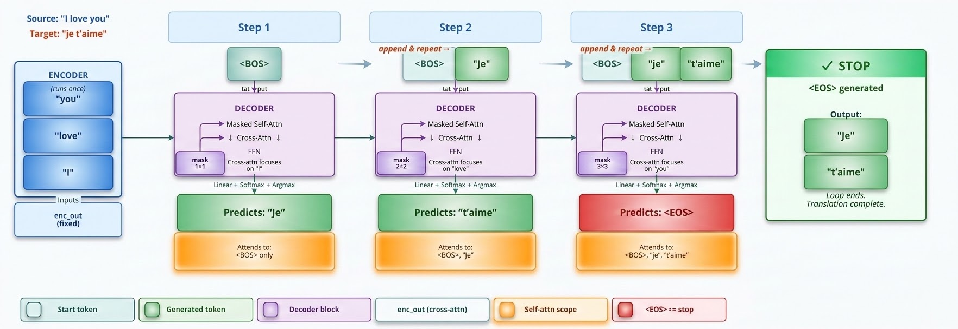
Autoregressive Generation — Step by Step Example
Translating "I love you" → "Je t'aime" : how the decoder loop runs token by token
① Encoder runs ONCE
Source sentence is encoded into enc_out and held fixed. The decoder re-reads it at every step via cross-attention.
② Mask grows each step
Step 1: mask is 1×1. Step 2: 2×2. Step 3: 3×3. Rebuilt every iteration as the target sequence lengthens.
③ Append & repeat
Each predicted token is concatenated to the input and fed back in. The decoder sees its own growing output.
✓ <EOS> stops the loop
When the model predicts <EOS>, or max_len is reached, generation halts. Output is everything between <BOS> and <EOS>.

Slide 45
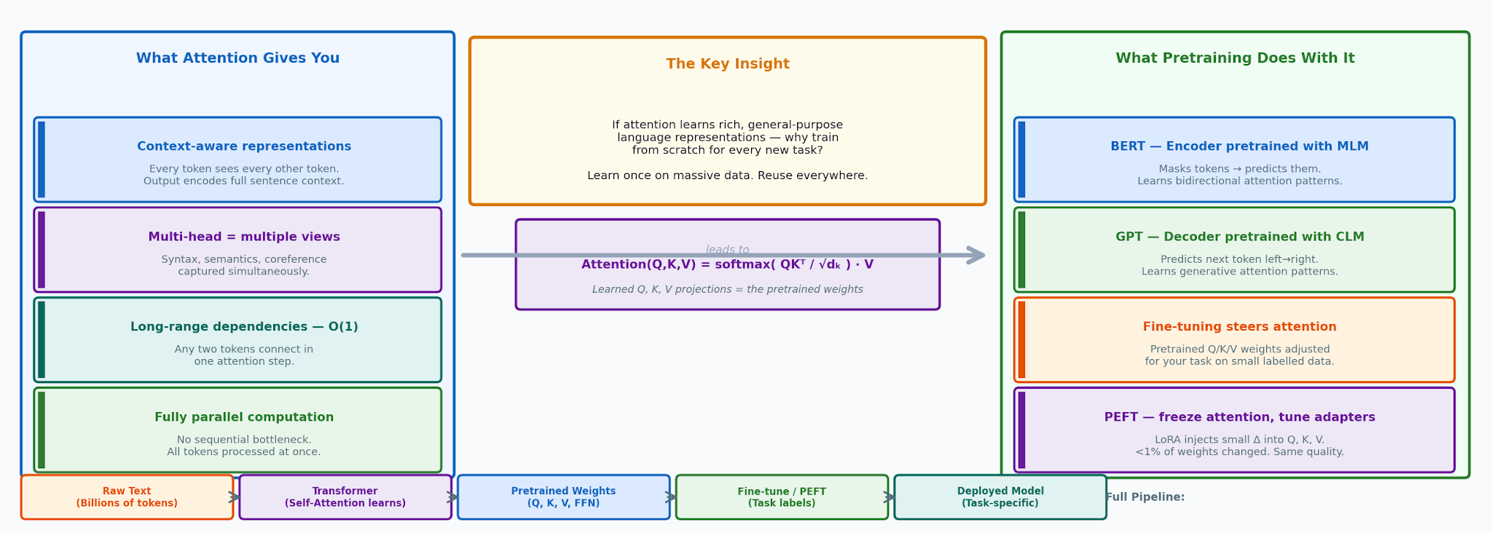
From Attention to Pretrained Models
Why the Transformer's attention mechanism makes pretraining not just possible — but inevitable
← Attention = general representations
Q, K, V weight matrices learn universal patterns of language — syntax, semantics, coreference — not task-specific features.
★ The key insight
General representations trained once on massive data transfer to any downstream task. Task-specific labels steer, not rebuild.
→ Pretraining = learning attention
BERT/GPT pretraining IS learning the Q, K, V projections. Fine-tuning adjusts them. PEFT injects tiny changes (LoRA Δ).
✓ Unified view
Every model from BERT to GPT-4 to LLaMA is the same idea: Transformer attention pretrained at scale, steered at fine-tune time.

Slide 46
The Modern Transformer Zoo
BERT
GPT-4
T5 / BART
Encoder only
Decoder only
Encoder-Decoder
→ Classification, NER, QA
→ Generation, chat, code
→ Translation, summarization
ViT
Whisper
CLIP
Vision Transformer
Speech → Text
Vision-Language
→ Image classification
→ ASR, multilingual
→ Image-text matching
All of these are just: Embeddings + Positional Encoding + Self-Attention + FFN, stacked.

Slide 47
The Pretrain → Fine-Tune Paradigm
Why training from scratch is dead — and what replaced it
Raw Text
(Unlabelled / Labelled)
Billions of tokens
Pretraining
(Self-supervised or
Supervised objective)
Pretrained Model
(General language
representations)
Fine-tuning
(Small labelled
task dataset)
Task
Model
STAGE 1
STAGE 2
OUTPUT
STAGE 3
✗ Training from Scratch
Needs millions of labelled examples per task. Expensive, brittle, doesn't generalise.
✓ Pretrain Once, Reuse
Learn universal language structure once on massive data. Adapt cheaply to any task.
⚡ Why It Works
Language has shared structure — grammar, facts, reasoning — that transfers across tasks.
★ Industry Impact
GPT-4, BERT, LLaMA all follow this paradigm. It is the foundation of modern NLP.

Slide 48
Three Types of Pretrained Transformer Models
Encoder-only
Decoder-only
Encoder-Decoder
BERT, RoBERTa
GPT, LLaMA, Claude
T5, original Transformer
Self-Attn
Masked Self-Attn
Masked Self-Attn
↓
↓
↓
FFN
FFN
Cross-Attn
↓
FFN
Bidirectional self-attention — every token sees every other token, both directions. No causal mask.
Causal (masked) self-attention only — each token sees only itself and earlier tokens. No encoder, no cross-attention.
Decoder block adds cross-attention to a separately encoded source sequence, on top of masked self-attention.
Classification, NER, embeddings, understanding tasks
Open-ended generation, chat, completion
Translation, summarization — fixed input → output mapping

Slide 49
Three Types of Pretrained Transformer Models
Encoder-only
Decoder-only
Encoder-Decoder
BERT, RoBERTa
GPT, LLaMA, Claude
T5, original Transformer
Self-Attn
Masked Self-Attn
Masked Self-Attn
↓
↓
↓
FFN
FFN
Cross-Attn
↓
FFN
Bidirectional self-attention — every token sees every other token, both directions. No causal mask.
Causal (masked) self-attention only — each token sees only itself and earlier tokens. No encoder, no cross-attention.
Decoder block adds cross-attention to a separately encoded source sequence, on top of masked self-attention.
Classification, NER, embeddings, understanding tasks
Open-ended generation, chat, completion
Translation, summarization — fixed input → output mapping

Slide 50
Encoder-only Models
Bidirectional context - Built for understanding, not generation
How it works
Input Tokens
Every token attends to every other token in both directions - full bidirectional context, no causal mask.
Pre-trained with masked language modeling: the model learns by predicting deliberately hidden tokens.
Outputs dense vector representations of meaning, not generated text - the model understands, it doesn't write.
Typically smaller and cheaper to run than generative models with comparable language understanding.
Multi-Head Self-Attention
(bidirectional)
x N
Feed Forward Network
Contextual Embeddings
Industry examples
BERT
RoBERTa
ALBERT
DistilBERT
Why teams choose it: low cost to fine-tune, fast at inference, and purpose-built for scoring, ranking, and classifying text at high volume.

Slide 51
Encoder-only in Production
Where bidirectional understanding earns its keep at industry scale
Search & Retrieval
Content Moderation
Document Intelligence
Dense embeddings rank documents by semantic similarity rather than keyword match - the backbone of modern enterprise search.
Real-time classification of toxicity, spam, and policy violations across millions of posts per day.
Named-entity extraction and clause classification in contracts, claims, and compliance review.
Deployment considerations
Latency: Single forward pass - typically 5-50 ms per request, ideal for synchronous APIs
Cost: Lowest cost per inference among transformer families; no autoregressive decoding loop
Scaling pattern: Horizontally scalable behind a load balancer; embeddings can be precomputed and cached
Common pitfall: Fixed input length limits (often 512 tokens) require chunking strategies for long documents

Slide 52
Encoder-Decoder Models
Two stacks linked by cross-attention - Built for sequence-to-sequence transformation
Source Input
How it works
Target Input (so far)
Self-Attention
(bidirectional)
Masked Self-Attention
(causal)
Feed Forward
Cross-Attention
(to encoder output)
Encoder reads the source sequence bidirectionally, building a contextual representation.
That representation feeds every decoder layer via cross-attention (dashed line).
Decoder generates the target sequence autoregressively, attending back to it at each step.
Feed Forward
ENCODER x N
DECODER x N
Generated Output
Industry examples:
T5 - BART - mT5 - the original Transformer (Vaswani et al., 2017)
Why teams choose it: when input and output are genuinely different sequences (a sentence in French, a paragraph to summarize), separating "read" from "write" is more efficient than forcing one stack to do both.

Slide 53
Encoder-Decoder in Production
Where transforming one sequence into another is the core task
Machine Translation
Summarization
Retrieval-Augmented QA
Production translation systems handling dozens of language pairs at enterprise scale.
Condensing long reports, transcripts, or support tickets into structured, faithful summaries.
Grounded question-answering pipelines that transform retrieved context into precise answers.
Deployment considerations
Latency: Encoder pass is parallel and fast; decoder pass is sequential - overall latency sits between the other two families
Cost: Often more parameter-efficient than decoder-only models for the same task, since the encoder isn't repeated each step
Scaling pattern: Encoder output can be cached and reused across multiple decoding calls in retrieval or multi-query pipelines
Common pitfall: Less flexible for open-ended generation; works best when the task has a clear, structured input-to-output mapping

Slide 54
Three Types of Pretrained Transformer Models
Encoder-only
Decoder-only
Encoder-Decoder
BERT, RoBERTa
GPT, LLaMA, Claude
T5, original Transformer
Self-Attn
Masked Self-Attn
Masked Self-Attn
↓
↓
↓
FFN
FFN
Cross-Attn
↓
FFN
Bidirectional self-attention — every token sees every other token, both directions. No causal mask.
Causal (masked) self-attention only — each token sees only itself and earlier tokens. No encoder, no cross-attention.
Decoder block adds cross-attention to a separately encoded source sequence, on top of masked self-attention.
Classification, NER, embeddings, understanding tasks
Open-ended generation, chat, completion
Translation, summarization — fixed input → output mapping

Slide 55
Decoder-only Models
Causal, left-to-right context - Built to generate, not just understand
How it works
Input Tokens (so far)
Each token attends only to itself and earlier tokens - a causal mask blocks any look-ahead at future positions.
Generates text one token at a time; each new token is appended and fed back in as input for the next step.
Pre-trained on next-token prediction over massive text corpora, then often fine-tuned or aligned for instruction-following.
This autoregressive design is what scales cleanly - it underlies essentially every modern large language model.
Masked Multi-Head
Self-Attention (causal)
x N
Feed Forward Network
Next-token Prediction
Industry examples
GPT family
Llama
Claude
Mistral
Why teams choose it: a single architecture handles writing, reasoning, coding, and conversation - flexibility that justifies the higher inference cost.

Slide 56
Decoder-only in Production
Where generative, autoregressive models are reshaping products
Conversational AI
Code Generation
Content & Drafting
Customer support agents, internal copilots, and chat interfaces that hold multi-turn context.
Autocomplete, code review, and agentic coding tools that write and refactor across a codebase.
Marketing copy, reports, and first-draft generation at a fraction of manual authoring time.
Deployment considerations
Latency: Sequential token-by-token decoding - total latency scales with output length, not just input size
Cost: Highest inference cost per request among the three families; cost scales with both prompt and output tokens
Scaling pattern: Throughput gains come from batching, speculative decoding, and KV-cache reuse across requests
Common pitfall: Context window limits and per-token pricing make long conversations or large documents expensive at scale

Slide 57
Choosing the Right Architecture
A practical decision framework for product and engineering teams
 | Encoder-only | Decoder-only | Encoder-Decoder
Primary task | Understanding / scoring | Open-ended generation | Sequence transformation
Inference cost | Lowest | Highest | Moderate
Latency profile | Single pass, fast | Scales with output length | Parallel encode, sequential decode
Pick it when... | You classify, rank, or embed text | You need flexible, creative output | Input and output are distinct sequences
Key takeaway
Architecture choice is a product and cost decision, not just a modeling one. Start from the task shape - are you scoring, generating, or transforming text - then match the architecture, and only then pick a specific model within that family.

Slide 58
Quiz 5
Your company is building a system that needs to answer customer questions by pulling in relevant support documents and producing a grounded, well-formed answer paragraph. Based on the deployment considerations and decision framework from the slides, which architecture fits best, and why?
A) Encoder-only — because the system needs to "understand" the support documents, and encoder-only models are purpose-built for understanding, not generation.
B) Decoder-only — because the final output is generated text (an answer paragraph), and decoder-only models are the most flexible at open-ended generation.
C) Encoder-decoder — because this is a Retrieval-Augmented QA task, which the slides explicitly list as a production use case for encoder-decoder models: the encoder reads and represents the retrieved context, and the decoder generates the answer while attending back to it via cross-attention.
D) Any of the three would work equally well, since "Pick it when..." in the decision table is just a suggestion, not a real constraint.

Slide 59
Quiz 5
Your company is building a system that needs to answer customer questions by pulling in relevant support documents and producing a grounded, well-formed answer paragraph. Based on the deployment considerations and decision framework from the slides, which architecture fits best, and why?
A) Encoder-only — because the system needs to "understand" the support documents, and encoder-only models are purpose-built for understanding, not generation.
B) Decoder-only — because the final output is generated text (an answer paragraph), and decoder-only models are the most flexible at open-ended generation.
C) Encoder-decoder — because this is a Retrieval-Augmented QA task, which the slides explicitly list as a production use case for encoder-decoder models: the encoder reads and represents the retrieved context, and the decoder generates the answer while attending back to it via cross-attention.
D) Any of the three would work equally well, since "Pick it when..." in the decision table is just a suggestion, not a real constraint.
✔️

Slide 60
Quiz 5 — Solution
Which architecture should you pick, and why?
A Encoder-only
Incorrect
Encoder-only models output contextual embeddings, not generated text — there's no mechanism here to write an answer paragraph at all.
B Decoder-only
Incorrect
Tempting since the output is generated text — but this skips the input shape: documents and answer are distinct sequences, which is what encoder-decoder is built to transform.
C Encoder-decoder
Correct
Retrieval-Augmented QA is listed directly as an encoder-decoder use case: the encoder reads the retrieved context, the decoder generates the answer while attending back via cross-attention.
D Any of the three would work equally well
Incorrect
The decision table maps task shape to architecture for a reason — input and output here are genuinely different sequences, which the framework assigns specifically to encoder-decoder.
Key Insight A generated answer doesn't automatically mean decoder-only. Match architecture to task shape, not output format — when input and output are distinct sequences (documents → answer), encoder-decoder's cross-attention is built exactly for that.

Slide 61
Why Decoder-Only Became The Industry Standard
CLM Does Almost Everything
Predicting the next token, at scale, implicitly learns classification, translation, summarization, and reasoning — no separate task heads needed.
1
Prompting Replaced Fine-Tuning
One pretrained model handles every new task via a prompt — no labeled data, no architecture change, no per-task fine-tuning.
2
Simpler Architecture, Cleaner Scaling Laws
Just one stack (masked self-attn + FFN) repeated N times. This uniformity made Chinchilla/Kaplan-style scaling laws clean and predictable.
3
No Fixed Input/Output Split
Chat, multi-turn dialogue, and chain-of-thought reasoning don't fit a clean source→target mold — decoder-only's single growing sequence handles all of them naturally.
4
Cross-Attention's Edge Stopped Mattering
Encoder-decoder's one real efficiency win — reusing a fixed encoded source — only helps when there IS a fixed source. Open-ended chat has none.
5

Slide 62
Decoder-Only vs The Alternatives
Factor
Encoder-only / Enc-Dec
Decoder-only
Pretraining objective
MLM — limited generation ability
CLM — generation is the core skill
New task adaptation
Fine-tuning, often per-task
Prompting — zero architecture change
Scaling research
Less uniform, less studied at scale
Clean Chinchilla/Kaplan scaling laws
Fits chat / multi-turn?
Awkward — assumes fixed I/O split
Natural — single growing sequence
Cross-attn efficiency
Real, but only for fixed-source tasks
N/A — but matters less as use cases diversified
The Honest Caveat — Encoder Models Aren't Dead
BERT-style encoder-only models remain excellent and cheaper for pure classification, embeddings, search, and ranking — tasks that don't need generation at all.
T5-style encoder-decoders still see use in dedicated translation/summarization pipelines with a clean, fixed source.
Decoder-only wins specifically for general-purpose, conversational, instruction-following use cases — which happen to be what the industry mostly wanted.
Notes:
Their practical rule of thumb was close to 20 training tokens per model parameter for compute-optimal training.
The result that made this famous: their own Chinchilla model, 70B parameters trained on 1.4 trillion tokens, outperformed DeepMind's own earlier Gopher model (280B parameters, ~300B tokens) — a 4x smaller model beating a much larger one, using the same total training compute, simply by giving it proportionally far more data instead.

Slide 63



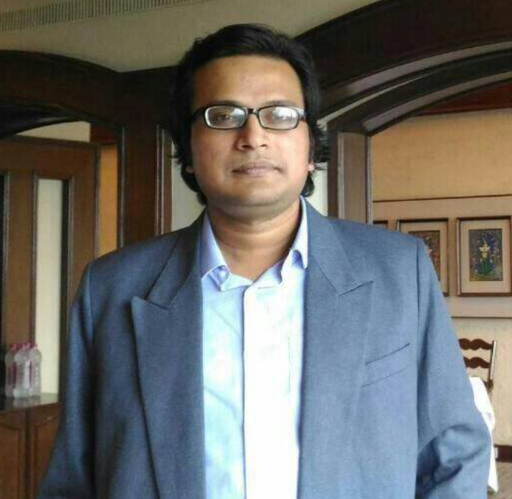

Thank you
Instructor
Teaching Assistants (IITKGP)
Sombit Bose
Anurup Naskar
Niloy Ganguly
niloy@cse.iitkgp.ac.in
Sabyasachi
Mukhopadhyay
Shrimon
Mukherjee

