Slide 1

Retrieval Augmented Generation (RAG)
Module 2 Lecture 5
Pawan Goyal
Department of Computer Science and Engineering
IIT Kharagpur

Slide 2
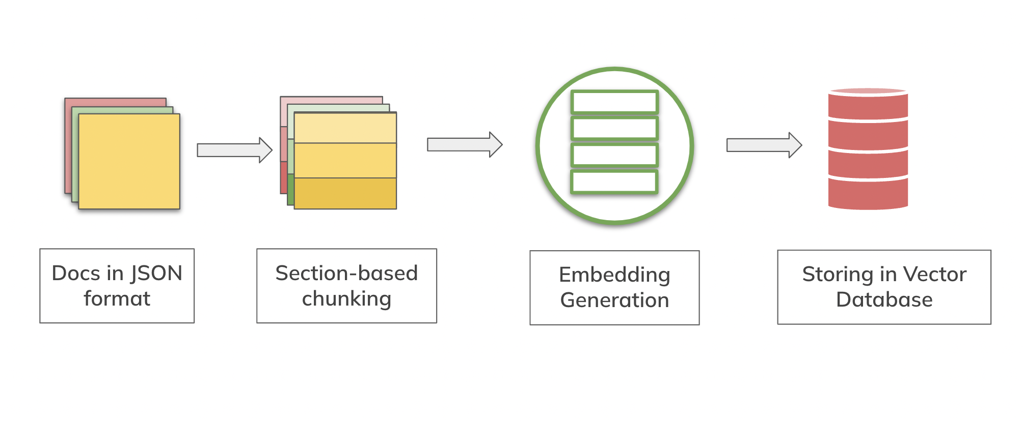
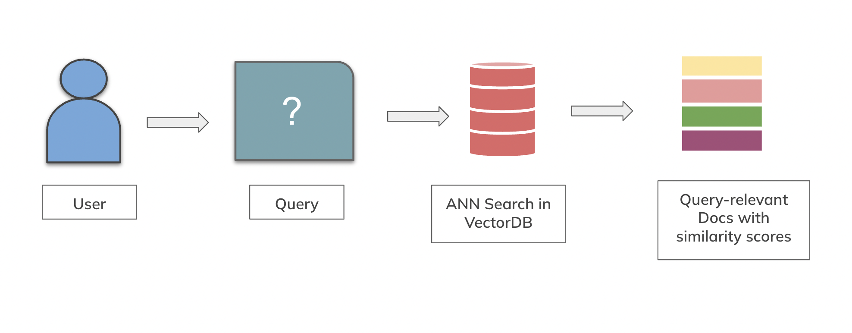
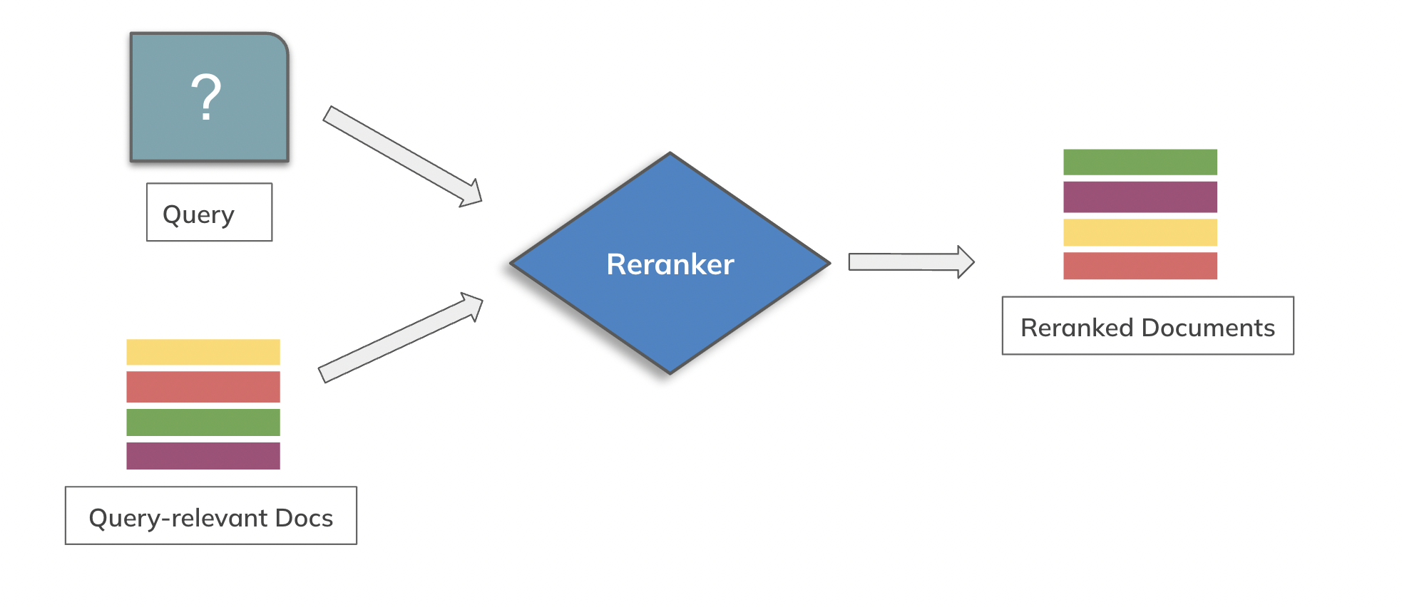
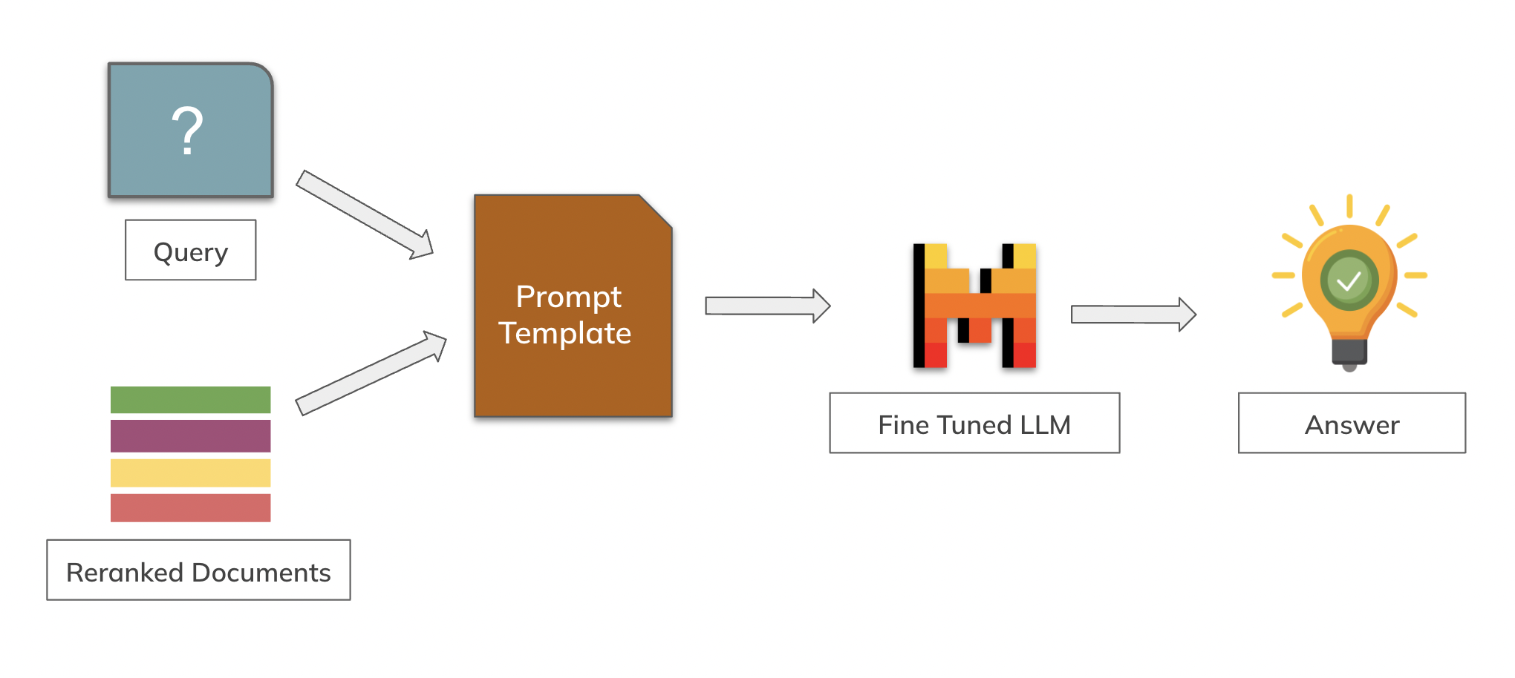
RAG with Vector DB - Recap From the last lecture
Pre-Retrieval
Retrieval
Post-Retrieval
Augmentation and Generation
https://ai.meta.com/blog/retrieval-augmented-generation-streamlining-the-creation-of-intelligent-natural-language-processing-models/

Slide 3
Finding the nearest — without checking everything
Comparing your query to all 10 million vectors is too slow. So databases take shortcuts.
Like a library: you don’t read every book to find one topic — you walk to the right section, then scan that shelf.
≡
Group & skip
Compress
Shortcut graph
Sort similar vectors into clusters. Only search the few clusters near your query — skip the rest.
Shrink each vector into a tiny code so millions fit in memory and comparisons get cheaper.
Link vectors to their neighbors, then “hop” toward the answer — a few jumps instead of a full scan.
(a.k.a. IVF)
(a.k.a. PQ)
(a.k.a. HNSW)
You almost never build these yourself — you pick an “index” by name and the database does all of this for you.
Notes:
This single slide replaces ~15 theory slides (IVF, PQ, IVF+PQ, HNSW). Give only the intuition + the name in parentheses so if they read elsewhere they recognize the term. The practical point: you choose an index type; the DB implements the trick. No k-means / Voronoi / ADC math needed here.

Slide 4
IVF: Inverted file for vector Database - Recap From the last lecture
Retrieval (The Search)
Coarse Search: Compare the query only against the k centroids to find the closest match.
Fine Search: Scan only the vectors inside that specific bucket (ignoring the rest)
nprobe : #clusters (centroids) the algorithm evaluates during an ANN search (=1 by default)
Outcome: Reduces search scope from O(N) to approximately O(N/k)

Slide 5
Product Quantization
We have N = 1,000,000 database vectors, d₁ through d₁,₀₀₀,₀₀₀.
D = 768 dimensions
Each is a D = 768-dimensional vector of floats — one row of the matrix. Storing them all raw is the problem PQ solves.
d1
d2
d3
N = 1,000,000
d4
Over the next slides we compress this whole set: split each row, cluster each segment, and keep only the cluster IDs.
d5
⋮
d1,000,000
N = 1,000,000 vectors · each D = 768 dims
Rows d₁ … d₁,₀₀₀,₀₀₀, each holding 768 floats.
Product Quantization · at scale
2

Slide 6
STEP 1 OF 3
Split every vector into 8 segments
Cut the D = 768 columns into m = 8 equal slices of 96 dims each. Every vector now has 8 sub-vectors — one per segment — compressed independently.
Segment 1
Segment 2
Segment 3
Segment 8
d1
d2
Segment 1
d3
…
d4
Segment 2
d5
⋮
Segment 3
d1,000,000
⋮
… through …
Segment 8
Product Quantization · at scale
3

Slide 7
STEP 2 OF 3
Cluster each segment → 8 codebooks of 256 centres
Run K-means inside each segment across all one million sub-vectors. With K = 256, every segment gets 256 cluster centres — its codebook Cᵢ.
C1 — Segment 1
C2 — Segment 2
C3 — Segment 3
C8 — Segment 8
256 centres · ids 0–255
256 centres · ids 0–255
256 centres · ids 0–255
256 centres · ids 0–255
c1,0 id 0
c2,0 id 0
c3,0 id 0
…
c8,0 id 0
c1,1 id 1
c2,1 id 1
c3,1 id 1
c8,1 id 1
⋮
⋮
⋮
⋮
c1,255 id 255
c2,255 id 255
c3,255 id 255
c8,255 id 255
Why 256? an id in 0–255 fits in exactly one byte — so each segment costs 1 byte, and a whole vector costs just 8.
Product Quantization · at scale
4

Slide 8
STEP 3 OF 3
Encode: each vector becomes 8 cluster IDs
Find the nearest centre in every segment and keep its id. The saved table is the compressed database — columns and rows abbreviated with …
Vector
Seg 1
Seg 2
Seg 3
…
Seg 8
Read a row
d1
12
5
200
…
88
d₂ → [ 42, 201, 7, …, 99 ]
one id per segment — 8 bytes in total.
d2
42
201
7
…
99
⋮
⋮
⋮
⋮
⋮
⋮
Discarded: the original float sub-vectors are dropped. Only the 8 IDs per vector are kept.
d1,000,000
255
60
9
…
120
Product Quantization · at scale
5

Slide 9
ZOOM IN
Following one vector, d₂, across its 8 segments
Split into 8 sub-vectors, match each to its nearest of 256 centres, keep the id. Segments abbreviated with …
Split into 8 segments
Nearest centre → id
segment 1
c1,42 → id 42
segment 2
c2,201 → id 201
stored code
d₂
8 bytes
split
segment 3
nearest
c3,7 → id 7
store
one vector
⋮
⋮
one per
segment
segment 8
c8,99 → id 99
d₂ → [ 42, 201, 7, …, 99 ] 8 one-byte IDs replace 768 floats. Every vector encodes the same way.
Product Quantization · at scale
6

Slide 10
THE PAYOFF
One million vectors, a fraction of the memory
BEFORE
AFTER
384×
3 GB
8 MB
→
smaller · ~99.7% saved
1M × 768-dim
as 32-bit floats
1M × 8 one-byte
segment IDs
Size per vector
Why it matters at a million
raw = D × 4 bytes (3 KB at D=768)
3 GB of raw vectors strains memory and won’t scale to billions; 8 MB fits easily — the index stays in RAM and search stays fast.
coded = m bytes = 8 bytes
m = 8 segments, K = 256 → one byte each. Independent of D.
More segments (m) → slightly larger codes, better accuracy.
Product Quantization · at scale
7

Slide 11
PQ: Product Quantisation (Indexing)
Indexing (Compression Phase)
Split (Sub-vectors): Divide the high-dimensional original vector (e.g., 128D) into m smaller sub-vectors (e.g., 8 chunks of 16D).
Train (Codebooks): Run K-Means independently on each sub-space to find K (eg. 256) representative centroids (the "Codebook").
Encode: Replace each sub-vector with the ID (0-255) of its nearest centroid.
Result: High-precision floats are converted into small byte codes, reducing memory usage by 95%+ (e.g., 4KB →64 bytes).
D = Dimension
Discarded
Segment 1
Segment 2
Segment 3
1
0
0
1
1
0
0
0
0
1
0
0
1
1
0
0
1
0
1
0
d1
0
0
N = Span
0
0
0
1
0
0
1
1
0
d2
0
0
0
1
0
0
1
1
0
0
0
0
1
0
0
1
1
0
d3
0
0
0
1
0
0
1
1
0
1
0
0
1
1
0
0
0
0
1
0
0
1
1
0
0
1
0
1
0
d4
0
0
0
0
0
1
0
0
1
1
0
d5
0
0
0
1
0
0
1
1
0
0
0
0
1
0
0
1
1
0
d6
0
0
0
1
0
0
1
1
0
0
0
0
1
0
0
1
1
0
d7
0
0
0
1
0
0
1
1
0
0
0
0
1
0
0
1
1
0
d8
0
0
0
1
0
0
1
1
0
0
0
0
1
0
0
1
1
0
d9
0
0
0
1
0
0
1
1
0
1
1
1
1
1
0
0
1
1
d10
1
1
1
1
1
0
0
1
1
Saved
Clustering
d1
c11
c21
c31
0
0
0
1
0
0
1
1
0
c12
c23
c32
0
0
0
1
0
0
1
1
0
d2
1
1
1
1
1
0
0
1
1
C1
C2
C3
d9
c13
c22
c33
c11
c12
c13
c21
c22
c23
c31
c32
c33
d10
c13
c21
c32
Cluster IDs Saved as 8 bit Integer

Slide 12
A 384-dim float32 vector is split into m = 4 sub-vectors, each encoded to one of 256 centroids. What is the size per vector and the compression ratio?
4 bytes, 384× compression
32 bytes, 48× compression
16 bytes, 96× compression
128 bytes, 12× compression

Slide 13

Quiz 1

Slide 14
A 384-dim float32 vector is split into m = 4 sub-vectors, each encoded to one of 256 centroids. What is the size per vector and the compression ratio?
4 bytes, 384× compression
32 bytes, 48× compression
16 bytes, 96× compression
128 bytes, 12× compression

Slide 15
QUERY TIME
Search: do the multiplications once, then just add
Brute force compares the query to every stored vector — a full distance each, a mountain of multiplications. A distance lookup table turns almost all of that into lookups and adds.
BRUTE FORCE (NO PQ)
ONCE PER QUERY
PER VECTOR
Distance to every vector
Build one distance table
Look up + add
Compute the full distance from the query to all 1,000,000 stored vectors — 768 multiplies each.
→
Measure the query against the 256 centroids in each of the 8 segments, then reuse it for all.
→
Each vector’s 8 IDs index 8 cells; sum them for its approximate distance. No multiplies.
768M
≈197K
8 lookups, 7 additions
multiplications per query
multiplications, computed once
Lookup, adds per vector (× 1M)
Asymmetric Distance Computation (ADC): the heavy multiplies run once (≈197K), not a million times (768M) — about 3,900× fewer multiplications. The million-vector scan is then only lookups and adds, because the query stays full-precision while the stored vectors are compressed IDs.
Product Quantization · at scale
8

Slide 16

PQ search: compute once, then just add
The database vectors are stored as centroid IDs, not floats. So distance becomes a table lookup + addition — no float math per vector.
1
Once per query: build the distance table
2
Per database vector: look up + add
Split the query into m sub-vectors. For each, measure its distance to that sub-space’s centroids.
A stored vector is just its centroid IDs, e.g. [c2, c3, c4]. Read those cells and sum them.
c1
c2
c3
c4
q₁→c2
+
q₂→c3
+
q₃→c4
=
0.5
q₁
0.9
0.2
0.7
0.5
0.2
0.1
0.2
q₂
0.4
0.6
0.1
0.8
q₃
0.3
0.7
0.9
0.2
approx. distance — 3 lookups, 2 adds
m × k table — tiny, reused for every vector
Why it’s fast — Asymmetric Distance Computation (ADC)
“Asymmetric” = the query stays full-precision while documents are compressed. The costly query–centroid math happens once; scanning a million vectors is then just lookups and additions — no per-vector float distance.
Contrast with the indexing slide: there you built the codebooks; here you reuse them to score fast.

Slide 17
For a database of 10 million 1024-dimensional vectors using Product Quantization (m=16 sub-vectors, k=256 centroids), the per-query distance lookup table size is
10 Million entries
1024 entries
4096 entries
16 entries

Slide 18

Quiz 2

Slide 19
For a database of 10 million 1024-dimensional vectors using Product Quantization (m=16 sub-vectors, k=256 centroids), the per-query distance lookup table size is
10 Million entries
1024 entries
4096 entries
16 entries
Answer: C.
Explanation: The lookup table is m × k = 16 × 256 = 4,096 entries, computed once per query.

Slide 20
You're storing 10,000,000 vectors, each 1024-dimensional float32. You apply Product Quantization with m = 16 sub-vectors, each encoded against a codebook of k = 256 centroids.
At search time, how many lookups and additions does it take to score one database vector, respectively? Answer is of the form #lookups, #additions.
1024, 1023
8, 8
16, 16
16, 15

Slide 21
Quiz 3

Slide 22
You're storing 10,000,000 vectors, each 1024-dimensional float32. You apply Product Quantization with m = 16 sub-vectors, each encoded against a codebook of k = 256 centroids.
At search time, how many lookups and additions does it take to score one database vector, respectively? Answer is of the form #lookups, #additions.
1024, 1023
8, 8
16, 16
16, 15
Answer: D
Explanation: Scoring one database vector is then m = 16 lookups and 15 additions

Slide 23
IVF + PQ
IVF and PQ each solve two different problems:
IVF solves "Too many vectors to check" (by clustering).
PQ solves "Vectors are too big to store" (by compression).
IVF+PQ Indexing (Construction)
1. Coarse (IVF): Run K-Means (e.g., 1024 clusters) on the dataset to find coarse centroids.
2. Assign each vector to its nearest centroid, then calculate the difference vector (Residual = Vector - Centroid).
3. Fine (PQ): Split the residual vector into sub-vectors and train the PQ codebooks on these residuals.
4. Save the PQ codes (byte IDs) into the specific Inverted List for that centroid.
0
0
0
1
0
0
1
1
0
1
0
0
0
0
1
0
0
1
1
0
0
0
0
1
0
0
1
1
0
0
0
0
1
0
0
1
1
0
1
0
0
0
0
1
0
0
1
1
0
Partition
0
0
0
1
0
0
1
1
0
0
0
0
1
0
0
1
1
0
0
0
0
1
0
0
1
1
0
0
0
0
1
0
0
1
1
0
1
1
1
1
1
0
0
1
1
Residual
0
0
0
1
0
0
1
1
0
0
0
0
1
0
0
1
1
0
1
1
1
1
1
0
0
1
1
0
0
1
0
0
1
1
0
0
1
0
c11
c12
c13
c21
c22
c23
c31
c32
c33
0
0
0
1
0
0
1
1
0
0
0
0
1
0
0
1
1
0
0
0
0
1
0
0
1
1
0
d1
c11
c21
c31
1
0
0
0
0
1
0
0
1
1
0
PQ
d2
c12
c23
c32
0
0
0
1
0
0
1
1
0
0
0
0
1
0
0
1
1
0
0
0
0
1
0
0
1
1
0
d9
c13
c22
c33
0
0
0
1
0
0
1
1
0
1
1
1
1
1
0
0
1
1
d10
c13
c21
c32

Slide 24
IVF + PQ
Query
IVF+PQ Search (Retrieval)
1. Coarse (IVF): Compare the query against the coarse centroids to find the nprobe closest buckets (e.g., top 10).
2. For each selected bucket, shift the query vector relative to that bucket's centroid (Queryshifted​=Query−Centroid).
3. Build Tables (ADC): Construct the PQ distance lookup tables using these shifted queries.
4. Scan: Iterate through the PQ codes in the selected buckets, summing values from the lookup table to approximate distance.
0
0
0
1
0
0
1
1
0
K Cluster
Residual
0
0
0
1
0
0
1
1
0
0
0
0
1
0
0
1
1
0
0
0
0
1
0
0
1
1
0
0
0
0
1
0
0
1
1
0
0
0
0
1
0
0
1
1
0
1
1
1
1
1
0
0
1
1
c11
c12
c13
c21
c22
c23
c31
c32
c33
ADC
Index
d1
c11
c21
c31
d1
s11
s21
s31
d2
c12
c23
c32
s11
s12
s13
d2
c12
c23
c32
s21
s22
s23
d9
c13
c22
c33
s31
s32
s33
d9
c13
c22
c33
d10
c13
c21
c32
d10
c13
c21
c32

Slide 25
INTUITION
Why IVF + PQ beats plain PQ — and why residuals
Plain PQ compresses vectors but still scores every one of them. IVF skips most of the data; encoding residuals keeps the compression precise.
IVF — skip most of the data
PQ the residual, not the vector
Cluster the space into cells (coarse centroids). Each vector lives in one cell. A query probes only its nearest few cells and ignores the rest.
The centroid already fixes the rough location. PQ then encodes only r = x − c — a small offset near zero. Same bits, far finer detail.
probed
Encode the short r, not the long x.
Residuals are small and alike across cells, so
one codebook fits all.
r (short)
skipped
x
query
c
scan a fraction of N, not all N
0
coarse position
Like a postal address: the city (coarse centroid) places you roughly; a short street-level offset (residual) does the rest. IVF makes search fast (probe a few cells, not all N); residual-PQ keeps it accurate (fine codes for a small offset) — wasting no bits re-describing what the centroid already told us.
Product Quantization · IVF + PQ

Slide 26
So… what is a vector database?
A place that stores these meaning-vectors and can find the closest ones — fast — even across millions of records.
DB
◎
⤢
Stores three things
Finds by meaning
Scales up
Each record keeps the vector, the original text, and metadata — together.
Give it a query; it returns the nearest chunks by meaning, ranked.
Built to search millions of vectors in milliseconds — the naive way can’t.

Slide 27
Two tools you’ll meet: ChromaDB vs FAISS
A ready-made database vs a raw search engine you assemble yourself
C
ChromaDB
F
FAISS
a database
a library
Stores text + metadata + vectors together — automatically
Extremely fast, highly tunable — scales to billions
Saves to disk (persists) on its own
Full control over index type & compression
Filters by metadata out of the box
NOT a database: no text, metadata, or persistence
A working search service in ~10 lines
You keep the id → text/metadata map yourself
Best up to a few million vectors
Lose that map = “numbers but no documents” bug
Notes:
Chroma = a database that wraps vector search with everything a RAG app needs (text, metadata, persistence, filtering). FAISS = a fast ANN library; you assemble the database around it and must maintain the id→text/metadata mapping yourself. Chroma for convenience/completeness at small–medium scale; FAISS for raw scale and control.

Slide 28
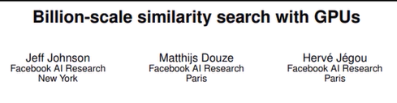
FAISS
Faiss is a library for efficient similarity search and clustering of dense vectors. It contains algorithms that search in sets of vectors of any size, up to ones that possibly do not fit in RAM.
Two main approaches:
IndexFlatL2 : Exact L2 matching but faster than manual implementation
IndexIVF (Inverted File) : Cluster similar features together, only searches relevant clusters

Slide 29


ChromaDB: a database wrapped around vector search
FAISS is a library that finds nearest vectors. ChromaDB is the database that wraps it with everything a RAG app actually needs.
The raw-search problem
Chroma stores all three together
A bare similarity search returns numbers:
Vector
for the similarity math
“vector #4471 is closest”
Text
the actual chunk the LLM reads
… but the LLM needs the text, and you need the source to filter & cite. With FAISS you track that ID→text map yourself — the classic “numbers but no documents” bug.
Metadata
source, page, date — to filter & cite
The feature raw search can’t do: metadata filtering
The trade-off
where={"source": "policy.docx"}
Pre-filter before the search → higher precision AND a smaller, faster candidate set.
Under the hood: HNSW (one index, CPU, single node). Convenience now, a ceiling later — graduate to FAISS for billions or fine index control.
In one line: take an ANN library like FAISS, wrap it in a real database — text, metadata, persistence, filtering included.

Slide 30
A practical superpower: filtering
Search only the documents that matter — before doing any vector math
People ask scoped questions
One line narrows the search
“In the HR policy, how many sick days…”
where = { "source": "hr_policy.pdf" }
“According to the 2024 handbook…”
✓
Higher precision Only HR passages can come back — no stray matches from other docs.
“In the engineering docs, how do I…”
✓
Faster A smaller candidate set means less to search through.
The scope is a filter — so use it.
✓
Fewer surprises The answer stays on-topic and easy to cite.
Metadata (source, date, section) lets you narrow the search first.
Notes:
The feature raw vector search alone cannot do. Pre-filtering on metadata (the "where" clause) restricts the candidate set before/alongside similarity search: better precision, faster, easier citations. Real questions are usually scoped ("in the HR policy...") — turn that scope into a filter.

Slide 31
Filtering: pre vs post
Apply metadata filters before the search, or after
Pre-filter
Post-filter
Narrow FIRST, then search only the matches
Search FIRST, then drop non-matches
where={"dept":"HR"} → search HR only
search all → keep rows where dept=HR
✓
Faster — smaller candidate set
✓
Simple — works on any index
✓
More precise — no off-topic hits
✕
May return fewer than K results
✓
Reliable K — always fills the top K
✕
Wastes work searching filtered-out docs
!
Needs an index that supports it
→
Fix: over-fetch, then filter
Rule of thumb: prefer pre-filtering when your vector DB supports it — it’s faster, more precise, and won’t come up short on results.
Notes:
Pre-filter = restrict to matching metadata before/within the ANN search: faster, precise, and reliably fills K, but the index must support filtered search. Post-filter = search then discard non-matches: works anywhere but can return <K and wastes effort; mitigate by over-fetching. Prefer pre-filtering when available.

Slide 32
Design Decisions of VectorDB

Slide 33
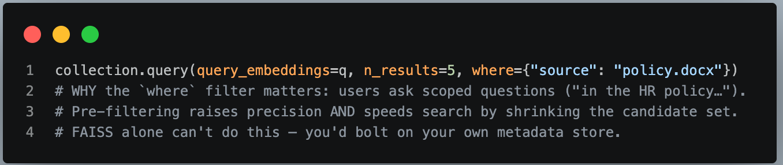
Prototype, course, app under ~a few million vectors, want metadata + persistence with minimal code
Choose: ChromaDB.
Because: it stores vectors + original text + metadata together, persists to disk, and filters by metadata - a working semantic search service in ~15 lines. It runs FAISS-class indexes underneath anyway, so you rarely lose speed at this scale.

Slide 34
2. Need raw speed / huge scale / fine index control / embedding inside another system
Choose: FAISS (the library).
Because: fastest and most tunable, scales to billions, full control over index type and compression. The cost: it's not a database - no persistence, no metadata, no text storage out of the box.
You must save/load the index file yourself and keep your own id → text/metadata map (losing that map is the classic "FAISS gave me numbers but I lost my documents" bug).

Slide 35
Question 2 - Which FAISS index? (corpus size is the main driver)
Branch 3D - Up to ~1M vectors, or you require 100% recall
Choose: IndexFlatIP (exact, brute force). Because: it compares the query to every vector — always finds the true nearest neighbors, no training, no tuning. Don't trade away accuracy to solve a speed problem you don't have yet.
Branch 3E - Millions of vectors, can tolerate a small recall loss, fits in RAM
Choose: IVFFlat. Knobs: nlist ≈ √N, nprobe = recall dial. Because: it clusters vectors and only searches the few clusters near the query, skipping ~90% of comparisons. Needs training (≥ ~30–40× nlist points or clustering is poor — that's the warning on small data). nprobe=1 is fastest/lowest-recall; raising it trades latency for recall until, at nprobe=nlist, it degenerates back to exact.

Slide 36
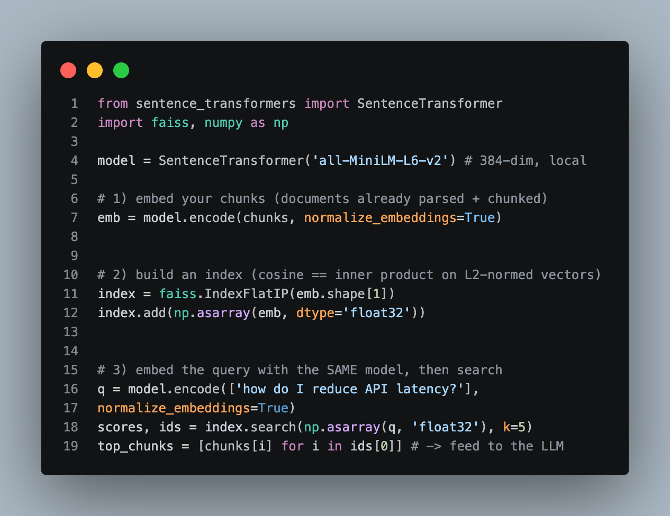
A minimal end-to-end pipeline​

Slide 37
RAG Reranking
Pre-Retrieval
Retrieval
Post-Retrieval
Augmentation and Generation
https://ai.meta.com/blog/retrieval-augmented-generation-streamlining-the-creation-of-intelligent-natural-language-processing-models/

Slide 38
Retrieve then rerank: the two-stage pattern
Retrieve a lot fast, then re-score the top few precisely
→
→
1
Retrieve
2
Rerank
3
Generate
Hybrid (dense + sparse) pulls the top ~100 candidates from millions.
A slower, sharper model re-scores those ~100 and reorders them.
The best 5–20 chunks go to the LLM as context.
fast · approximate
slow · precise
grounded answer
The catch: the precise reranker is too slow to run on millions. So stage 1 narrows to ~100, and stage 2 only reranks those. That split — recall first, precision second — is industry standard (Google, Bing, Meta).
Notes:
The retrieve→rerank→generate pipeline. Stage 1 optimizes recall cheaply (hybrid + ANN → top ~100). Stage 2 optimizes precision expensively (rerank the 100). Then top 5–20 to the LLM. You cannot afford the precise model on the whole corpus — that is the entire reason for two stages.

Slide 39
Who does each stage: bi- vs cross-encoder
Two jobs, not two rivals — one retrieves, one reranks
Bi-encoder — retrieve
Cross-encoder — rerank
query
document
query + document (together)
↓ encoded separately ↓
↓ read jointly by one model ↓
[vector]
[vector]
score
compare = similarity
sees word-by-word interaction
Doc vectors are pre-computed offline
Runs at query time on each pair
Search = fast similarity → scales to millions
Far more accurate relevance score
Approximate: pulls top ~100 candidates
Too slow for millions → only the ~100
Separate = fast & scalable (retrieve). Together = precise but costly (rerank).
Notes:
Why the split works. Bi-encoder embeds query and doc SEPARATELY, so doc vectors precompute and search is just similarity → scales. Cross-encoder feeds query+doc TOGETHER into one model, seeing token interactions → much better relevance, but must run per pair at query time → only affordable on the ~100 shortlist. Same "meaning as vectors" idea as before, applied at two speeds.

Slide 40
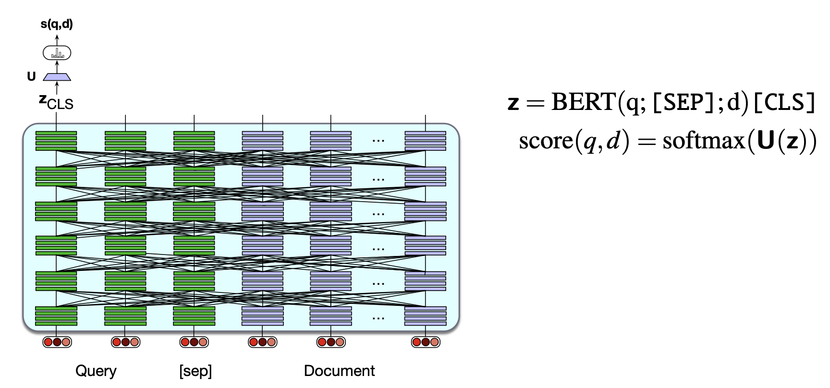
Dense Retrieval (costlier but more accurate): Cross-Encoder
Use a single encoder to jointly encode query and document and finetune to produce a
relevance score with a linear layer over the CLS token. This is too compute-expensive to use except in rescoring

Slide 41
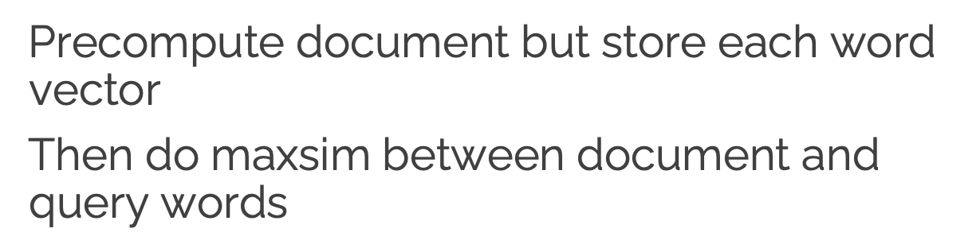
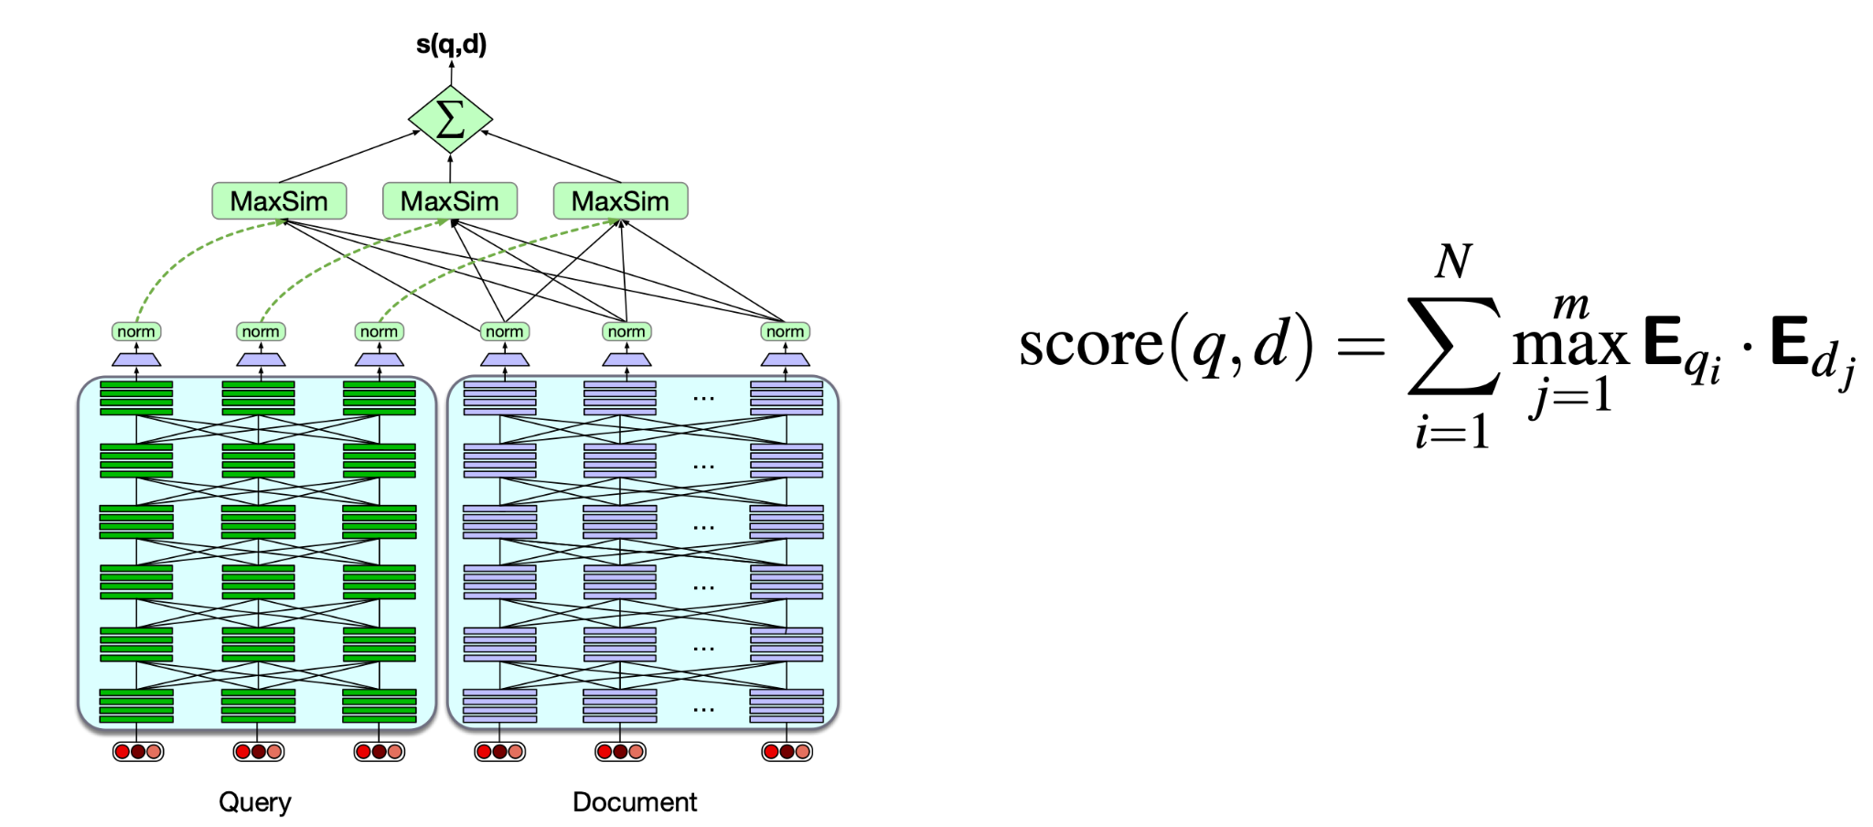
ColBERT

Slide 42
ColBERT: a middle ground (nice to know)
Between one-vector-per-doc and full cross-encoder
Store a vector per word, not per document. For each query word, find its best-matching word in the doc, then add those best matches up.
“best match” per query word (MaxSim)
Where it sits
“best”: no strong match
car
best
✓
More precise than one-vector-per-doc — keeps word detail
insurance
car
✓
Much cheaper than a cross-encoder at scale
auto
insurance
!
Costs storage many vectors per document
insurance
Notes:
Optional/advanced. ColBERT = "late interaction": one vector per token; score = sum over query tokens of the max similarity to any doc token (MaxSim). More expressive than a single doc vector, far cheaper than a cross-encoder, but storage-heavy. Frame as a middle ground; audiences do not need the math.

Slide 43
A legal-tech startup has: 20 million contracts, PDFs with tables, Latency budget: 500 ms, High accuracy requirements. Which architecture is most apt?
Whole-doc embeddings + exact search
OCR -> Chunking -> Dense Retrieval -> Cross-Encoder ReRanking
BM25 Only
Cross Encoder over entire Corpus

Slide 44
Quiz 4

Slide 45
A legal-tech startup has: 20 million contracts, PDFs with tables,Latency budget: 500 ms, High accuracy requirements. Which architecture is most apt?
Whole-doc embeddings + exact search
OCR -> Chunking -> Dense Retrieval -> Cross-Encoder ReRanking
BM25 Only
Cross Encoder over entire Corpus

Slide 46
RAG in Production: Practical Application of What we have learned till now
- but with some extra things :)

Slide 47

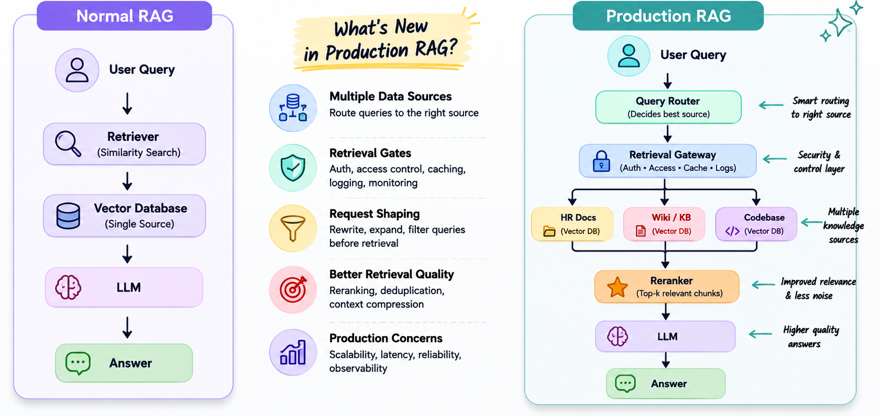
Production Rag Systems (What’s different?)

Slide 48
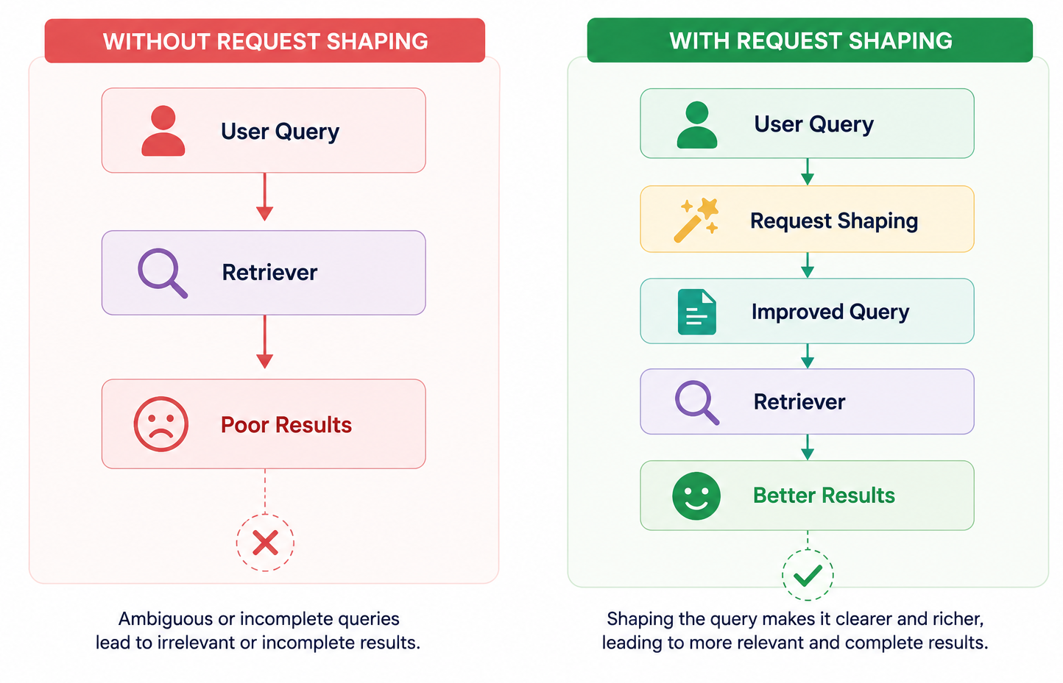
Request Shaping
Motivation : Requests made by users are not always precise and usable.
Example: Teach me attention. This prompt doesn’t specify what attention really means.
Request shaping transforms a user query before retrieval to improve relevance, precision, and retrieval quality.

Slide 49
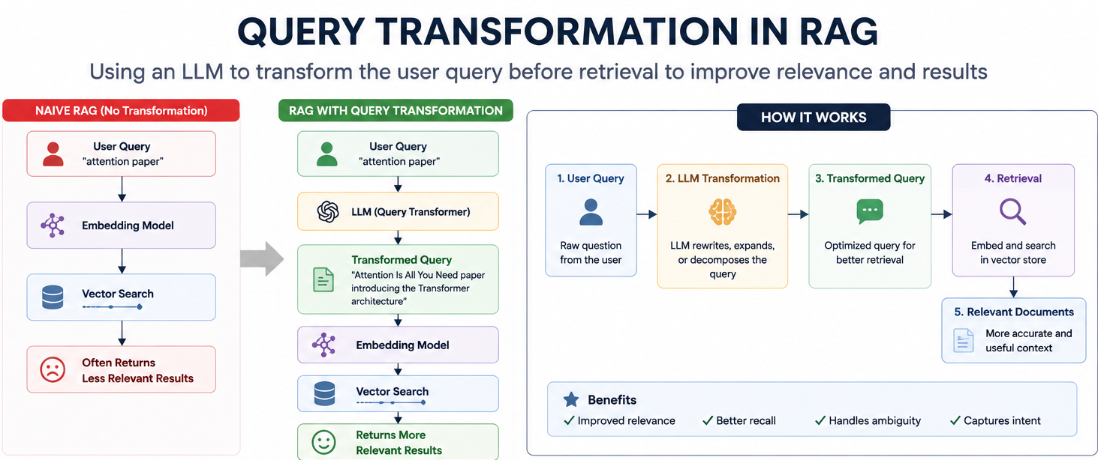

Slide 50

Example of Request Shaping in Project Context
Original User Query
Transformed / Shaped Request
“Server down.”
“Find active incident reports and server logs for the past 60 minutes.”
“Car leasing policy”
“Information about Employee benefit: Car-Leasing policy”
“Latest bugs assigned”
“Fetch top-10 bugs assigned to the user”

Slide 51
Query Transformations: Rewriting
What it is: The process of using an LLM to rewrite ambiguous, vague, or shorthand queries into clearer, highly specific search statements.
When to use it: Essential for support channels (Slack, Teams) where fragmented sentences, error codes, or jargon hinder vector database matching.
Project Example:
USER QUERY (ORIGINAL)
"OOMKilled"
TRANSFORMED QUERY (REWRITTEN)
What causes the OOMKilled container exit code in Kubernetes, and what are the remediation steps?
The Impact: Instead of returning random documents containing "OOM", the agent retrieves specific internal runbooks for memory allocation and container scaling.

Slide 52
Query Transformations: Rewriting
from llm_providers import LLM
# Connect to the LLM
client = LLM()
# User's short / unclear query
user_query = "OOMKilled"
# Ask the LLM to rewrite it
prompt = f"""
Rewrite the following user query into a clear and specific
search question.
User query: {user_query}
Return only the rewritten question.
"""
response = client.responses.create(
model="gpt-5.6",
input=prompt
)
# Get the LLM's rewritten query
rewritten_query = response.output_text
print("\nRewritten query:\n", rewritten_query)

Slide 53
Query Transformations: Follow-up Question
What it is: Converting contextual follow-up questions into complete, standalone queries by injecting the history of the current conversation.
When to use it: During active, multi-turn troubleshooting or policy inquiries where the user naturally relies on pronouns ("it," "they," "that server").
Project Example:
CONVERSATION HISTORY
User: "What is the standard parental leave policy?"
Agent: [Returns standard policy details]
User: "Does it apply to contractors?"
TRANSFORMED QUERY
"Does the standard parental leave policy apply to contract employees?"
The Impact: Without this step, the retriever searches for "Does it apply to contractors?" and fails. The standalone query ensures high-accuracy retrieval.

Slide 54
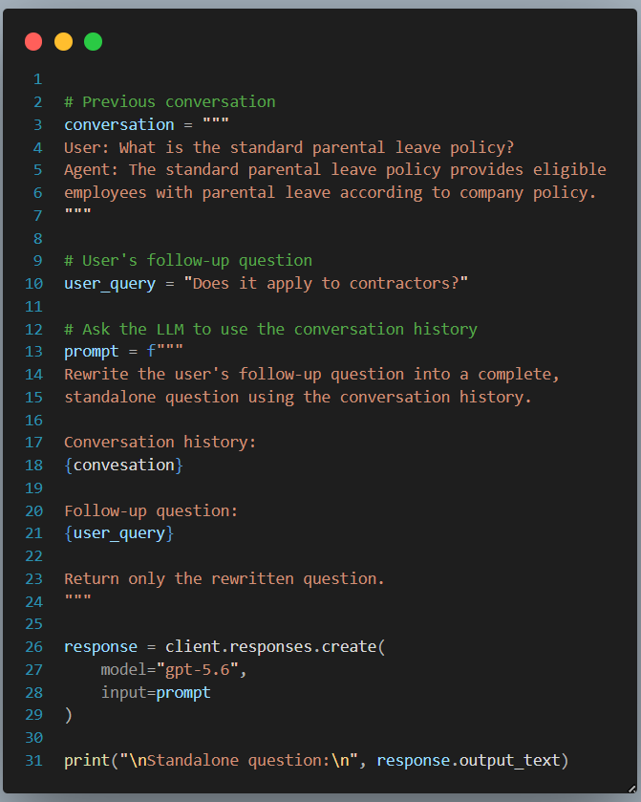
Query Transformations: Follow-up Question

Slide 55
Query Transformations: Multi-Query Retrieval
What it is: Generating multiple, distinct related queries from a single complex question and retrieving documents for all of them in parallel.
When to use it: When a prompt spans multiple microservices, compares entities, or requires joining info from separate documents.
Project Example:
USER QUERY
"Did the latency spike happen in both the Mumbai and US-East Vertex AI deployments?"
GENERATED QUERIES
Q1: What are the recent latency metrics and error logs for the Mumbai Vertex AI deployment?
Q2: What are the recent latency metrics and error logs for the US-East Vertex AI deployment?
The Impact: Guarantees the LLM gets necessary context for both deployments before comparison, avoiding regional bias.

Slide 56
Query Transformations: Multi-Query Retrieval
# User's complex question
user_query = (
"Did the latency spike happen in both the "
"Mumbai and US-East Vertex AI deployments?"
)
# Ask the LLM to split the question into separate queries
prompt = f"""
Break the following question into separate, simple search queries.
User question:
{user_query}
Return the queries as a numbered list.
"""
response = client.responses.create(
model="gpt-5.6",
input=prompt
)
# Get the generated queries
print( "\nGenerated queries:\n", response.output_text)

Slide 57
Quiz Time
What is the hidden cost of multi-query retrieval?
A) Loses user intent
B) Breaks offline mode
C) Multiplies retrieval calls and context size
D) Requires regex

Slide 58
Quiz 5

Slide 59
Quiz Time
What is the hidden cost of multi-query retrieval?
A) Loses user intent
B) Breaks offline mode
C) Multiplies retrieval calls and context size
D) Requires regex
Ans: C — N queries means N retrievals and N chunk sets competing for the context window.

Slide 60
Query Transformations: Step-Back Prompting
What it is: Creating a broader, high-level question to retrieve foundational context before attempting to answer a hyper-specific user query.
When to use it: When an engineer's query is so deep in the weeds that it misses underlying architectural rules, leading to "no results" or hallucinations.
Project Example:
USER QUERY
"Why can't I pull the switch association data for the rogue units on Floor 3?"
STEP-BACK (BROADER) QUERY
"What is the overall architecture of our network troubleshooting system, and what data is collected from reporting access points versus rogue units?"
The Impact: The step-back query retrieves the foundational rule: switch association data is only available for reporting access points, not rogue units. This allows the agent to explain the architectural limitation.

Slide 61
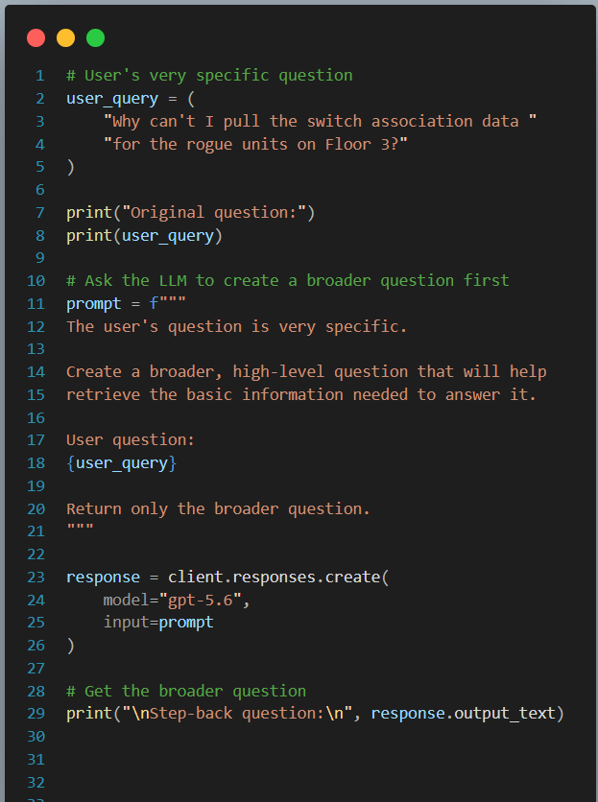
Query Transformations: Step-Back Prompting

Slide 62
The Need for Dynamic Decisions for User Queries
The Immediate Problem
We now have four powerful ways to transform a query (Rewriting, Follow-ups, Multi-Query, Step-Back). But how does the system know which technique to apply to a specific user prompt?
The Broader RAG Challenge
As system scales, this decision-making dilemma appears everywhere:
Which transformation technique should I use?
Should I search the HR vector database or the GitHub code repository?
Do I need a fast, cheap LLM for this, or a highly capable, expensive reasoning model?
The Solution: Query Routing
Hardcoding if/else statements for every scenario creates a brittle system. We need an intelligent layer that dynamically routes requests to the optimal workflow, tool, or data source.
Notes:
We've just given our agent a toolkit for shaping queries, but a toolkit is useless if you don't know when to use which tool. If an engineer pastes a massive error log, doing a 'Step-Back' prompt might ruin the context. If they ask a vague policy question, 'Multi-Query' is overkill. In production systems, you cannot hardcode these paths. You need the system to read the state and decide the next best action dynamically. This brings us to the brain of our traffic control: Query Routing.

Slide 63
Query Routing: The Traffic Cop of Production RAG
What it is:
Query routing directs a user query to the most relevant knowledge source, workflow, or model before execution.
The "So What?" (Production Impact)
If a user asks a simple question, searching the entire company's infrastructure (HR, Codebase, Logs, Wiki) is slow, expensive, and increases the chance of the LLM hallucinating by pulling irrelevant data.
Routing isolates the search to only the necessary domains.
The Goal:
Maximize accuracy while minimizing latency and API costs.

Slide 64
Routing Strategies: From Simple to Smart
Rule-Based (Logical)
Hard Coded logic or Regex. Fast and deterministic.
e.g., If query contains "PTO" or "leave", route to HR.
Embedding-Based
Semantic Router using vector similarity against route profiles. Fast, scalable, and offline-capable.
LLM-Based
LLM classification for JSON decisions. Highly accurate for ambiguity, but adds latency/costs.
Classifier-Based Routing
Train a dedicated intent classifier for core business domains like:
HR / Legal
Research / Code
Hybrid Routing (The Pro Approach)
Workflow: Rule → Embedding → LLM
Logic:
Only trigger the expensive LLM router if the fast Embedding router has a low confidence score.

Slide 65
Rule-Based (Logical) Routing
What it is & How it works
The most fundamental routing technique. It relies on hard coded logic, keywords, or Regular Expressions (Regex) to map a raw query string against if/else conditions before AI processing.
Project Example:
Logic:
IF query.contains(["PTO", "leave", "payroll", "manager"]): route_to = "HR_Database"
User Query:
"How many days of leave do I have left?"
The Result:
Instant route to HR docs. Cost: $0.00 | Latency: ~1ms
The Catch: Fragility
Highly brittle system. It lacks semantic understanding and fails if exact keywords are missing.
USER TYPES:
"I need to take time off"
SYSTEM STATUS:
✘ REGEX FAILS
Missing exact keyword "leave" or "PTO".
Deterministic • Zero Cost • Extremely Low Latency • Low Generalization

Slide 66
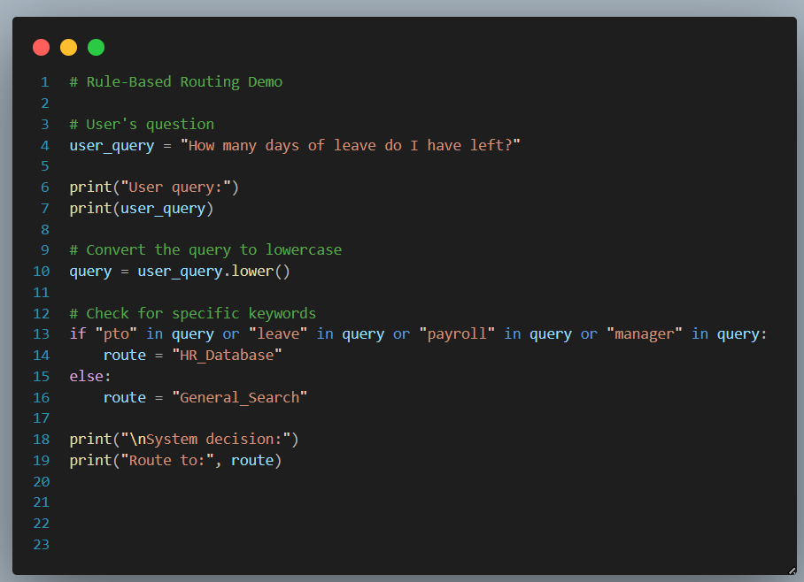
Rule-Based (Logical) Routing

Slide 67
Embedding based routing
What it is:
Transforms queries into vectors for similarity checks against "route profiles". Deterministic, fast (no LLMs), and works offline.
How it is done:
Create "profiles" (20-50 sample questions) for each database. Real queries are embedded and matched via cosine similarity.
Project Example:
User Query: "I'm feeling burnt out and need a break next Tuesday."
Route Profiles: HR_Policy (benefits, time off) vs. Code_Profile (bugs, PRs).
Result: Semantic match favors HR_Policy cluster. Routed without a heavy LLM.

Slide 68
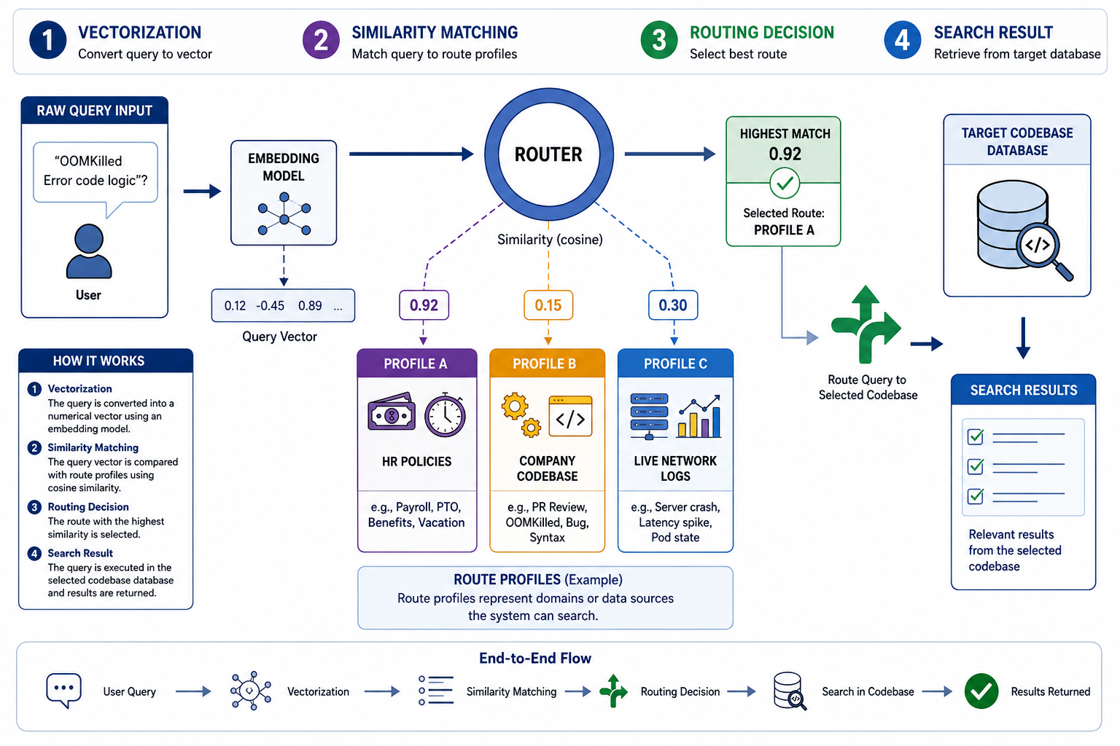
Embedding based routing

Slide 69
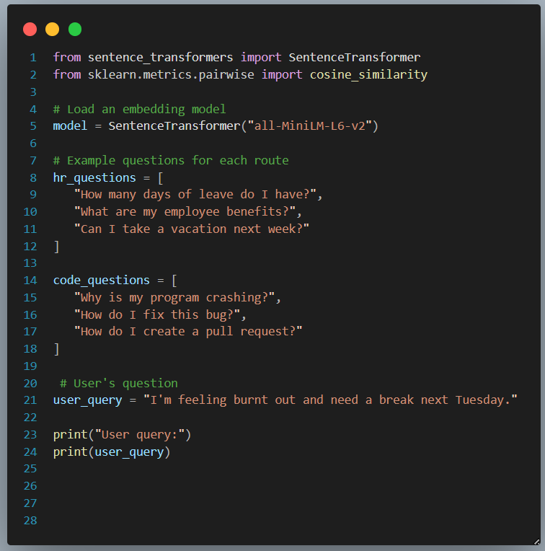
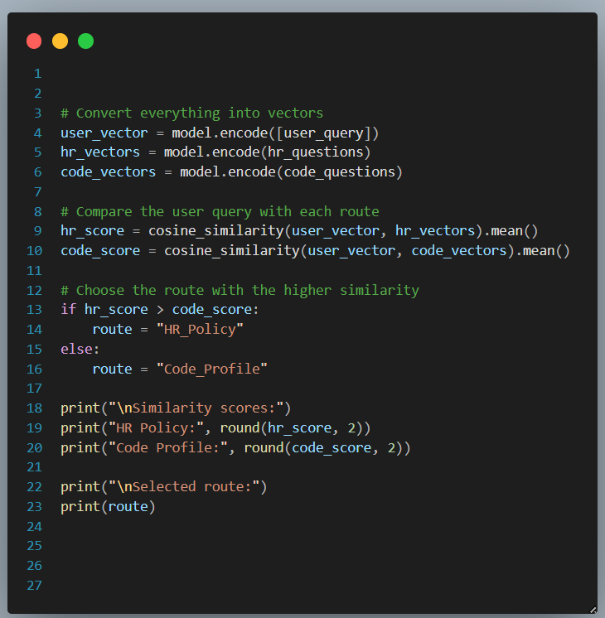
Embedding based routing

Slide 70
Classifier-Based Routing: Learning Intent
What it is
Uses a trained, lightweight ML model (e.g., Random Forest, Naive Bayes, small BERT) to categorize query intent into predefined buckets like HR, Legal, or Ops.
How it is done
The classifier is trained on historical queries mapped to correct labels. At runtime, it ingests queries and outputs probability scores for each category.
Project Example:
Query: "My compensation seems wrong this month." | Result: Recognizes semantic pattern Intent: HR (95% confidence)

Slide 71
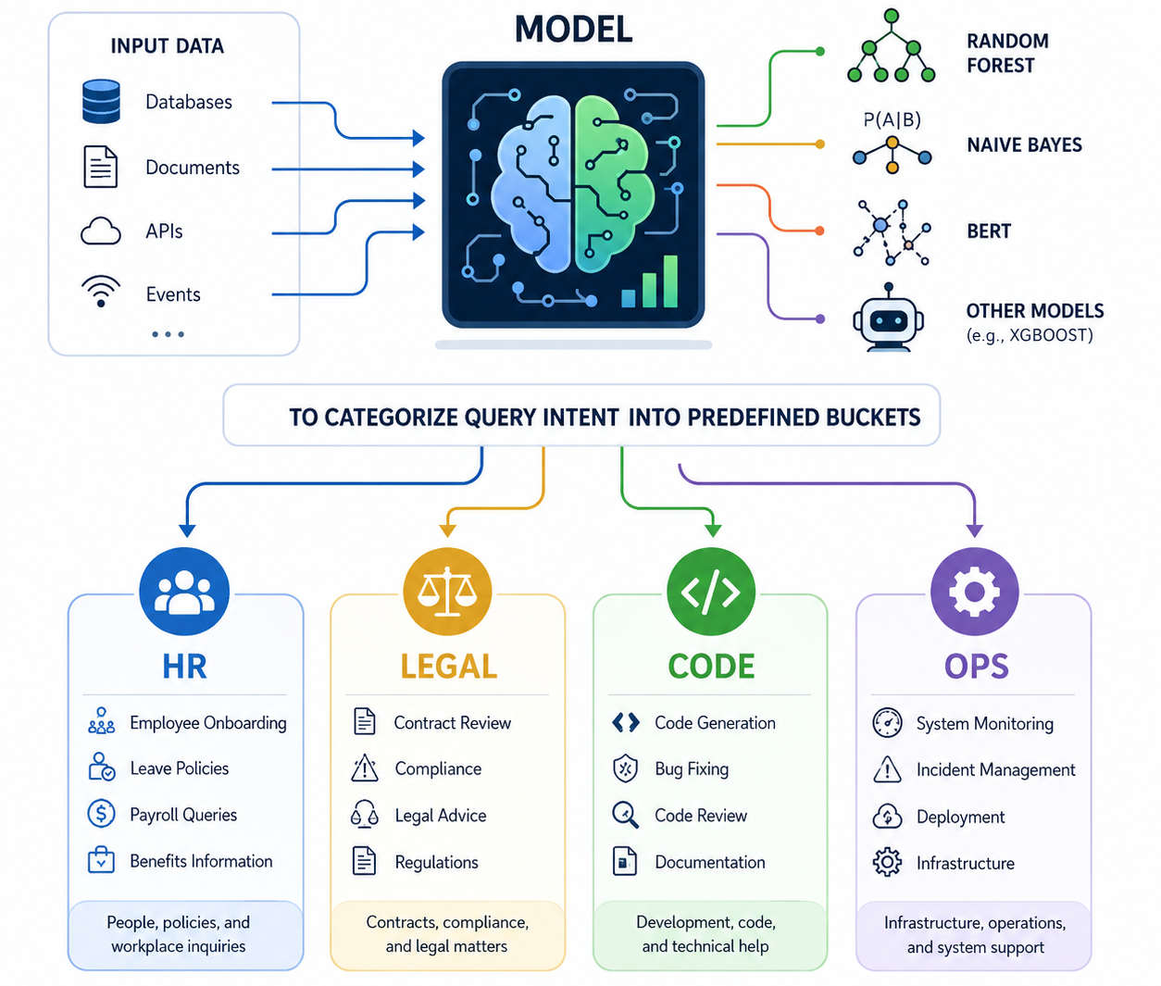
Classifier-Based Routing: Learning Intent

Slide 72
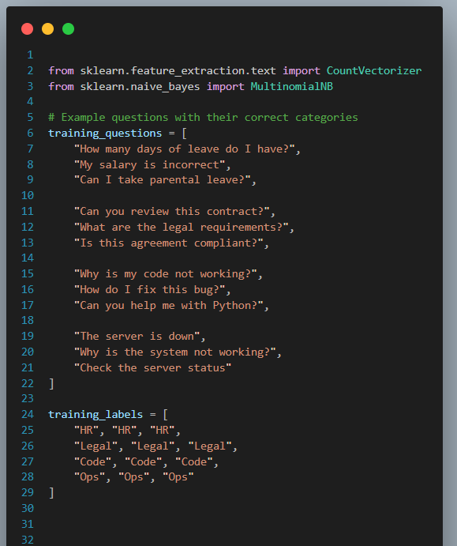
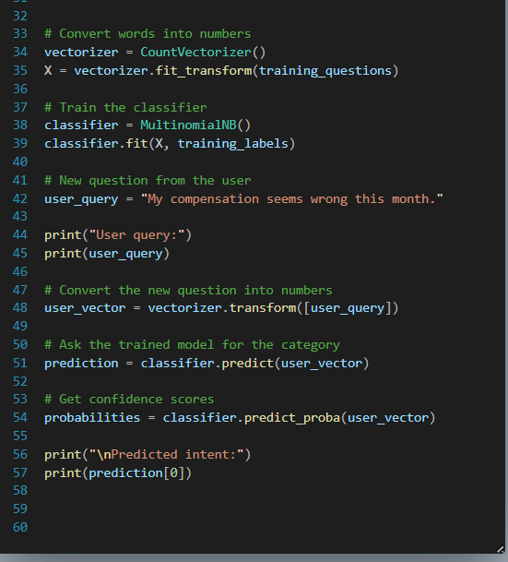
Classifier-Based Routing: Learning Intent

Slide 73
LLM based routing
Concept & Implementation
What it is: Simple queries use cheaper models; complex ones use stronger models. Ask LLM to reason and output structured JSON.
How it is done: A prompt with query and route descriptions asks: "Analyze this query and return a JSON object with 'target_database' and 'reasoning'."
Project Example:
Query: "The auth token is expiring too fast. Is this a new security policy thing or a bug?"
Result: LLM recognizes technical execution over policy, outputting {"route": "Codebase_DB"}.
The Catch: Balances quality vs. cost dynamically, but adds latency and API cost to the pipeline.

Slide 74
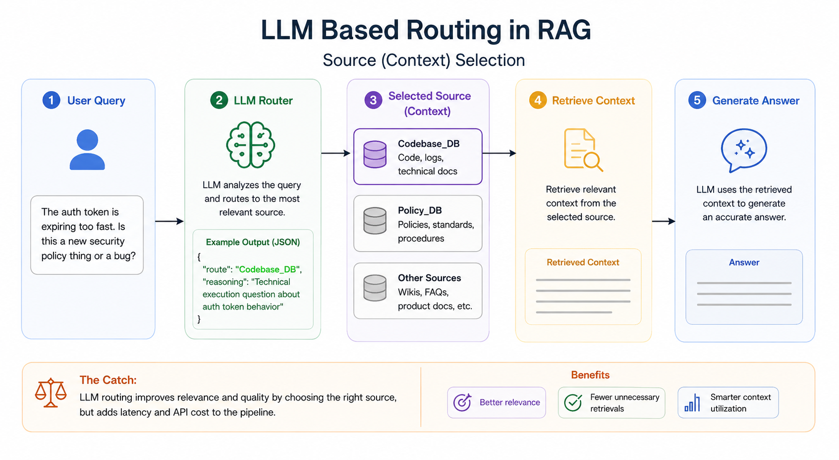
LLM based routing

Slide 75
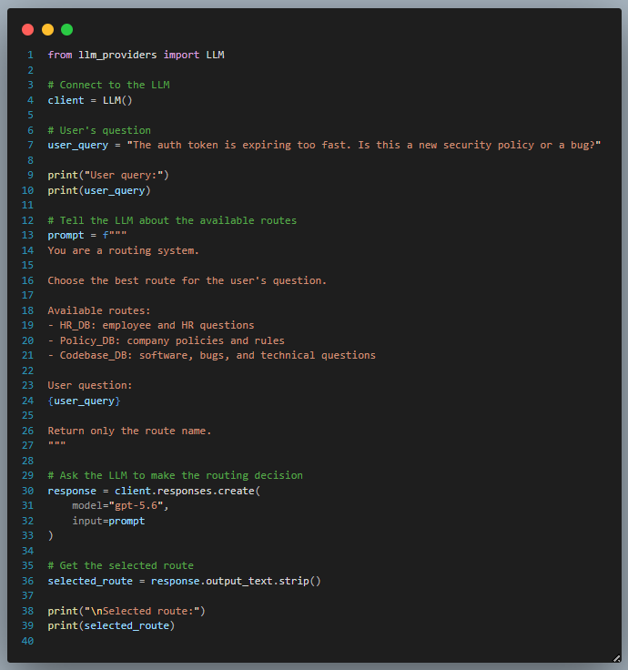
LLM based routing

Slide 76
Hybrid routing
What it is: Hybrid routing combines multiple strategies to leverage individual strengths while mitigating weaknesses.
How it is done: Routers are structured sequentially as a waterfall. Moving to the next stage occurs only upon low confidence.
1. Rule-Based
2. Embedding-Based
3. LLM-Based
Sequential Workflow
Example:
User Query: "Pipeline failed."
Step 1: Rule-Based
Result: FAIL → Route to Embedding-BASED
No obvious keywords found in query.
Step 2: Embedding
Result: 50% Confidence → less than threshold → Route to LLM-based
No semantic match found.
Step 3: LLM-Based
Result: SUCCESS
Reviews query + Metadata (Role: DevOps). Accurately routes to Infrastructure_Logs.
Cost efficiency: Only paid for expensive LLM when cheaper methods failed.

Slide 77
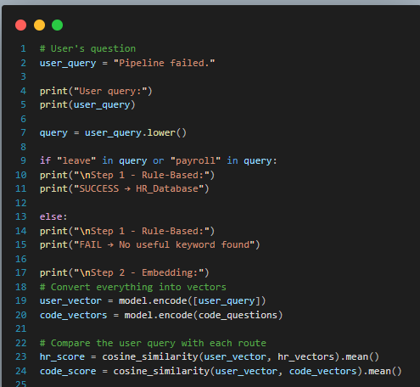
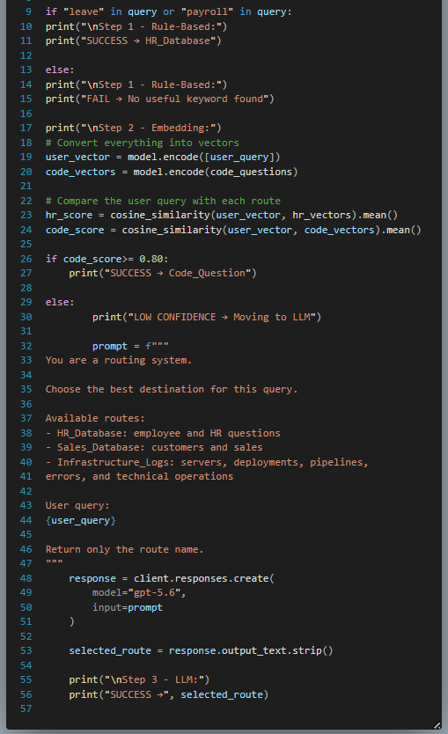
Hybrid routing

Slide 78
Quiz
In hybrid routing, why putting the rule-based stage first might be risky?
A) Adds latency
B) Can confidently route wrong
C) Needs GPU
D) Costs more

Slide 79
Quiz 6

Slide 80
Quiz
In hybrid routing, why putting the rule-based stage first might be risky?
A) Adds latency
B) Can confidently route wrong
C) Needs GPU
D) Costs more
Ans: B — a keyword match short-circuits the waterfall, so smarter stages never run. "Payroll server crashed" → HR can happen if the rule-based has a keyword payroll assigned to HR docs.

Slide 81
Application 1: Data Source Routing
General Use: Selecting the correct vector database, SQL database, or API based on the user's intent.
Example : Since RAG outputs depend on the data-corpus it accesses, different questions must refer to different corpora.
HR & POLICY
TECHNICAL ASSETS
LIVE MONITORING
User Query:
"What is the maternity leave policy?"
Route:
Retrieve from the HR Docs Vector DB.
User Query:
"How does the auth module handle token expiry?"
Route:
Retrieve from the Company Codebase Vector DB.
User Query:
"Why did the payment container crash 5 min ago?"
Route:
Trigger an API call to Live Splunk/Datadog Logs.
(Bypass Vector DB entirely)

Slide 82
Application 2: Model & Workflow Routing
General Use: Routing isn't just for finding documents; it is used to dynamically select which LLM or which pipeline to use, balancing response quality and inference cost dynamically for each query.
SIMPLE EXTRACTION
COMPLEX REASONING
User Query:
"Format this server log into a JSON block."
Route to Model:
Direct to a smaller, faster, cheaper model (e.g., Llama-3-8B or Haiku).
Lowers latency and avoids wasting expensive model capacity.
User Query:
"Review this 500-line Python PR, check it against our security guidelines, and draft a summary."
Route to Workflow:
Direct to a premium reasoning model (e.g., GPT-4 or Opus).
Triggers a multi-step Agentic Orchestration workflow.

Slide 83
Application 3: Prompt & Index Routing
General Use: Deciding how to search the data or how to prompt the LLM once the data is found.
INDEX ROUTING EXAMPLE
PROMPT ROUTING EXAMPLE
User Query:
"Find the specific error code in the network manual."
Route to Index:
Route to a Sparse Index (BM25/Keyword Search).
Exact matches matter more than semantic meaning here.
User Query:
"Summarize the architectural changes made to the database last quarter."
Route to Prompt:
Route to a Summarization Prompt Template.
Instructs the LLM to aggregate rather than extract a single fact.

Slide 84
Before We Search: Securing the Perimeter
The Current State: Our Query Router just successfully mapped a complex user prompt to the exact correct database (e.g., finding the HR_Docs_DB or the Live_Server_Logs).
The Enterprise Dilemma: Three Massive Production Risks
SECURITY
EFFICIENCY
COST
security
speed
payments
"What if a Junior Engineer query is routed to HR, but they ask for the CTO's salary?"
"What if 50 engineers ask the same question in 10 seconds? Do we pay for 50 searches?"
"What if a recursive bug triggers 10,000 expensive LLM evaluations?"
shield
The Solution: The Retrieval Gateway
A protective "bouncer" layer between routing logic and private company data.

Slide 85
Quiz
A brand-new startup has zero query logs. Which routing strategy can it not deploy yet?
A) Rule-based
B) Embedding
C) Classifier
D) LLM

Slide 86
Quiz 7

Slide 87
Quiz
A brand-new startup has zero query logs. Which routing strategy can it not deploy yet?
A) Rule-based
B) Embedding
C) Classifier
D) LLM
Ans: C -- classifiers need labelled historical queries; route profiles can just be hand-written.

Slide 88
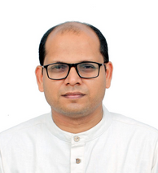


Thank You
Teaching Assistants (IITKGP)
Instructor
Pawan Goyal
Manoj Balaji Jagadeeshan
Kavin R V

