Slide 1



TITLE SLIDE
Team Name: Supreme X
Team Members: Jaydatt Mahendra Khodave (1st Year, CSE, Email: jaydatt@itisuniqueofficial.com, Phone: +91-7517651748) | Sanket Kadam (2nd Year, IT, Email: sanket@itisuniqueofficial.com, Phone: +91-8766812945)
College Name: Jawaharlal Nehru Engineering College - JNEC
Project Name: One ID for Every Skill – Trusted, Verified, Recognised

Slide 2


PROBLEM STATEMENT
India has a huge pool of talented students and professionals, but many genuine candidates lose opportunities due to fake resumes and certificates. Employers often fail to review resumes properly and waste a lot of time manually verifying skills. There is no standard system to check and showcase real talent. While Aadhaar proves identity and PAN tracks taxes, there is no Aadhaar-like system for skills.

Slide 3
WHY THIS PROBLEM IS IMPORTANT
48% recruiters in India encounter fake information in resumes. (Naukri Hiring Trends Report)
India produces 1.5M+ engineering & technical graduates annually, but verification is slow & unreliable.
Lack of a standard system creates mismatch between real skills & job opportunities.
Employers spend 30–40% extra time on hiring due to verification delays.

Slide 4
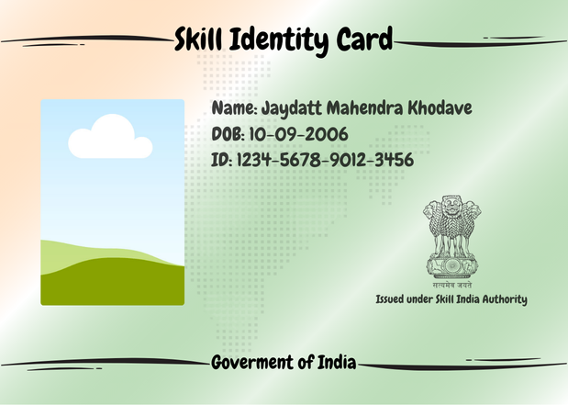
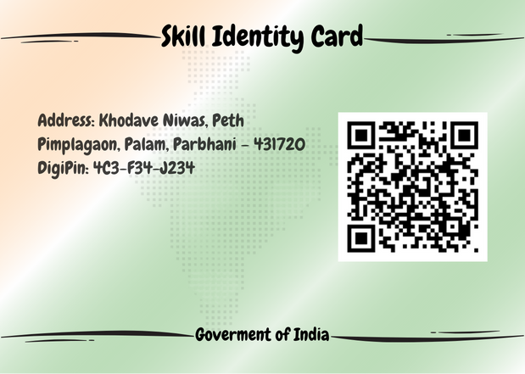
PROPOSED SOLUTION
Skill Identity Card (Physical + Digital)
Unique Skill Card ID + QR Code.
Front: Photo, Name, DOB, Card ID, Govt. branding.
Back: Address (DigiPin), QR → real-time verification.
Web Portal / Mobile App:
Enter ID / Scan QR → View verified skills.
Shows: Skill Name, Score (%), Issuing Authority, Certificate Download.

Slide 5
KEY FEATURES & TECH APPROACH
✔ Verified skill database (centralised & secure).
✔ Resume-ready → Only Skill ID needed.
✔ Skill updates only via authorised centres (Govt./Universities/NSDC-approved).
✔ Blockchain for tamper-proof verification.
✔ Integration with DigiLocker + Job Portals.
Technology Stack (Planned):
Backend: PHP / Python (FastAPI)
Database: PostgreSQL + Blockchain layer
Frontend: JavaScript + Kotli (Web + Mobile App)
Verification: QR + DigiPin integration

Slide 6
INNOVATION & UNIQUENESS
First-of-its-kind Skill Aadhaar for India.
Eliminates fake resumes, ensures real talent is recognised.
Integrates Govt, Universities, NSDC, Job Portals in one ecosystem.
AI Resume Analyzer: Suggests missing skills for jobs.
Employer Dashboard for bulk verification in campus placements.
Future scope: Skill Badges, Endorsements, Progress Tracking.

Slide 7
POTENTIAL IMPACT & TARGET USERS
Target Users:
Expected Impact:
Students & Job Seekers → One ID for all verified skills.
Employers → Faster hiring, zero fraud.
Training Institutes → Easy digital certification.
Government → Workforce data for policy making.
✔ Eliminates fake certificates & fraud.
✔ Saves time & cost in recruitment.
✔ Builds a skill-based economy.
✔ Creates national workforce registry → better job opportunities & policies.

