Slide 1
ABSOL
Automatic Builder for Semantically Oriented Languages
Specification and Verification of Domain-Specific Languages Through Automated Compiler Generation in Haskell
Notes:
Today I’m going to give you a brief overview of my project: ABSOL, the Automatic Builder for Semantically Oriented Languages.

Slide 2

Why?
Spread of important domain logic throughout software systems
Increasing usage of Domain-Specific Languages (DSLs)
A broad range of DSLs categories in use today
DSLs act to centralise domain logic
Centralisation -> a single point-of-failure
DSLs in General-Purpose Languages as sources of bugs
Notes:
In recent years, modern software systems have seen significant increases in complexity.
As a result, it has become apparent that Domain-Specific Logic, logic pertaining to how the system operates in an environment, is becoming integrated throughout these systems.
However, studies by Fowler and Mernik have demonstrated that this dispersion of logic increases the risk of it being incorrect somewhere in the system.
As a result, there has been a “significant uptick in interest” in Domain-Specific Languages, or DSLs.
The term ‘DSL’ is a broad one, encompassing many syntaxes for defining domain logic.
DSLs specify the required domain logic, and no more.
DSLs centralise domain logic, ensuring that there is only one place where it needs to be changed.
However, as domain logic becomes centralised, this creates a single-point-of-failure within the system in which the DSL is used.
A bug in your domain logic, while simpler to find, now has a greater impact.
This project was inspired by my time at Bloomberg, where I observed certain projects in the company to be the using General-Purpose Programming Language (GPL) OCaml for specifying trading strategies at runtime.
This provided much more power than required, increasing the surface area for system bugs.

Slide 3
What?
Provably Correct DSLs
Restricted language feature-set
A comprehensive system for creating DSLs
A Metalanguage: Metaspec
A Metacompiler: ABSOL
All in the name of proving each little language to be correct
Notes:
This project is concerned with preventing the DSL from becoming such a critical failure point through formal specification, making it easier to verify as a specification rather than an implementation.
Full specification of the DSL aims to prevent common errors, such as poor implementations, and divergent programs through a termination proof mechanism.
Being able to provide these guarantees, however, requires placing a restriction on the types of programs that these languages can represent.
While this would be an unreasonable restriction for a GPL, in the world of DSLs it is far less limiting.
By restricting the DSLs to operations on finite data and disallowing the use of unbounded recursion, it is possible to prove the DSL correct.
The system has two main components
The first is Metaspec, the metalanguage.
This allows the specification of the syntax and semantics of the DSL, and in doing so forces the creators to carefully evaluate how they want their language to behave.
The second component is ABSOL, the metacompiler.
It is a software program that ingests a specification for a DSL, verifies the semantics of this language (meaning that all programs in the DSL terminate), and then produces a compiler.
This ensures that mistakes cannot be made in the implementation of the DSL, thus ensuring correct language semantics.
Combined, these two elements of the system should provide for the creation of provably correct DSLs.

Slide 4
Prior Work – DSLs and Metalanguages
“DSL – A programming language or specification that offers expressive power focused on a particular domain”
– Van Deursen, Domain-Specific Languages: An Annotated Bibliography
DSLs provide a more appropriate level of abstraction
A focus on executable, external DSLs via Transpilation
Language Grammars based on EBNF
Semantics as a transformation of Big-Step Operational Semantics
Notes:
This project has been heavily influenced by related literature, so I feel that a brief overview of the material is necessary.
While many uses of a DSL could be replaced by a GPL, proponents of DSLs find that they provide a “more appropriate level of abstraction” for a given problem domain, encoding domain logic orthogonally to the business software itself.
There are many kinds of DSLs in use, ranging from static specification to executable programs.
This project, however, focuses on executable DSLs.
Furthermore, it focuses on what the literature terms ‘external’ DSLs: those which integrate with the GPL via a foreign function interface, allowing maximum control over execution semantics.
The DSL will be generated via transpilation to Haskell, a process that transforms one high-level language into another.
Metalanguages are languages used to describe other languages, so research was conducted into methods for specifying both syntax and semantics.
Focus was placed on Extended Backus-Naur form as, unlike other grammar formats, it provides multiple extension mechanisms for integration of additional language features.
Semantics, however, is a much broader category of work, with all variants consisting of semantic functions: mappings from a program’s abstract syntax to its behaviour.
While the review examined operational, denotational, axiomatic and hybrid semantics, it was decided to use big-step operational semantics.
This provided the best balance between conciseness and expression, as well as the recursive structure required for the proof engine.

Slide 5
Prior Work – Verification and Generation
“Totally Correct – When a program terminates and performs the operations as defined by its specification.”
– Manna and Pnueli, Axiomatic Approach to Total Correctness of Programs
Impossible to verify arbitrary programs
Must restrict programs to data to enable this
Termination proofs by induction
Compiler generation from the language specification
Notes:
While it would be preferable to prove the correctness of arbitrary DSLs, this is generally impossible
.
As a result, research into program verification focused on the duality of data and codata.
Data is captured by inductive types, and can hence be constructed in a finite number of steps.
It has been shown that it is possible to prove that programs that use well-founded general recursion over data are correct.
The general termination proof for the DSLs comes from Nordstrom, who shows that big-step semantics can be reasoned about through induction.
The main proof mechanism operates inductively on the structure of the semantics, with some additional features being relegated to special-case proofs.
The semantic forms are restricted such that their convergence hypothesis depend only on their sub-terms.
Based on this, the proof engine recursively decomposes more complex semantics until they can be shown to terminate at the specified base cases.
Finally, there has been some work on the automated generation of compilers given syntax and semantics.
It is found to offer benefits around correctness, maintainability and portability, so this was the approach that the project elected to take.

Slide 6
The Work So Far
“When asked for a formal semantics of the formal semantics Milner's head explodes.”
– James Iry, A Brief, Incomplete and Mostly Wrong History of Programming Languages
This project involves multiple levels of systems and metasystems
The Metalanguage -> The Language
The Metacompiler -> The Compiler
Notes:
As you can probably already see, this project involves multiple levels of ‘meta’.
There are two main elements of the project that have seen progress so far.
The metalanguage, that specifies the DSL
The metacompiler, which verifies the DSL and generates a compiler for it

Slide 7
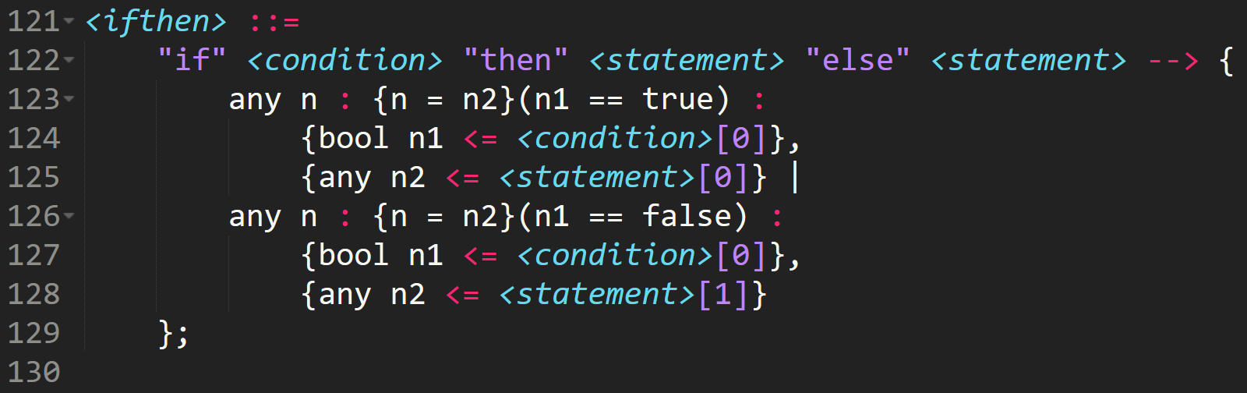
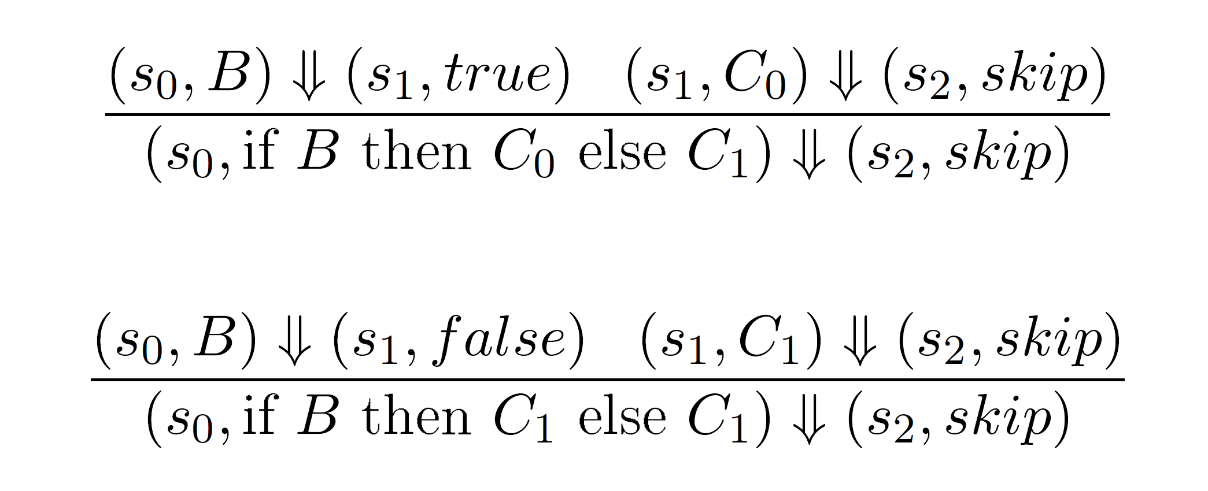
The Work So Far – Metaspec
An initial sketch of the syntax
Notes:
The initial design of metaspec emerged from a sketch of how the syntax was intended to look.
Significant care was taken designing this syntax, with the major challenge revolving around how to effectively specify both syntax AND semantics in one place.

Slide 8
The Work So Far – Metaspec
Care taken with semantic form
Representing complex functionality
Notes:
The semantics also required careful work, allowing it to provide facilities for directly addressing the syntax within the semantics, tying the two together in an intuitive fashion.
As you can see here, there is a direct transformation of the conventional big-step semantics into the metalanguage.
This flexibility is the result of significant design work.
As they exist today, the semantics support restrictions on evaluation by the results of sub-evaluations, and specifications of how the semantic result is produced.
The resultant semantics are able to represent complex functionality.

Slide 9
The Work So Far – Metaspec
Notes:
Consider this segment of metaspec, which encodes the conditional expression for an example DSL.

Slide 10
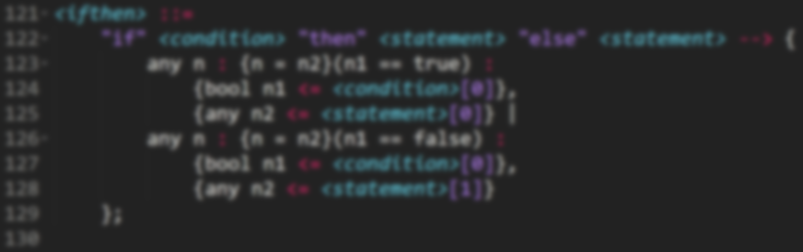
The Work So Far – Metaspec
Notes:
First and foremost, you can see the EBNF-style notation for describing syntax.
The terminal symbols are enclosed in quotes, while the non-terminal symbols are enclosed in angle-brackets.
The ENBF-variant used here retains all of the expressive power of ISO EBNF, and hence allows for flexible syntax definitions.

Slide 11

The Work So Far – Metaspec
Notes:
The semantics, on the other hand, are a direct textual translation of the big-step operational semantics form.
Reading a rule we are able to say that

Slide 12
The Work So Far – Metaspec
Notes:
The semantics evaluate to an n of type any

Slide 13
The Work So Far – Metaspec
Notes:
Where n is equal to n2 when n1 is true

Slide 14
The Work So Far – Metaspec
Notes:
Where n1 is the result of evaluating the condition and n2 is the result of evaluating the first statement

Slide 15
The Work So Far – Metaspec
Notes:
The semantics also provide for alternation, allowing specification if the restriction evaluates differently.

Slide 16
The Work So Far – Metaspec
Notes:
This demonstrates just a few of the comprehensive mechanisms for specifying the DSL semantics, and showcases how the types are enforced at the semantic level.

Slide 17
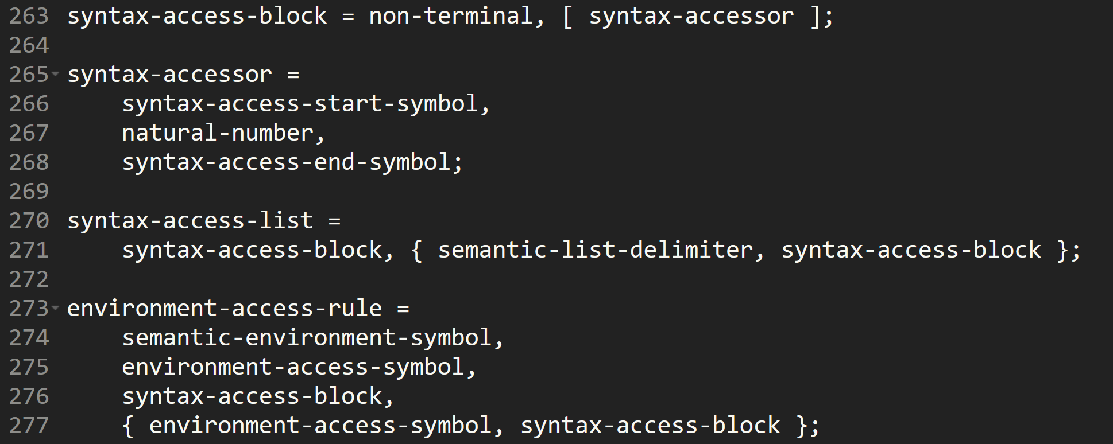
The Work So Far – Metaspec
Grammar Complete
Left-Recursive, but lookahead
Metaspec semantics not yet entirely complete
Notes:
The metaspec grammar is now complete, and the resultant language has many features that are important for the project, including:
A reasonable but restricted set of allowable semantic operations
A semantics-enforced typing discipline to aid the DSL implementer AND
Extension syntax to provide useful features such as data traversal, function calls and environment access (for functions and stateful computation).
The grammar caused me some initial frustration as it is left-recursive, but I decided to work around this through use of an infinite-lookahead parser.
While it would have been possible to avoid left-recursion, it would have led to significant complications in the metasyntax which was considered undesirable.
While the metaspec semantics aren’t entirely specified, this work will take place as the metacompiler evolves.

Slide 18
The Work So Far – ABSOL
At a very rudimentary stage
Basic program structure
Partial lexer implementation
Input Metaspec File
Lex and Parse
Semantic Verification
Code Generation
Notes:
The metacompiler is currently at a very rudimentary stage, and will be the main focus of the next stage of the development effort.
The program architecture is complete AND
is currently capable of lexing a portion of the metaspec grammar.
The intended mode of operation for the metacompiler pipeline is as follows
An ‘Alex’-based lexer produces a token-stream that can then be parsed by a ‘Parsec’ parser into an AST for the metalanguage.
The input semantics are verified via induction on the structure of the semantics and the special-case proofs. If the language cannot be proved to be total, it is rejected at this stage.
The metacompiler will then generate Haskell code that implements a compiler for the DSL itself, based upon the semantics of the specification

Slide 19
The Work So Far – ABSOL
At a very rudimentary stage
Basic program structure
Partial lexer implementation
Input DSL File
Input Metaspec File
Lex and Parse
Semantic Verification
Code Generation
Parse and Lex DSL
DSL Code Generation
Notes:
This resultant code can then be compiled into the DSL compiler, which can produce executable code for a DSL program.

Slide 20
The Work So Far – ABSOL
At a very rudimentary stage
Basic program structure
Partial lexer implementation
Input DSL File
Parse and Lex DSL
DSL Code Generation
Notes:
- This compiler can now operate totally independently, producing DSL programs that can be used via a Foreign-Function interface.

Slide 21
Future Plans
Continue work on ABSOL
Iteratively develop the semantics of Metaspec
Notes:
While the project has been proceeding fairly smoothly up to this point, there is still much work to be done!
The metacompiler pipeline has a number of stages still to be finished.
The unfinished elements of the metalanguage, namely the semantics of some features, will be developed as-needed alongside the implementation of the metacompiler.
There is a lot of work to be done, but with a concerted effort it should be achievable within the remaining project timeframe.
(Clarify some of the goals of the project from the start)

Slide 22

Questions?
(Yes, the project is named after a Pokémon)
Notes:
Any questions?

