Slide 1

MomoGo Delivery System
Full-Stack Food Ordering System
Course Title: Software Engineering
Course Code: CSE412
Section: 04
Instructor: Dr. Mohammad Mahdi Hassan
Group Members:
Member 1 | Member 2 | Member 3 | Member 4 | Member 5
Md. Esrafil Rahman ID: 2020-2-60-106 | Asifa Akter Liya ID: 2022-3-60-186 | Benazir Meem ID: 2022-3-60-169 | Julfa Binte Shafiq ID: 2022-3-60-286 | Md. Ashraful Islam ID: 2021-1-60-009

Slide 2
Introduction
Project: Momogo Delivery
Full-stack food ordering system
Users: Customers & Admin/Staff
Simple ordering + efficient management
Faster service, fewer errors

Slide 3
Problem & Objectives
Problem:
Manual order process
No tracking visibility
Hard to manage orders
Objectives:
Smooth ordering experience
Secure login & role access
Admin dashboard for control
Better insights

Slide 4
Features
Customer:
Sign up/login
Browse menu
Cart & checkout
Order history
Admin:
Manage orders
Update status
Menu control
Analytics

Slide 5
System Design
Frontend: React + Vite
Backend: Node.js + Express
Database: MongoDB
Flow:
User → API → Server → DB → Response
Security:
JWT Authentication
Role-based access

Slide 6
Technologies
Frontend:
React, TypeScript, Tailwind
Backend:
Node.js, Express, Mongoose
Database:
MongoDB

Slide 7
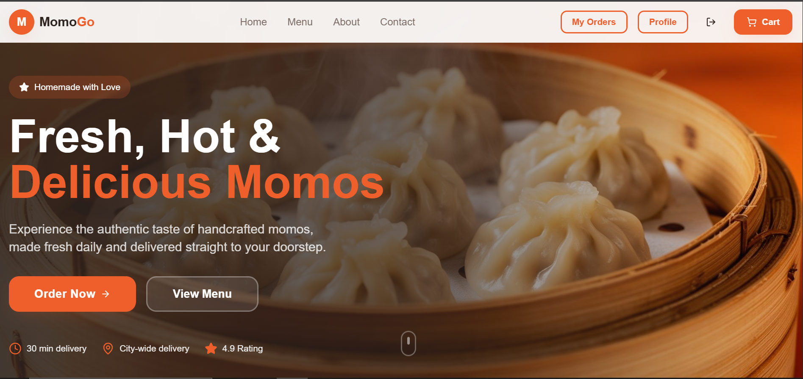
UI Screens
Home page:

Slide 8
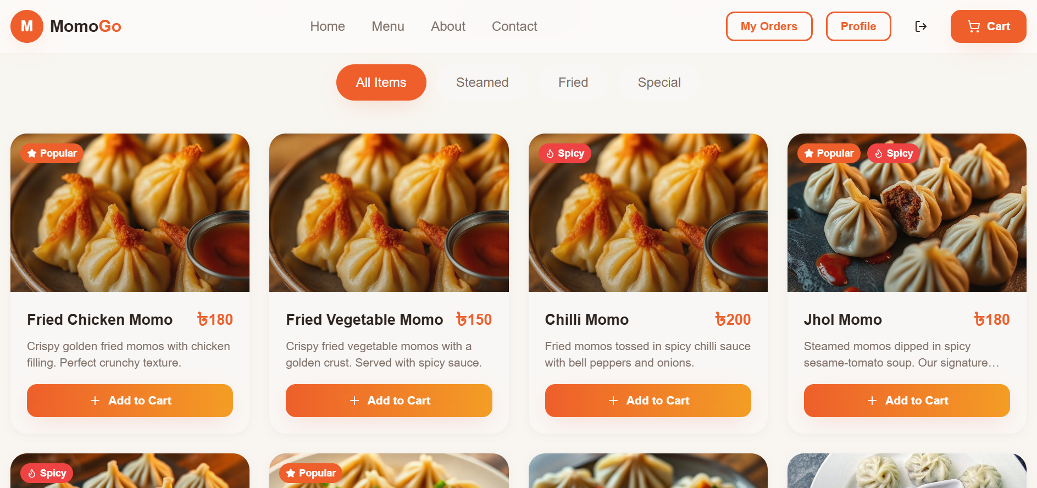
UI Screens
Menu page:

Slide 9
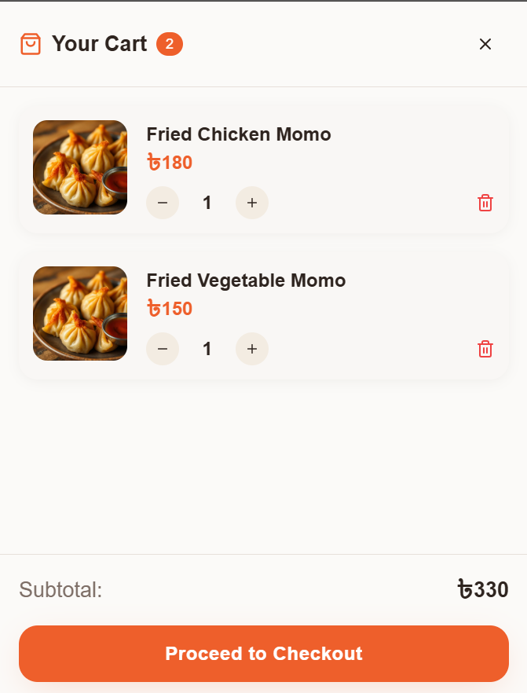
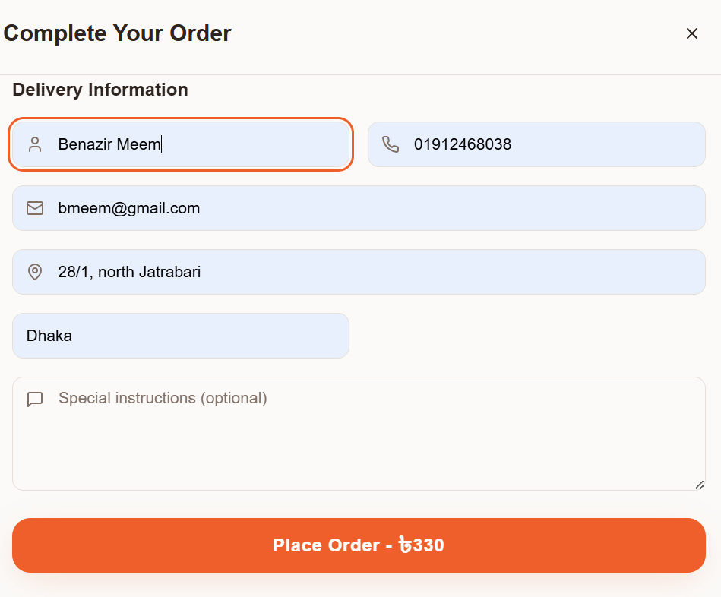
UI Screens
Cart & Checkout:

Slide 10
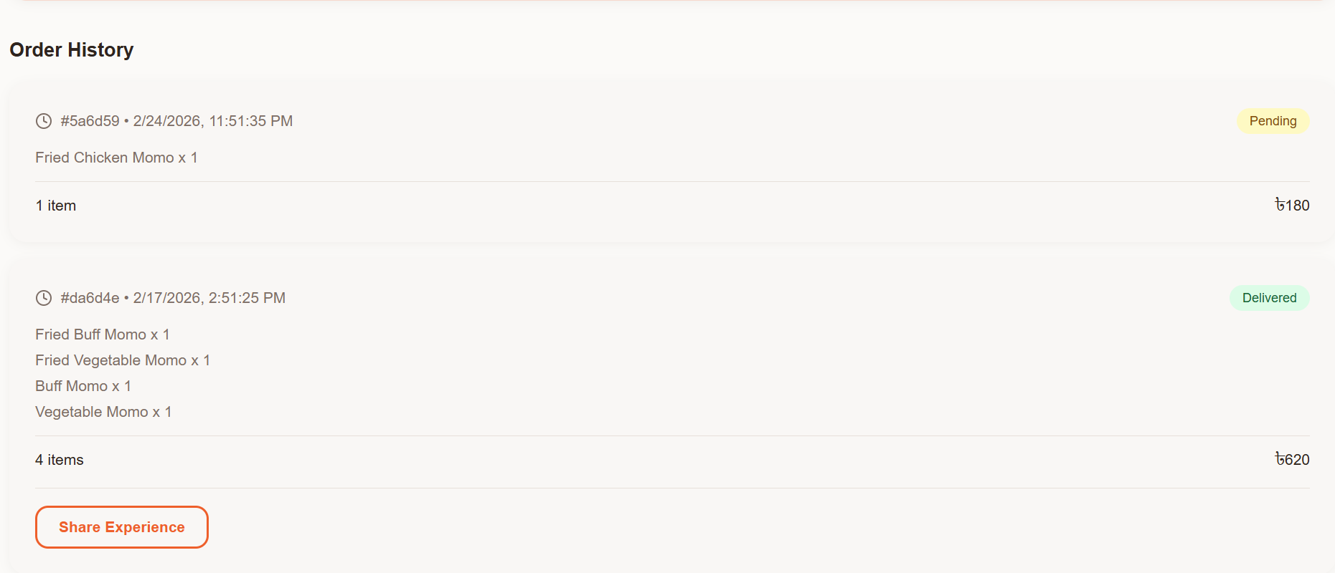
UI Screens
Orders page:

Slide 11
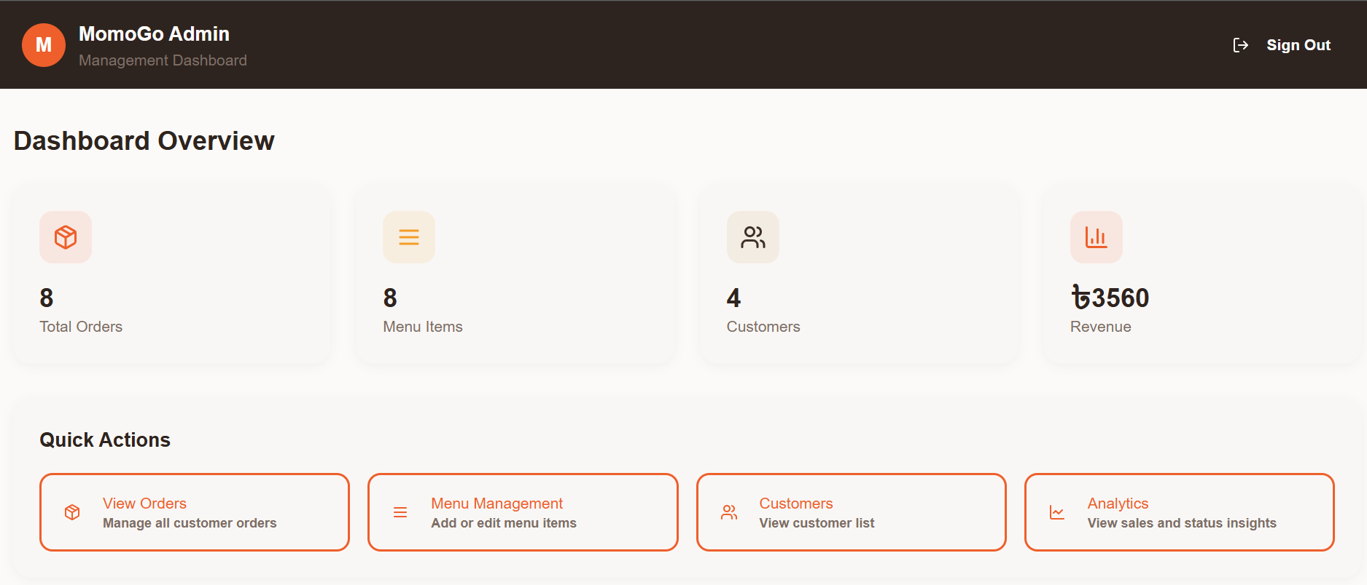
UI Screens
Admin Dashboard:

Slide 12
Limitations & Future Work
Limitations:
No payment
Basic notifications
No multi-branch
Future:
Payment integration
Real-time updates
Mobile app

Slide 13
Conclusion
Developed a full-stack food ordering platform
Simplified customer ordering experience
Enhanced admin control & order visibility
Built a scalable system for future upgrades

Slide 14
Thank You
For Your Time & Attention

