Slide 1
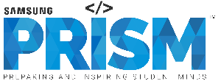
[Samsung PRISM] Mid Review Report
IoT Connectivity | Android & BLE support for IoTivity-Lite
Team
College Professor(s): Prof.M.Anand, Prof.Vijayarajan
Students:
Eknoor Oberoi (eknoor.oberoi2017@vitstudent.ac.in)
Amitayu Banerjee
Muskan Chanana
Raunak Jain
Department:
Date: 26th Feb 2019

Slide 2

IoT Connectivity | Android & BLE support for IoTivity-Lite
Problem Statement
To implement IoTivity-lite on Android.
To implement BLE connectivity support for IoTivity-lite.
Notes:
-

Slide 3
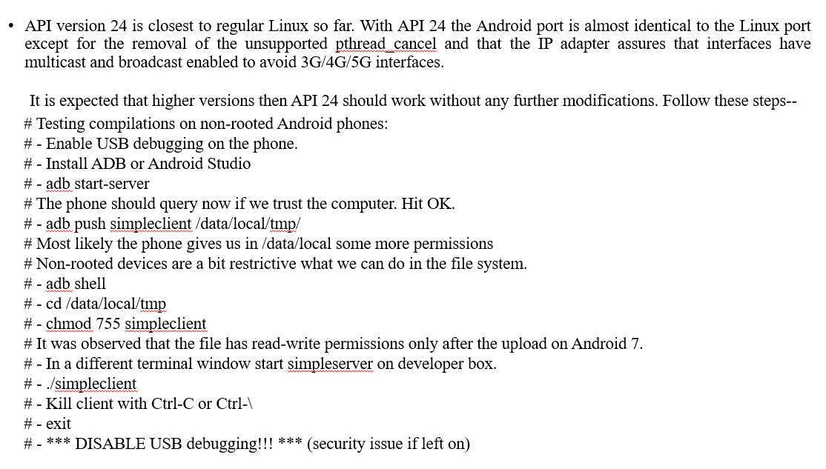
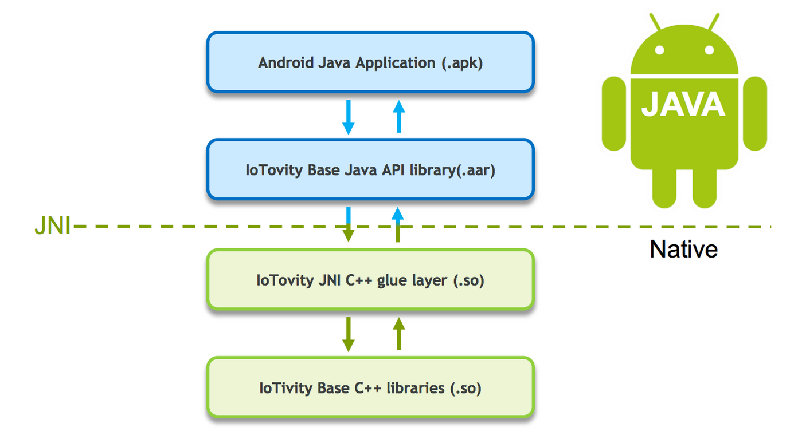
Proposed Approach / Solution
Concept Diagram :

Slide 4
Dataset(s) Analysis / Description
Resource Capture / Preparation / Generation :
The IoTivity lite git repo was accessed for aid in the project from the link mentioned below.
https://github.com/iotivity/iotivity-lite
Resource Understanding / Analysis :
The easiest way to discover resources is using IP. IP is fast and can easily be multicasted to many devices, or unicast to just one. To do multicast discovery over IP, just add IP to the connectivityTypeSet and don't specify a host. The discovered resources will be returned via the given OnResourceFoundListener's onResourceFound(OcResource) callback.
Discovery over BLE is the same as IP, however BLE is not able to multicast easily like IP. Rather, in order to do a muticast BLE discovery, we have to do an initial scan using the native Android BLE scanner in order to get all available OIC enabled hosts. Next, we must do unicast discovery for each host device discovered in the initial BLE scan one-by-one. In the Mynewt Sensors app, there is an AsyncTask which handles this process (described below). However, unicast discovery of a BLE device is pretty much the same as using IP.
Resource Pre-Processing / Related Challenges (if any) :
Lack of proper documentation related to the guidelines for setup.

Slide 5
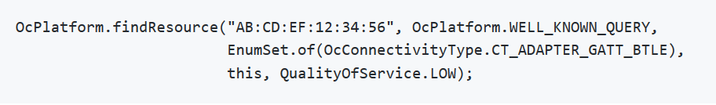
Experimental Results / Simulations / Observations
Major Observations / Conclusions & Challenges :
To discover OIC enabled devices, hit the discovery button floating in the bottom right of the Main screen. This will discover devices using the options given to the DiscoveryTask. By default, we will do a general discovery of all OIC enabled devices over BLE and IP transport unless modified in the source. Any resource containing a valid Mynewt sensor framework resource type will be added to the Sensors list while any other device will be added to the Smart Devices list.
To Observe a sensor, click the sensor in the list. This will bring up the Sensor activity which will immediately start observing the sensor. We can stop/start observing the sensor by hitting the start/stop observe button in the top right of the actionbar. When not observing the sensor, you may want to turn on an off certain sensor values from the chart using the switches on the each sensor value in the list.

Slide 6
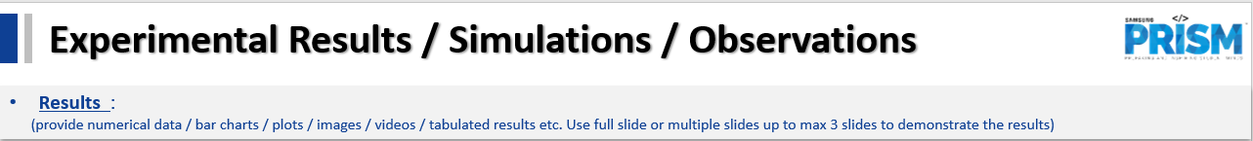
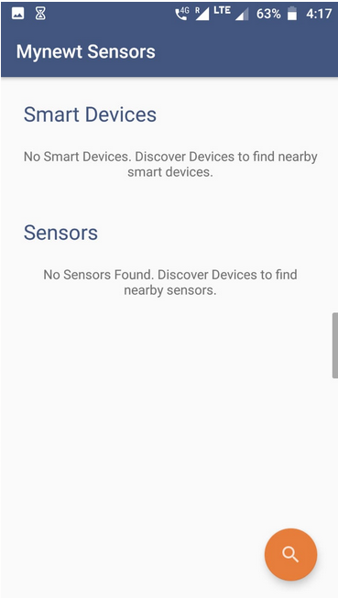
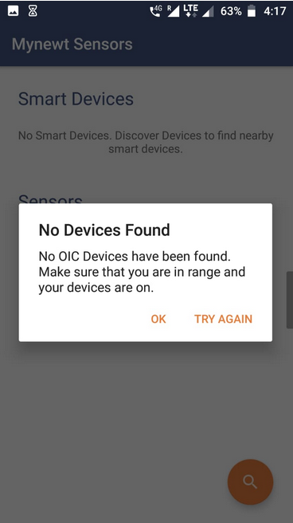
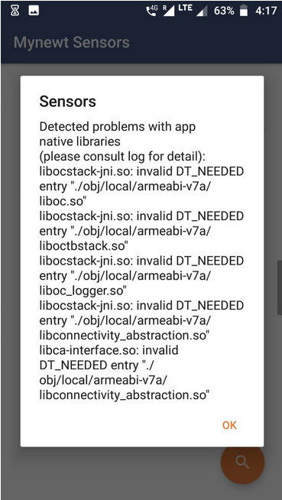

Slide 7
Further Plan to Complete Project
Final Probable Deliverables :
Resolving error due to processor incompatibility raised during sensor discovery using multicast BLE.
Fully working sensor application for multicast discovery of OIC sensors using BLE for android.
Risk of incompatibility of the app for higher level APIs.
Improving front-end features for discovery and better management of resources.
IP Target / Plan :
Discussion for future possibility for paper publication based on the final deliverable and future scope of the prototype.

Slide 8
Further Plan to Complete Project
Completion Plan:
(High level plan to complete the project in next 8 weeks after review, in format below)
Week 1 to 2
Create independent apps for BLE and Sensor discovery to identify the error.
Week 2 to 4
Work on resolving the error and seek help from mentors if needed.
Week 5 to 6
Once error is resolved, combine the app architectures for BLE and independent sensor discovery.
Week 7 to 8
Work on introducing multicast feature to the app.
Challenges Anticipated:
Probability of the app not working for higher level APIs

Slide 9
Thank you

