Slide 1



E-commerce Application: A Microservices Approach
Welcome to a deep dive into our newly designed e-commerce application, built using a robust microservices architecture. This presentation will explore the key components and benefits of this approach.
by Rakesh Kumar Dey

Slide 2

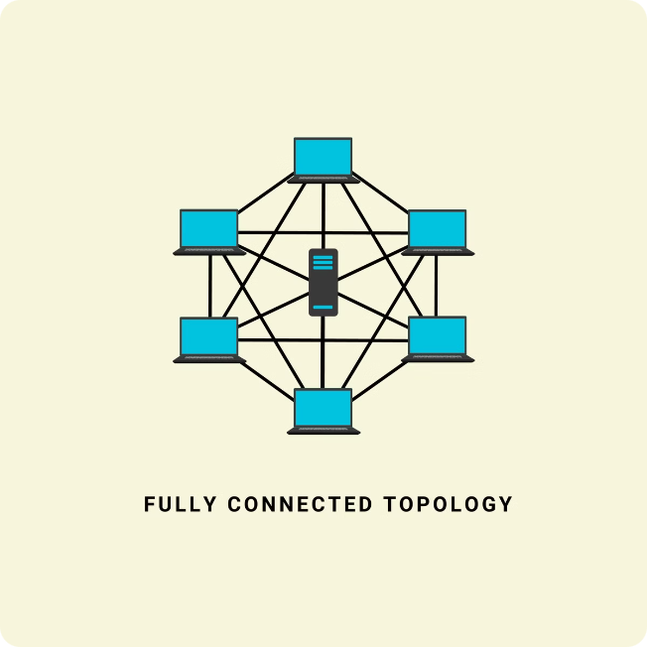
Microservices Architecture
Our e-commerce application leverages a microservices architecture, breaking down the application into smaller, independent services. Each service is responsible for a specific business function.
Improved Scalability
Enhanced Flexibility
Each service can be scaled independently based on demand, ensuring optimal performance.
Individual services can be updated or replaced without affecting the entire application, enabling agile development.
Increased Resilience
Failure in one service does not impact the entire system, leading to greater overall stability.

Slide 3
Service Registry
The Service Registry acts as a central directory for all microservices within the application. It stores information about each service, including its location and availability.
Service Discovery
Dynamic Updates
Load Balancing
Microservices can discover each other through the registry, facilitating communication and collaboration.
Service registry updates in real-time when services are added or removed, ensuring that microservices always have access to the latest information.
The service registry can also help with load balancing by routing requests to the least busy instance of a service, optimizing performance.

Slide 4

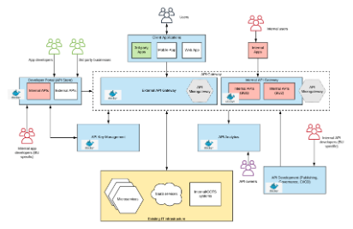



API Gateway
The API Gateway acts as the entry point for all requests to the e-commerce application. It provides a unified interface for external clients and protects internal services.
Request Routing
Security
Rate Limiting
The API Gateway routes requests to the appropriate backend service based on the request path and parameters.
It handles authentication and authorization, protecting services from unauthorized access.
The API Gateway can enforce rate limits to prevent abuse and ensure system stability.

Slide 5



Config Server
The Config Server is responsible for managing the configuration of all microservices within the application. It centralizes configuration data and makes it readily accessible.
Centralized Management
Dynamic Updates
Security
The Config Server centralizes all configuration data, simplifying management and reducing inconsistencies.
Configuration updates can be made dynamically without restarting services, providing flexibility and agility.
The Config Server encrypts sensitive configuration data to protect it from unauthorized access.

Slide 6


Cart, Order, Authorization, and Product Services
These services handle core business logic related to the customer's journey, from adding items to the cart to completing an order.
Cart Service
Manages the customer's shopping cart, allowing items to be added, removed, and updated.
Order Service
Processes orders, including payment handling, order confirmation, and order fulfillment.
Authorization Service
Handles user authentication and authorization, ensuring access to appropriate resources.
Product Service
Provides information about products, including pricing, availability, and descriptions.

Slide 7

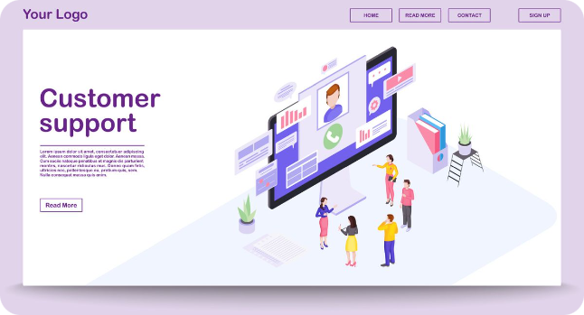
Customer Service
The Customer Service handles interactions with customers, providing support, managing accounts, and handling inquiries.
1
Account Management
2
Support
The service provides customer support through various channels, such as email, chat, and phone.
Customers can manage their accounts, including personal information, order history, and payment methods.
3
Feedback and Reviews
Customers can provide feedback and reviews on products, contributing to a more transparent and engaging shopping experience.

Slide 8


Conclusion and Key Takeaways
By adopting a microservices architecture, our e-commerce application enjoys improved scalability, flexibility, and resilience, enabling a more agile and efficient development process.
1
Modular Design
Breaking down the application into independent services promotes modularity and simplifies development.
2
Independent Deployment
Microservices can be deployed and updated independently, enabling faster releases and continuous improvements.
3
Technology Diversity
Each microservice can use the most appropriate technology for its specific purpose, fostering innovation and efficiency.

