Slide 1

CSE 638 · GRADUATE SYSTEMS · FINAL PROJECT
Profiling Kernel Scheduling Delays
Under Network-Intensive Workloads
An eBPF-Based Analysis & Mitigation Framework
TEAM 24
Rohit Kumar
MT25037
Arpit Kumar
MT25017
Abhinay Prakash
MT25010
Nindra Dhanush
MT25074
Adarsh Shukla
PhD25001
16
experiments
48
total runs
IIIT-Delhi · April 2026

Slide 2

THE PROBLEM
p99 Latency is Degrading Network Services
The Scenario
Why It Matters
High-throughput server receives packets at line rate
Kernel softirq (NET_RX) processes them on CPUs
Application threads wait in runqueue for the CPU
Wakeup → execution delay grows from μs → ms
Tail latency (p99, p99.9) spikes invisibly
27×
increase in p99 delay
under heavy CPU load
4 ms
vs 150 μs baseline
wakeup-to-execute stall
−45%
throughput collapse
when CPU is saturated
Critical for low-latency trading, microservices, real-time web services.
CSE 638 · Profiling Kernel Scheduling Delays · Team 24 · IIIT-Delhi
2 / 20

Slide 3


RESEARCH QUESTION
Can network-stack mitigations (RPS, pinning, CFS tuning, busy polling) recover tail latency when CPUs are saturated?
Where is the delay?
Does placement matter?
Do mitigations compose?
Is it softirq preemption,
runqueue depth, or scheduler
resolution?
Can RPS spread softirq
away from application
threads?
Does stacking techniques
add up, or cause new
contention?
CSE 638 · Profiling Kernel Scheduling Delays · Team 24 · IIIT-Delhi
3 / 20

Slide 4






BACKGROUND
The Kernel Concepts We Need
Softirq
NAPI
Runqueue Delay
Deferred interrupt handler. NET_RX_SOFTIRQ processes incoming packets off the NIC ring buffer — runs in interrupt context, can preempt app threads.
Polling model under load. netdev_budget caps packets per cycle. Reducing it forces deferral to ksoftirqd kernel threads (schedulable by CFS).
Time between sched_wakeup (runnable) and sched_switch (dispatched). Our primary metric — measured in μs via eBPF tracepoints.
RPS
CFS
SO_BUSY_POLL
Receive Packet Steering. Software distribution of softirq CPU placement via rps_cpus sysfs. Correct mechanism for veth (no hw IRQs).
Completely Fair Scheduler. Default Linux scheduler using vruntime. Tunables: sched_min_granularity, sched_wakeup_granularity.
Per-socket option. App thread polls the NIC directly, bypassing the softirq wakeup path — trades CPU cycles for lower latency.
CSE 638 · Profiling Kernel Scheduling Delays · Team 24 · IIIT-Delhi
4 / 20

Slide 5


DETECTION GAP
Why Classical Tools Miss This
Conventional tools
eBPF solves this
top / htop — only coarse % CPU; masks μs-scale stalls
perf / sar — aggregates over long windows
App-level metrics show tail spikes but can't locate cause
No visibility into sched_wakeup → sched_switch gap
Sampling profilers miss sub-ms scheduling events
Safe, in-kernel programs attached to tracepoints
Nanosecond-precision timestamps on scheduling events
In-kernel histogram aggregation → sub-5% overhead
Zero source-code changes to kernel or application
Correlates scheduler + softirq + network events
CSE 638 · Profiling Kernel Scheduling Delays · Team 24 · IIIT-Delhi
5 / 20

Slide 6




APPROACH
Our Four Objectives
01
02
03
04
Instrument
Analyze
Evaluate
Reproduce
Build 5 eBPF scripts (bpftrace) to measure runqueue delay, softirq duration, packet drops, CPU migrations — under 5% overhead.
Design a 16-experiment matrix varying CPU contention, network load, RPS, CPU pinning, CFS tuning, NAPI, protocol, busy-poll.
Test 5 mitigations: RPS steering, app CPU pinning, CFS low-latency, forced ksoftirqd, SO_BUSY_POLL — under heavy CPU contention.
Deliver a full package: scripts, configs, raw data, analysis notebooks. Re-runnable on any Linux 5.15+ with ≥ 4 cores.
CSE 638 · Profiling Kernel Scheduling Delays · Team 24 · IIIT-Delhi
6 / 20

Slide 7


ARCHITECTURE
Single-Machine Testbed: Namespaces + veth
HOST MACHINE · Ubuntu 22.04.5 LTS · Kernel 6.8.0 · 20 cores · 16 GB RAM
srv namespace
cli namespace
10.0.0.1
10.0.0.2
memcached
veth pair · 88 Gbps
memcslap (latency)
iperf3 -s
packets → softirq (NET_RX) → runqueue
iperf3 -c
busy-poll echo (E15/E16)
Primary latency target
Load generator
stress-ng · system-wide CPU contention · moderate (2 cores) or heavy (N−2 cores)
Why veth? Exercises the full kernel network path (socket → TCP/IP → qdisc → virtual NIC → peer ns) without NIC hardware variability — full reproducibility. Softirq via netif_rx/NAPI, not hw IRQ.
CSE 638 · Profiling Kernel Scheduling Delays · Team 24 · IIIT-Delhi
7 / 20

Slide 8



INSTRUMENTATION
Five eBPF Probes Running in Parallel
sched_delay.bt
PRIMARY METRIC
Attaches to sched_wakeup + sched_switch. Computes runqueue delay = ts(switch) − ts(wakeup). In-kernel histogram + 1-in-1000 sampled CSV.
softirq_net.bt
SOFTIRQ CPU%
Tracks NET_RX (vec=3) / NET_TX (vec=2) durations via softirq_entry/exit. Computes per-CPU softirq CPU%. Guards against orphaned events.
net_drops.bt
PACKET DROPS
Monitors kfree_skb drop locations, tcp_retransmit_skb, and SYN receives — correlates drops with CPU contention.
cpu_migrations.bt
TASK MOBILITY
Tracks sched_migrate_task events. Records per-process migration counts + orig_cpu → dest_cpu matrices.
proc_pollers.sh
/proc METRICS
1-sec polling of /proc/stat, /proc/net/softnet_stat, /proc/net/snmp, /proc/net/sockstat, /proc/interrupts.
CSE 638 · Profiling Kernel Scheduling Delays · Team 24 · IIIT-Delhi
8 / 20

Slide 9
EXPERIMENT MATRIX
16 Experiments × 3 Runs = 48 Total Runs
PHASE 1
PHASE 2
PHASE 3
PHASE 4
Baselines
Softirq Placement
Advanced Tuning
Mitigations
E1 – E4
E5 – E8
E9 – E13
E14 – E16
None/Heavy CPU × Low/High net. E1 = reference. E4 = worst case.
RPS pinned, RPS spread, app CPU pinning, combined — isolate softirq from app.
CFS low-latency, forced ksoftirqd, UDP vs TCP, moderate stress threshold.
Combined stack, RPS + busy_poll, busy_poll only — test compositional effects.
Exp | CPU Stress | Net Load | RPS | App Pin | CFS | Protocol | Purpose
E1 | None | Low | Default | — | Default | TCP | Baseline
E4 | Heavy | High | Default | — | Default | TCP | Worst case
E6 | Heavy | High | All | — | Default | TCP | RPS spread
E10 | Heavy | High | Default | — | Default | TCP | ksoftirqd
E12 | Heavy | High | Default | — | Default | UDP | UDP + stress
E13 | Moderate | High | Default | — | Default | TCP | Threshold
E14 | Heavy | High | All | 2,3 | Lowlat | TCP | Combined
E16 | Heavy | High | Default | — | Default | TCP | Busy poll
(Showing 8 representative rows — full 16-experiment matrix defined in orchestrator script)
CSE 638 · Profiling Kernel Scheduling Delays · Team 24 · IIIT-Delhi
9 / 20

Slide 10

EACH RUN FOLLOWS THIS STRICT PROTOCOL
Reproducible, automated, 60-second measurement windows
Reset
state
Apply
config
Start server
+ probes
Start
stressors
Stabilize
Warmup
MEASURE
Archive
+ reset
—
—
—
—
2 s
10 s
60 s
10 s
KEY PROPERTIES
3
<5%
21
runs per experiment
eBPF overhead
files per run
for statistical consistency
in-kernel histogram aggregation
complete artifact archive
CSE 638 · Profiling Kernel Scheduling Delays · Team 24 · IIIT-Delhi
10 / 20

Slide 11
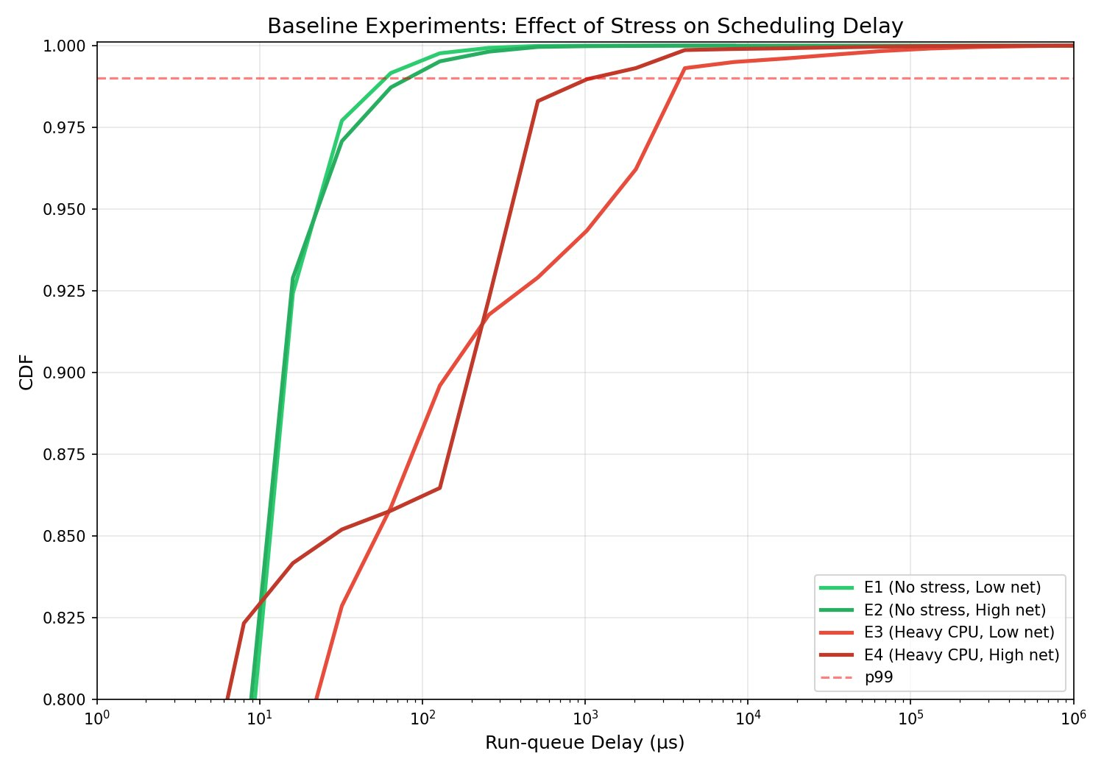
OBSERVATION 1
CPU Contention — Not Network Load — Dominates
KEY FINDING
27×
p99 increase under heavy CPU stress
E1
no stress, low net
149 μs
E2
no stress, high net
64 μs
E3
heavy stress, low
4,096 μs
E4
heavy stress, high
4,096 μs
Takeaway: high network load on an idle system has ≈ 0 scheduling impact. The pain only appears when CPUs are contested.
CSE 638 · Profiling Kernel Scheduling Delays · Team 24 · IIIT-Delhi
11 / 20

Slide 12
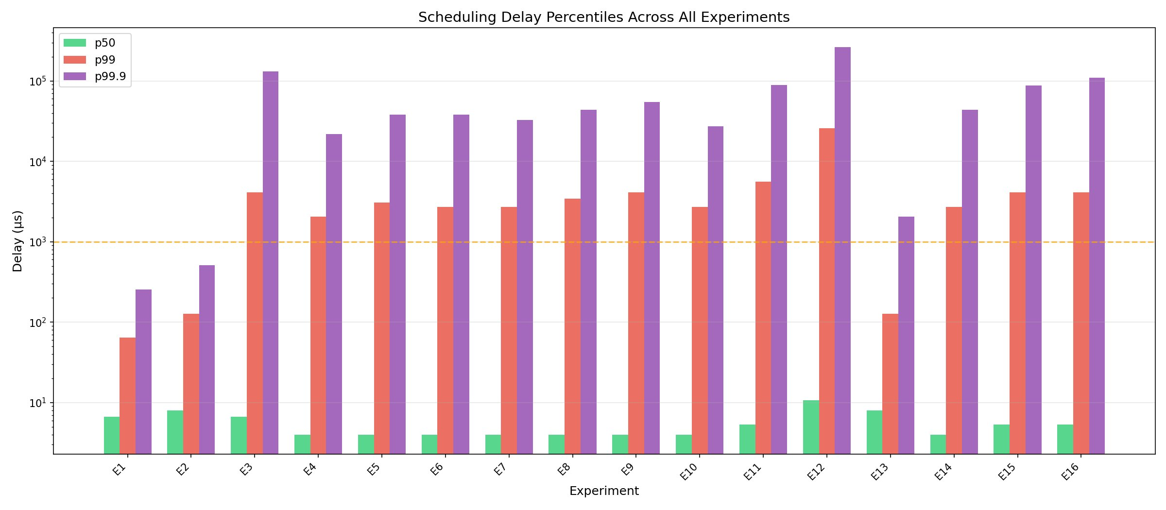
OBSERVATION 2
Scheduling Delay Comparison for all Experiment
p50 stays ≈ 4–8 μs
p99 crosses 1 ms under stress
p99.9 reaches tens of ms
The median is flat across every experiment — users never see the problem at the 50th percentile.
Every heavy-stress experiment (E3–E10, E14–E16) sits above the 1 ms line, reaching 2–4 ms.
Tail events reach 20–260 ms under heavy stress — thousands of times worse than the median.
CSE 638 · Profiling Kernel Scheduling Delays · Team 24 · IIIT-Delhi
12 / 20

Slide 13
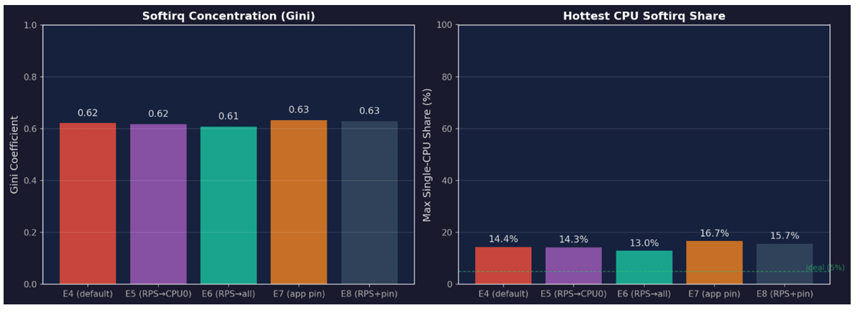
OBSERVATION 3
On veth interfaces, softirq follows the socket — Not RPS
RPS EFFECTS
0.62 → 0.61
Gini coefficient
RPS spread (E6) reduces concentration — small but measurable.
14.4% → 13.0%
Max single-CPU share
Hottest CPU softirq load drops under RPS spread.
61.6%
Still on app CPUs (E8)
Even with RPS pinned to CPU 0, CPUs 2 & 3 still handle most softirq — kernel follows socket affinity on veth.
Hypothesis ≥5× delay from colocation: partially falsified.
CSE 638 · Profiling Kernel Scheduling Delays · Team 24 · IIIT-Delhi
13 / 20

Slide 14
OBSERVATION 4
The CPU Contention Cliff is Non-Linear
THE CLIFF
E1
149 μs
no stress
baseline
E13
683 μs
2 cores (mod)
14.7 Gbps
E4
4,096 μs
N−2 (heavy)
8.2 Gbps
Moderate stress is absorbed. Heavy stress triggers a sharp, non-linear collapse.
CSE 638 · Profiling Kernel Scheduling Delays · Team 24 · IIIT-Delhi
14 / 20

Slide 15
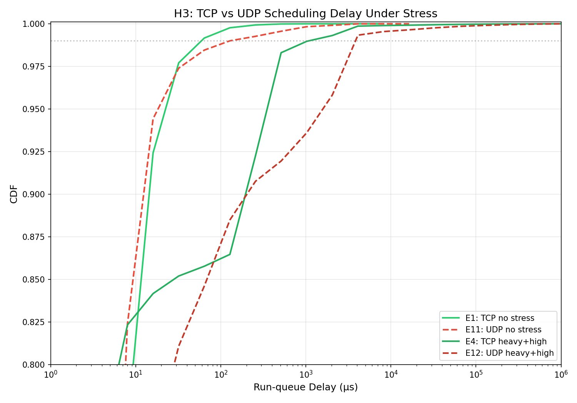
OBSERVATION 5
TCP and UDP Converge Under CPU Stress
COUNTER-INTUITIVE
100×
more softirq events for UDP vs TCP (per byte)
63.8 M
UDP softirq events (0.34 Gbps)
636 K
TCP softirq events (14.88 Gbps)
Both TCP and UDP cross the 1 ms line under heavy stress — CPU starvation dominates over protocol cost.
CSE 638 · Profiling Kernel Scheduling Delays · Team 24 · IIIT-Delhi
15 / 20

Slide 16
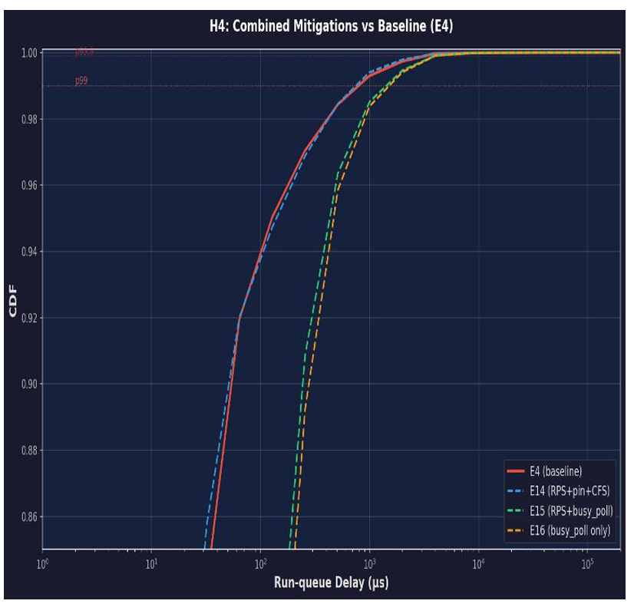
OBSERVATION 6
No Single Mitigation Fixes p99 Under Saturation
RPS spread
App pinning
CFS lowlat
ksoftirqd
No p99 fix
No p99 fix
No p99 fix
No p99 fix
Recovers 21% throughput, but p99 stays at 4,096 μs
Reduces migrations, but softirq still co-located
More context switches, unchanged tail latency
veth has no sustained NAPI poll pressure
CSE 638 · Profiling Kernel Scheduling Delays · Team 24 · IIIT-Delhi
16 / 20

Slide 17
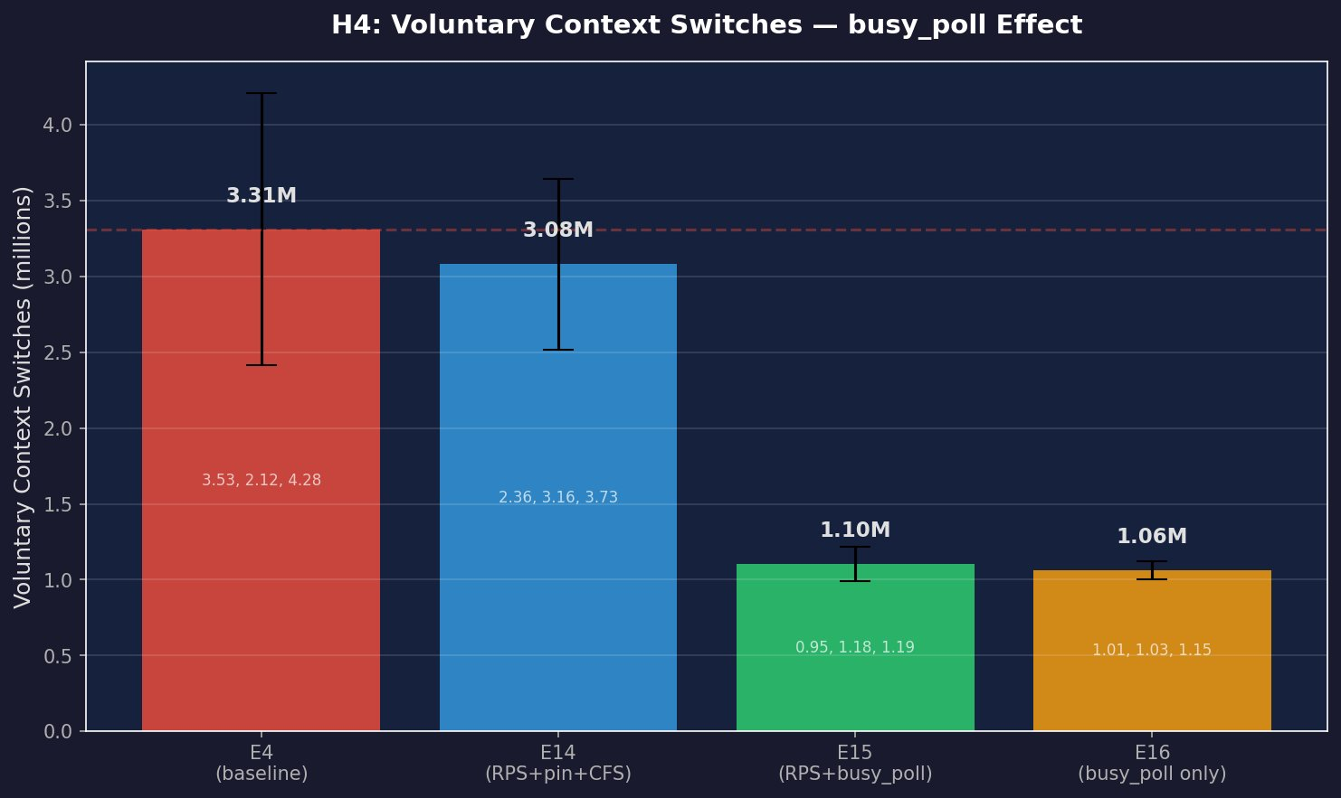
OBSERVATION 7
SO_BUSY_POLL — The One Mitigation With a Distinct Signal
WINS
−68%
voluntary switches
1.06 M vs 3.31 M (E16 vs E4)
−65%
CPU migrations
2.2 M vs 6.2 M
7.4%
softirq CPU
lowest of all 16
LIMITATIONS
p99 unchanged (still 4,096 μs)
Voluntary switches drop, but p50 jitter remains
RPS + busy_poll combo is worse: −35% throughput
CSE 638 · Profiling Kernel Scheduling Delays · Team 24 · IIIT-Delhi
17 / 20

Slide 18
VERDICT
Hypothesis Results
H1
Softirq colocation increases p99 delay
PARTIAL
RPS spread reduces Gini 0.62 → 0.61, but softirq follows socket affinity on veth — CPU contention dominates delay.
H2
ksoftirqd threading reduces tail latency
FALSIFIED
E10 p99 identical to E4. NAPI budget reduction has no effect on veth (no sustained NAPI pressure).
H3
UDP adds less per-packet scheduling delay
FALSIFIED
E12 UDP p99 = E4 TCP p99 under heavy stress. CPU starvation dominates protocol overhead.
H4
All fixes combined reduce p99 by ≥20%
FALSIFIED
stacking too many optimizations creates problems as they start competing with each other.
CSE 638 · Profiling Kernel Scheduling Delays · Team 24 · IIIT-Delhi
18 / 20

Slide 19
PRIMARY RECOMMENDATION
Foundation of low latency : CPU provisioning and thread isolation.
Network-stack tuning boost throughput — but saturated CPU will ruin p99 latency.
Provision, then tune
Isolation second
Tuning is gravy
Keep some CPUs free. Overloading them causes performance to degrade suddenly, not gradually.
Lock latency critical threads to the specific CPUs and keep the interrupt processed on separate cores.
Optimization helps in throughput and efficiency — not tail latency under saturation.
CSE 638 · Profiling Kernel Scheduling Delays · Team 24 · IIIT-Delhi
19 / 20

Slide 20

THANK YOU
Questions?
What we built
What we Understand
eBPF profiling toolkit (5 scripts, <5% overhead)
16-experiment matrix, 48 total runs
Full reproducibility package
CPU contention — not network load — owns tail latency
Moderate → heavy is a non-linear cliff
No single stack mitigation fixes saturation
busy_poll cuts switches, trades median for tail
Team 24 · IIIT-Delhi · CSE 638 Graduate Systems · April 2026

