Slide 1
Forecasting the Canadian Economic Landscape Using AutoML
Wenlong Zhao, Rogelio Magos, Lucas Krenn

Slide 2
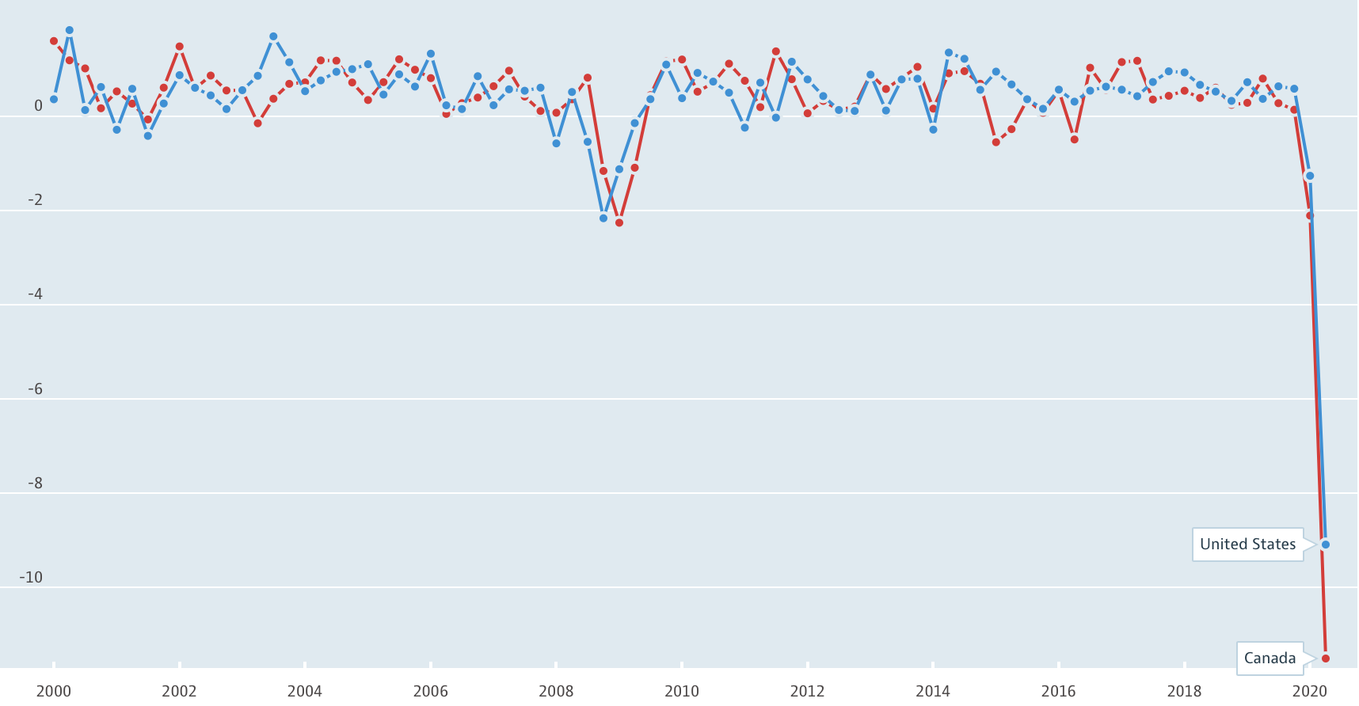
Motivations
Canadian and American economic activity are strongly correlated
Use AutoML to forecast Canadian economic outlook with Canadian and US economic variables
(Optional) The Canadian economy is very dependent on USA’s economy but not the other way around. Check if AutoML can discover this relationship by itself without supervision.
Figure 1: Canada and USA GDP %QoQ, source: Organization for Economic Co-operation and Development
Notes:
Canada historical, USA historical as well as point-in-time

Slide 3
Approach
Approach
Learning
Preparing
Executing
Comparing
Optional
Get to know Autokeras and [insert_name] framework and study the basic syntax
Data collection and cleaning
Data from Bank of Canada, Statistics Canada, FRED Economic Database, etc.
Use the two autoML frameworks to train the datasets
Test and make forecasts
Compare and contrast the two methods
Which worked better (if any)? Why?
Use a VAR model as a benchmark to check if the predictions are aligned with traditional time series model.

Slide 4
Timeline
Date | Progress
2020-09-28 | This presentation
2020-10-05 | Learn code, collect data
2020-10-12 | Progress check-in
2020-10-19 | Write up, optional
2020-10-26 | Final presentation

