Slide 1
Data Science Forecasting Canadian GDP
Rogelio Magos, Will Zhao, Lucas Krenn

Slide 2
Agenda
Azure - AutoML
When to use AutoML: Classify, Regression, & Forecast
How AutoML Works
Local vs. Remote
Python SDK vs. Web
Live Demonstration
Short Summary
H2O
Overview
Model Leaderboard
Model Metrics and Results
Short Summary
Comparison
Prediction performance metrics
Variable importance plot

Slide 3
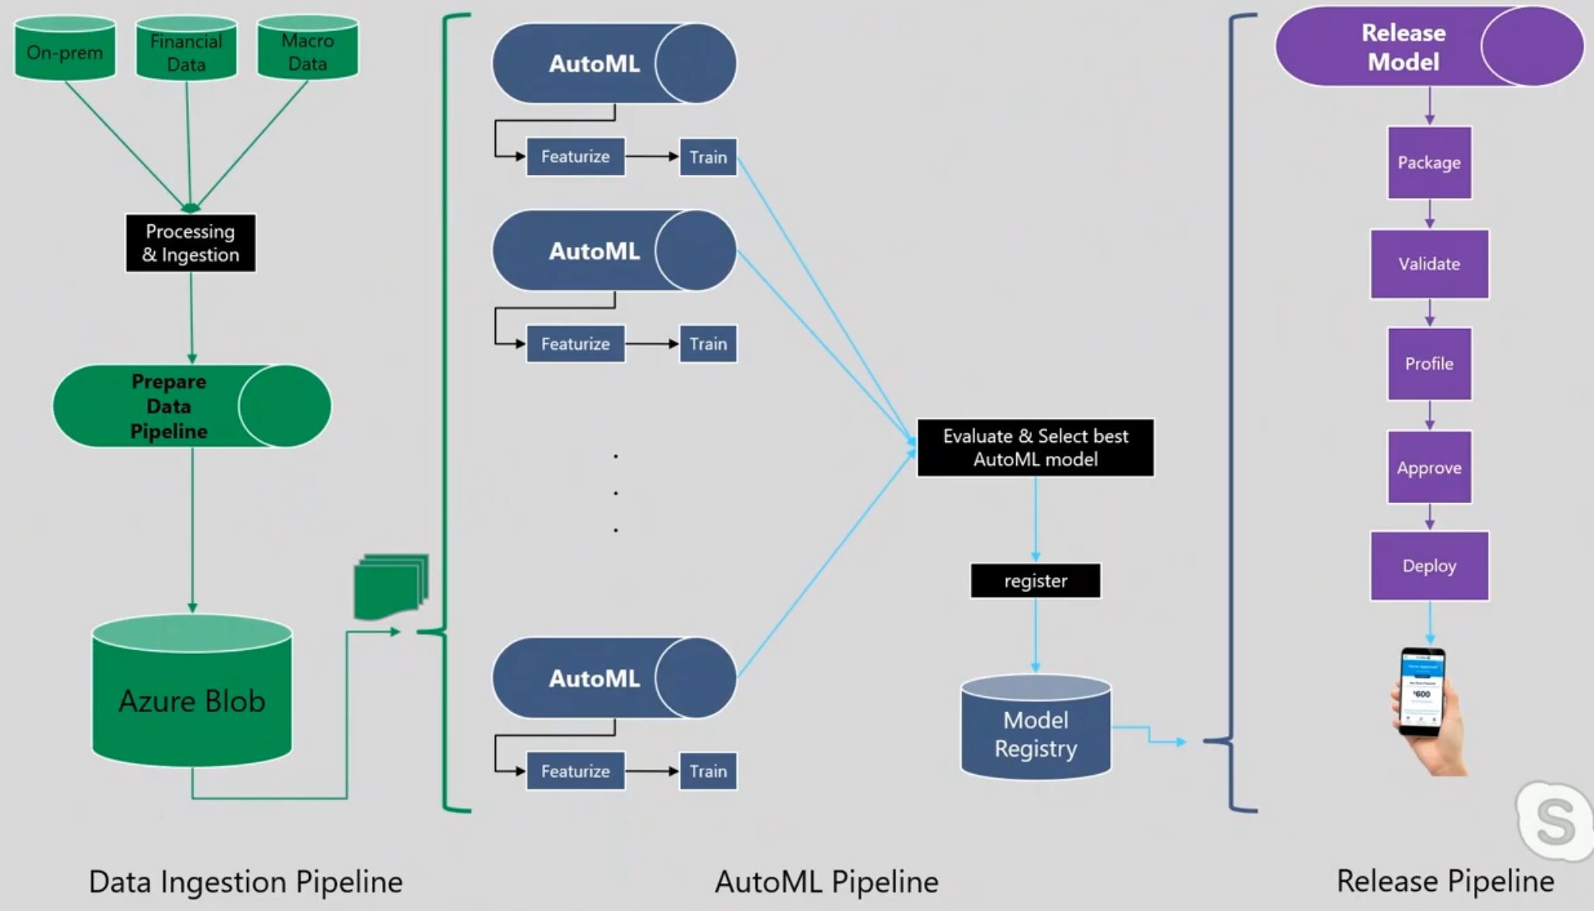
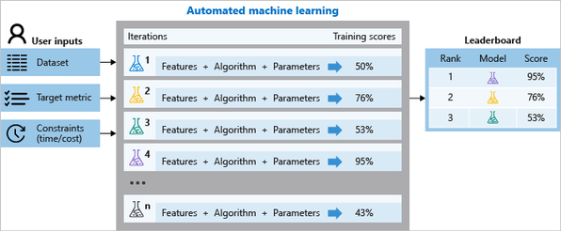
How AutoML Works

Slide 4
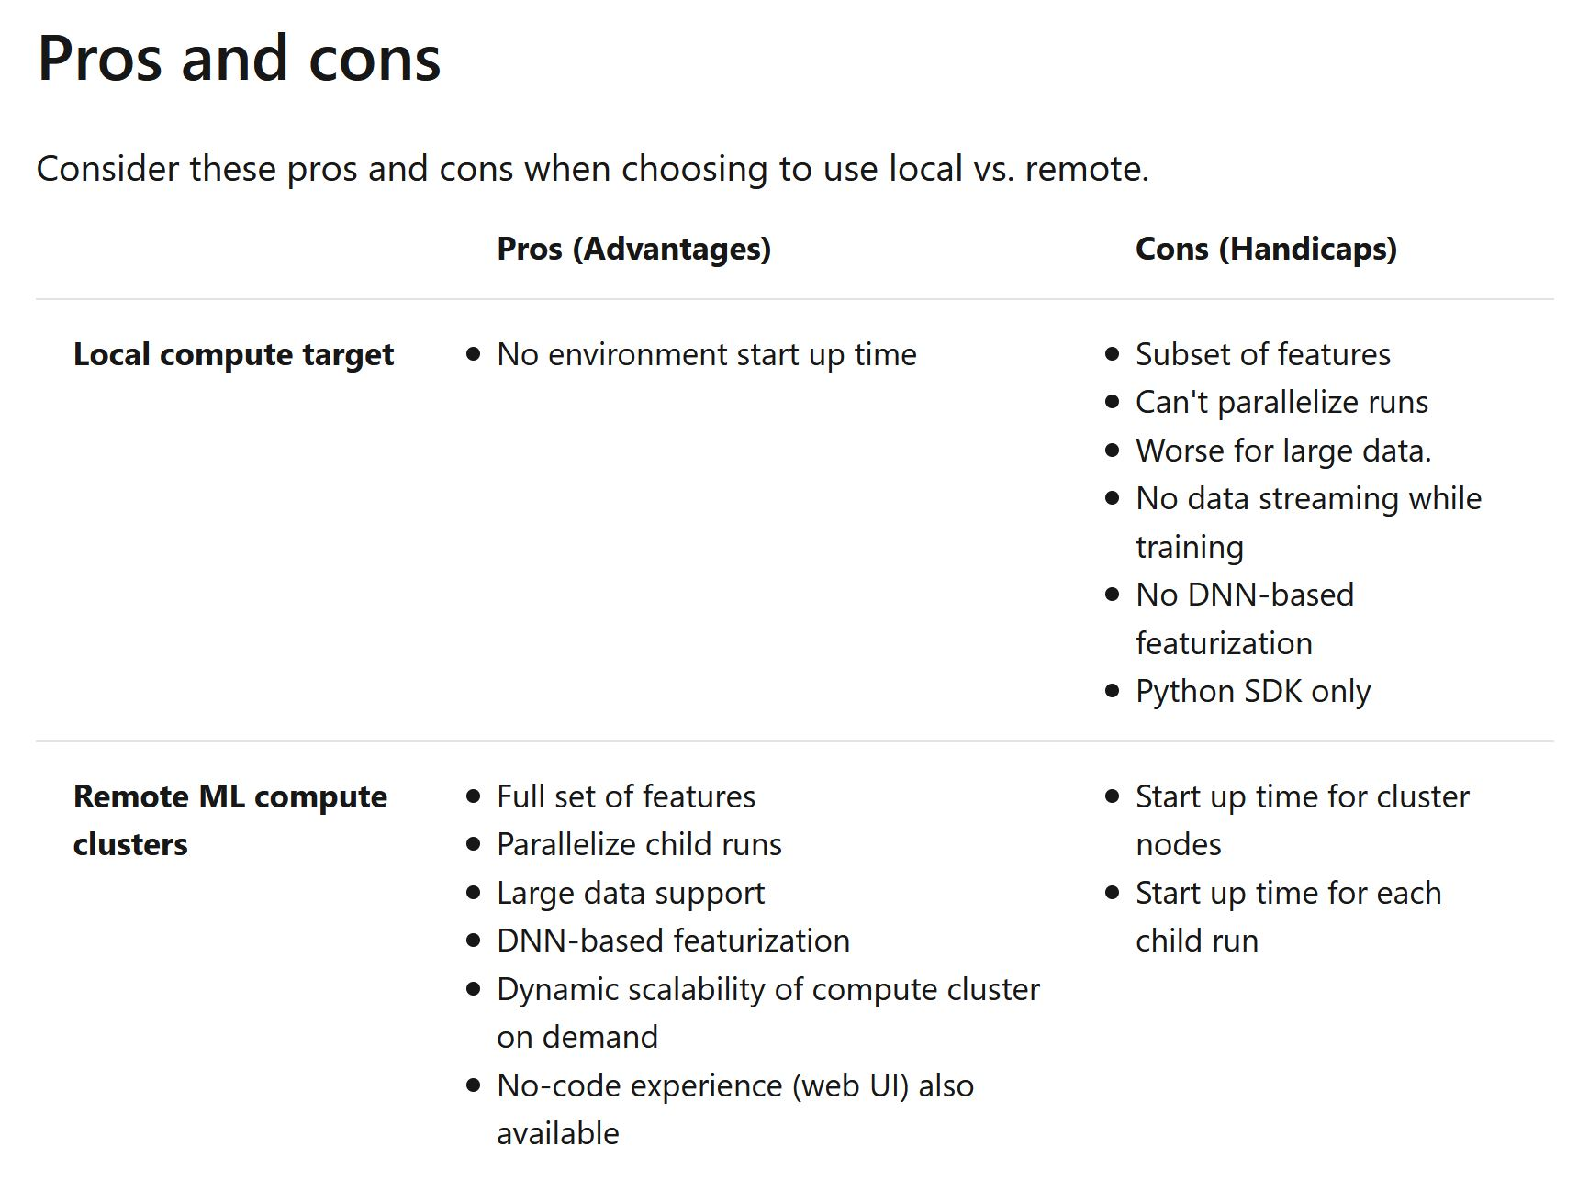
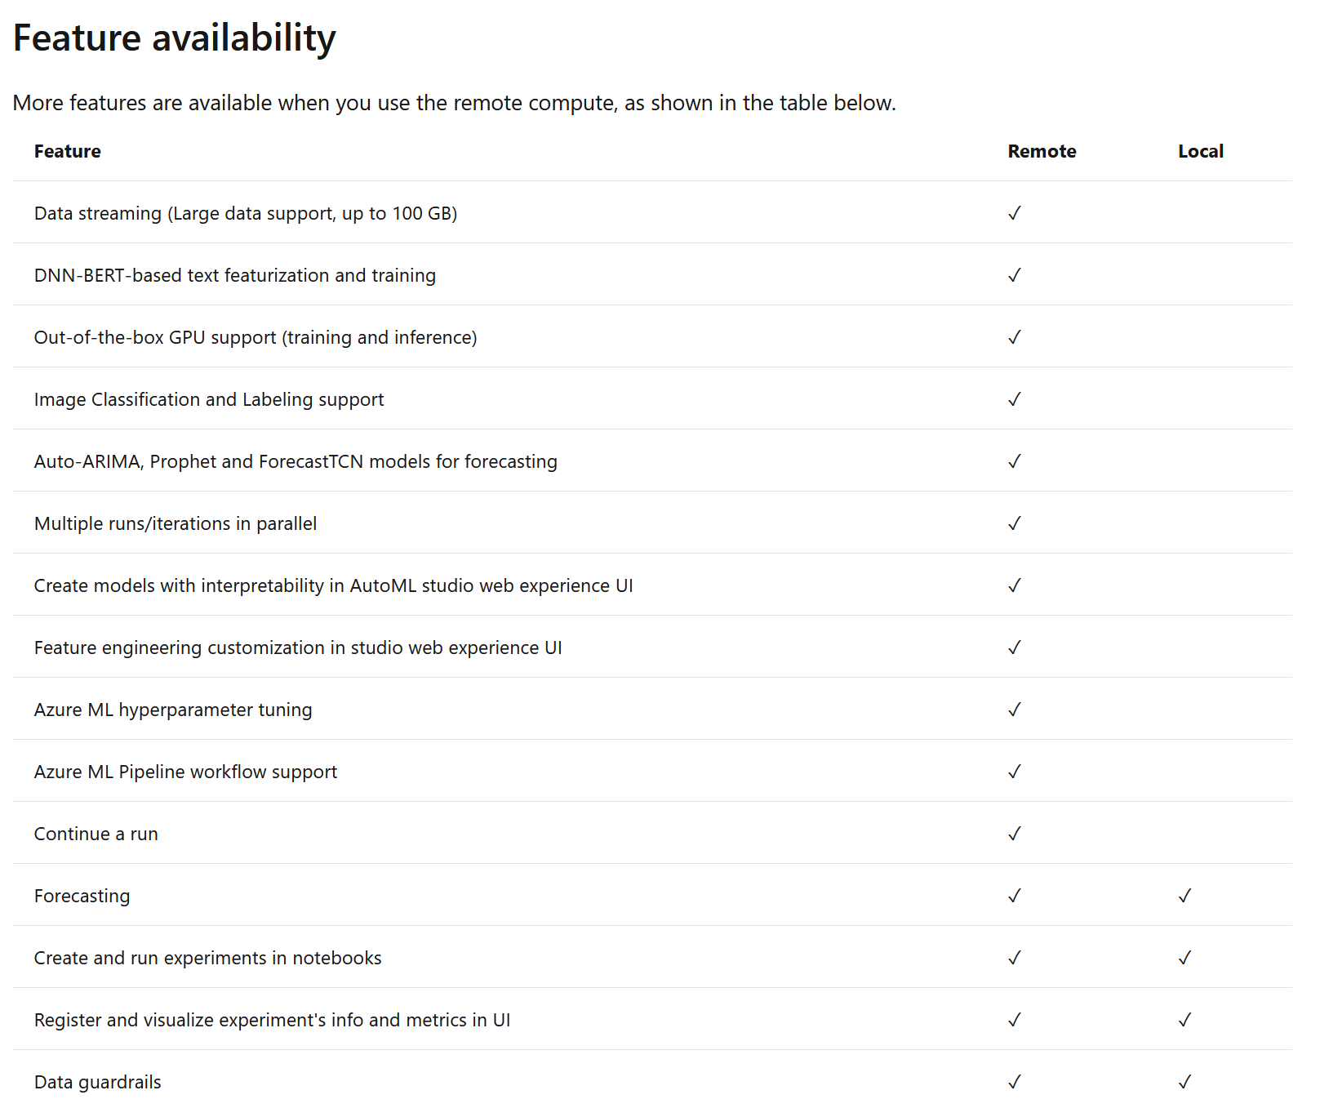
Local vs. Remote

Slide 5
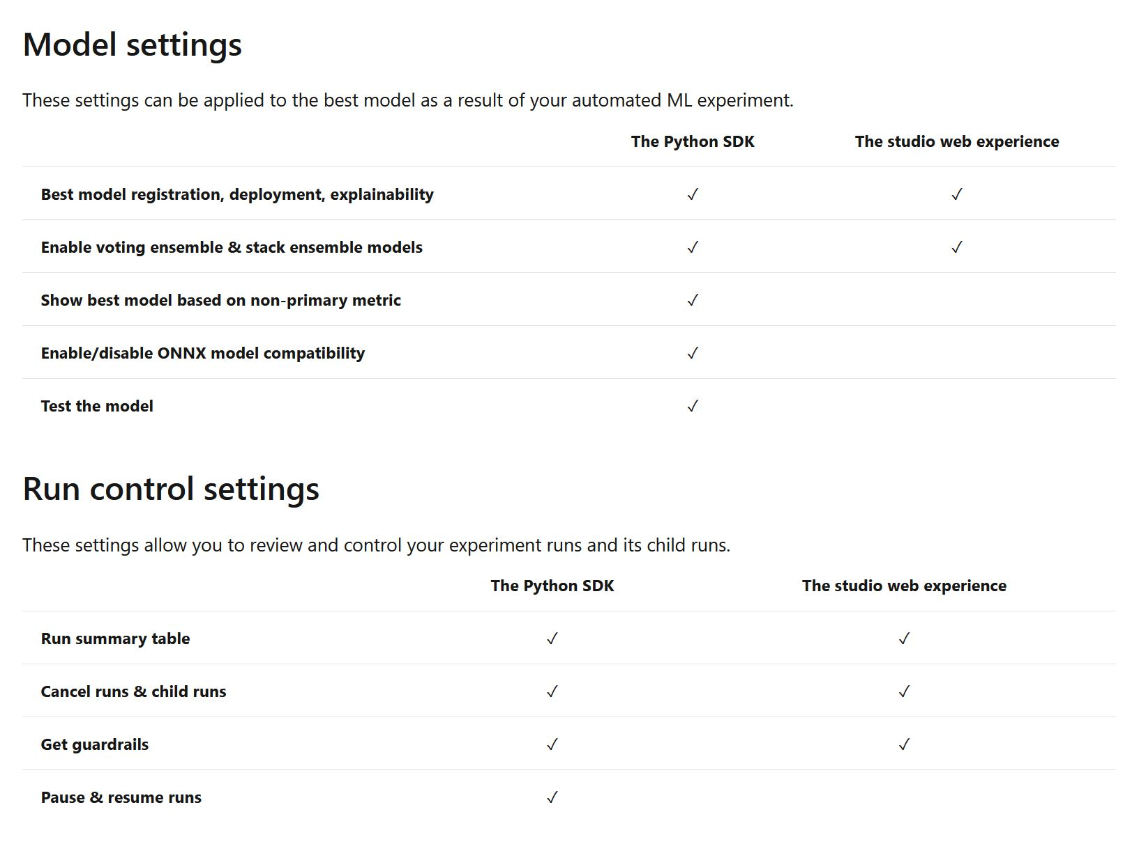
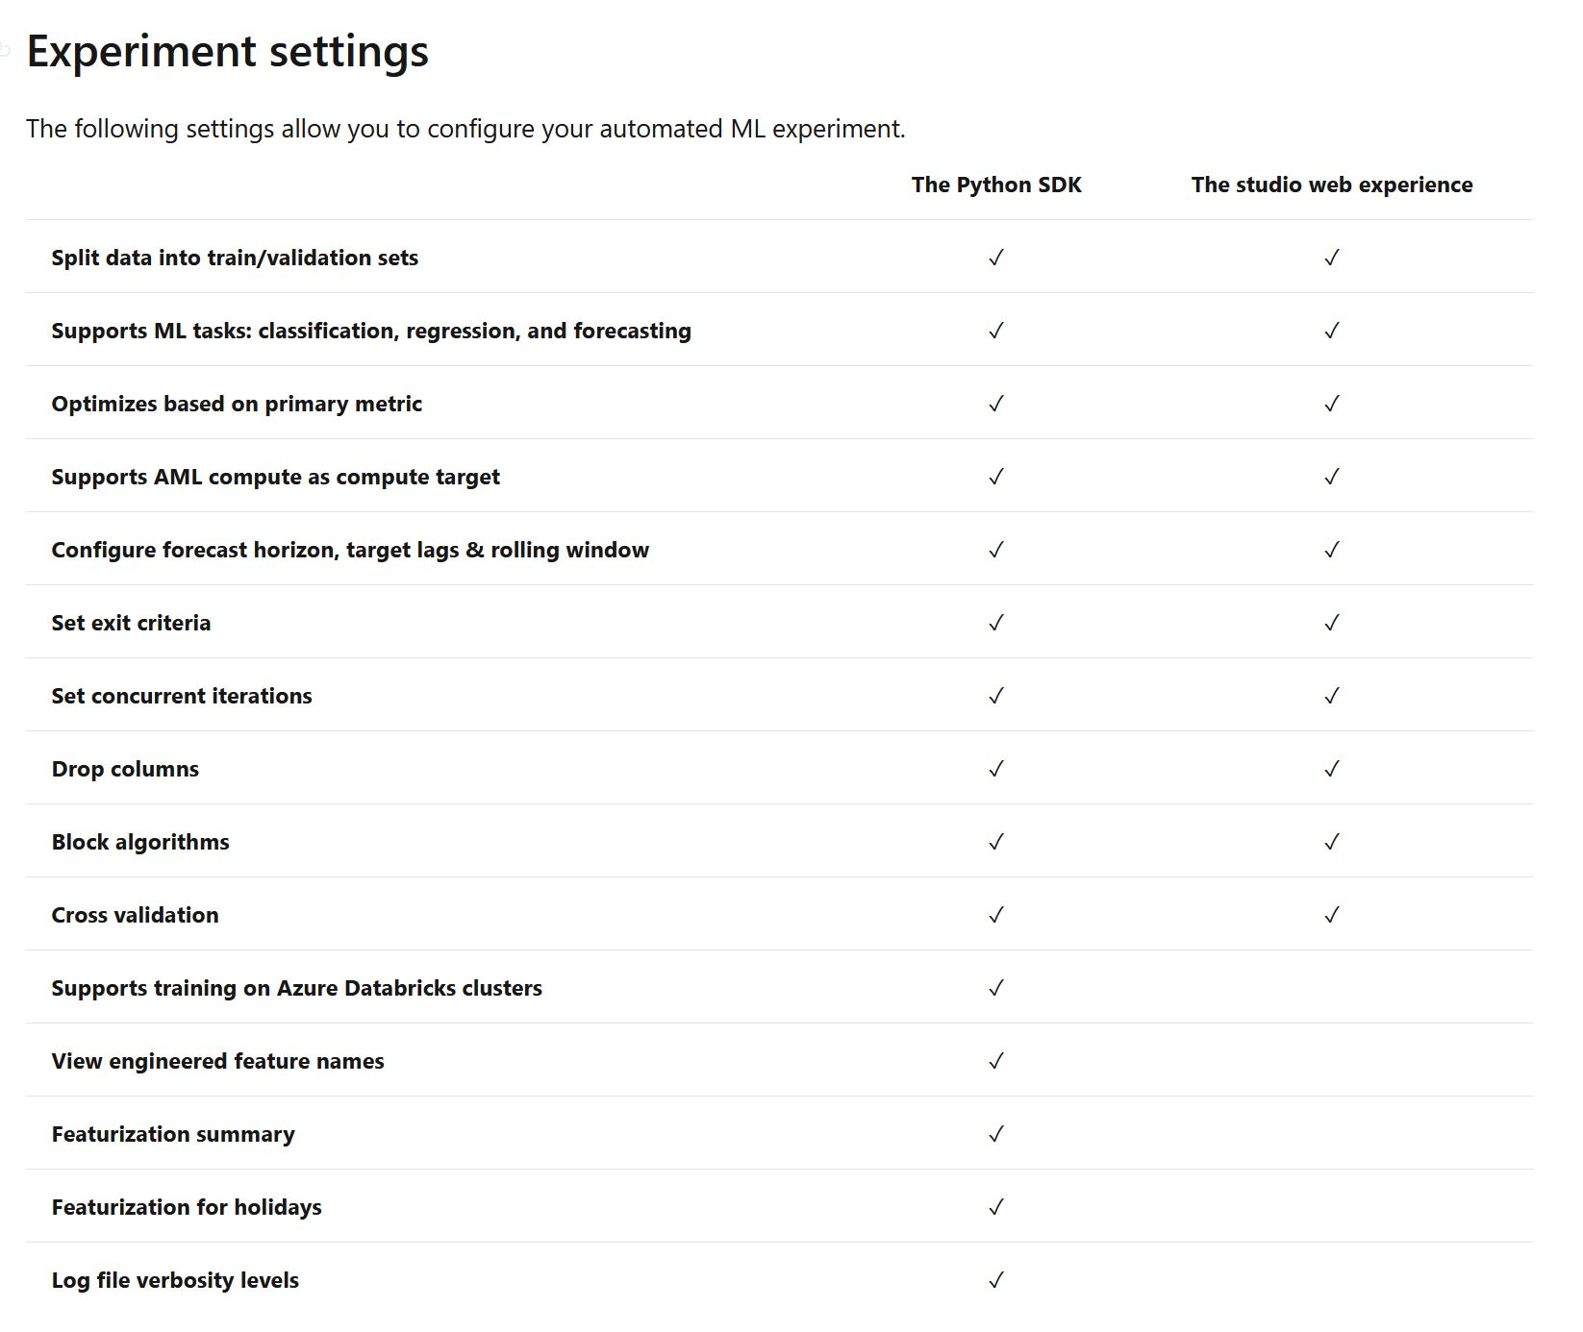
Python SDK Vs. Web

Slide 6
Live Demonstration

Slide 7
Short Summary
Local compute may be fast, but it is almost useless
Remote compute is slow and users are charged by usage.
Web (low code) experience is easy to use, but prediction is not free.
Python SDK is code heavy, lots of system settings, data formatting and version issues.
And the actual prediction, well, not so good for time series.
Predictions need to be made
Strange values

Slide 8
H2o Auto ML Framework
H2O is a Java-based software for data modeling and general computing. The primary purpose of H2O is as a distributed (many machines), parallel (many CPUs), in memory (several hundred GBs Xmx) processing engine.
H2O AutoML is a function in H2O that automates the process of building a large number of models, with the goal of finding the "best" model without any prior knowledge or effort by the Data Scientist.
H20 AutoML trains and cross-validates a default Random Forest, an Extremely-Randomized Forest, a random grid of Gradient Boosting Machines (GBMs), a random grid of Deep Neural Nets, a fixed grid of GLMs, and then trains two Stacked Ensemble models at the end.

Slide 9
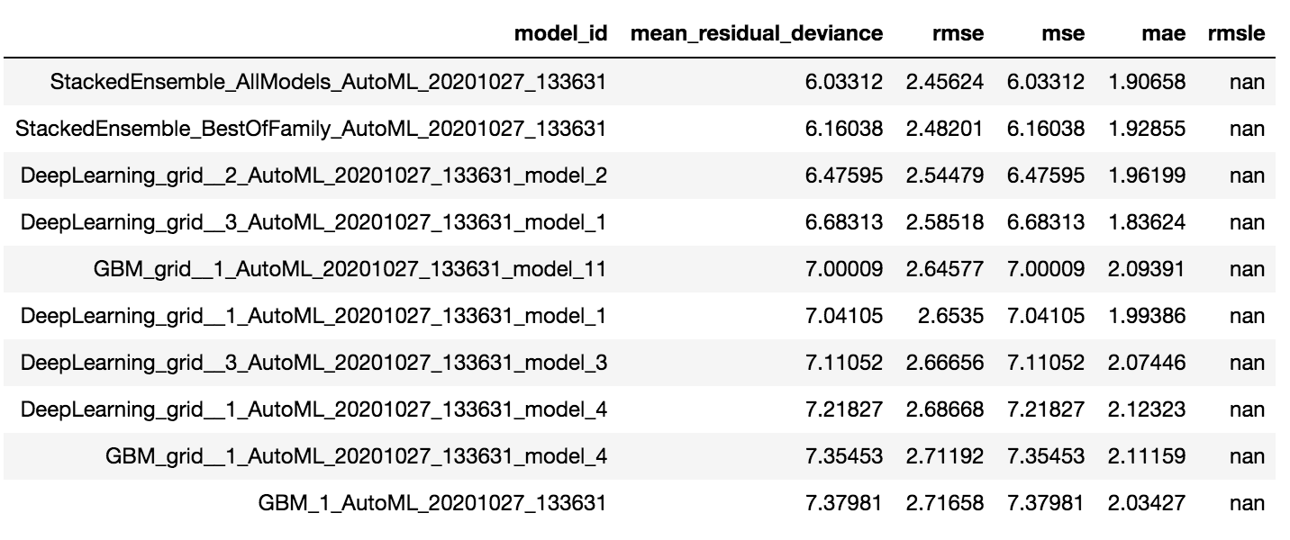
Leaderboard

Slide 10
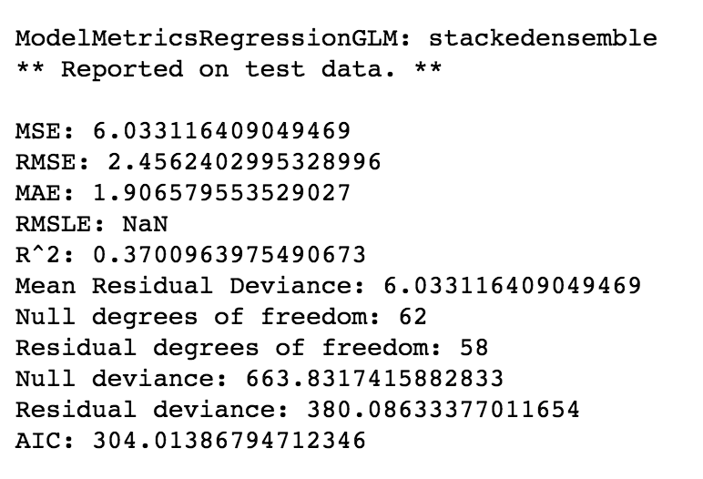
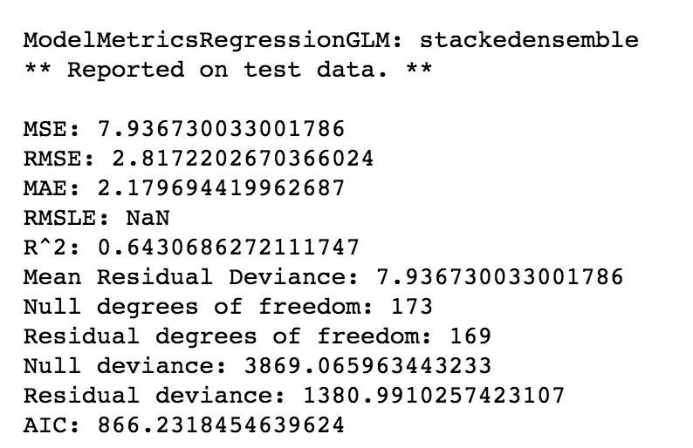
Training and Validation Metrics
Train data
Test data

Slide 11
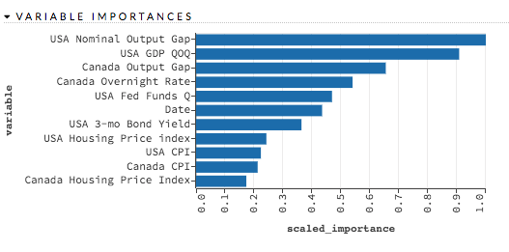
Deep Learning Models

Slide 12
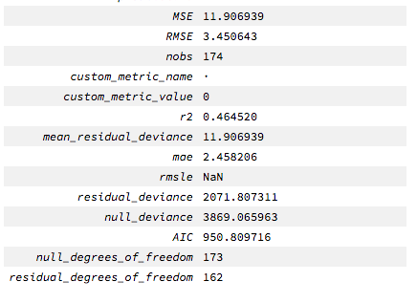
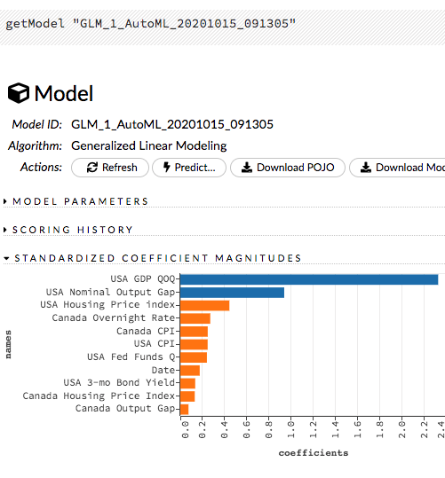
Generalized Linear Model

Slide 13
H2o Short Summary
The H2o Python module is free and easy to use. It is not intended as a replacement for other popular machine learning frameworks
Computing is fast and you can limit the maximum running time
Predictions are free
Stacked models are difficult to understand
Mojo code is available for model deployment

Slide 14
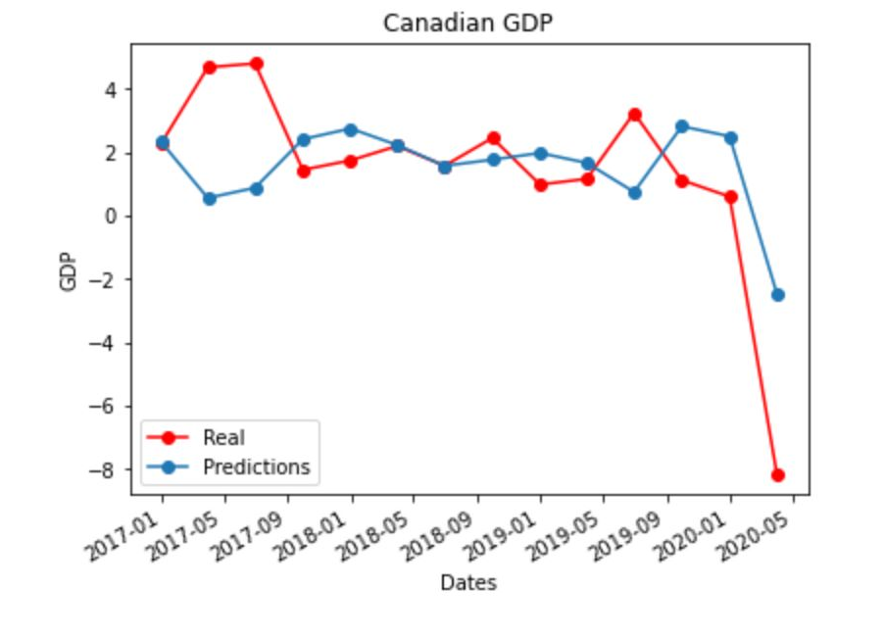
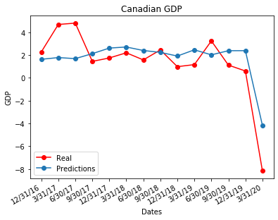
Predictions Comparison
AZURE
H20

Slide 15
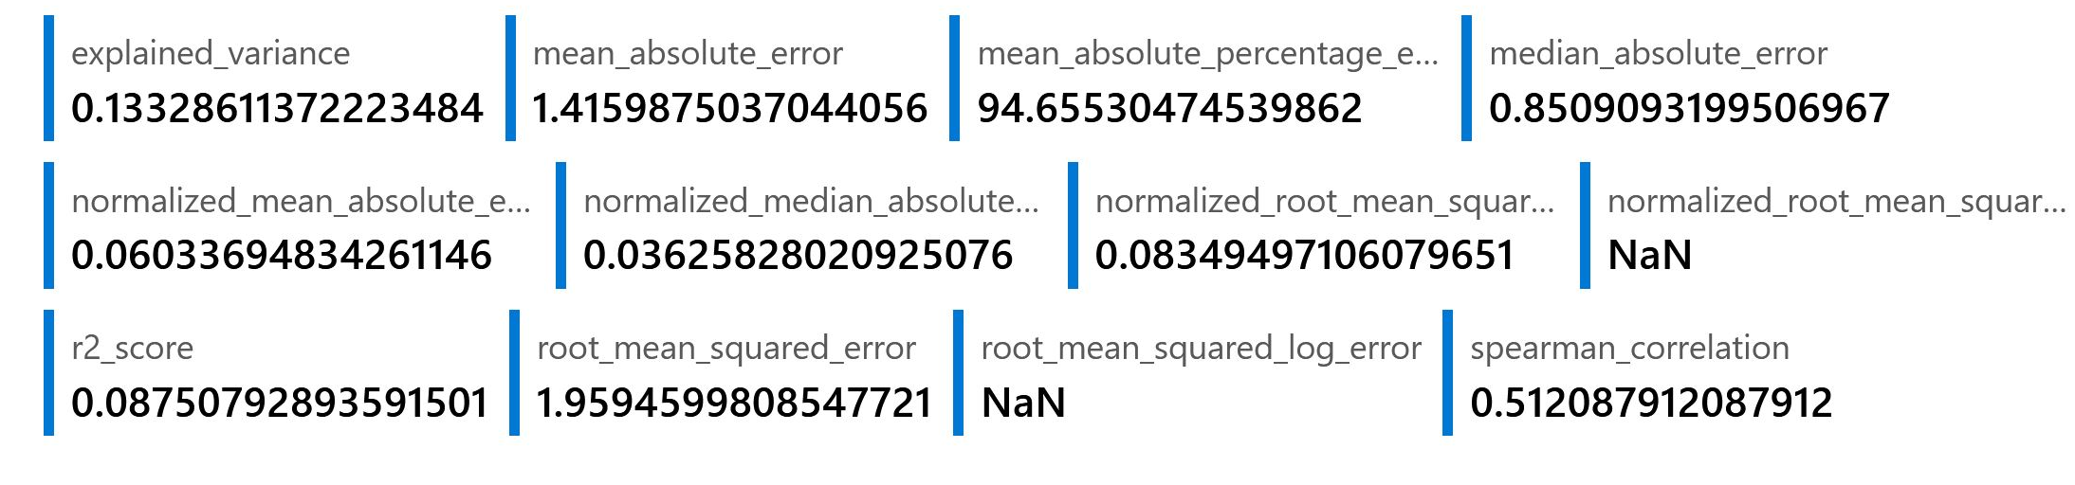
Predictions Metrics Comparison
AZURE
H2o metrics | Value
MSE | 3.25
RMSE | 1.80
MAE | 1.45
H20

Slide 16
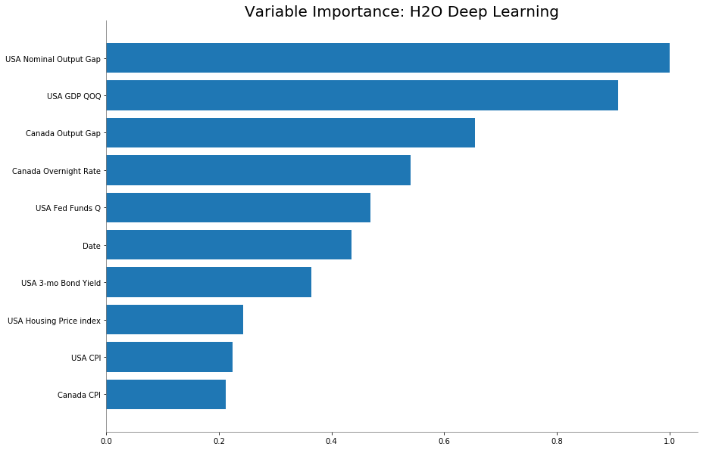
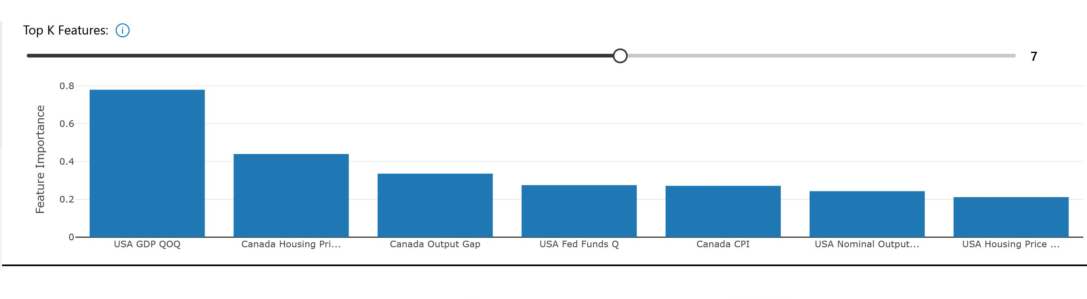
Variable importance plot
AZURE
H20

Slide 17
Thank you

Slide 18
References
https://docs.microsoft.com/en-us/azure/machine-learning/tutorial-automated-ml-forecast\
https://github.com/Azure/MachineLearningNotebooks/blob/master/how-to-use-azureml/automated-machine-learning/forecasting-orange-juice-sales/auto-ml-forecasting-orange-juice-sales.ipynb
https://www.youtube.com/watch?v=IRuMqnWzGP0
https://docs.h2o.ai/h2o/latest-stable/h2o-docs/automl.html#
http://docs.h2o.ai/h2o-tutorials/latest-stable/h2o-world-2017/automl/index.html

