Slide 1
rootnode (struct cgroupfs_root)
.cgroupfs_root
.number_of_cgroups
.top_cgroup <<struct cgroup>>
cgroup
.root
cgroup
.root
cgroup
.root
css_set

Slide 2
cgroupfs_root
.cgroupfs_root
.top_cgroup

Slide 3
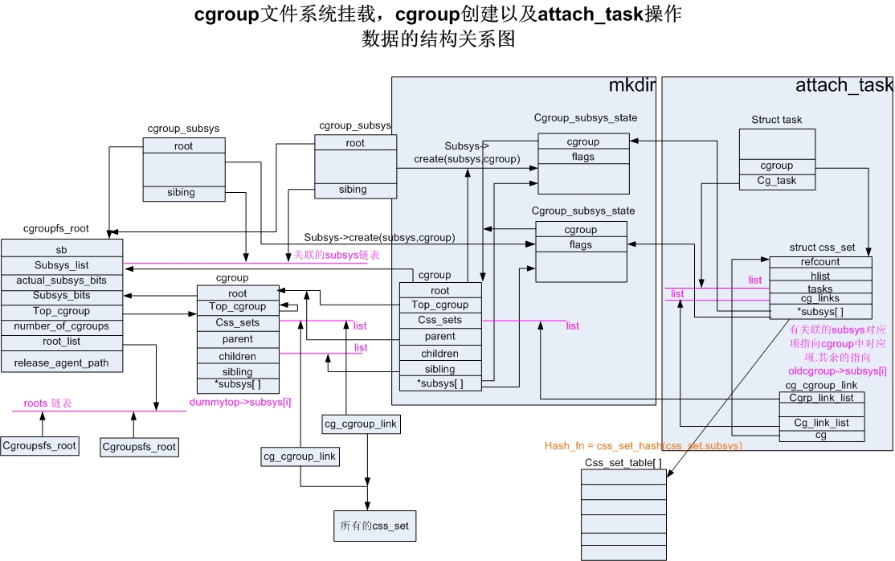
rootnode

Slide 4
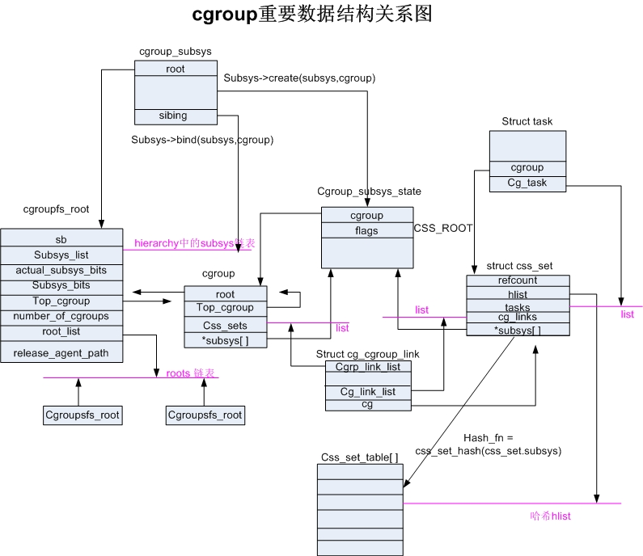
rootnode
init_css_set
init_css_set_link
Rootnode, init_css_set, init_css_set_link
init_cgroup_early에서 초기화 되는 데이터

