Slide 1
TRACK 02 · EchoGesture
EchoGesture
Sign language → live AR captions, fully on-device
Members Details
Team Name: [CollegeName_TeamName]
College Name: [College Name]
[Member 1 · year · branch]
[Member 2 · year · branch]
[Member 3 · year · branch]
[Member 4 · year · branch]
XR Hackathon 2026 · Samsung R&D Institute India, Bangalore · Track 02: Sign Language Prediction on Edge Devices
Notes:
EchoGesture: exocentric, fully on-device isolated sign recognition with an AR caption HUD. Track 02.

Slide 2
THE PROBLEM
Signed conversation moves fast. Captions have to keep up, and the camera must keep what it sees to itself.
THE BUDGET ON A WEARABLE
≤ 50 ms
1
The conversation gap
per-frame latency
Natural signing is rapid. If translation lags past ~50 ms, turns fall out of sync and the dialogue feels awkward.
≤ 20 MB
quantized INT8 model
2
The privacy principle
Glasses film bystanders. Raw video of people who never consented must never be uploaded to a cloud server.
0 bytes
of video sent to the cloud
3
The exocentric reality
2,000
A wearer sees signers from the side, moving, in low light and partly occluded, not a tidy front-facing webcam.
ASL words in WLASL
Notes:
Problem framed from the track brief: conversational cadence (≤50 ms), on-device privacy (zero cloud streaming), exocentric capture (moving heads, angled signers, low light).

Slide 3
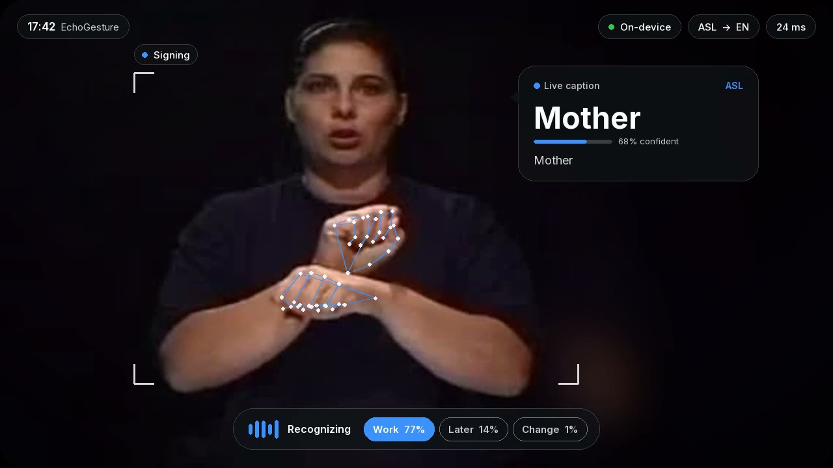
SOLUTION
See what's signed, right where it's signed
Keypoints, not pixels
MediaPipe tracks 21 points per hand plus the upper body. The model never sees faces or backgrounds.
Tiny temporal model
A 3-model 1D-CNN ensemble reads 32 frames of motion. INT8, 5.8 MB, 1.6 ms.
Glanceable AR caption
Words pop in with a confidence meter; unsure guesses show in amber with a “?”.
Two-way ready
Wearer's view: the caption floats beside the signer, never over the face or hands
Optional speech output says each word aloud.
Notes:
Pipeline: camera -> MediaPipe hand+pose keypoints -> pose-invariant features -> INT8 SignNet ensemble -> AR caption + optional TTS. All on device.

Slide 4
ARCHITECTURE
RUNTIME · every stage runs on the device, per frame
Camera frame
Keypoints
Features
SignNet ×3
Glass HUD
Exocentric view
15–30 fps
Hands + upper body
55 3D points
Body-centred, roll-fixed
hand shape + velocity
Dilated depthwise
temporal CNN
Anchored caption
+ top-3 + voice
OpenCV
MediaPipe Tasks
hand ∥ pose threads
32 × 458
occlusion flags
ONNX INT8 · 5.8 MB
1.6 ms
Pillow · OpenCV
macOS say / espeak
TRAINING · offline, once
WLASL100
Augment
Train
Quantize
1,019 clips downloadable
held-out test signers
mirror · yaw · roll · speed
hand & fingertip dropout
PyTorch · 3 seeds
label smoothing, cosine LR
static INT8 QDQ, per-channel
FP32 ↔ INT8 agreement 100%
Python 3.11
MediaPipe Tasks
PyTorch
ONNX Runtime
OpenCV
Pillow
Docker
Notes:
Hand and pose landmarkers run in parallel threads: per-frame p95 dropped from 48.6 ms to 39.7 ms. Classifier is 1.6 ms of that.

Slide 5
TRACK FINAL OUTPUT
results.csv · WLASL100 held-out signers · Mac mini (Apple M1), CPU only
predict(video_path) → dict
Metric | Target | Measured | Status
Top-1 accuracy | ≥ 70 % | 71.4 % | PASS
Latency p95 / frame | ≤ 50 ms | 39.7 ms | PASS
Model size | ≤ 25 MB | 19.4 MB | PASS
Robustness drop | ≤ 5 pt | 3.0 pt | PASS
Thermal drift, 10 min | ≤ 20 % | 2.1 % | PASS
Average power | ≤ 500 mW | — | needs device
{"clip_id": "17713",
"prediction": "DRINK",
"top5": ["DRINK","HOW",
"FINISH","NOW","COLOR"],
"confidence": 0.9878,
"latency_ms": 3.02}
Deliverables
✓ predictions.jsonl (161 test clips)
✓ results.csv + benchmark_report.json
✓ signnet_int8.onnx + export.py
✓ Repo: predict(), README, Dockerfile
✓ Demo video (53 s, HUD + voice)
Top-5 accuracy 88.8 % · sign model 5.8 MB INT8 (+13.6 MB MediaPipe) · power needs an on-phone reading
Notes:
All numbers come from scripts/benchmark.py. Robustness = accuracy drop when 100 test videos are re-run under low light, sensor noise, motion blur, an occluder and 8° tilt (76% -> 73%). Thermal = 10-minute sustained load, first vs last minute.

Slide 6
DIFFERENTIATION
Privacy by architecture
Caption that respects ASL
Honest uncertainty
The classifier only sees 55 keypoints per frame. No faces, no backgrounds, no cloud.
The bubble floats beside the head and avoids the face and hands, which carry the grammar.
Low-confidence guesses show in amber with a “?” instead of being stated as fact.
Robust by design
Fast where it counts
Evaluator-ready
Mirror, yaw, roll and occlusion augmentation. Only −3 pt under low light, blur and occlusion.
Parallel hand/pose trackers: p95 48.6 → 39.7 ms. Classifier 1.6 ms, flat after 10 min.
One predict() call, Docker image, and one command that fills results.csv.
Notes:
Key differentiators vs. a pixel-based classifier: privacy, size, robustness; and a HUD designed around how sign language is actually read.

Slide 7
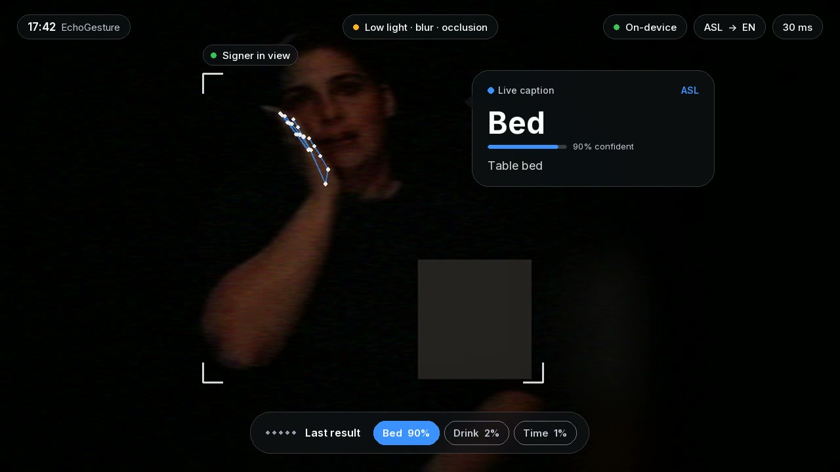
DEMO & LOCAL SETUP
Run it locally
# setup (Python 3.11)
pip install -r requirements.txt
# evaluator entry point
python predict.py clip.mp4
# whole test set -> predictions.jsonl
python scripts/make_predictions.py \
--clips-dir test_clips/
# results.csv (+10-min thermal run)
python scripts/benchmark.py
# live AR caption HUD (webcam)
python demo/live_hud.py --tts
Stress scene from the demo: low light · blur · occlusion
▶ Demo video (53 s)
[Demo video link: YouTube / Drive]
Notes:
Docker: docker build -t echogesture . && docker run --rm -v clips:/clips echogesture python scripts/make_predictions.py --clips-dir /clips

Slide 8
Brownie Slides
WHAT MOVED THE NEEDLE · test top-1
Limitations
Next steps
569 clips, single model
52.5%
Only 1,019 of 2,038 WLASL100 clips were still online
Isolated words, not continuous sentences
Benchmarked on an M1 Mac, not a Galaxy phone yet
Power needs an on-device reading
Android XR app: ONNX Runtime Mobile + MediaPipe Android
Continuous signing with a CTC head
Scale to WLASL2000 and How2Sign
Speech → caption for the signer (two-way)
1,019 clips (+ YouTube)
67.1%
+ train on val, 3-model ensemble
71.4%
target 70%
Notes:
Ablation on the same 161-clip test split. Test clips were never used for model selection.

Slide 9
Thank You
EchoGesture · conversation without the gap, privacy without compromise
Track 02 · XR Hackathon 2026 · [CollegeName_TeamName]

