Slide 1


AI Models Benchmark
A Comparative Analysis of Intelligence, Cost, Performance & Use Cases
Data-driven evaluation of modern large language models
PREPARED BY RUPNATH SHAW
PYTHON • PANDAS • MATPLOTLIB

Slide 2

Why This Analysis Matters
Core Business Workflows
Complex Trade-offs
Model selection involves balancing intelligence, cost, speed, and usability—not a single "best" choice
LLMs now power analytics, development, content creation, and customer support
Beyond Intelligence
Brand vs. Data
Cost, latency, and performance metrics matter as much as raw capability
Many organizations choose models based on hype rather than evidence
Goal: Enable defensible, data-driven model selection

Slide 3
PROBLEM & OBJECTIVES
Structured Framework for AI Selection
Core Problem
Compare Metrics
Identify Value Leaders
Organizations lack a structured framework to compare AI models across performance, cost, and user experience dimensions
Evaluate models across intelligence, price per million tokens, speed, latency, and context window
Surface high-value and cost-efficient models that deliver exceptional performance relative to price
Understand Trade-offs
Real-World Mapping
Map specialization patterns—which models optimize for speed vs. intelligence vs. cost
Connect model characteristics to specific business use cases and deployment scenarios

Slide 4
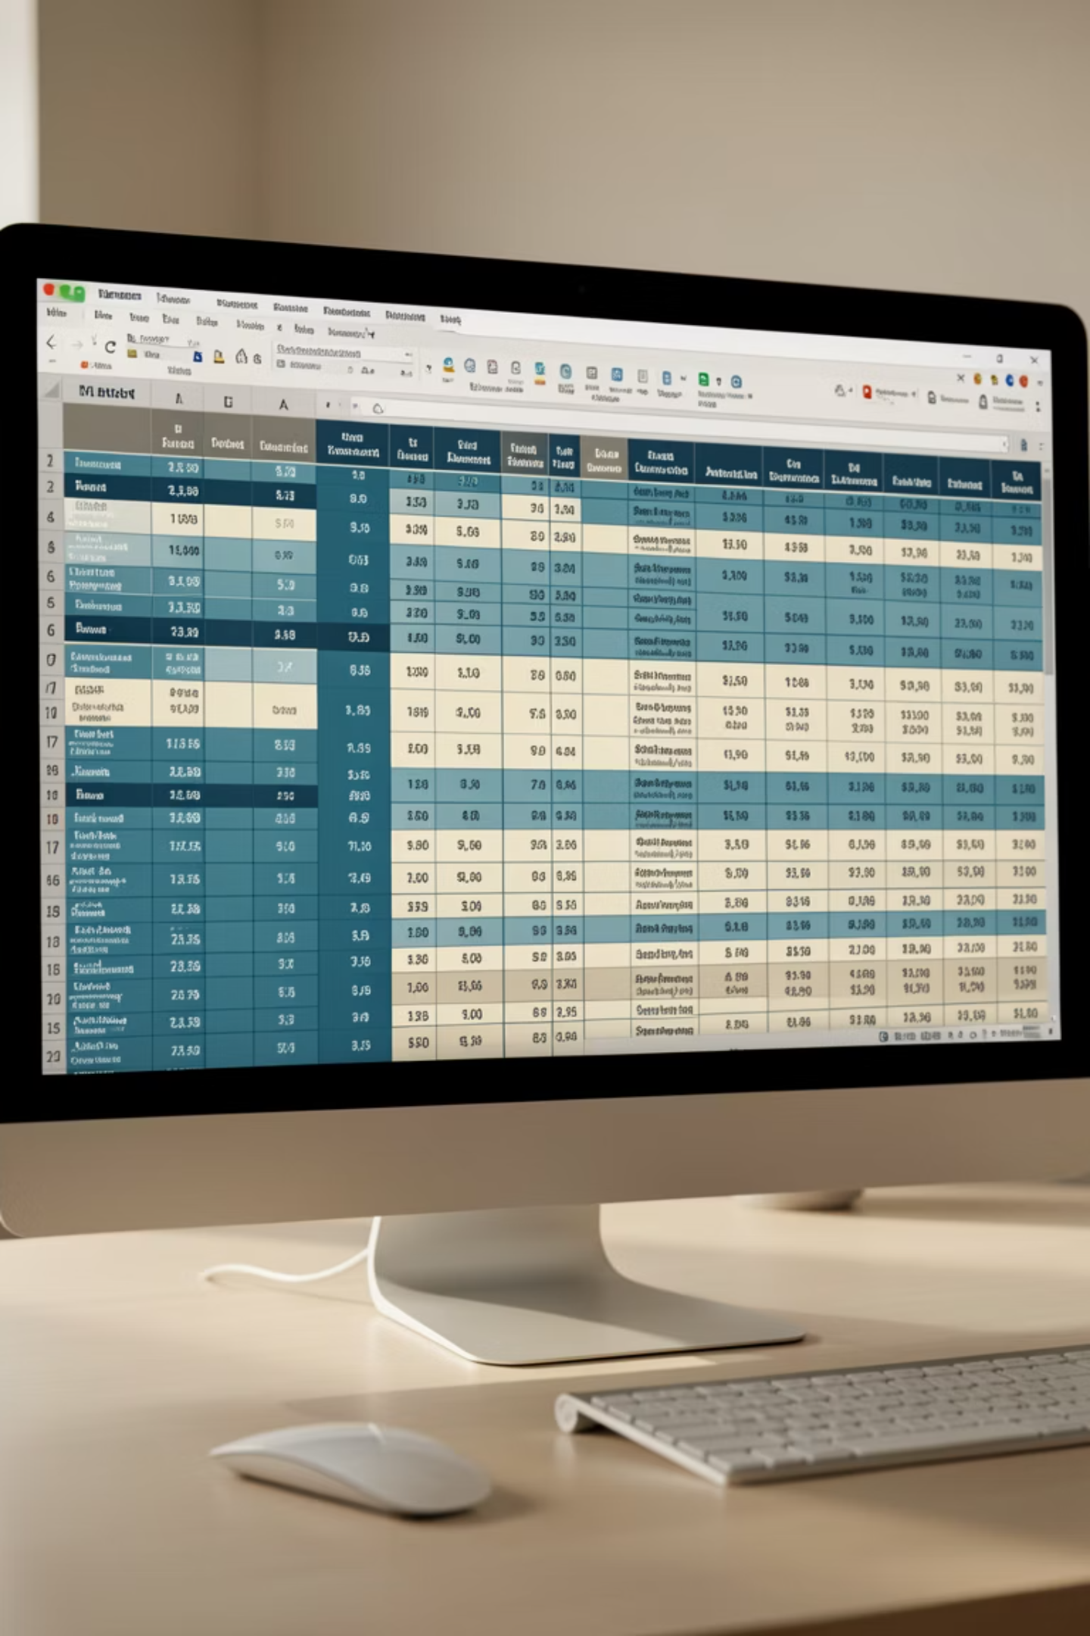
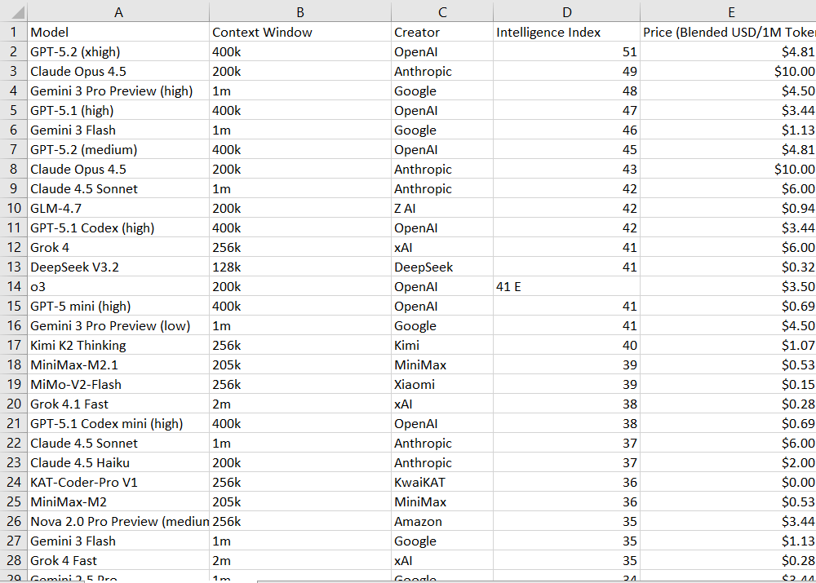
Dataset Overview
Structure
Key Metrics
Each row represents one AI model. Each column captures a performance or cost metric.
Intelligence Index, Price (USD/1M tokens), Speed (tokens/sec), Latency (seconds), Context window size, Creator/vendor
Scope
Cross-sectional benchmark captured at a single point in time—not a longitudinal time-series analysis

Slide 5


Data Preparation & Methodology
How the Data Was Prepared
Standardization
Converted text-based metrics to numeric values for analysis
Normalization
Unified context window units (k/m → tokens) for consistency
Filtering
Removed invalid or zero-price records to ensure quality
Derivation
Approach: Exploratory, descriptive analysis—no machine learning, no assumptions. Pure data-driven insights.
Created calculated metrics like intelligence-per-dollar for deeper insights

Slide 6
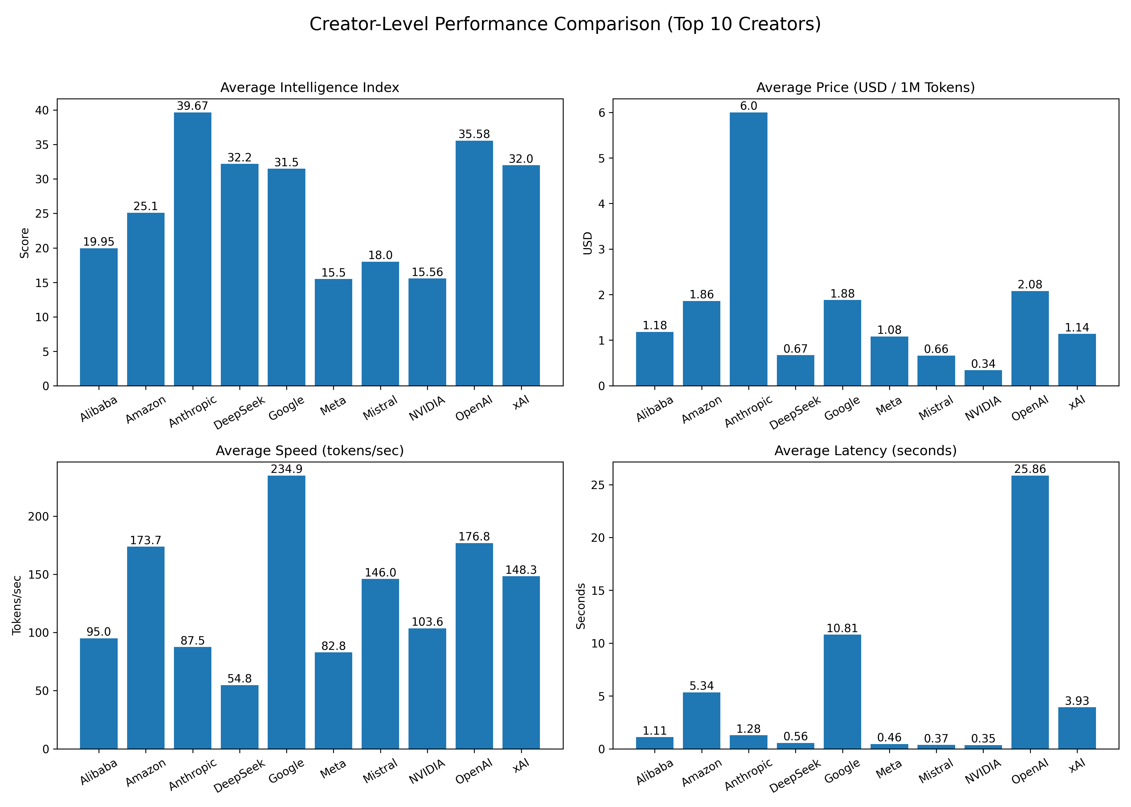
CREATOR COMPARISON
Creator-Level Performance Comparison
Top 10 Vendors by Key Metrics
Average Intelligence
Price Distribution
Benchmark capability scores aggregated by creator reveal strategic positioning
Cost per million tokens varies dramatically—some creators target premium, others volume
Speed & Latency Patterns
Clear differences in vendor optimization—throughput vs. responsiveness trade-offs emerge
Key Insight: No creator dominates all dimensions simultaneously. Each optimizes for different strategic priorities—intelligence, cost-efficiency, or performance.

Slide 7
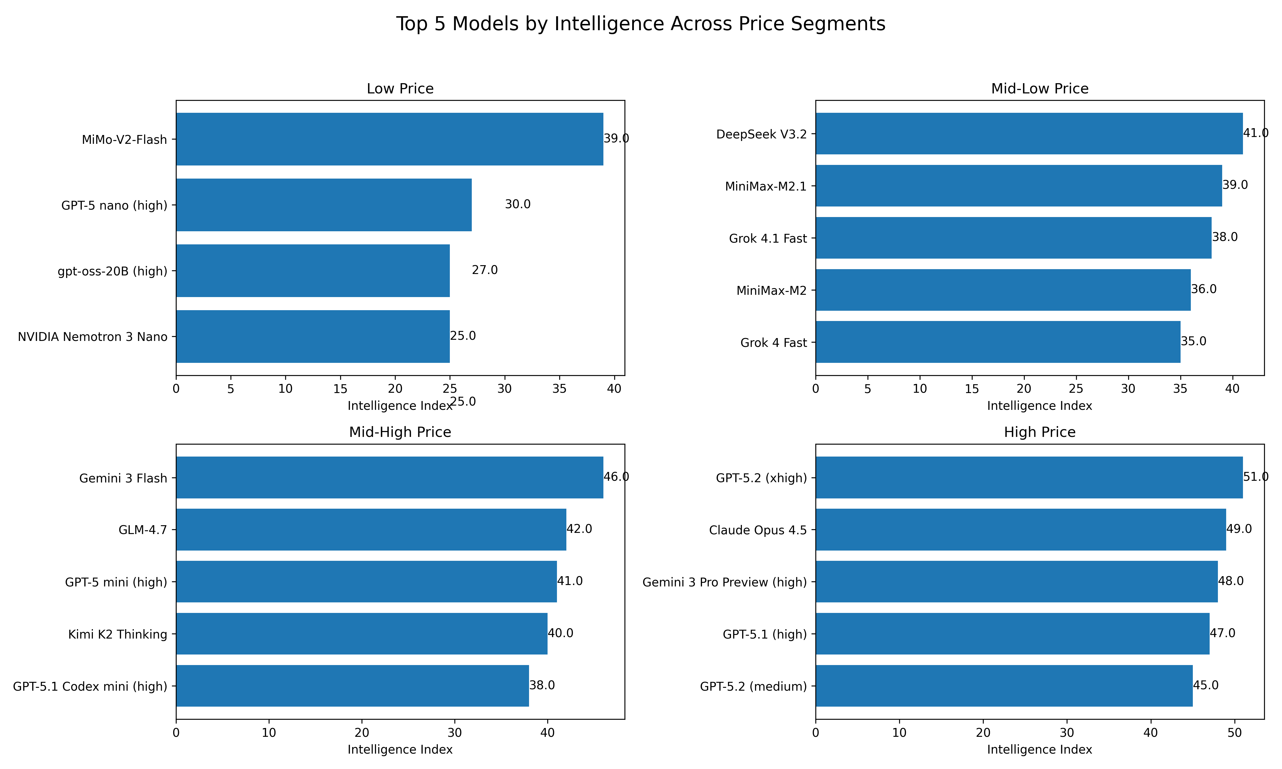

VALUE ANALYSIS
Intelligence vs Price
Does Higher Cost Guarantee Higher Intelligence?
Non-Linear Relationship
Undervalued Models
Intelligence does not scale linearly with price. Value leaders emerge at mid-tier pricing.
Strong mid-priced models compete directly with premium offerings on capability.
Diminishing Returns
At the top end, incremental price increases deliver smaller intelligence gains.
Strategic Implication: Price is a weak proxy for intelligence. Organizations can achieve enterprise-grade performance without premium pricing.

Slide 8
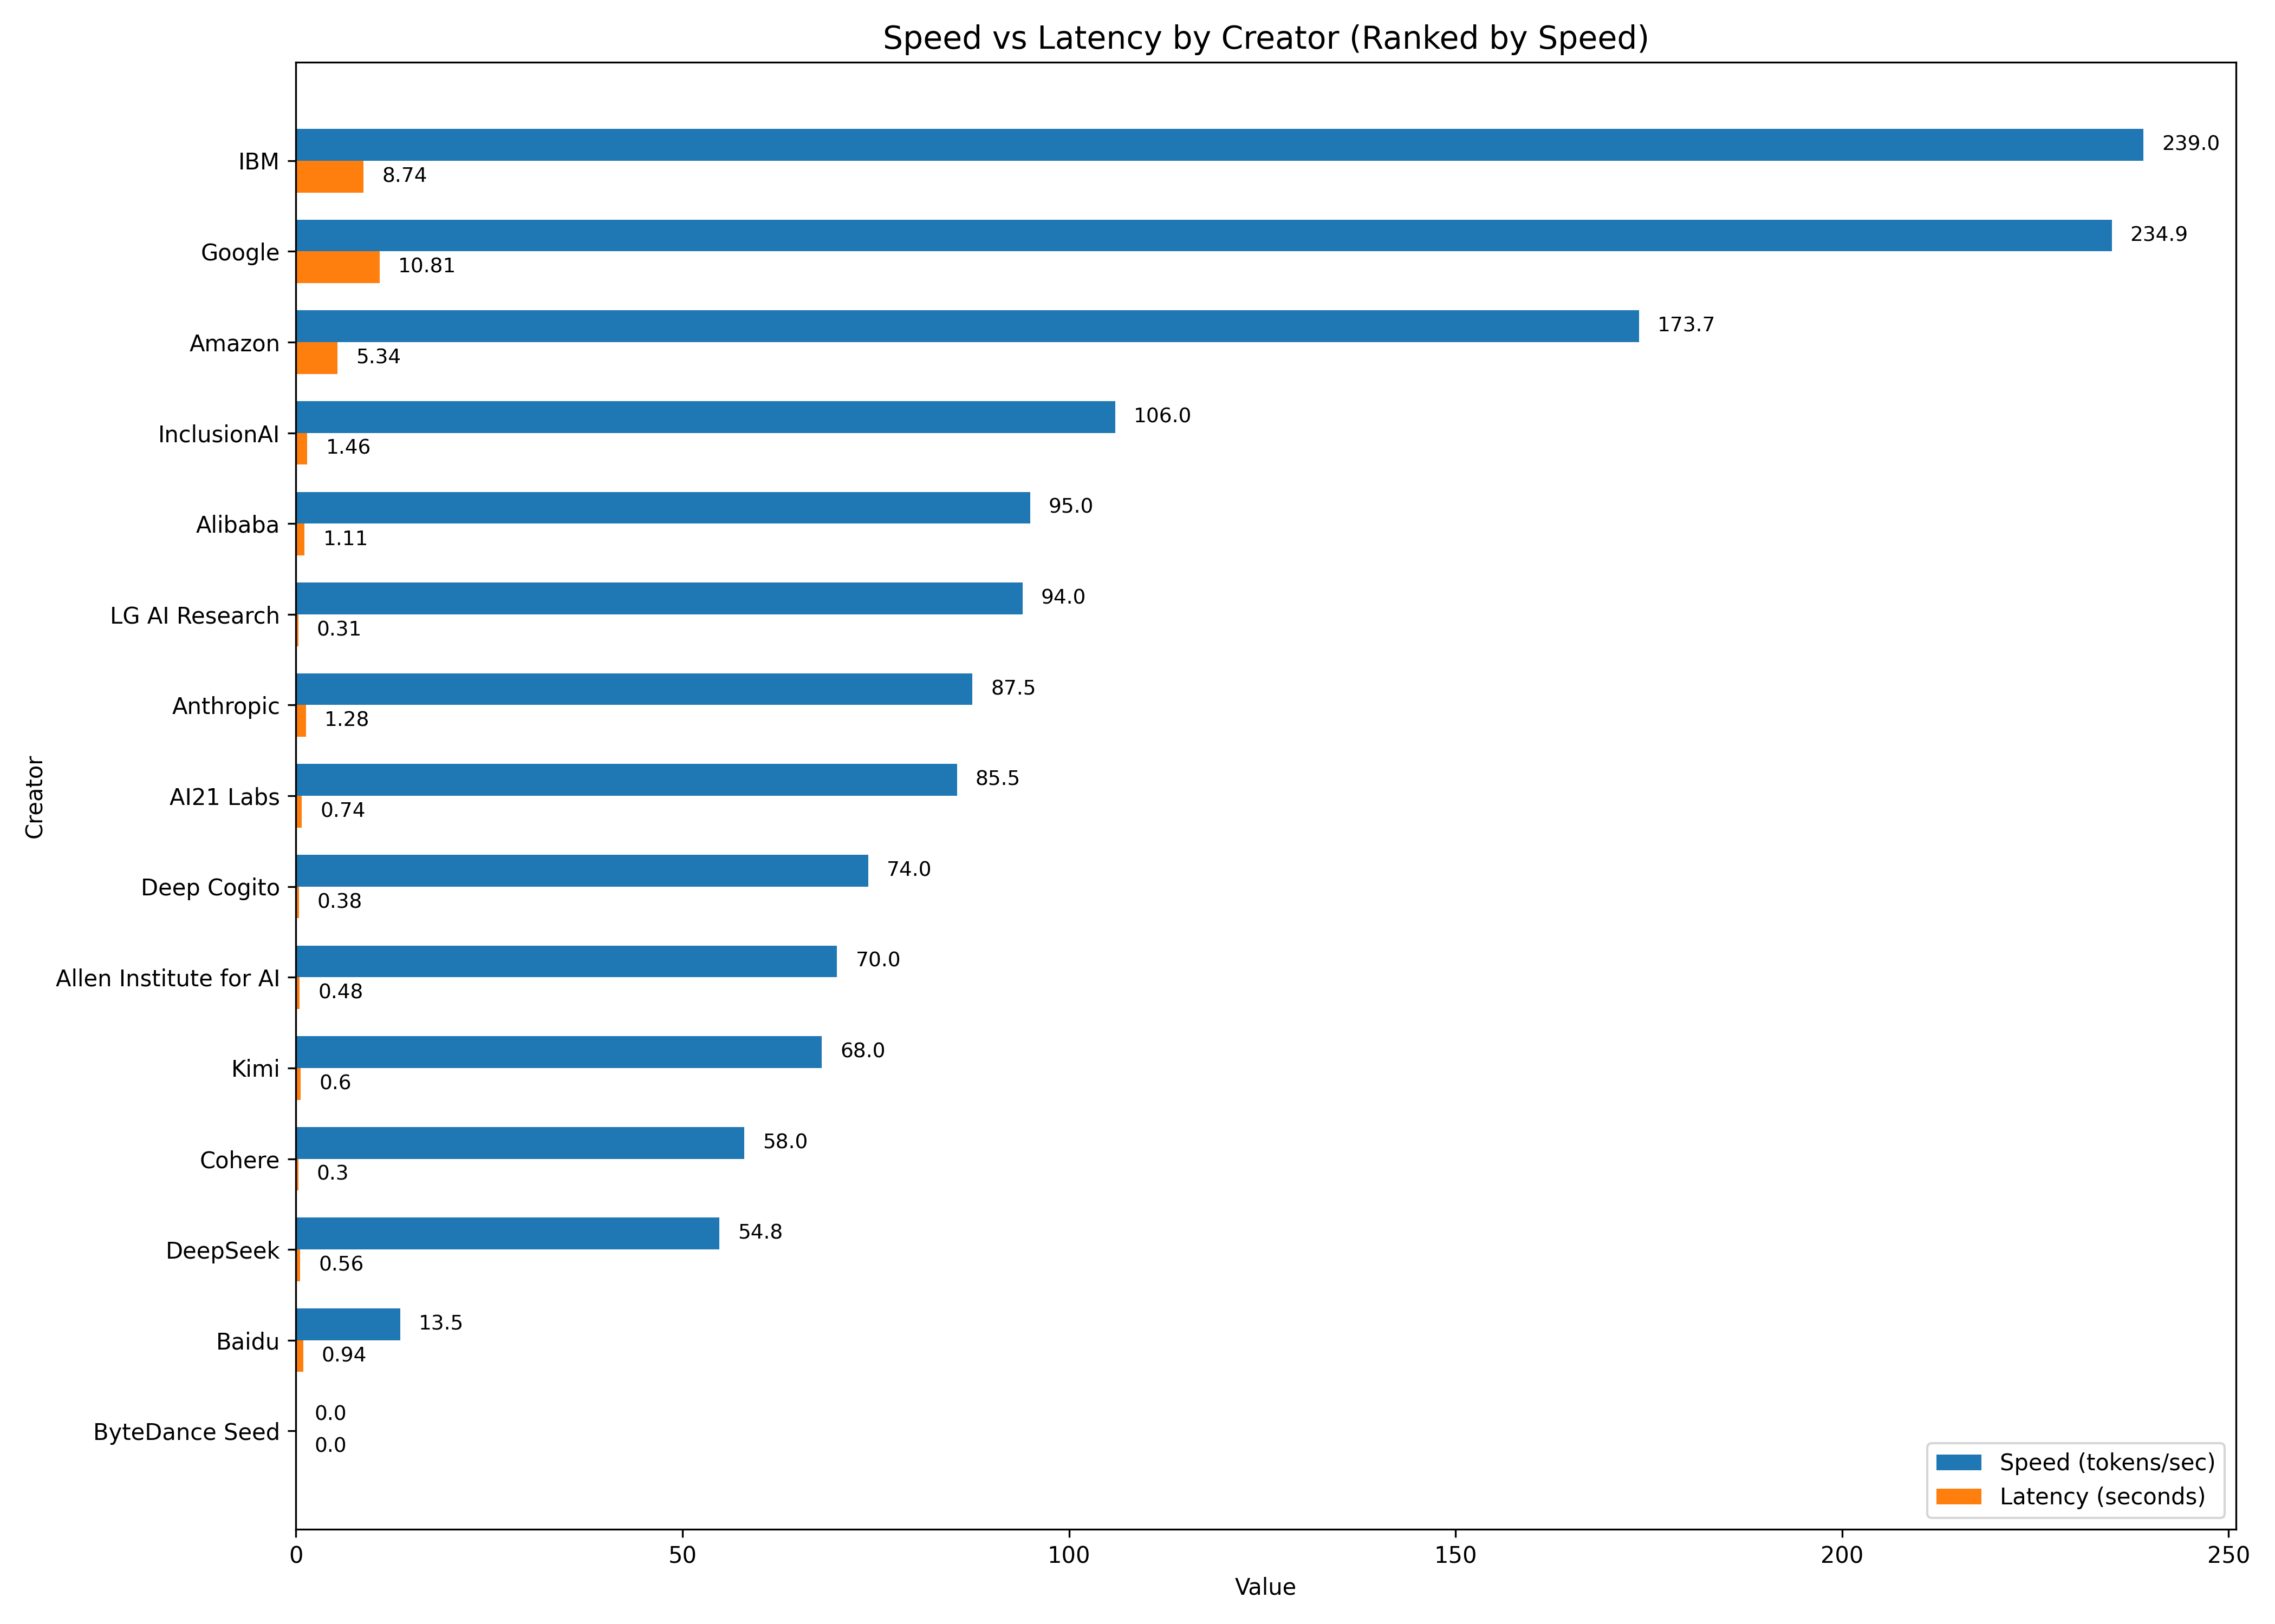

PERFORMANCE DEEP DIVE
Speed vs Latency by Creator
Ranked by Throughput Performance
High Speed ≠ Low Latency
Speed Favors Batch
Fast token throughput doesn't guarantee instant responsiveness
High tokens/sec optimizes for offline processing and bulk workloads
Latency for Real-Time
Low initial response time is critical for interactive, user-facing applications
Strategic Implications
Batch analytics: Prioritize speed (tokens/sec)
Chatbots & assistants: Prioritize latency (time to first token)
Mixed workloads: Balance both—or deploy specialized models per use case
Architecture decisions should align with workload characteristics, not vendor defaults.

Slide 9
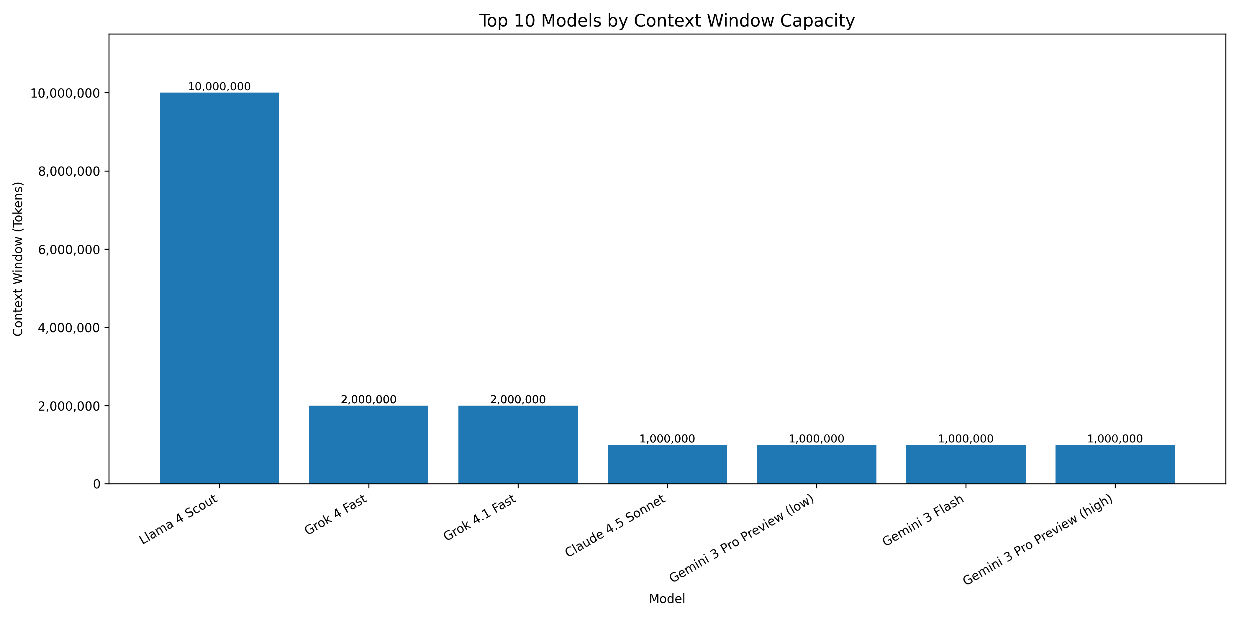

CONTEXT WINDOW CAPABILITY
Context Window Capability (Top 10 Models)
Rare at Scale
Cost Implications
No Intelligence Guarantee
Extremely large context windows are still a specialized feature, not broadly available across all models.
Higher context capacity often correlates with increased operational costs and resource consumption.
A larger context window does not automatically translate to higher intelligence or better reasoning abilities.
Key Takeaway: Large context capacity is a specialized feature, not a default requirement. Assess actual use case needs carefully.

Slide 10
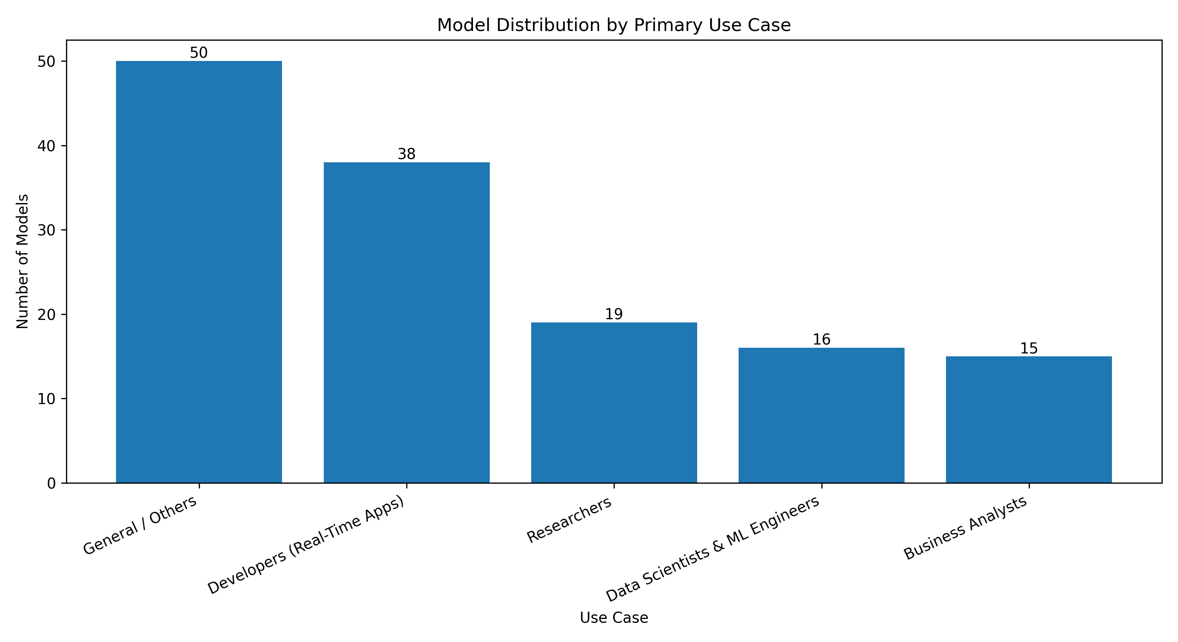
Use-Case-Driven Model Distribution
How Models Are Best Used
Developers
Prioritize real-time optimized models for rapid response and high throughput in interactive applications and APIs.
Data Scientists & ML Engineers
Leverage models with superior intelligence and extensive context windows for complex data analysis, advanced problem-solving, and model fine-tuning.
Researchers
Require models pushing the boundaries of maximum capability, focusing on cutting-edge performance and novel applications rather than cost.
Business Analysts
Seek cost-efficient intelligence, finding models that offer strong performance at an optimal price point for impactful, budget-conscious insights.
General Users
Benefit from balanced models that offer a good blend of intelligence, speed, and cost-effectiveness for versatile everyday tasks and content generation.

Slide 11
Key Conclusions
What We Learned From This Analysis
No Universal "Best"
Price-Intelligence Disconnect
Speed vs. Latency
AI models are optimized for specific strengths; a one-size-fits-all solution doesn't exist.
Throughput (speed) and responsiveness (latency) are distinct metrics requiring separate optimization strategies.
Higher cost does not automatically equate to superior intelligence; value leaders emerge at various price points.
Balance is Uncommon
Use-Case Driven Selection
Models excelling across all dimensions (intelligence, speed, latency) are exceptionally rare; most specialize.
Optimal model choice hinges on aligning specific organizational needs and performance priorities with model capabilities.

Slide 12

RECOMMENDATIONS & NEXT STEPS
Recommendations
Actionable Insights for Model Selection
Avoid Defaulting to Premium
Prioritize Intelligence-per-Dollar
Don't select models based on perceived prestige; justify choices with clear performance metrics.
For budget-sensitive projects, identify models that offer the best performance for their cost.
Optimize for Latency
Choose High-Speed for Batch
For real-time applications, prioritize models with fast initial response times (time to first token).
For bulk data processing and offline tasks, select models with high token throughput.
Context Windows are Specialized
Treat large context capabilities as a feature for specific use cases, not a universal requirement.

Slide 13
Thank You

