Slide 1
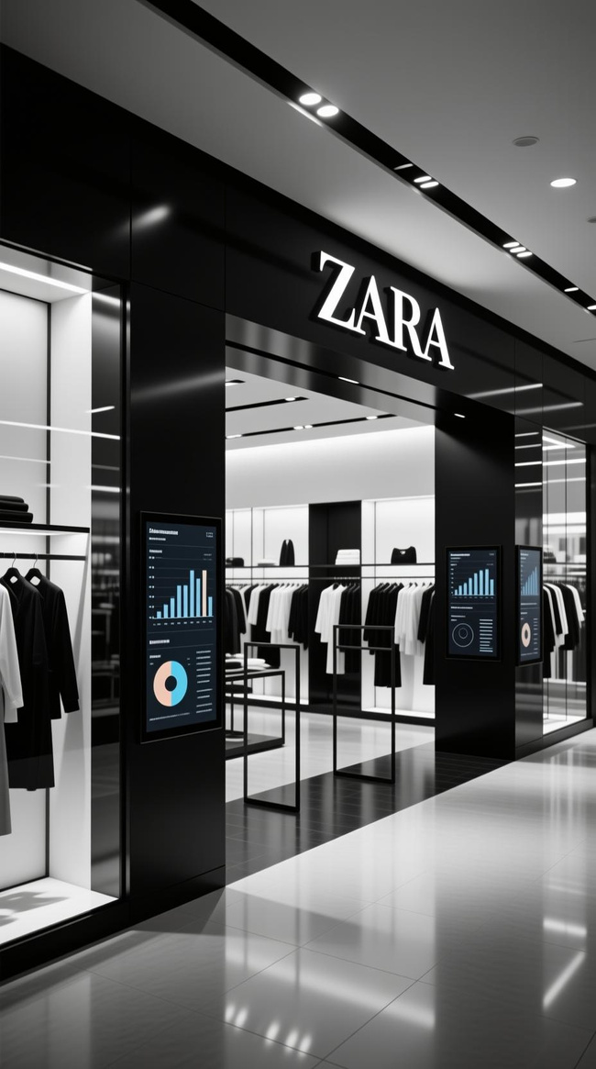


ZARA Sales Analysis Dashboard
Comprehensive Sales and Product Insights
Tools - Power BI Rupnath Shaw

Slide 2

Project Introduction
Objective
Dataset Scope
Analyze Zara's sales performance, promotional effectiveness, material trends,
section dynamics, and category-
level insights
Product attributes: price, material, section, season, origin
Sales metrics: units sold, revenue,
promotions
Profit & pricing analytics
Multi-dimensional performance
tracking

Slide 3
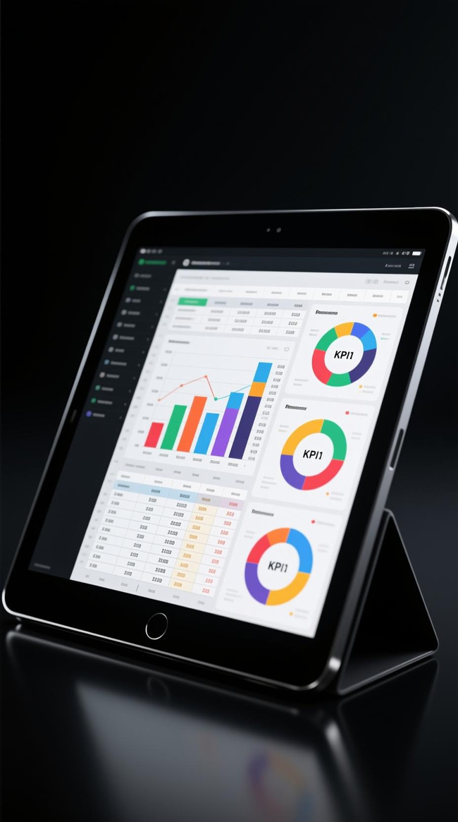
Dataset Summary
Product-Level Data
Price, material, section, season, promotional status for each item
Sales Metrics
Total sales, units sold, profit calculations tracked across dimensions
Multi-Dimensional Analysis
Seasons, materials, store locations, price bands, positioning
Performance Tracking
Promotions, pricing strategies, product positioning effectiveness

Slide 4

Data Cleaning & Transformation
Profiling
Identified missing values & inconsistencies
Standardization
Text fields cleaned, nulls handled, types corrected
Integration
Merged tables, unpivoted columns
Calculation
Created Promotion %, Profit %, unified schema

Slide 5
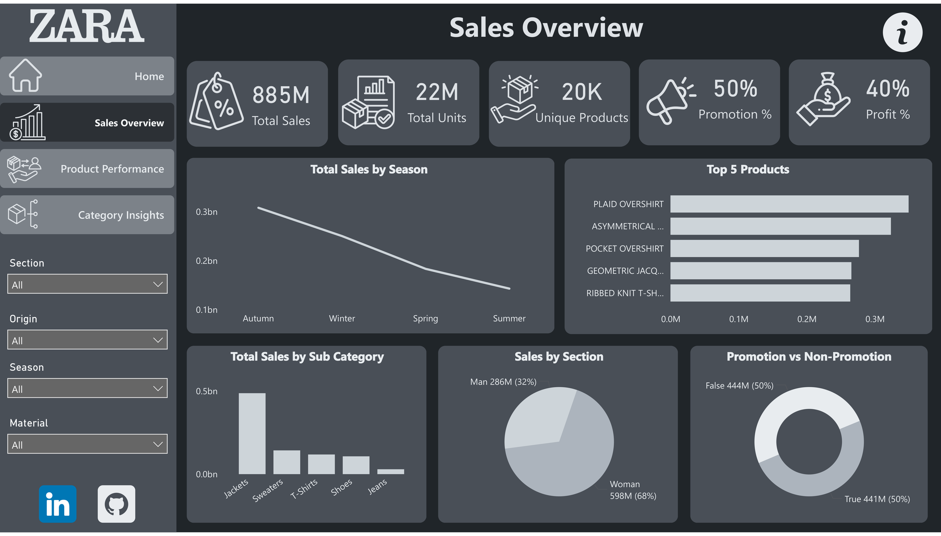

Slide 6

Sales Overview: Key Insights
Seasonal Performance
Top Products
Section Dominance
Autumn leadsas best-performing season; Summer shows significant drop
Plaid Overshirt & Asymmetrical Jacket drive highest revenue
Women's section contributes 68% of
total sales
Promotion Impact
Profitability
50% of sales occurduring promotional periods
Consistent 40% profit margin across categories

Slide 7

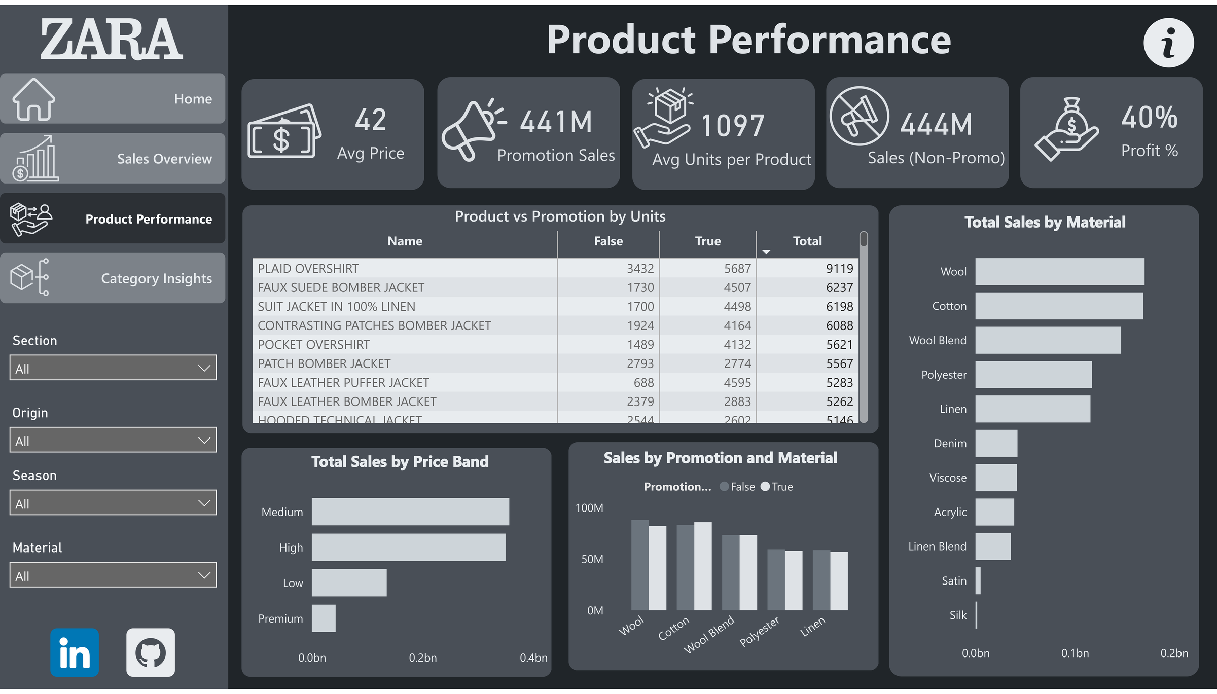

Slide 8

Product Performance: Insights
Material Leadership
Price Band Performance
Promotion Effectiveness
Wool &Cotton dominate material-based sales performance
Medium-priced products generate highest revenue contribution
Promotions significantly boost sales
performance and volume
Key Finding
High-unit products correlate strongly with promotional activity. Material composition directly impacts profitability margins.

Slide 9
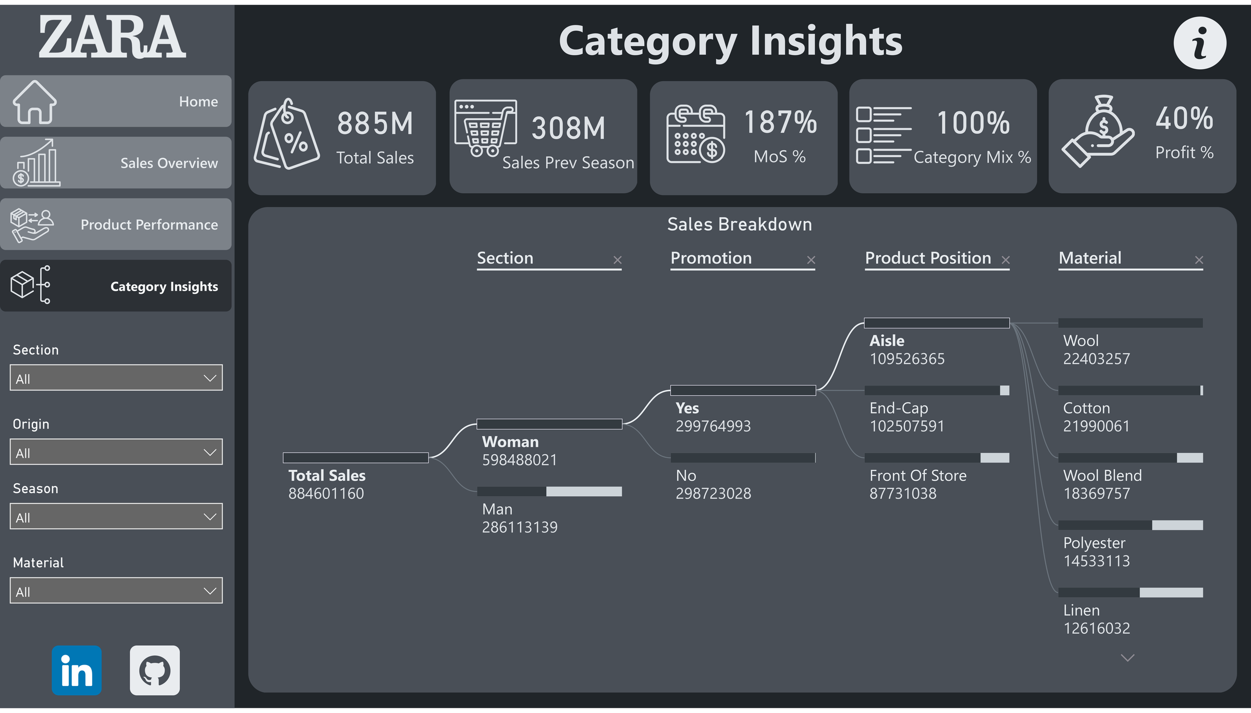

Slide 10
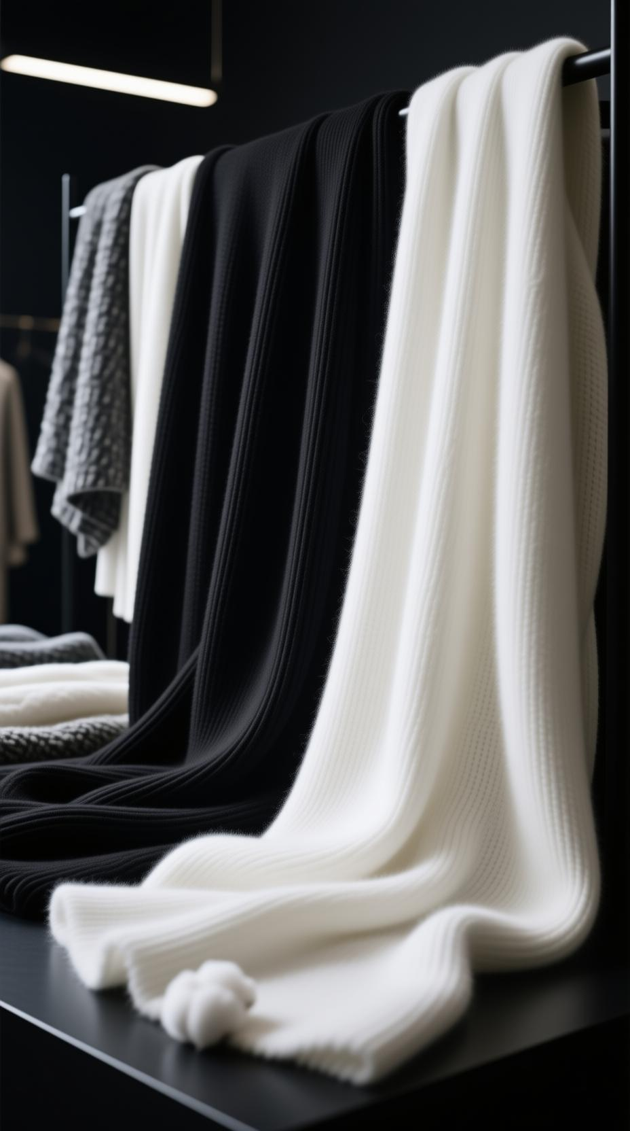
Category Insights: Breakdown
Women's Section
Promotion Split
$598 M sales
Clear market leader
$300M vs $298M
Evenly balanced
Top Placement
Aisle& End-Cap
Prime visibility
Top Materials
Key Insight: Product placement strongly influences sales visibility and customer engagement in-store
Wool Cotton Wool Blend

Slide 11
Conclusion
Strategic Drivers of Success
03
Material Excellence
01
Women's Section Dominance
Performance drivenby women'scategory and seasonal demand cycles
04
Price Band Optimization
02
Promotion Power
Promotions heavily influence sales uplift and product visibility
Wool and Cotton emerge a stop-performing materials
05
Placement Strategy
Medium price band products contribute most revenue
Store placement (Aisle³End-Cap) plays major role in sales success

Slide 12
Thank You

