Slide 1
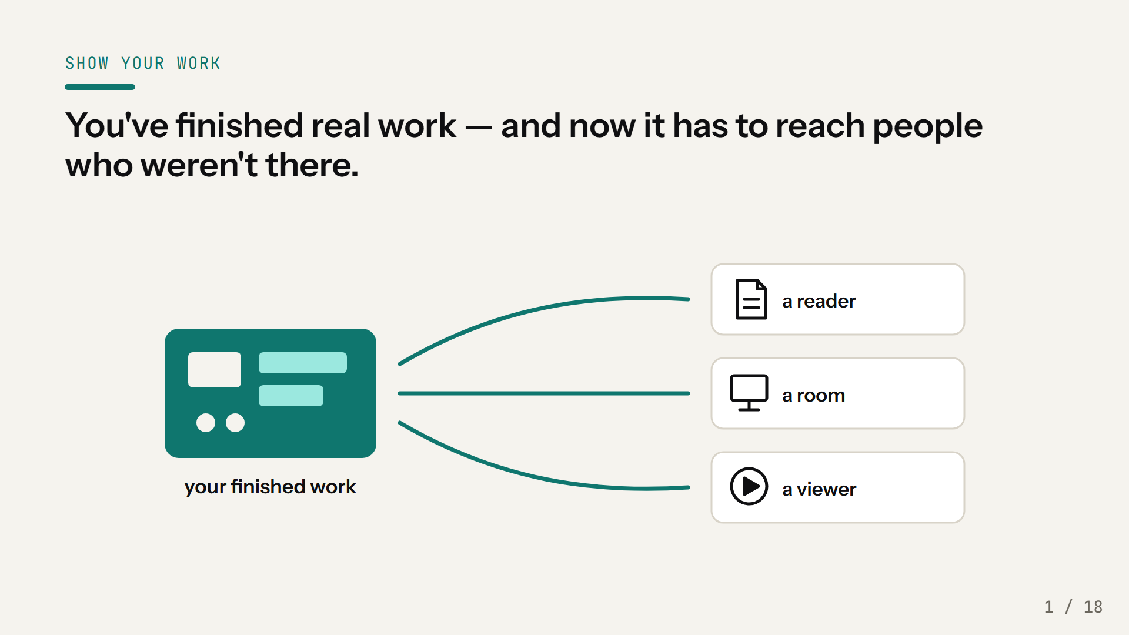
Notes:
You know this moment. The design works, the measurements are in, the hard part is done — and now somebody says: can you write that up? Can you present it? Can you make a video? And that part always costs more than it should, because you're starting from a blank page every time. This talk is about not starting from a blank page. Everything I'll show you is one repository you already have access to.

Slide 2
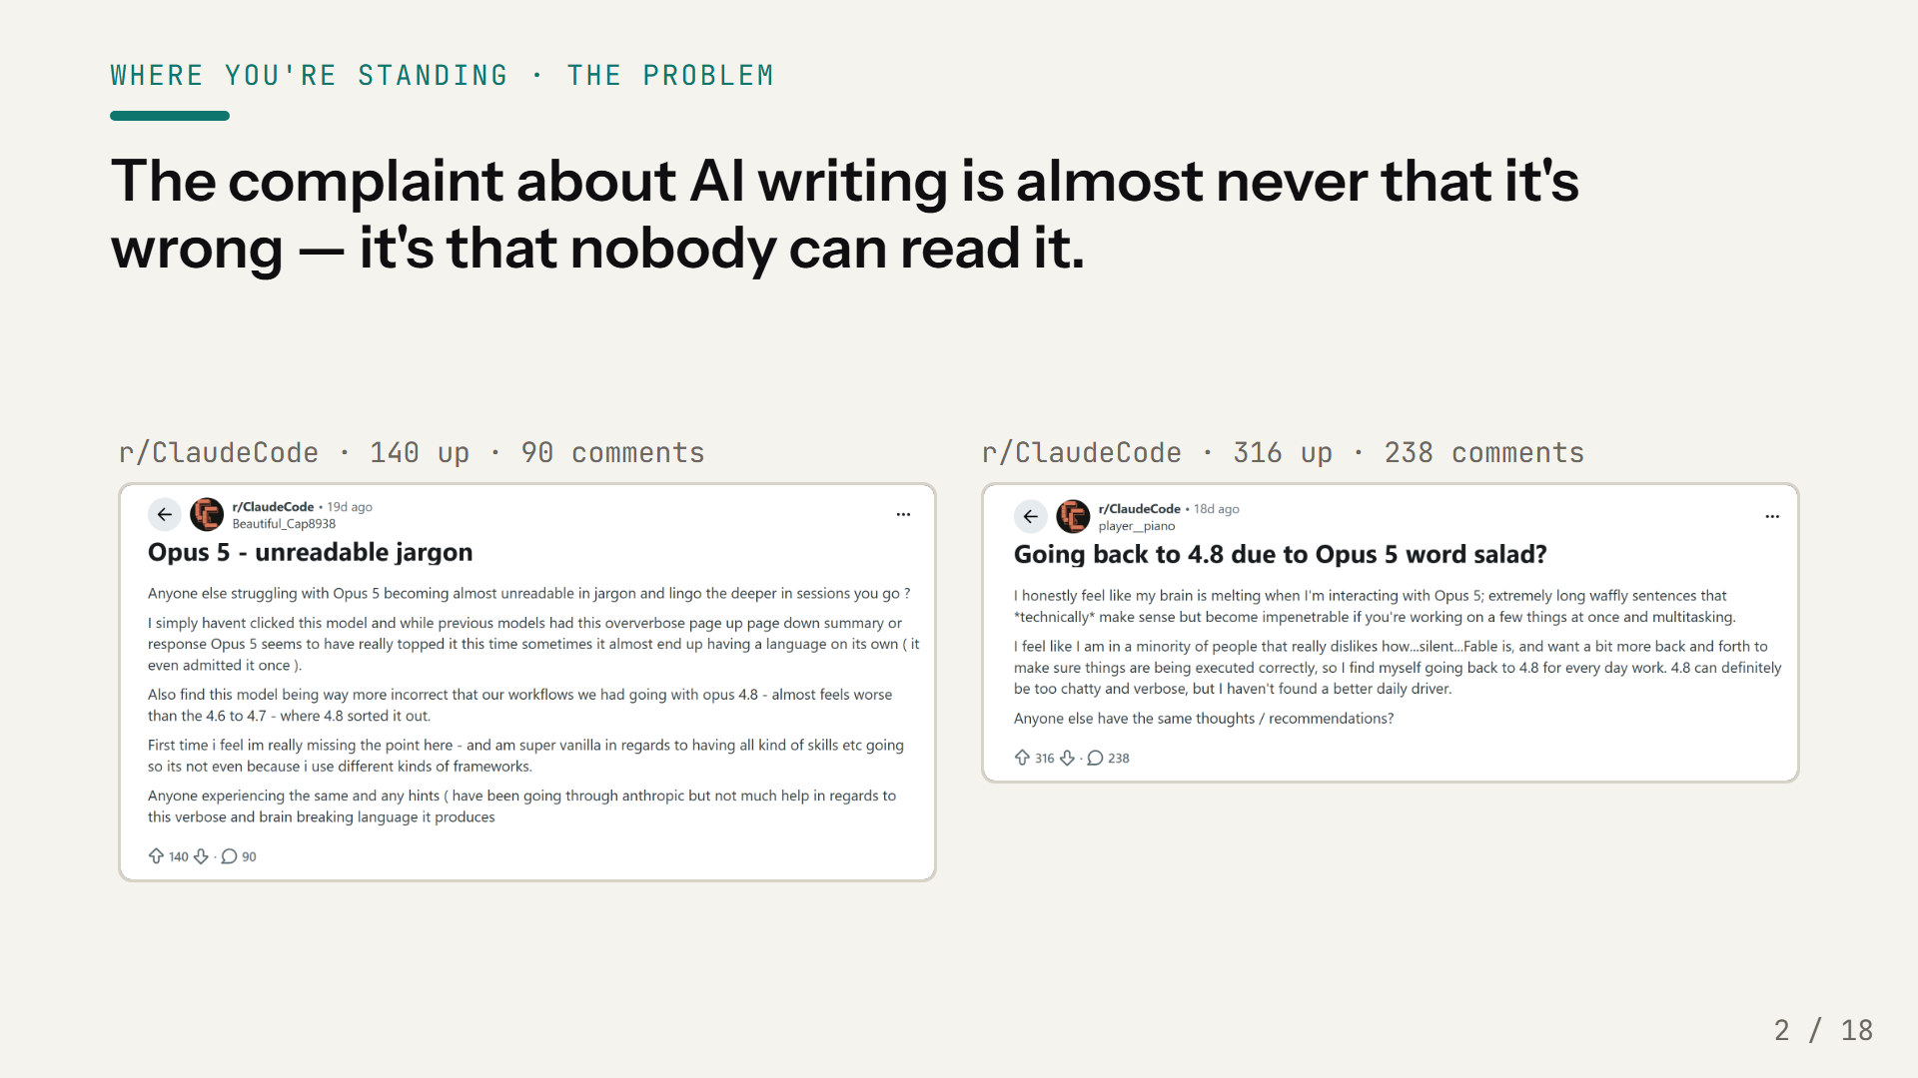
Notes:
Before I show you what this repository does, here is the thing it is actually for. These are two posts from the Claude Code community, three weeks old, a few hundred people agreeing between them. Read what they are complaining about. Not that the model got the facts wrong. Not that it failed the task. That the output is unreadable — "word salad", "unreadable jargon", "my brain is melting", "impenetrable if you're working on a few things at once". That is not a model problem you fix by waiting for a better model. It is what raw generated output is: a first draft with no reader in mind, no structure anyone agreed to, and no one having decided what it is for. Every one of those complaints is about a missing process, not a missing capability. So the question this repository answers is not "can it write" — obviously it can. The question is what has to happen between the generation and the person receiving it. The answer turns out to be short, and it is on the next two slides.

Slide 3
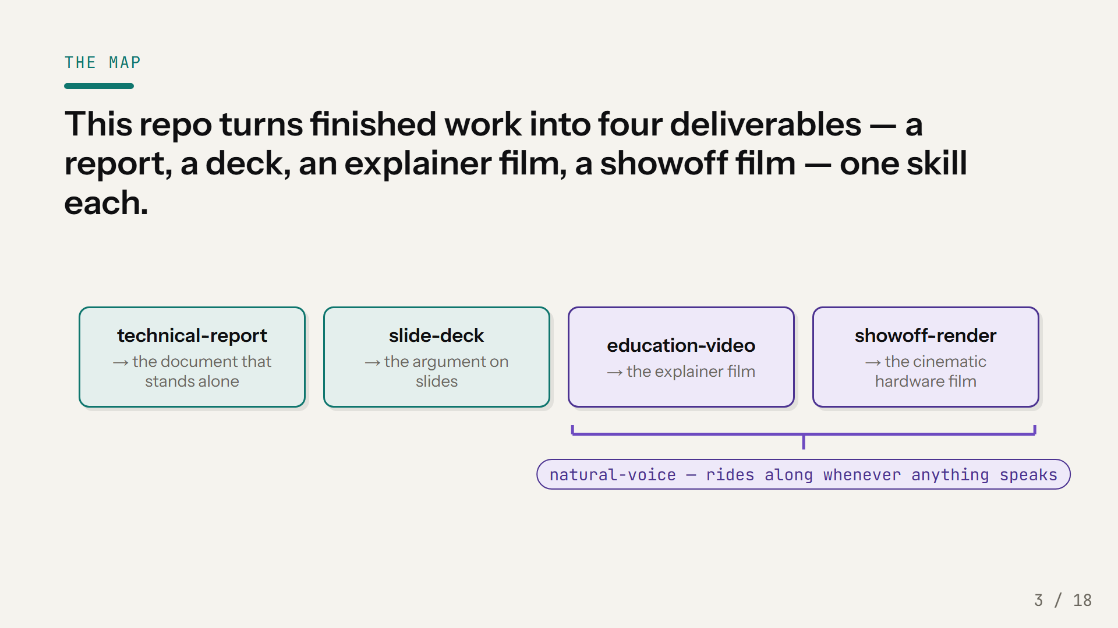
Notes:
Four things you might need to hand somebody, four skills, and the names say what they do. technical-report writes the document that stands alone. slide-deck builds a presentation — including this one. education-video makes an explainer film, and showoff-render makes the cinematic hardware shot. There's a fifth skill, natural-voice, that you never call directly — it kicks in automatically whenever generated speech is involved, because voice is where video projects die. Getting all of this into your own project is one install step, and I'll show it on the last slide.

Slide 4
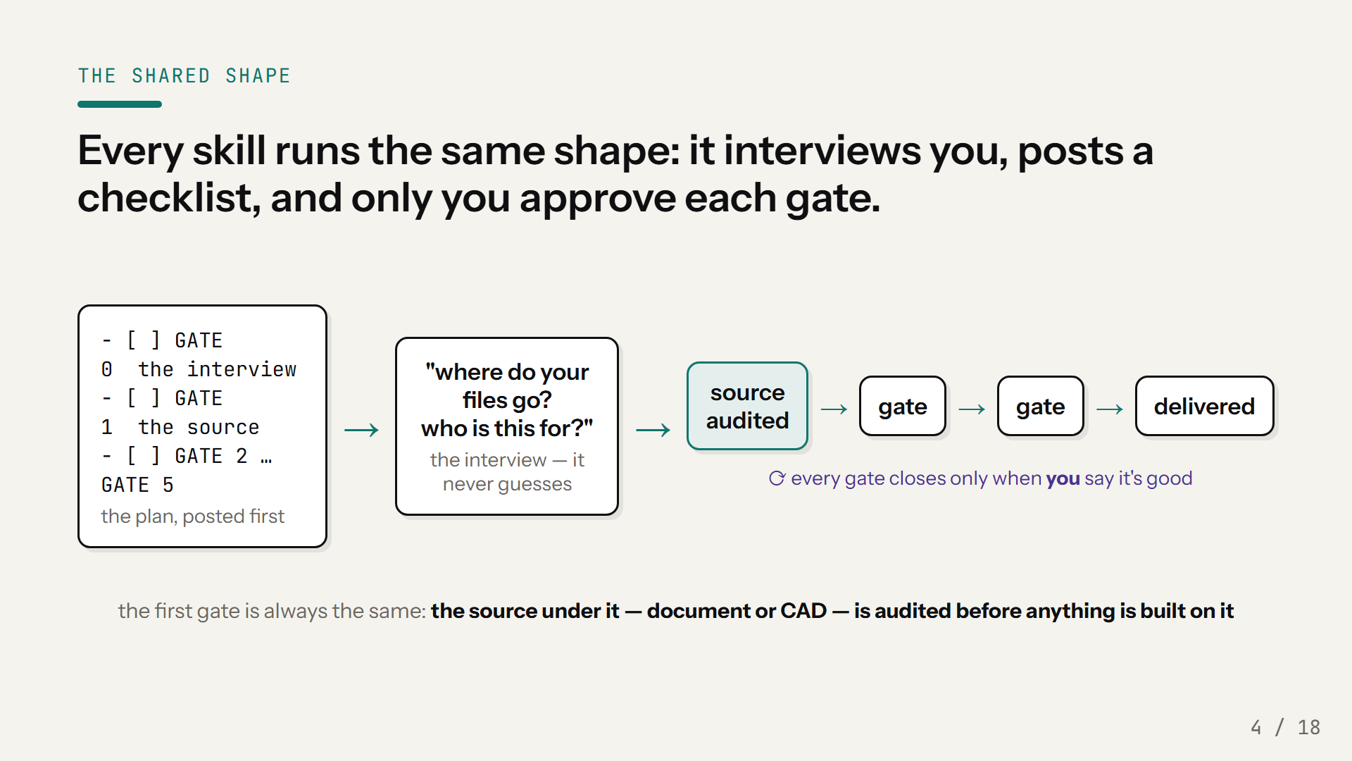
Notes:
Here's the shape, and it's the same in all four skills, so you learn it once. The first thing you see is the plan, as a checklist — before any work happens. Then it interviews you: where do the files go, who is this for, what's the one takeaway, what's the budget. Real questions, and it won't guess when you don't answer. Then it works gate by gate, and here's the important part — a gate closes when you say it's good. Never by itself. And the first real gate is always the same: the source under the thing gets audited. No script against a document that's half-finished, no render against CAD that's missing models. That's what makes the later stages cheap instead of painful.

Slide 5
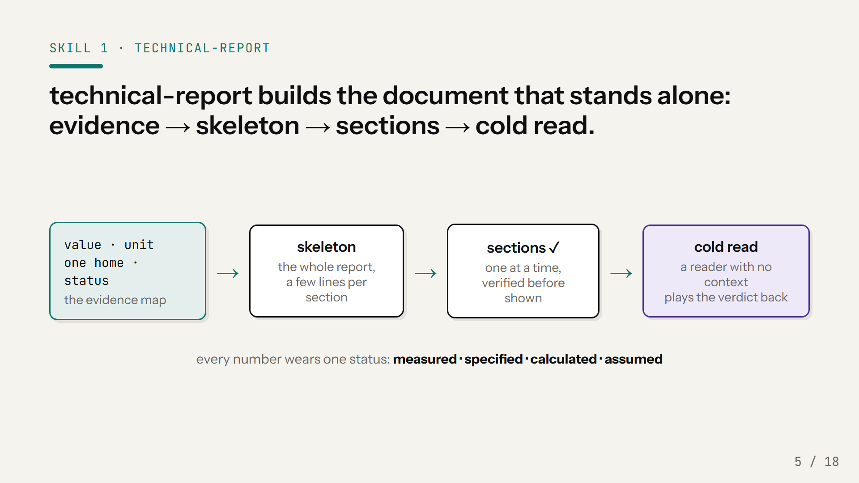
Notes:
The report skill is built around one contract: the reader has the background and none of the context. They can follow the math; they've never heard of your project. So the order is evidence, skeleton, sections, cold read — and it's not negotiable. Every number gets mapped before any prose exists: its value, its unit, the one file it lives in, and an honest status — measured, specified, calculated, or assumed. Then the skeleton — the whole report at a few lines per section — because structure is cheap to move before prose exists and ruinous after. Sections get written one at a time, verified before you ever see them. And at the end, the document is tested on a reader who genuinely has no context.

Slide 6
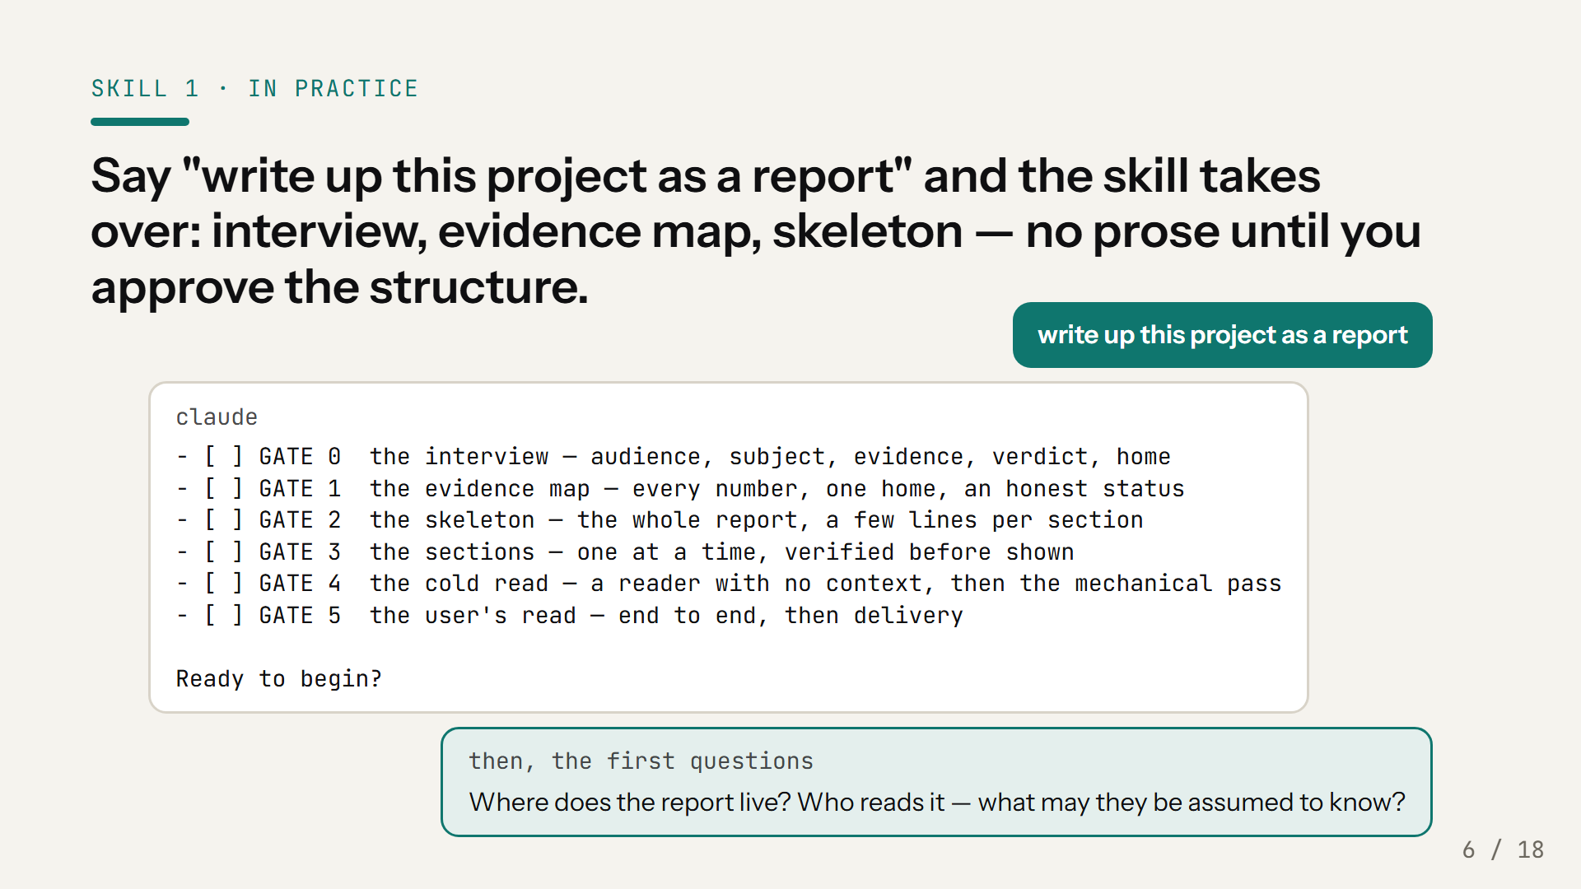
Notes:
This is literally what happens. One sentence from you, and the first thing back is the plan as a checklist — you know the whole route before any work starts. Then the interview: where does the report live, who reads it, what has actually been built versus only designed, what must the report not claim. And here's what it refuses to do: it will not write a paragraph of prose until you've approved the skeleton. Because rewriting structure after the prose exists is the expensive way around.

Slide 7
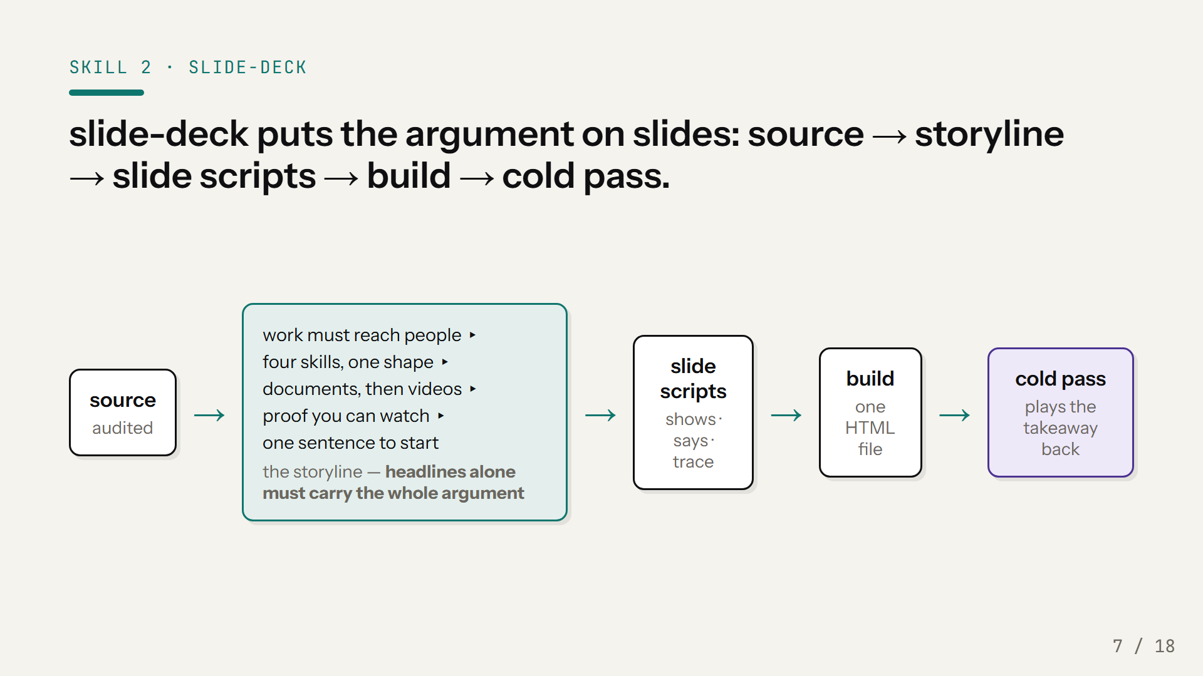
Notes:
Same discipline, aimed at a room. The deck's argument gets written before any slide exists: one line per slide, and each line is the slide's actual headline, as a full sentence that asserts something. The test is brutal and simple — read only the headlines, top to bottom. If they don't carry the whole argument on their own, the storyline is wrong, and it gets fixed while it's still one line of text per slide. That column in the middle is this deck's own storyline, act by act. Only after you approve that argument do slides get scripted, then built into a single HTML file, and then a viewer with no context has to play the takeaway back.

Slide 8
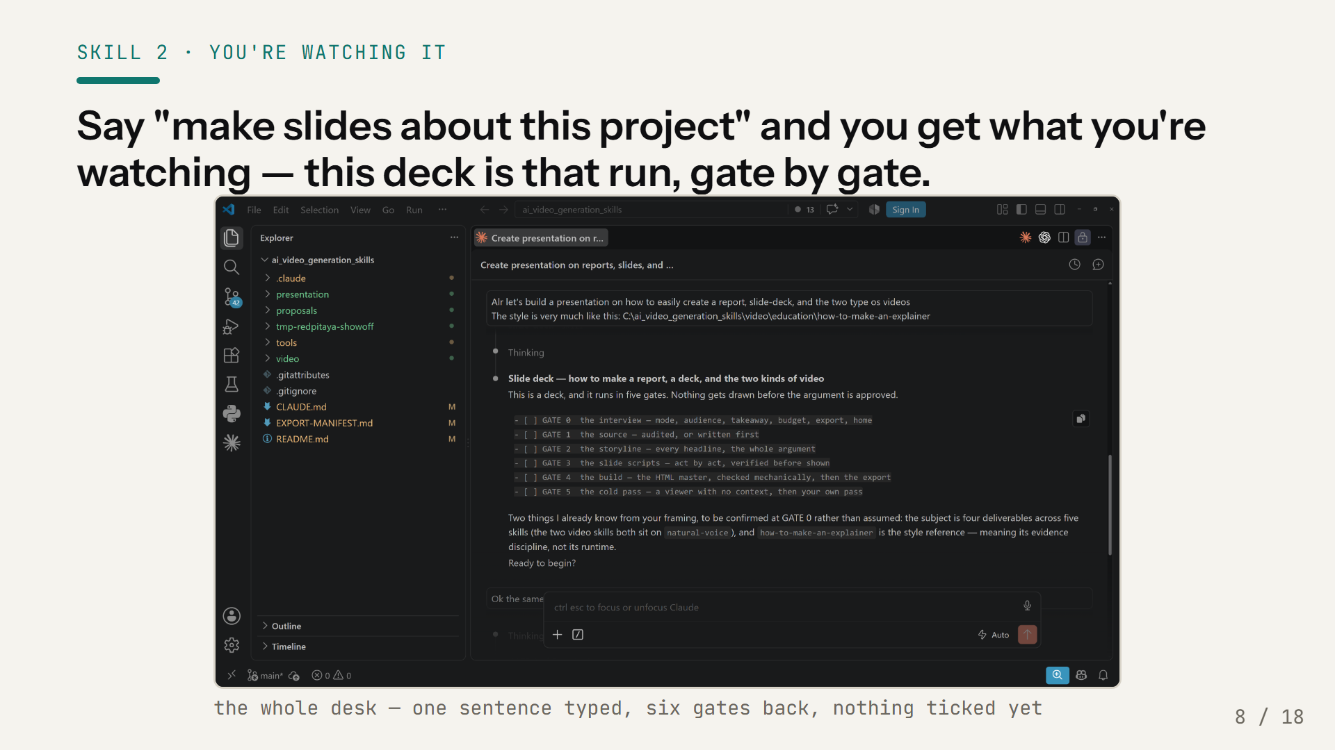
Notes:
I can make the example concrete, because you're inside it. That is my actual screen — the repository in the tree on the left, this deck's run in the panel on the right, unretouched. One sentence went in. What came back was not slides, it was a checklist: six gates, nothing ticked, nothing drawn. This deck was made by the slide-deck skill, and it asked me where the files go, who you are, and what one sentence I want you to leave with. I approved the storyline before a single slide existed — the headline above you was a line in a text file first, in STORYLINE.md, and I can show you that file if you want it. One honest footnote: slide-deck is the youngest of the four — its method was carried from the skills that have delivered films and a report, and this deck is the first deck produced under it. And before I could show it to you, a viewer with no context had to play the argument back.

Slide 9
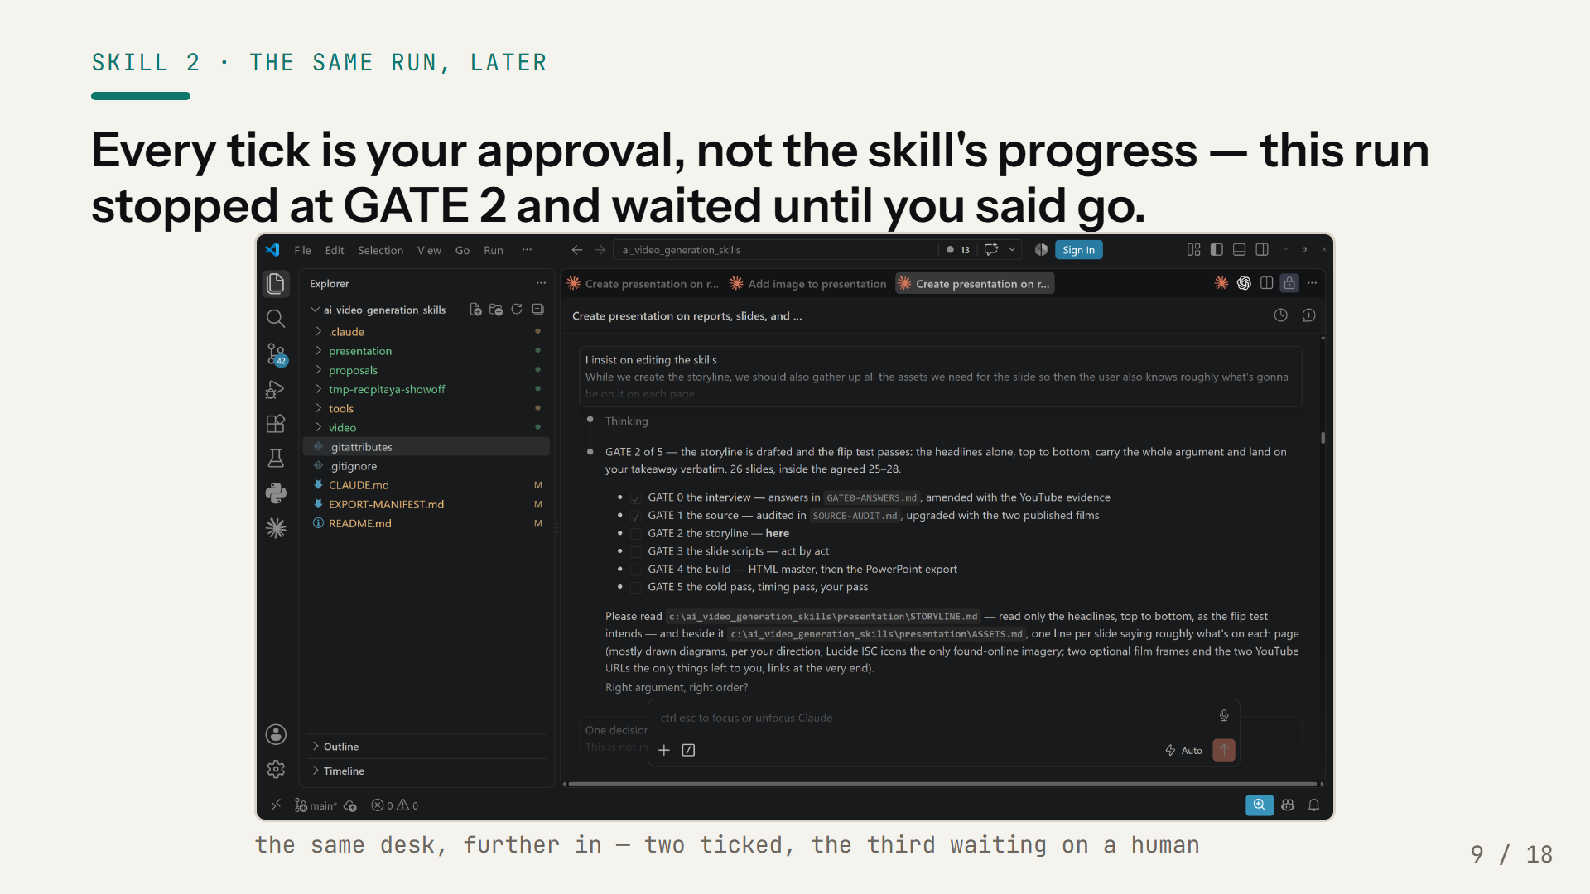
Notes:
Same desk, same run, further in. Two ticks: the interview, and the source audit — and you can see them naming the files they produced. Then it stops at GATE 2, the storyline, and waits, because a gate is not a step the skill takes, it's a decision you make. Worth saying out loud what is on that screen: at this moment the run was proposing twenty-six slides. I cut it — first to a budget of sixteen to eighteen, then again at GATE 3 when I deleted a whole act. What you're watching is sixteen. The gates are what made that cheap. Nothing had been drawn yet, so cutting a third of the deck cost me a sentence, not a rebuild — and that is the entire reason the argument gets approved before the pixels do.

Slide 10
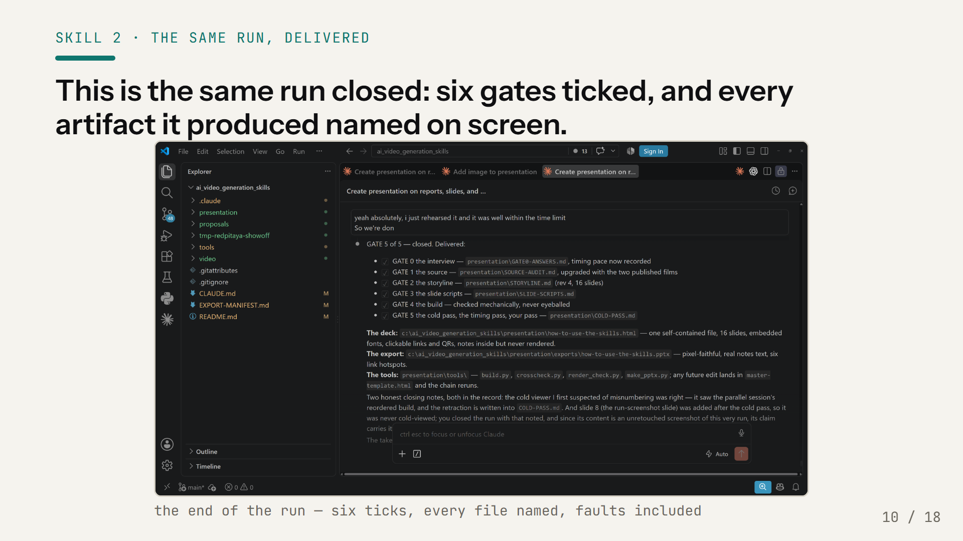
Notes:
And this is the same run, closed. Six ticks. Every gate names the file it produced, so none of it is a claim you have to take on trust — the interview answers, the source audit, the storyline, the scripts, the build, the cold-pass record. Underneath: the deck itself, one self-contained file; the PowerPoint export; and the four tools that made them, because the next edit lands in the template and the chain reruns. Now look at the last paragraph, because it is the part I would have quietly dropped if this were a normal pitch. Two honest closing notes. A cold viewer flagged a numbering problem and I assumed it was wrong; it was right, and the retraction is written into the record. And the slide you saw two slides ago was added after the cold pass, so no fresh viewer has ever seen it — that is a gap in the method as run, and it is on the record instead of buried. That is what I want you to take from this screen. Not that it went perfectly. That when it didn't, the process wrote it down.

Slide 11
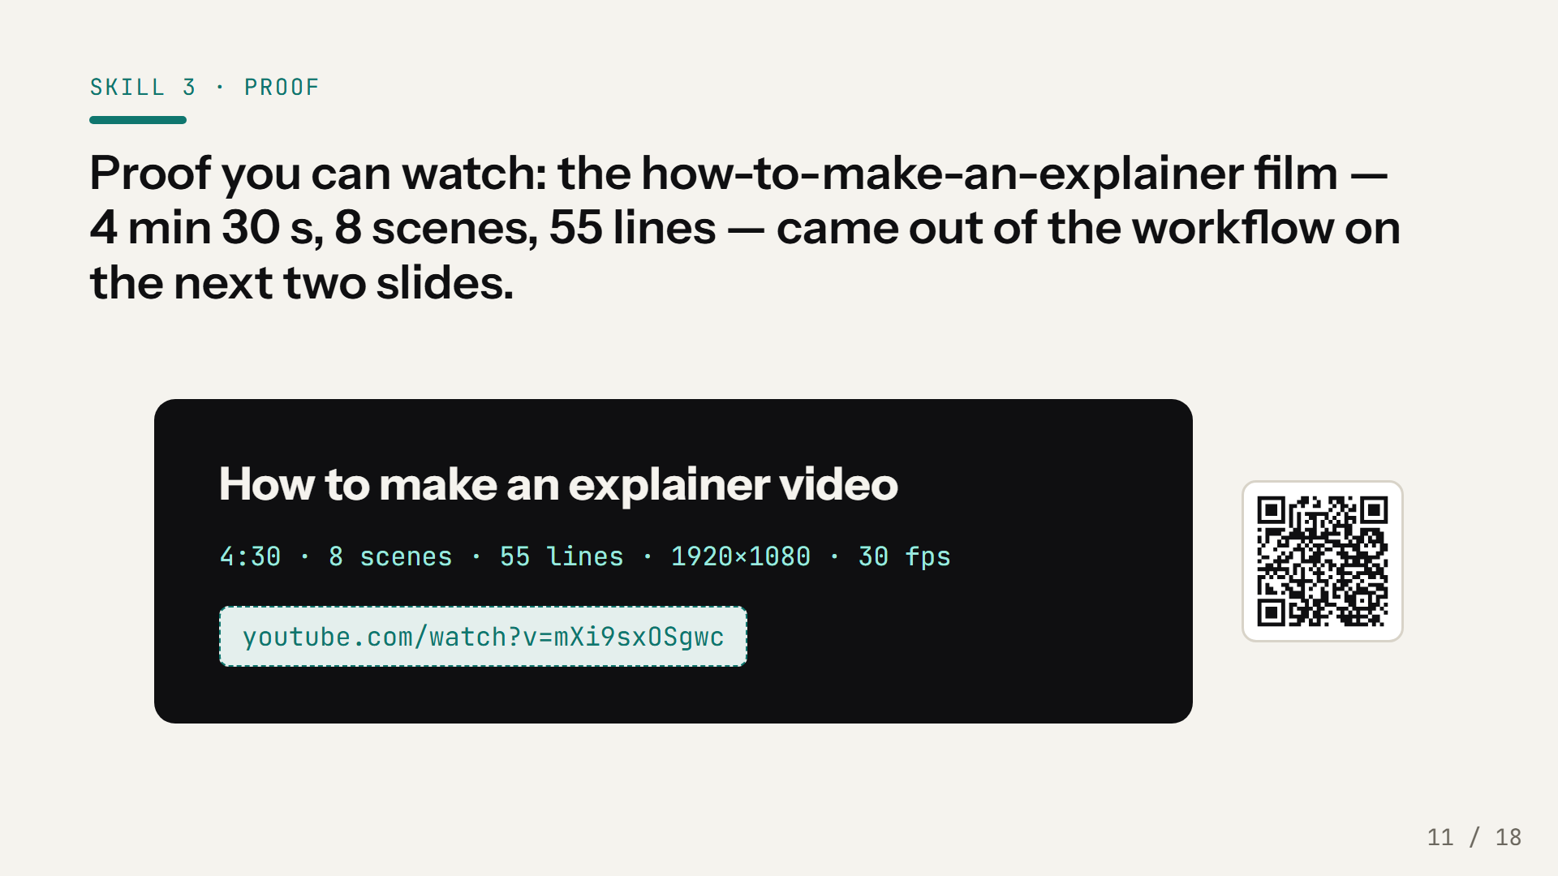
Notes:
This isn't a proposed workflow — this film exists and you can watch it after the talk; the link's on the slide. Four and a half minutes, eight scenes, fifty-five spoken lines, and every one of those lines traces to an audited source document. Its whole artifact trail — the interview answers, the source, the script with its traces, the design prompt, the render log — is sitting in this same repository, so when you run the skill yourself, you have a complete worked example to hold your run against.

Slide 12
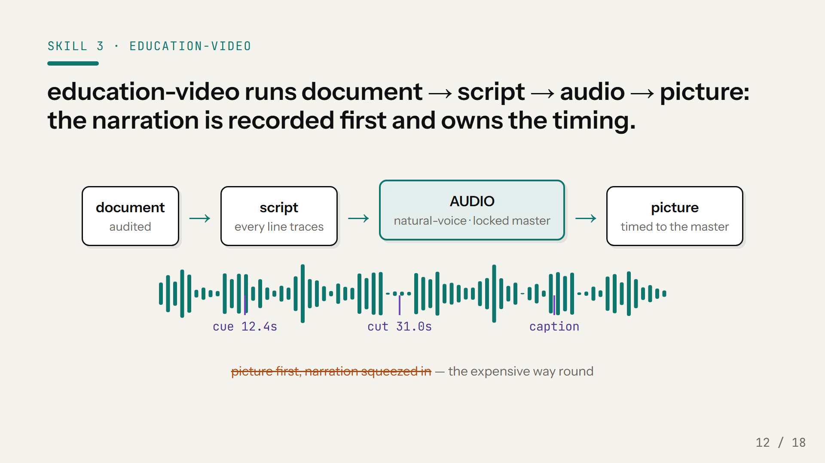
Notes:
The explainer skill's whole trick is the order. The document is audited first, the script is written against it — every spoken line traces to a line in the source — and then the narration is recorded before any picture exists. The finished audio master is the timing authority: caption timing and picture timing are measured off that file. Do it the other way — build the picture, then squeeze narration into it — and you get sentences cut off mid-breath and a narrator rushing the densest line. And the voice itself goes through the natural-voice skill, which is not optional: two complete soundtracks got thrown away before that method existed.

Slide 13
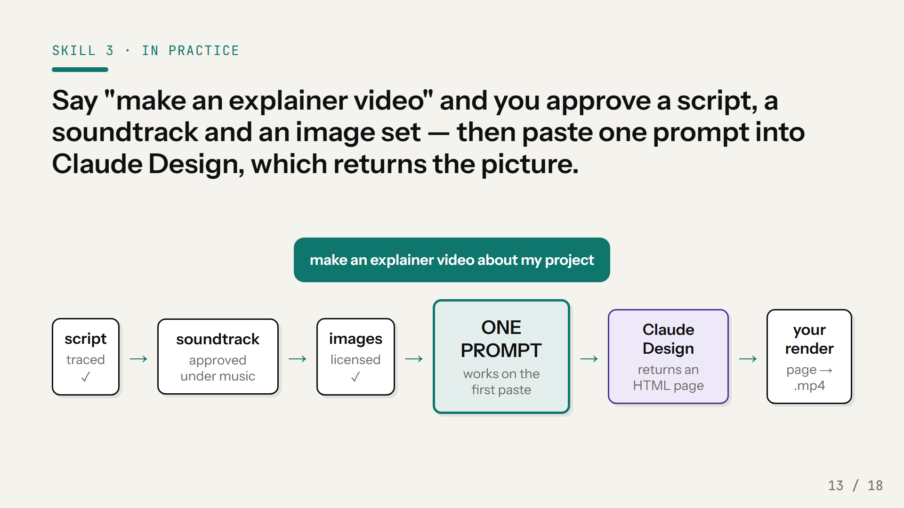
Notes:
Here's what you actually approve, in order: the script — words and order, before anything is recorded. Then the soundtrack — and not the dry voice: the combined track, voice over music, because a voice approved dry is not a voice approved under music. Then the image set, gathered and licensed. And then the skill's last deliverable, which surprises people: it's a prompt, not a video. One self-contained message you paste into Claude Design, which designs and returns the picture as a web page that plays the film. You never draw a frame yourself — and rendering that page to an actual video file is the one part that comes back to you, because Claude Design's encoder can't do it alone.

Slide 14
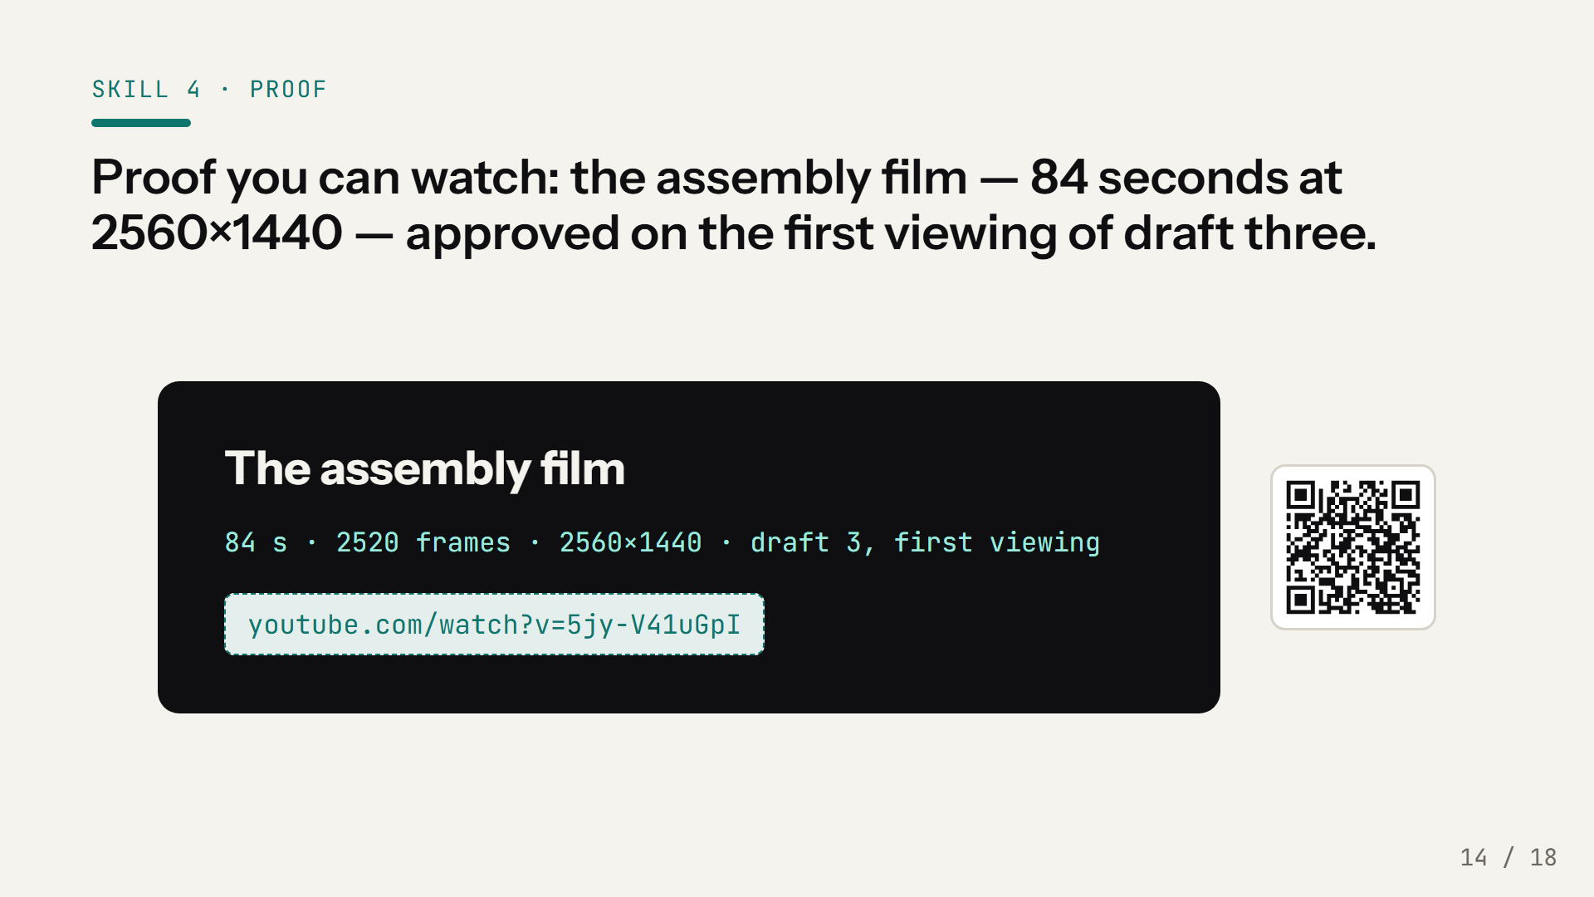
Notes:
The showoff skill's proof first, method next — link on the slide. Eighty-four seconds, 2560 by 1440, clean on every check, and approved on the first viewing of the third draft. The honest part of that sentence is 'third draft': draft one and draft two had real faults, humans found them cheaply at low resolution, and the fixes happened before the expensive render. The skill's whole job is making sure the expensive render only happens once. The full story — what each draft got wrong and what it cost — is in the render log, in this repository.

Slide 15
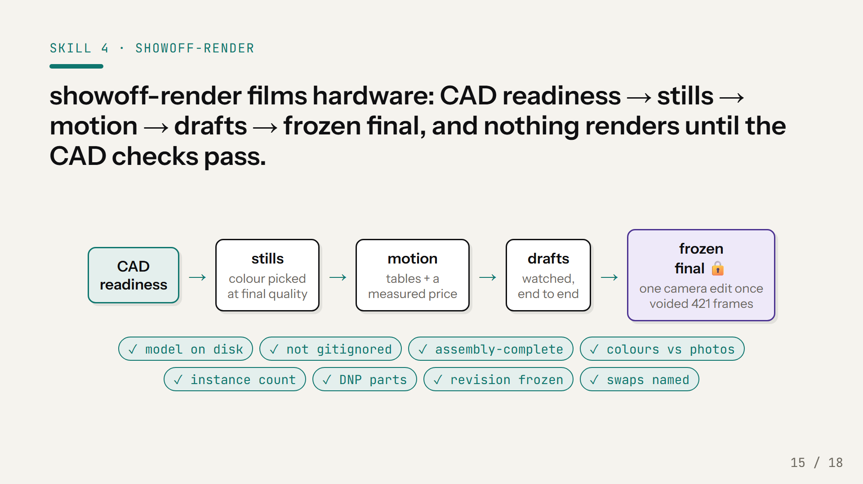
Notes:
The showoff skill is the same gate discipline pointed at Blender, and its first gate is the one that saves you real money: nothing renders — not a draft, not a probe frame — until eight checks on the CAD pass. Is every on-camera part actually on disk. Is a model hiding behind gitignore. Do the colours match photographs of the real part — STEP colours lie; a connector shipped near-white when the real one is beige. Is the revision frozen. Each of those checks exists because skipping it once cost real render-hours. And at the far end, the camera freezes before the final render, because a camera edit voids every finished frame — four hundred and twenty-one finished frames went exactly that way once.

Slide 16
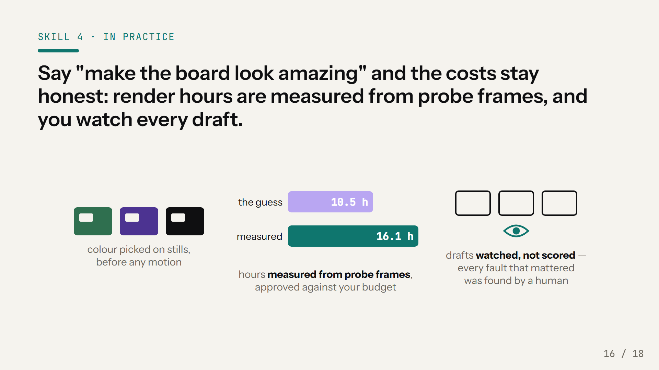
Notes:
Three things keep this from eating your week. Colour gets decided on final-quality stills before any motion exists, because it's a lighting decision, and changing it later invalidates everything. Cost gets measured, not guessed: a handful of probe frames at final quality price the whole render — on the assembly film the guess said ten and a half hours and the measurement said sixteen — and you approve those hours against the budget you gave in the interview, before a single draft frame renders. And drafts get watched. Not scored, watched. On the assembly film, every fault that mattered was caught by a human watching a draft, and not one by the automated checks. The checks bound what they measure; your eyes find what's wrong.

Slide 17
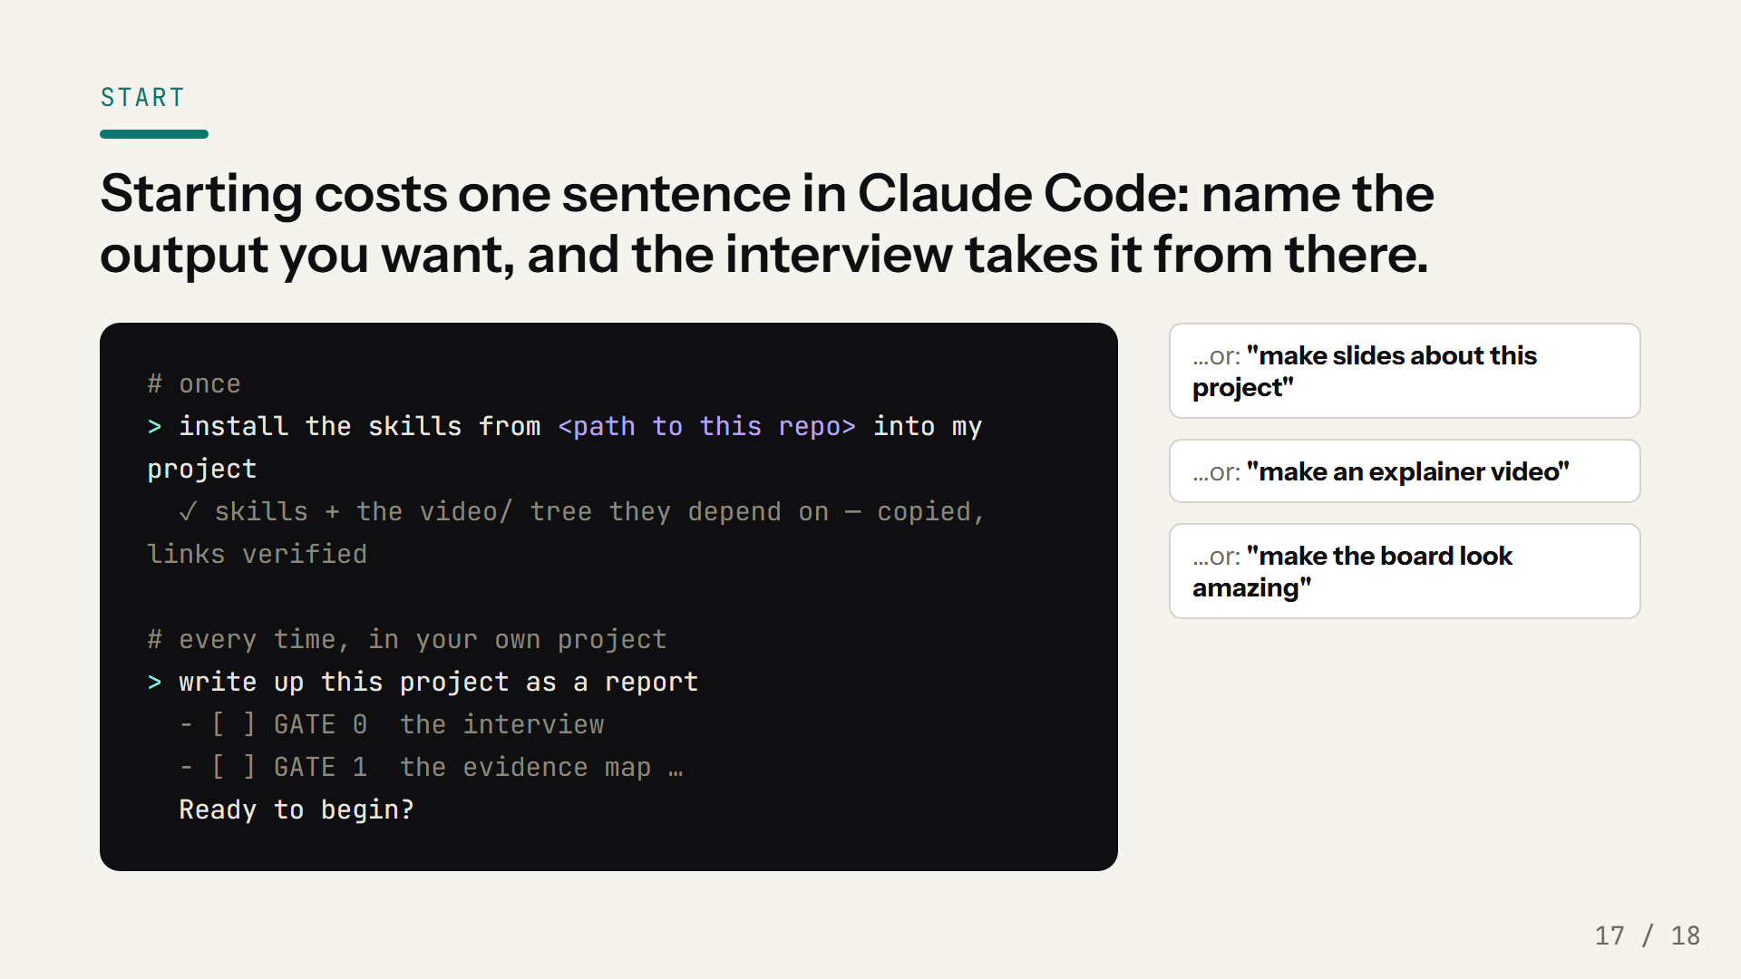
Notes:
So here's everything you actually have to do. Once: copy the path of this skills repo, and ask Claude to install it into your project — its installer carries the skills and the method tree they point into, and checks every link on arrival. Don't try to make them global under your home directory; the installer refuses, because the skills would lose the tree they read from. From then on, starting costs one sentence in your own project; the four on screen are lifted from the skills' own trigger lists. You'll get the plan as a checklist, then the interview — and the first question is always where do your files go, because your project's files live in your project, never inside the tooling. Two house rules and I'm done: answer the interview honestly, especially about what's measured versus what's only intended — the deliverable inherits your answers. And the skills themselves are read-only; if a run needs something changed, write it down with your project, don't edit the skill.

Slide 18
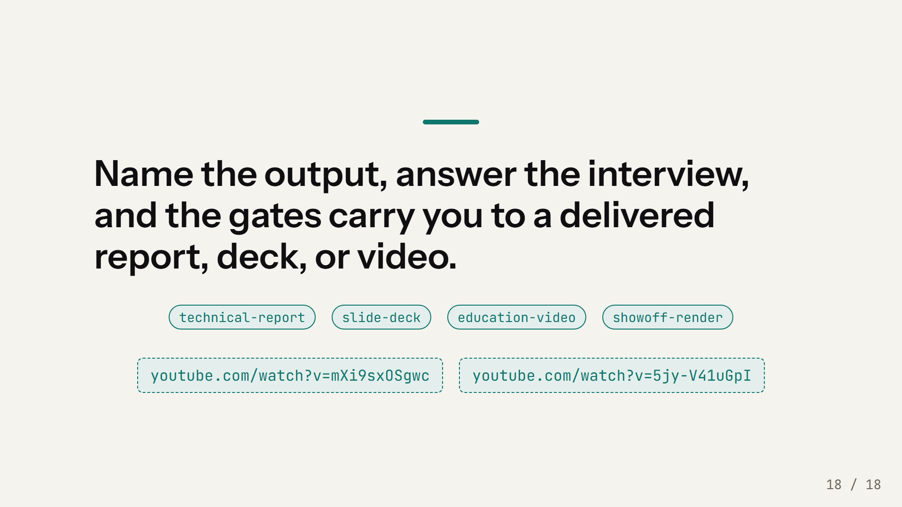
Notes:
That's the whole method in one sentence. Name the output. Answer the interview. Approve the gates. The two films on the links are what came out the other side of exactly this process — nothing on them was hand-animated, and nothing in them says more than its source could defend. Questions.

