Slide 1
Mini-Project
Saad Bouayad CSC 510.03
San Francisco State University

Slide 2
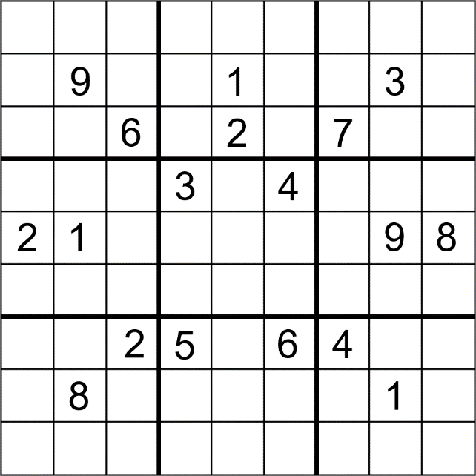


Motivation and Overview
Constraint Satisfaction Problem
CSP is ubiquitous and can be found in all technical and professional fields(airlines scheduling, solving games like sudoku or chess)

Slide 3
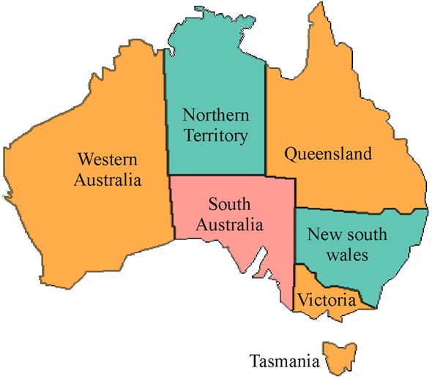
Motivation and Overview
Solve a specific CSP problem:
Using a minimum number N of colors, color a map such that no two neighbor(adjacent) states should have the same color.
Example of the Australian Map

Slide 4
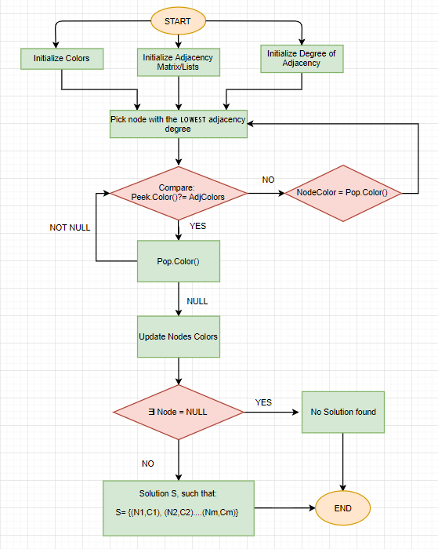
Flowchart: Block-diagram

Slide 5
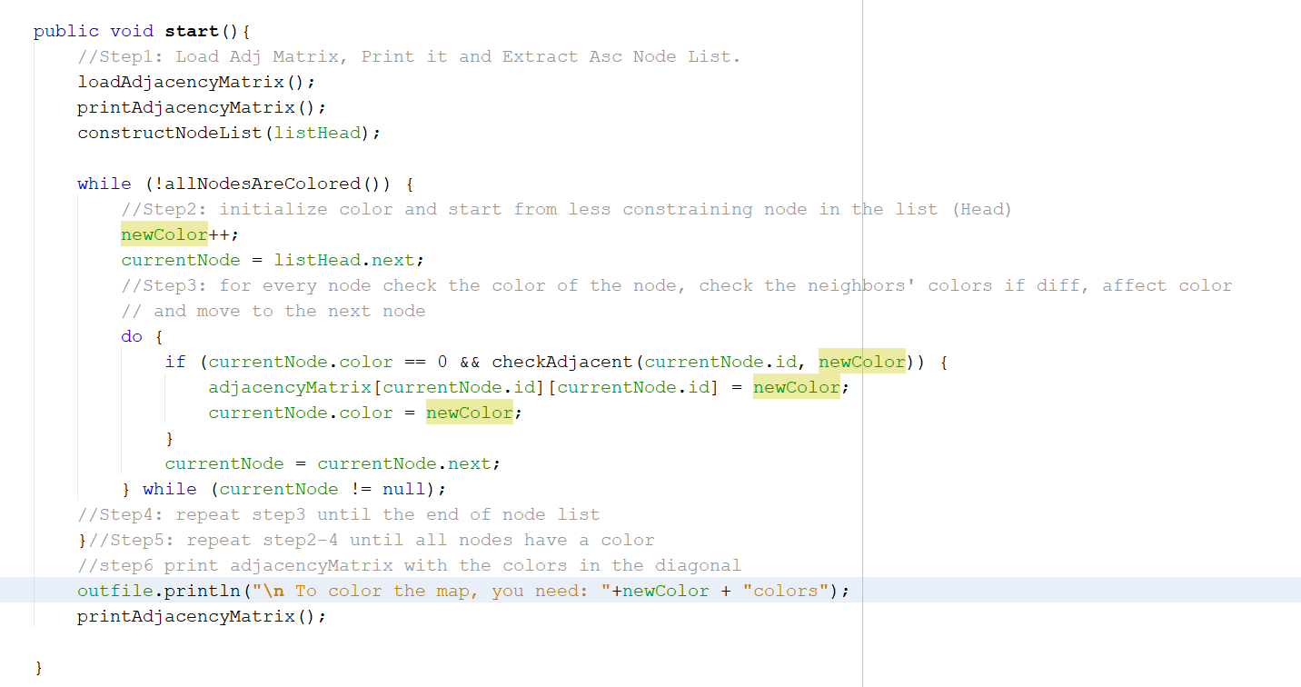
Implementation

Slide 6
Data Structures
A
B
Degree of Adjacency → Number of Edges
States → Nodes
Solution: Matrix
C
D
Node | Adjacency | Adj degree
A | B-C | 2
B | A-C-D | 3
C | A-B-D | 3
D | B-C | 2

Slide 7
Example
6
5
1
7
4
2
8
3
9
10

Slide 8
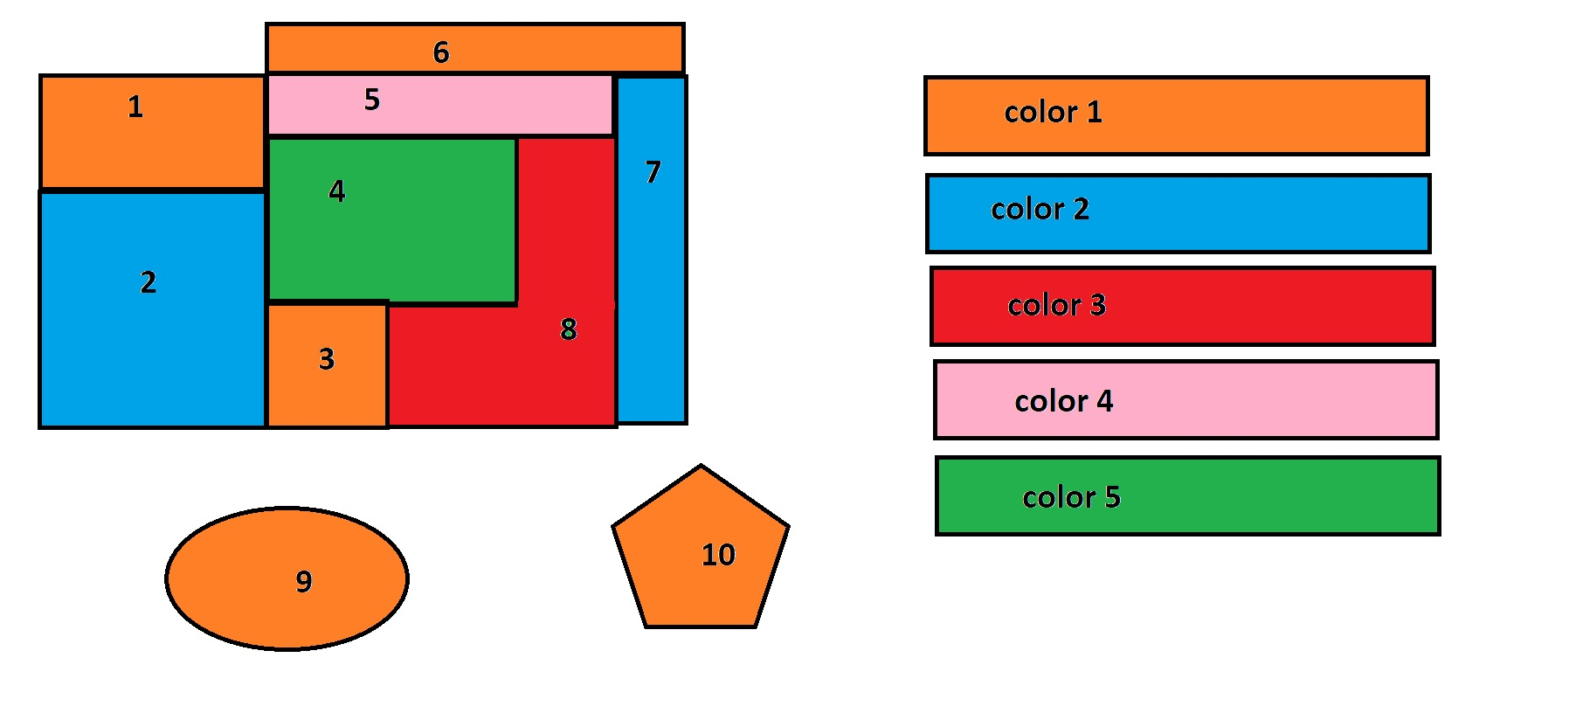
Output

