Slide 1
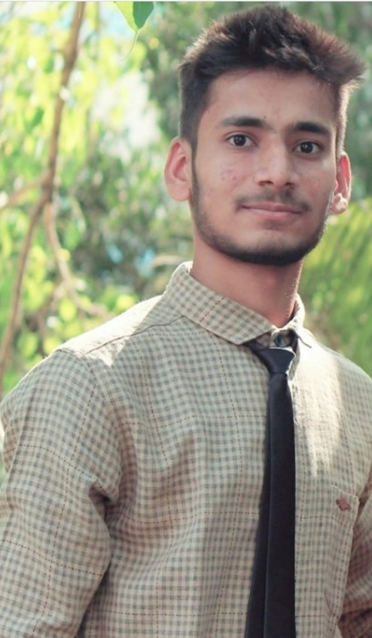

Hails form Jalgaon
B.Tech in Mechanical Engineering
Hobbies
Trekking
Reading
Cricket
Akshay Agiwal
Trainee Analyst
New Business

