Slide 1
Web Design Principles
Riyam k.Marjan
University Of Babylon – Faculty of Information Technology
Third Stage – 2019-2020

Slide 2
Outlines
Introduction
principles of Graphic Design
The elements of Graphic Design

Slide 3
principles of Graphic Design

Slide 4
Introduction
Good design, much like anything, starts with understanding the basics. Applying the following design principles will help you avoid design disasters and allow you to communicate your key theme.

Slide 5
Design Principles
Alignment
Alignment creates a sharper, more ordered design. Aligning elements allows them to create a visual connection with each other. It tightens the design and eliminates the haphazard, messy effect which comes when items are placed randomly.
Aligning elements which are not in close proximity with each other, helps to provide an invisible connection between them.
Alignment is one of the most basic and important principles of design. It allows us to create order and organisation among elements.

Slide 6
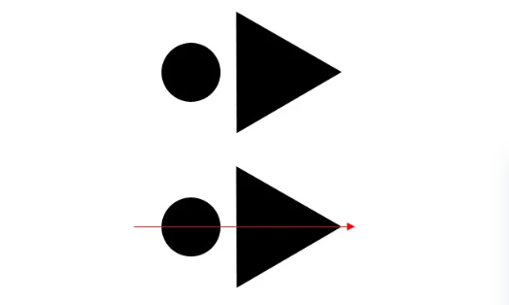
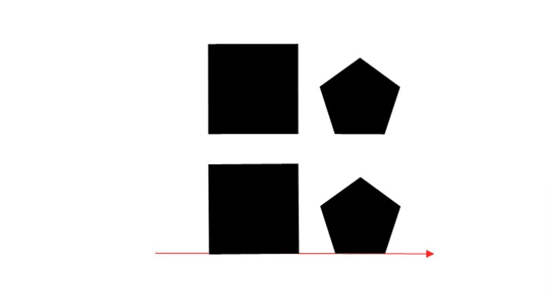

Slide 7
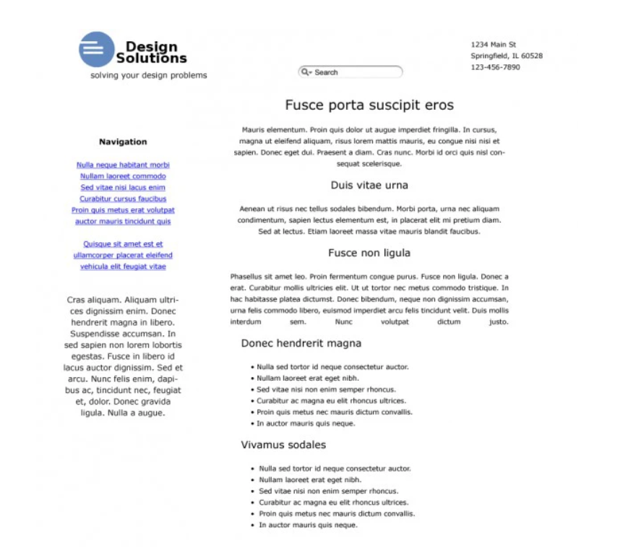
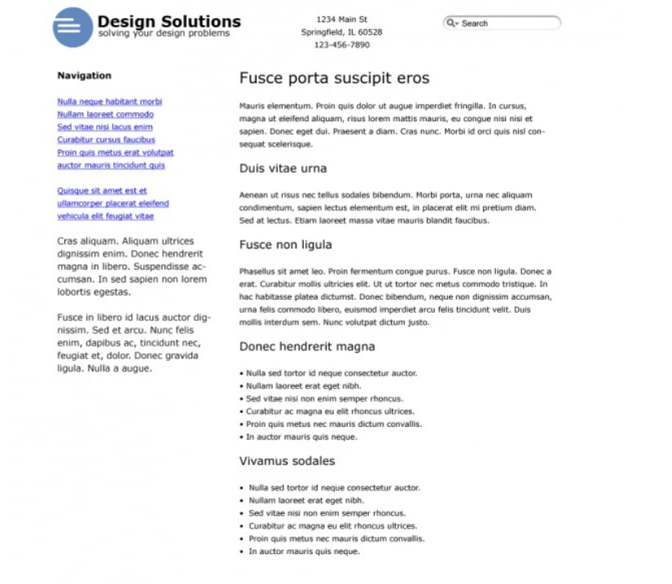

Slide 8
Design Principles
Repetition
Repetition strengthens a design by tying together individual elements. It helps to create association and consistency.
The consistent repetition of an element is widely used in multi-page documents & websites. Elements can be as simple as colour, shapes, typefaces or even texture.

Slide 9
Design Principles
Contrast
Contrast allows you to emphasize or highlight key elements within your design. Contrast is created when two elements are total opposites.
This doesn’t necessarily have to be colours either. It can be achieved with fonts (classic/contemporary), lines (thick/thin) and shapes (big/small), just to name a few.
Contrast plays a crucial part in the organisation of information on a page. It will guide the reader to where they should look first or to the most important element. For it to work successfully though, it must be strong and obvious. It needs to make an impact.

Slide 10


Slide 11
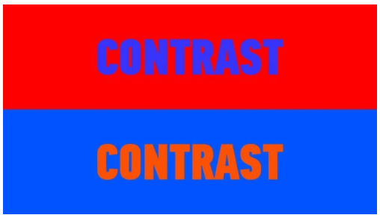
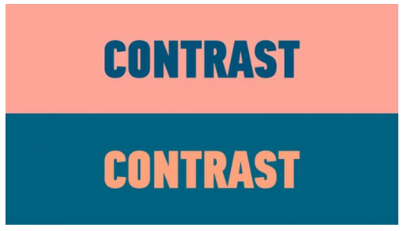

Slide 12

Design Principles
Proximity
The principle of proximity states that elements that are associated with each other should be placed closely (grouped together), and vice versa.
The application of proximity, especially in web design, can lead to better user experience.

Slide 13
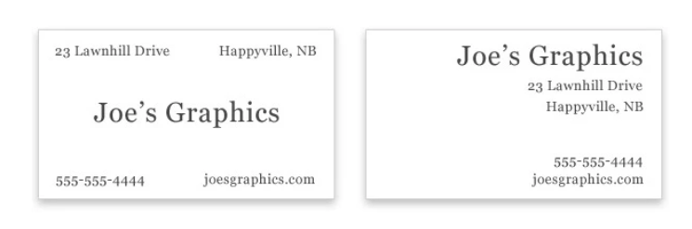

Slide 14
Design Principles
Balance
Balance provides stability and structure to a design. It’s the weight distributed in the design by the placement of your elements. The elements don’t necessarily need to be of the same size. Balance can be achieved by placing a large element on one side of your design and several small elements on the other side.
There are three main types of balance;
Symmetrical Balance (formal)
Asymmetrical Balance (informal)
Radial Balance

Slide 15
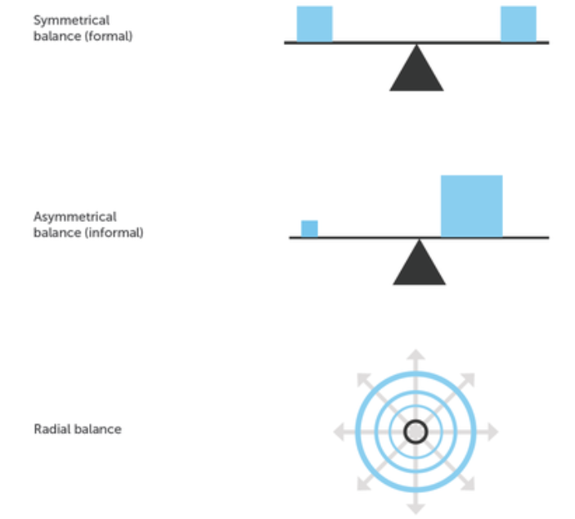

Slide 16
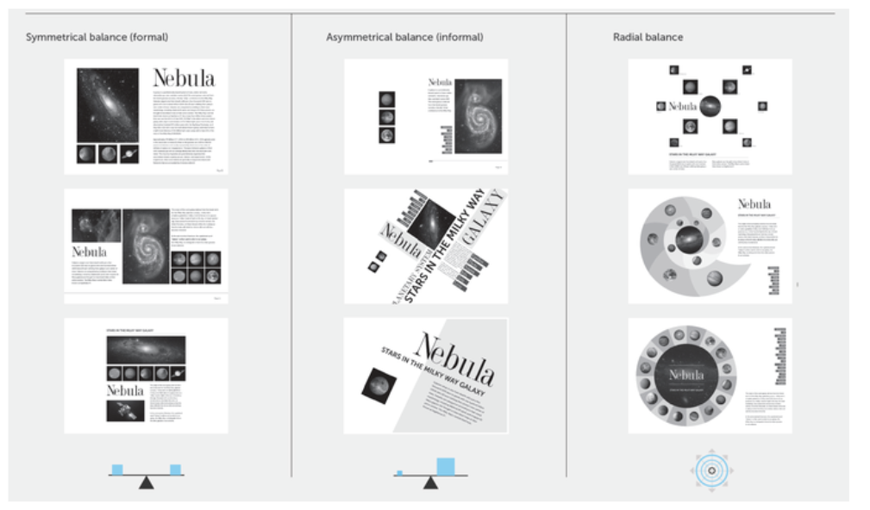

Slide 17
Elements of Graphic Design

Slide 18
The elements of graphic design are the things that make up a design which are:
Line
Shape
Direction
Size
Texture
Color

Slide 19
Thank you

