Slide 1


Operating System
Lecturer
Ameer Sameer Hamood
University of Babylon
Information Technology - Information Networks
Ameersameer.it@gmail.com

Slide 2
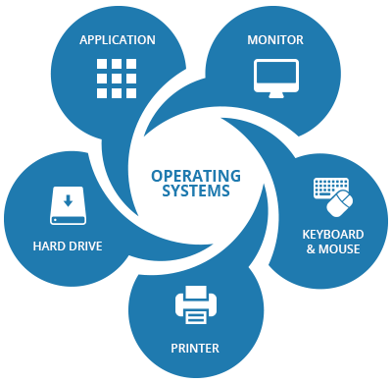
Overview : Lecture 2
Computer-System Architecture
Interrupt Request and Interrupt Handler
System Call
Interrupt Controller
Common Functions of Interrupts
Exception
I/O Structure
Direct Memory Access (DMA) Structure
Storage Structure
Moving-Head Disk Mechanism
Hardware Protection
Dual-Mode Operation
Memory Protection

Slide 3
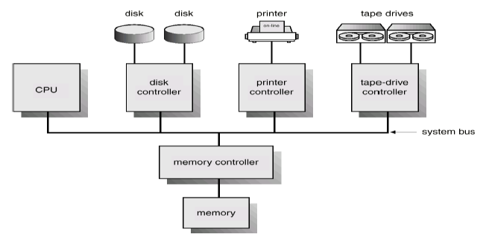
Computer-System Architecture

Slide 4
Interrupt Request and Interrupt Handler
Interrupt Request (or IRQ) is a hardware signal sent to the processor that temporarily stops a running program and allows a special program, an interrupt handler, to run instead. Hardware interrupts are used to handle events such as receiving data from a modem or network card, key presses, or mouse movements.
Interrupt Handler
In computer systems programming, an interrupt handler, also known as an interrupt service routine or ISR, is a special block of code associated with a specific interrupt condition. Interrupt handlers are initiated by hardware interrupts, software interrupt instructions, or software exceptions, and are used for implementing device drivers or transitions between protected modes of operation, such as system calls.

Slide 5
System Call
System Call
a system call is the programmatic way in which a computer program requests a service from the kernel of the operating system it is executed on. This may include hardware-related services (for example, accessing a hard disk drive), creation and execution of new processes, and communication with integral kernel services such as process scheduling. System calls provide an essential interface between a process and the operating system.

Slide 6
Interrupt Controller
Interrupt Controller
a programmable interrupt controller (PIC) is a device that is used to combine several sources of interrupt onto one or more CPU lines, while allowing priority levels to be assigned to its interrupt outputs. When the device has multiple interrupt outputs to assert, it asserts them in the order of their relative priority. Common modes of a PIC include hard priorities, rotating priorities, and cascading priorities. PICs often allow the cascading of their outputs to inputs between each other.

Slide 7
Interrupt Latency and Non-Maskable Interrupt (NMI)
Interrupt Latency is the time that elapses from when an interrupt is generated to when the source of the interrupt is serviced. For many operating systems, devices are serviced as soon as the device's interrupt handler is executed. Interrupt latency may be affected by microprocessor design, interrupt controllers, interrupt masking, and the operating system's (OS) interrupt handling methods.
Non-Maskable Interrupt (NMI) is a hardware interrupt that standard interrupt-masking techniques in the system cannot ignore. It typically occurs to signal attention for non-recoverable hardware errors.

Slide 8
Common Functions of Interrupts
Interrupts transfers control to the interrupt service routine generally, through the interrupt vector, which contains the addresses of all the service routines. Interrupt architecture must save the address of the interrupted instruction. Incoming interrupts are disabled while another interrupt is being processed to prevent a lost interrupt.
A trap is a software-generated interrupt caused either by an error or a user request. An operating system is interrupt driven.

Slide 9
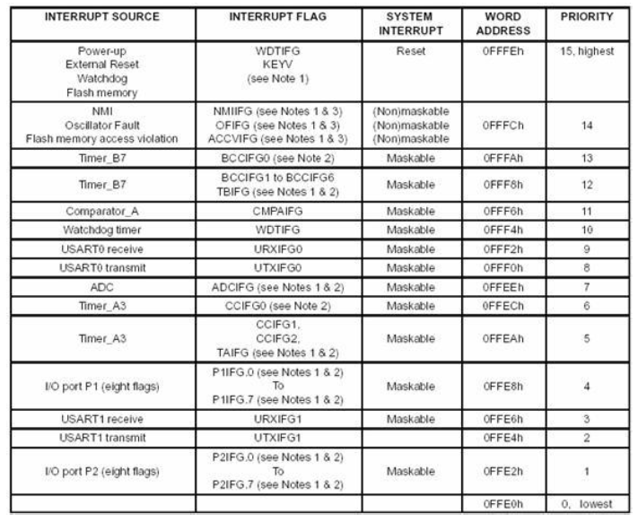
Interrupt Vector Table

Slide 10
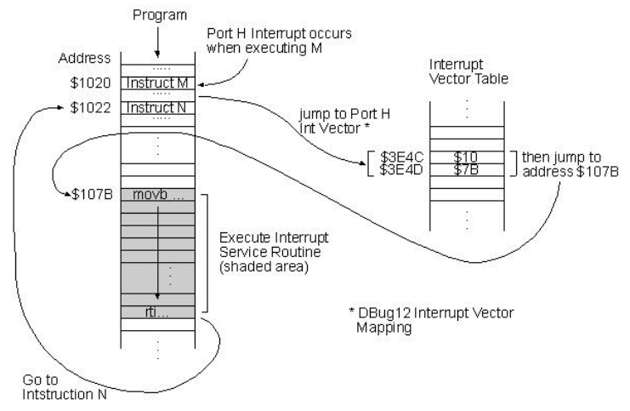

Slide 12
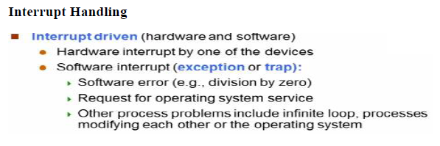
Notes:
Problems
1. How does the monitor know about the nature of the job (e.g., FORTRAN versus Assembly) or which program to execute?
2. How does the monitor distinguish (a) job from job? (b) Data from program? Solution Introduce control cards
Spooling A spool is a buffer that holds output for a device, such as a printer, that cannot accept interleaved data streams. Although a printer can serve only one job at a time, several applications may wish to print their output concurrently, without having their output mixed together. The operating system solves this problem by intercepting all output to the printer. Each application’s output is spooled to a separate disk file. When an application finishes printing, the spooling system queues the corresponding spool file for output to the printer. The spooling system copies the queued spool files to the printer one at a time. In another words (Overlap I/O of one job with computation of another job. While executing one job, the OS). Reads next job from card reader into a storage area on the disk (job queue). Outputs printout of previous job from disk to printer. Job pool – data structure that allows the OS to select which job to run next in order to increase CPU utilization Multiprogrammed Batch Systems Several jobs are kept in main memory at the same time, and the CPU is multiplexed among them.

Slide 13
Exception
Exception: “internal” events those are abnormal Invalid instruction (divided by zero), Illegal bus access Interrupts: Hardware driven signals, Internal signals, Peripheral Flags The operating system preserves the state of the CPU by storing registers and the program counter. Determines which type of interrupt has occurred: Polling Vectored interrupt system Separate segments of code determine what action should be taken for each type of interrupt

Slide 14
I/O Structure
After I/O starts, control returns to user program only upon I/O completion. Wait instruction idles the CPU until the next interrupt Wait loop (contention for memory access). At most one I/O request is outstanding at a time, no simultaneous I/O processing. After I/O starts, control returns to user program without waiting for I/O completion. System call – request to the operating system to allow user to wait for I/O completion. Device-status table contains entry for each I/O device indicating its type, address, and state.
Operating system indexes into I/O device table to determine device status and to modify table entry to include interrupt.

Slide 15
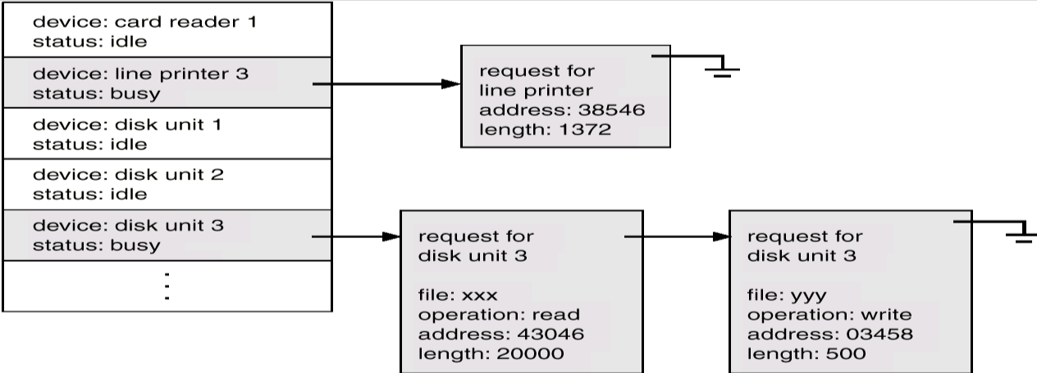
Device-Status Table

Slide 16
Direct Memory Access (DMA) Structure
It is special purpose controller used for high-speed I/O devices able to transmit information at close to memory speeds. Device controller transfers blocks of data from buffer storage directly to main memory without CPU intervention. Only one interrupt is generated per block, rather than the one interrupt per byte.

Slide 17
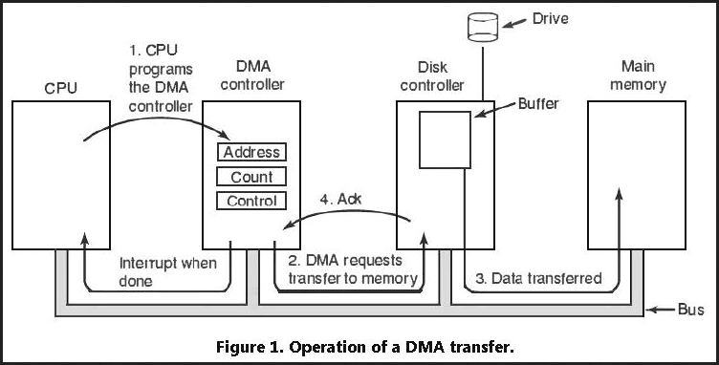

Slide 18
Storage Structure
Main memory – only large storage media that the CPU can access directly. Secondary storage – extension of main memory that provides large nonvolatile storage capacity.
Magnetic disks – rigid metal or glass platters covered with magnetic recording material Disk surface is logically divided into tracks, which are subdivided into sectors. The disk controller determines the logical interaction between the device and the computer

Slide 19
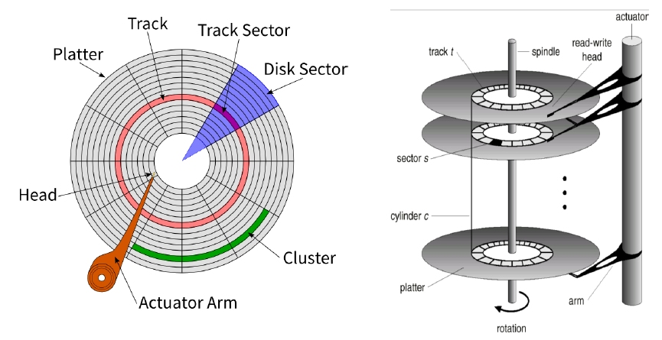
Moving-Head Disk Mechanism

Slide 20
Storage Hierarchy
Storage systems organized in hierarchy can be as cost or speed or volatility
Caching – is the process of storing data in a cache. A cache is a temporary storage area. Caching copying information into faster storage system; main memory can be viewed as a last cache for secondary storage.

Slide 21
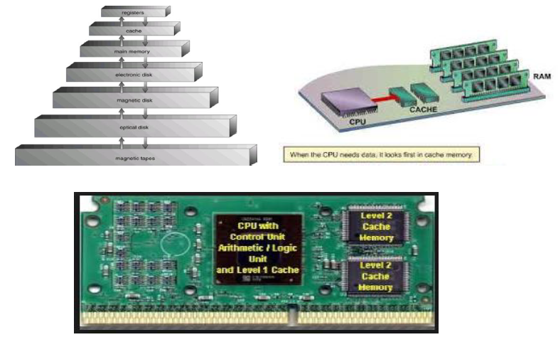
Storage-Device Hierarchy

Slide 22
Hardware Protection
Consist of:
-Dual-Mode Operation
-I/O Protection
-Memory Protection
-CPU Protection

Slide 23
Dual-Mode Operation
Sharing system resources requires operating system to ensure that an incorrect program cannot cause other programs to execute incorrectly. Provide hardware support to differentiate between at least two modes of operations.
1. User mode – execution done on behalf of a user. 2. Monitor mode (also supervisor mode or system mode) – execution done on behalf of operating system.

Slide 24
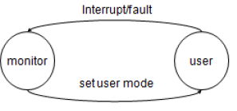
Dual-Mode Operation
Mode bit added to computer hardware to indicate the current mode: monitor (0) or user (1). When an interrupt or fault occurs hardware switches to monitor mode.
Privileged (necessary) instructions can be issued only in monitor mode.

Slide 25
I/O Protection
All I/O instructions are privileged instructions. Must ensure that a user program could never gain control of the computer in monitor mode (I.e., a user program that, as part of its execution, stores a new address in the interrupt vector).

Slide 26
Memory Protection
Must provide memory protection at least for the interrupt vector and the interrupt service routines. In order to have memory protection, add two registers that determine the range of legal addresses a program may access: base register – holds the smallest legal physical memory address. Limit register – contains the size of the range Memory outside the defined range is protected A Base and a limit Register Define a Logical Address Space

Slide 27
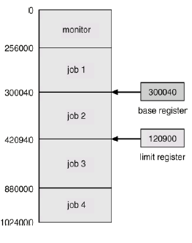
Dual-Mode Operation

Slide 28
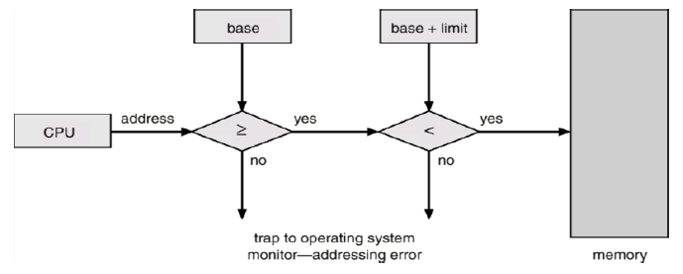
Protection Hardware

Slide 29
Protection Hardware
When executing in monitor mode, the operating system has unrestricted access to both monitor and user’s memory. The load instructions for the base and limit registers are privileged instructions.

Slide 30
CPU Protection
Timer – interrupts computer after specified period to ensure operating system maintains control.
❖ Timer is decremented every clock tick.
❖ When timer reaches the value 0, an interrupt occurs.
Timer commonly used to implement time sharing.
❖ Time also used to compute the current time.
❖ Load-timer is a privileged instruction.

Slide 31
General-System Architecture
Given the I/O instructions are privileged, how does the user program perform I/O? System call – the method used by a process to request action by the operating system. Usually takes the form of a trap to a specific location in the interrupt vector. Control passes through the interrupt vector to a service routine in the OS, and the mode bit is set to monitor mode. The monitor verifies that the parameters are correct and legal, executes the request, and returns control to the instruction following the system call.

Slide 32
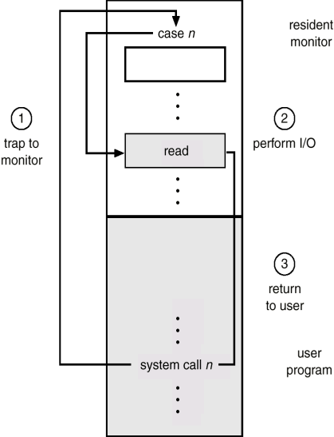
Use of A System Call to Perform I/O

Slide 33
Thank You

