Slide 1
Optical System Components(Part II)

Slide 2
In this lecture:
Wavelengths
Wavelength converters
Wavelength-division multiplexing (WDM)
Optical Ampliﬁers

Slide 3
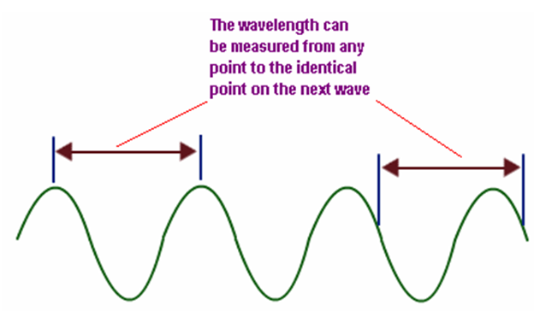
Wavelength s
Light travels as waves of energy.
Waves of light have different wavelengths (the distance between the top of one wave and the top of the next).
Different colors of light have different wavelengths.
Purple and blue light waves have short wavelengths.
Red light has a longer wavelength.

Slide 4
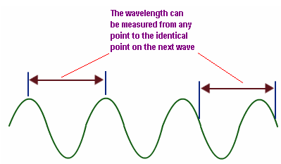
This distance between those two points is called Wavelength.
Hence the Wavelength is defined as the difference between two points of same phase.
the Wavelength unit is meters

Slide 5
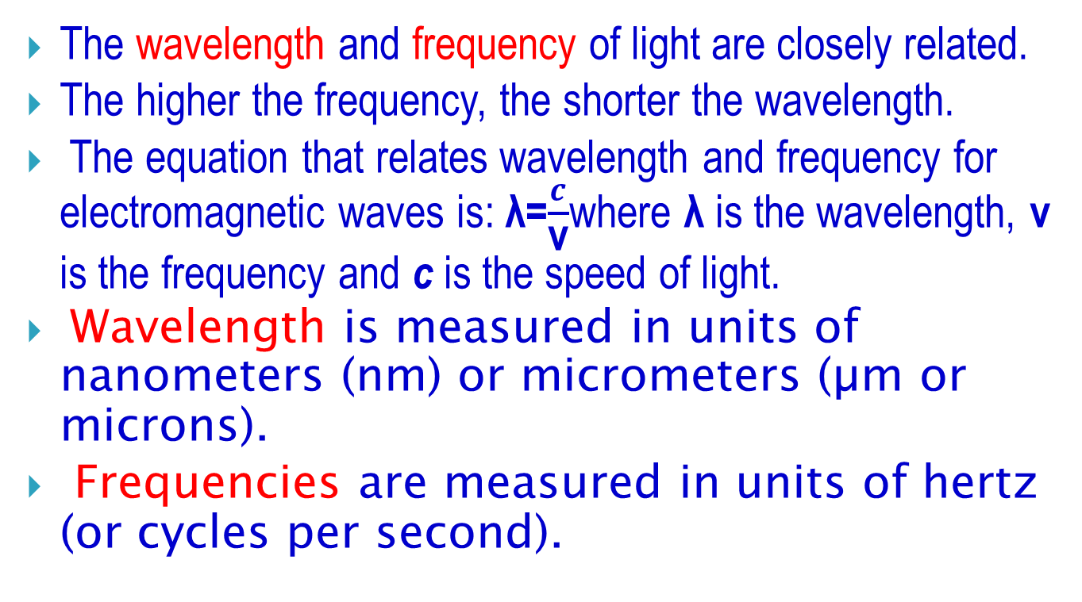
The wavelength and frequency of light are closely related.
The higher the frequency, the shorter the wavelength.
The equation that relates wavelength and frequency for electromagnetic waves is: λ=$\frac{c}{\text{v}}$where λ is the wavelength, ν is the frequency and c is the speed of light.
Wavelength is measured in units of nanometers (nm) or micrometers (µm or microns).
Frequencies are measured in units of hertz (or cycles per second).

Slide 6
Wavelength converters
A wavelength converter is a device that converts data from one incoming wavelength to another outgoing wavelength.
Wavelength converters are useful components in Wavelength-Division Multiplexing (WDM )networks for three major reasons:

Slide 7
First, data may enter the network at a wavelength that is not suitable for use within the network.
For example, the first-generation networks transmit data in the 1310 nm wavelength window, using LEDs or lasers. Neither the wavelength nor the type of laser is compatible with WDM networks.
So at the inputs and outputs of the network, data must be converted from these wavelengths to narrow-band WDM signals in the 1550 nm wavelength range. A wavelength converter used to perform this function is sometimes called a transponder.

Slide 8
Second, wavelength converters may be needed within the network to improve the utilization of the available wavelengths on the network links.
Finally, wavelength converters may be needed at boundaries between different networks if the different networks are managed by different entities.

Slide 9
Wavelength converters can be classified based on the range of wavelengths that they can handle at their inputs and outputs:
A fixed-input, fixed-output device always takes in a fixed-input wavelength and converts it to a fixed-output wavelength.
A variable-input, fixed-output device takes in a variety of wavelengths but always converts the input signal to a fixed-output wavelength.

Slide 10
A fixed-input, variable-output device does the opposite function.
Finally, a variable-input, variable-output device can convert any input wavelength to any output wavelength.

Slide 11
Example
Optoelectronic: This type of optical wavelength converter is variable input, fixed output type.
It converts the input signal first to electrical form, regenerates it and transmits it using the laser device.
Optical Receiver takes either 1310 or 1550 nm wavelength as input.

Slide 12
Wavelength-division multiplexing (WDM)
In fiber-optic communications, wavelength-division multiplexing (WDM) is a technology which multiplexes a number of optical carrier signals onto a single optical fiber by using different wavelengths (i.e., colors) of laser light.

Slide 13
Wavelength division multiplexing (WDM) is the combining of different optical wavelengths From two or more optical fibers into just one optical fiber.
This combining or coupling of the wavelengths can be very useful in increasing the bandwidth of a fiber optic system.
WDM multiplexers are used in pairs: one at the beginning of the fiber to couple the inputs and one at the end of the fiber to decouple and then route the separated wavelengths into separate fibers.
An WDM multiplexer can be thought of as an optical fiber highway; the highway can support a very large bandwidth, thus increasing the system’s capacity.

Slide 14
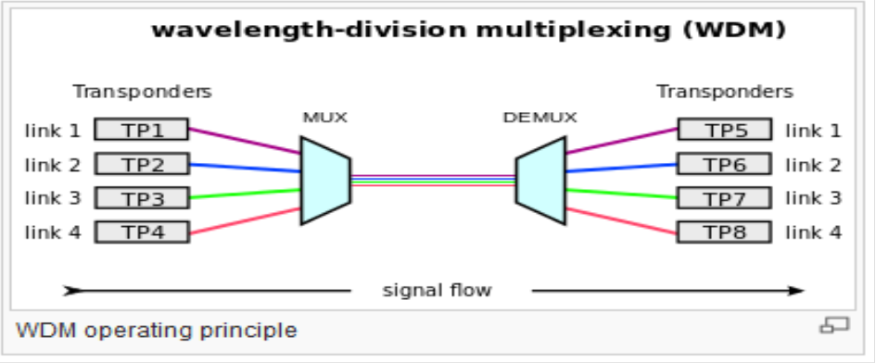
A WDM system uses a multiplexer at the transmitter to join the signals together, and a demultiplexer at the receiver to split them apart.

Slide 15
Optical Ampliﬁers
In an optical communication system, the optical signals from the transmitter are attenuated by the optical ﬁber as they propagate through it.
Other optical components, such as multiplexers and couplers, also add loss.
After some distance, the cumulative loss of signal strength causes the signal to become too weak to be detected.
Before this happens, the signal strength has to be restored.

Slide 16
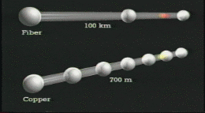
Prior to the advent of optical ampliﬁers over the last decade, the only option was to regenerate the signal, that is, receive the signal and retransmit it.
This process is accomplished by regenerators. A regenerator converts the optical signal to an electrical signal, cleans it up, and converts it back into an optical signal for onward transmission.
The amplifier directly amplifies optical signals without a need to do the optical-to- electrical conversion

Slide 17
Optical ampliﬁers offer several advantages over regenerators.
Ampliﬁers, however, are not perfect devices.
It introduce additional noise, and this noise accumulates as the signal passes through multiple ampliﬁers along its path.

