Slide 1


Classical Cryptographic Techniques
Lectrue 2
Assistant Lecturer
Rasha Hussein
Network Securty Theory & Algorithms
3rd Class-First Course

Slide 2
Outline
Classical Cryptography Techniques
Substitution Cipher Categorized
Monoalphabetic Substitution Cipher
Additive Cipher
Multiplicative Cipher
Methods For Finding The Modular Multiplicative Inverse
Affine Cipher

Slide 3
Classical Cryptography Techniques
Have two basic components of classical: Substitution and Transposition.
Classical Cipher
Substitution
Transposition
Monoalphabetic
Polyalphabetic
Polygram
Rail Fence
Columnar Tran.*
Disrupted Tran.
Homophonic
Route Cipher
Double Tran.
Fractionation
Figure 1 : Most Important Classical Cipher Types
* Tran. = Transposition

Slide 4
Classical Cryptographic Techniques
Transposition/permutation Ciphering: It is the process of reorders the letters, numbers and symbols in the plain text or data to be encrypted and placed in a different of location from its original on in the plain text or data. A symbol in first position of the plaintext may appear in the tenth position in the ciphertext.
Substitution Ciphering: replaces one symbol with another. If symbols in the plaintext are alphabetic characters, we replace one character with another. For example, we can replace letter A with letter D , and letter T with letter Z. if the symbols are digits ( 0 to 9) , we can replace 3 with 7 , and 2 with 6.

Slide 5
Substitution Cipher Categorized
Substitution cipher categorized into
Monoalphabetic (Simple) Substitution Cipher
Polyalphabetic Substitution Cipher
Polygram Substitution Cipher
Homophonic Substitution Cipher

Slide 6
1- Monoalphabetic Substitution Cipher
Monoalphabetic substitution ciphers: a character ( or a symbol) in the plaintext is always changed to the same character ( or symbol) in the cipher text regardless of its position in the text. For example, if the algorithm says that letter A in the plaintext is changed to letter D, every letter A is changed to letter D. In other word , the relationship between letters (symbol) in the plaintext and the cipher text is one-to-one.
Additive Cipher
Multiplicative Cipher
Affine Cipher
Reverse Cipher

Slide 7
Additive Cipher (The Caesar Cipher)
This cipher is sometimes called a shift cipher or Caesar cipher.
Assume that the plaintext consist of lowercase letters ( a to z) , and that the cipher text consists of uppercase letters ( A to Z). To be able to apply mathematical operations on the plaintext and cipher text , we assign numerical values to each letter ( lower or uppercase ) as shown in Table 1
Table 1 : Representation of plaintext and cipher text characters in $Z_{26}$
z | y | x | w | v | u | t | s | r | q | p | o | n | m | l | k | j | i | h | g | f | e | d | c | b | a | P
Z | Y | X | W | V | U | T | S | R | Q | P | O | N | M | L | K | J | I | H | G | F | E | D | C | B | A | C
25 | 24 | 23 | 22 | 21 | 20 | 19 | 18 | 17 | 16 | 15 | 14 | 13 | 12 | 11 | 10 | 9 | 8 | 7 | 6 | 5 | 4 | 3 | 2 | 1 | 0 | value
Note :In Table 1 , P=plain text and c = cipher text

Slide 8
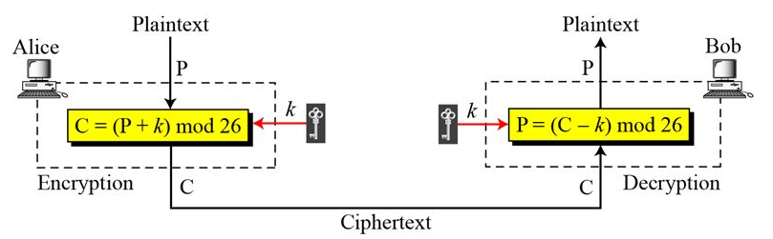
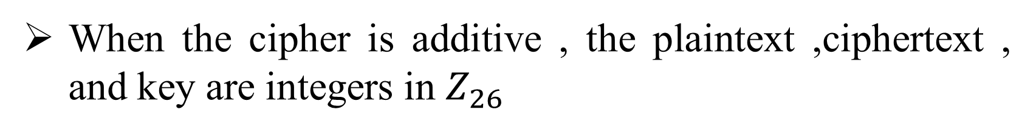
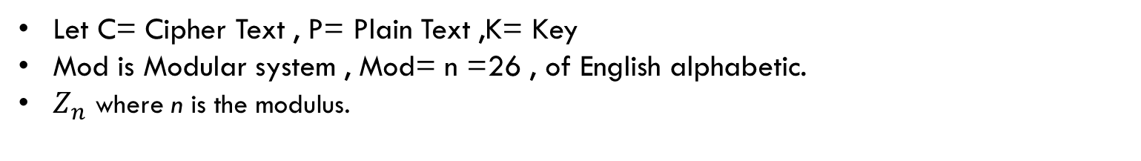
Additive Cipher (The Caesar Cipher)
When the cipher is additive , the plaintext ,ciphertext , and key are integers in $Z_{26}$
Figure 2 : Additive Cipher
Let C= Cipher Text , P= Plain Text ,K= Key
Mod is Modular system , Mod= n =26 , of English alphabetic.
$Z_{n}$ where n is the modulus.

Slide 9
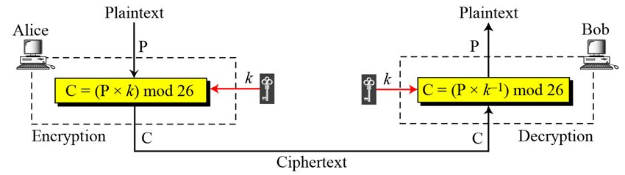
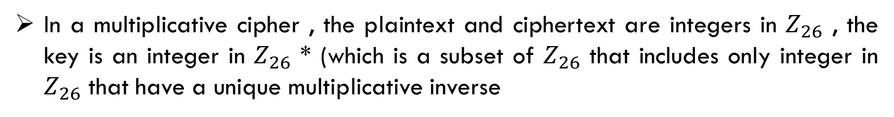
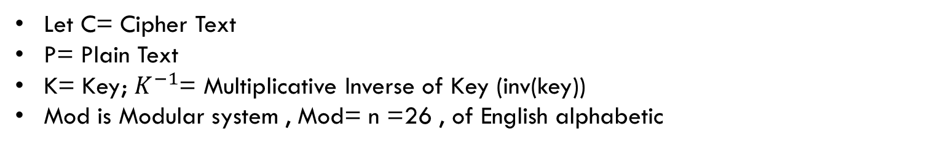
Multiplicative Cipher
In a multiplicative cipher , the plaintext and ciphertext are integers in $Z_{26}$ , the key is an integer in $Z_{26}$ * (which is a subset of $Z_{26}$ that includes only integer in $Z_{26}$ that have a unique multiplicative inverse
Let C= Cipher Text
P= Plain Text
K= Key; $K^{−1}$= Multiplicative Inverse of Key (inv(key))
Mod is Modular system , Mod= n =26 , of English alphabetic
Figure 3 : Multiplicative Cipher

Slide 10
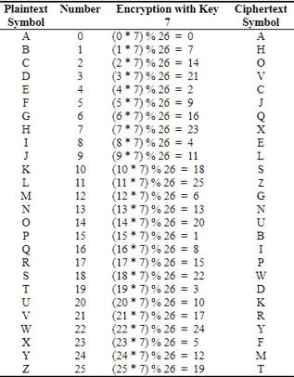
Multiplicative Cipher
If k=7 and implementation Multiplicative Cipher for English aliphatic as table.

Slide 11
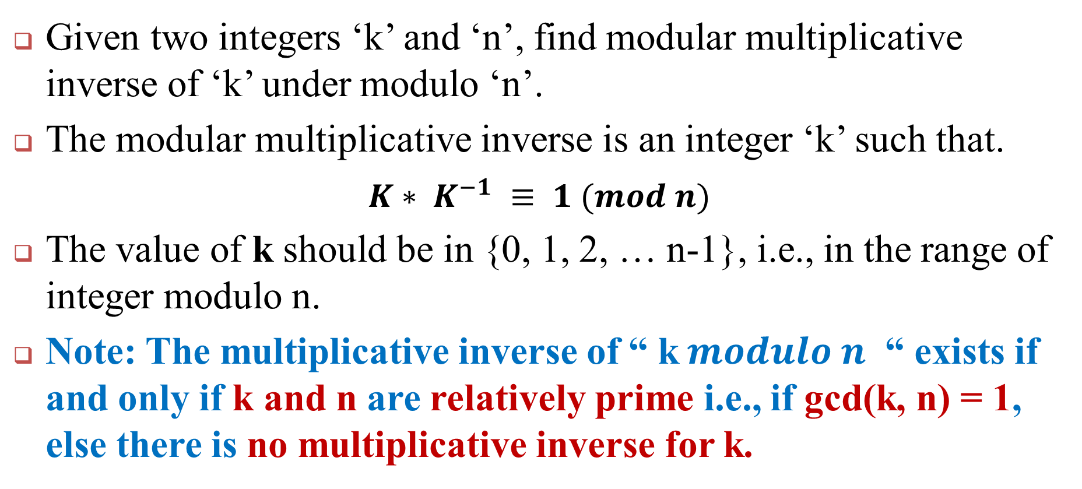
Modular Multiplicative Inverse
Given two integers ‘k’ and ‘n’, find modular multiplicative inverse of ‘k’ under modulo ‘n’.
The modular multiplicative inverse is an integer ‘k’ such that.
$K∗ K^{−1} ≡ 1 (mod n)$
The value of k should be in {0, 1, 2, … n-1}, i.e., in the range of integer modulo n.
Note: The multiplicative inverse of “ k$modulo n$ “ exists if and only if k and n are relatively prime i.e., if gcd(k, n) = 1, else there is no multiplicative inverse for k.

Slide 12
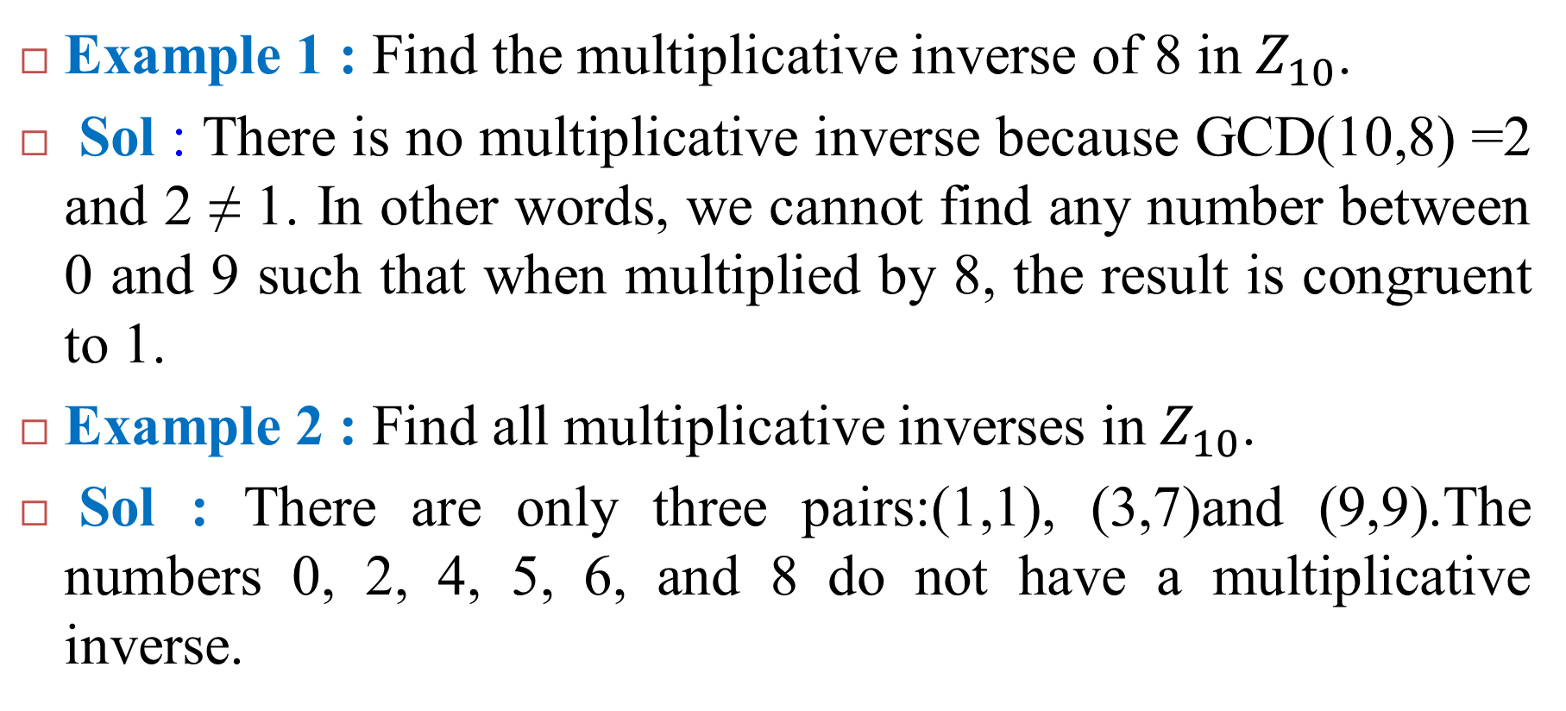
Modular Multiplicative Inverse
Example 1 : Find the multiplicative inverse of 8 in $Z_{10}$.
Sol : There is no multiplicative inverse because GCD(10,8) =2 and 2 ≠ 1. In other words, we cannot find any number between 0 and 9 such that when multiplied by 8, the result is congruent to 1.
Example 2 : Find all multiplicative inverses in $Z_{10}$.
Sol : There are only three pairs:(1,1), (3,7)and (9,9).The numbers 0, 2, 4, 5, 6, and 8 do not have a multiplicative inverse.

Slide 13
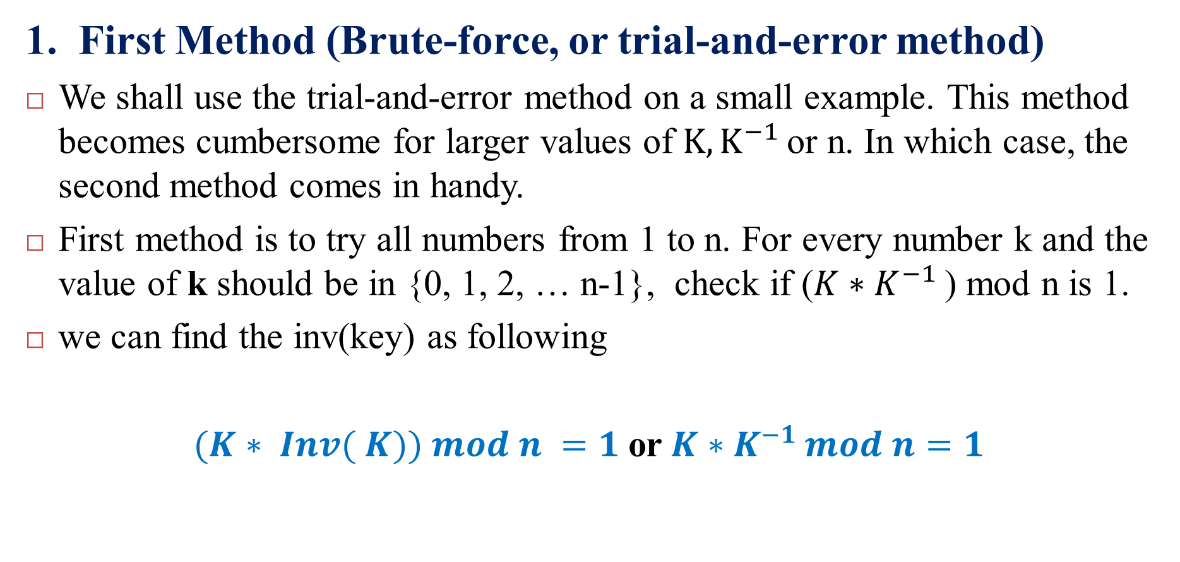
Methods For Finding The Modular Multiplicative Inverse
1. First Method (Brute-force, or trial-and-error method)
We shall use the trial-and-error method on a small example. This method becomes cumbersome for larger values of $K,K^{−1 }$or n. In which case, the second method comes in handy.
First method is to try all numbers from 1 to n. For every number k and the value of k should be in {0, 1, 2, … n-1}, check if ($K∗K^{−1 }$) mod n is 1.
we can find the inv(key) as following
$(K∗ Inv( K)) mod n =1$or$K∗K^{−1 }mod n=1$
Notes:
ملاحظة : انت مخير باستخدام واحدة من الطرق في الحل
ملاحظة : لكي نعرف هل الرقم له معكوس او لا شرط ان يكون القاسم المشترك الاكبر بين المود والمفتاح =1 أي GCD(n,K) =1 كما وضحنا في السلايد رقم 11 و 12
الطريقة الاولى تستخدم عندما يكون المود عدد صغير أي بالامكان اخذ الاحتمالات
فكرة الطريقة فقط تطبيق قانون المعكوس
$$(K∗ Inv( K)) mod n =1$$
ناخذ كل الاحتمالات التي هي اقل من رقم المود الى ان نصل الى حل يكون
ضرب العدد * معكوسة / المود = 1 .... الواحد هو باقي القسمة

Slide 14
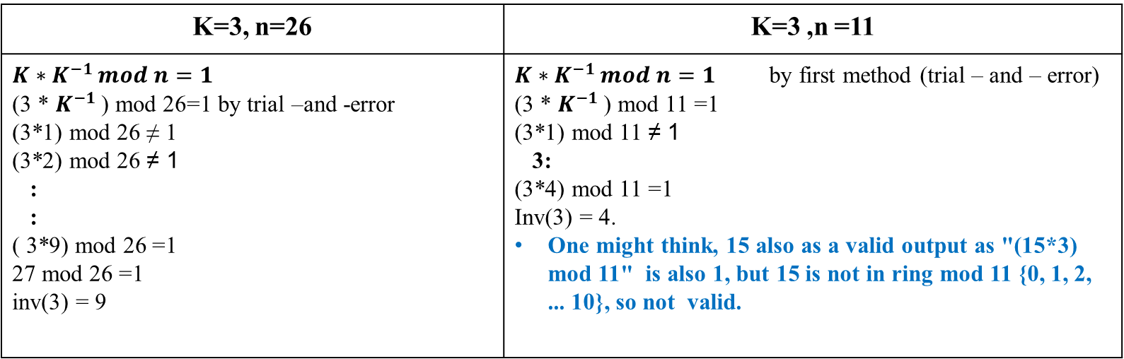
Example of First Method
Example: Let Key=3, n=26 and key=3 , n=11 find inv(key)
Sol:
K=3 ,n =11 | K=3, n=26
$K∗K^{−1 }mod n=1$ by first method (trial – and – error) (3 * $K^{−1 }$) mod 11 =1 (3*1) mod 11 ≠ 1 3: (3*4) mod 11 =1 Inv(3) = 4. One might think, 15 also as a valid output as "(15*3) mod 11" is also 1, but 15 is not in ring mod 11 {0, 1, 2, ... 10}, so not valid. | $$K∗K^{−1 }mod n=1$$ (3 * $K^{−1 }$) mod 26=1 by trial –and -error (3*1) mod 26 ≠ 1 (3*2) mod 26 ≠ 1 : : ( 3*9) mod 26 =1 27 mod 26 =1 inv(3) = 9

Slide 15
Methods For Finding The Modular Multiplicative Inverse
Note: The number of useful key in multiplicative inverse
Table 2: Examples of Invers Numbers if mod =26
Inverse Key | Key
1 | 1
9 | 3
21 | 5
15 | 7
3 | 9
19 | 11
7 | 15
23 | 17
11 | 19
5 | 21
17 | 23
25 | 25

Slide 16
Methods For Finding The Modular Multiplicative Inverse
2. Second Method
Find the multiples of modular
Add number 1 for the results of step 1
Try all numbers that output of the previous step that are divisible by the key without a remainder.

Slide 17
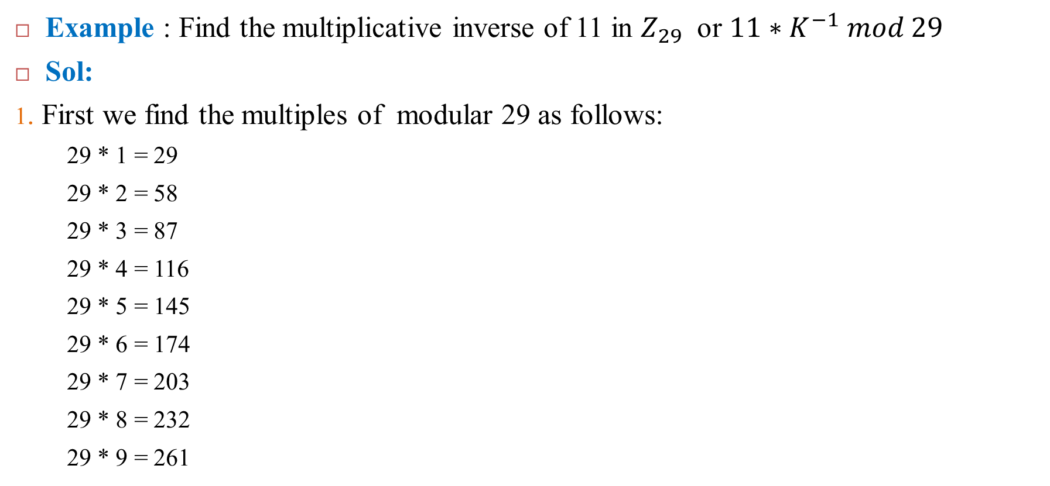
Example of Second Method
Example : Find the multiplicative inverse of 11 in $Z_{29}$ or $11∗K^{−1} mod 29$
Sol:
1. First we find the multiples of modular 29 as follows:
29 * 1 = 29
29 * 2 = 58
29 * 3 = 87
29 * 4 = 116
29 * 5 = 145
29 * 6 = 174
29 * 7 = 203
29 * 8 = 232
29 * 9 = 261

Slide 18
Methods For Finding The Modular Multiplicative Inverse
2. Add number 1 to the list of multiplication in first step so the list will be as follows:
29 +1=30
58 +1=59
87 +1=88
116 +1= 117
145 +1=146
174 +1=175
203 +1= 204
232 +1= 233
261 +1= 262

Slide 19
Methods For Finding The Modular Multiplicative Inverse
3. The last step is to try the numbers that resulted from step 2 in order to find which one of them can be divisible by the key (11) without remainder.
We find that the number (88) is divisible by (11), and the result is (8).
Therefore, The inverse of key 11 mod 29 is 8
To be sure
11 * 8 = 88
88/29 = 3 and the remainder is 1
Note : There are other methods to find the inverse , the most famous used “Extended Euclidean Algorithm “ and others.
Notes:
الطريقة الثالثة هي ابسط طريقة
1- في البداية نجد مضاعفات العدد 29 أي نضربها بالأعداد من 1 الى 9 كالتالي: 29*1 = 29 29*2 = 58 29*3= 87 29*4= 116 29*5=145 29*6=174 29*7=203 29*8=232 29*9=261 2- الخطوة التالية هي إضافة العدد 1 إلى قائمة نواتج الضرب من الخطوة الاولى لتصبح القائمة كالتالي: 30 59 88 117 146 175 204 233 262 3- الخطوة الأخيرة هي تجربة أي من الأعداد في القائمة يقبل القسمة على المفتاح (في المفتاح 11) بدون باقي نجد أن العدد (88) يقبل القسمة على (11) والناتج هو (8)بدون باقي إذن , المعكوس الضربي للمفتاح 11 تحت مود 29 هو 8 للـتأكد من الحل 11*8= 88 88/29= 3 والباقي 1
ملاحظة : هناك طرق اخرى لايجاد المعكوس ومن اشهرها طريقة استخدام خوارزمية اقليدس (طريقة الحل باستخدام الجدول او معادلة)

Slide 20
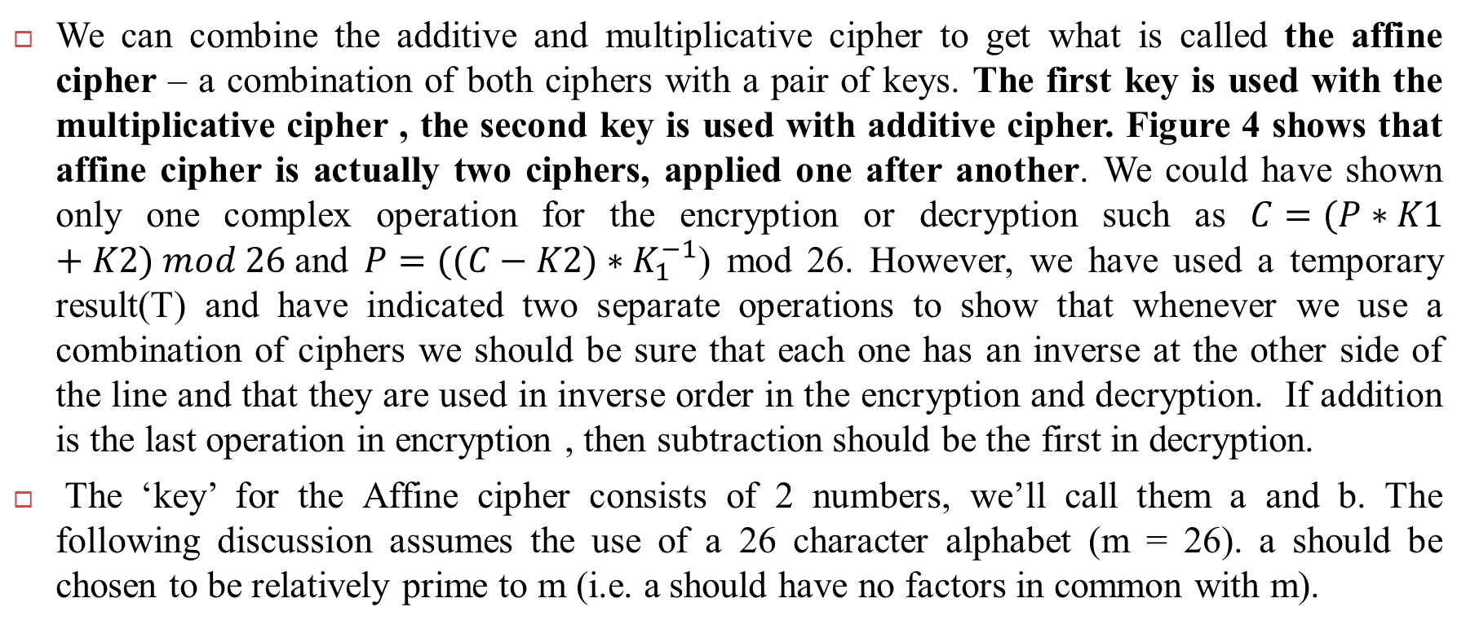
The Affine cipher
We can combine the additive and multiplicative cipher to get what is called the affine cipher – a combination of both ciphers with a pair of keys. The first key is used with the multiplicative cipher , the second key is used with additive cipher. Figure 4 shows that affine cipher is actually two ciphers, applied one after another. We could have shown only one complex operation for the encryption or decryption such as $C=(P∗K1+K2) mod 26$and $P=((C−K2)∗K_{1}^{−1}$) mod 26. However, we have used a temporary result(T) and have indicated two separate operations to show that whenever we use a combination of ciphers we should be sure that each one has an inverse at the other side of the line and that they are used in inverse order in the encryption and decryption. If addition is the last operation in encryption , then subtraction should be the first in decryption.
The ‘key’ for the Affine cipher consists of 2 numbers, we’ll call them a and b. The following discussion assumes the use of a 26 character alphabet (m = 26). a should be chosen to be relatively prime to m (i.e. a should have no factors in common with m).

Slide 21
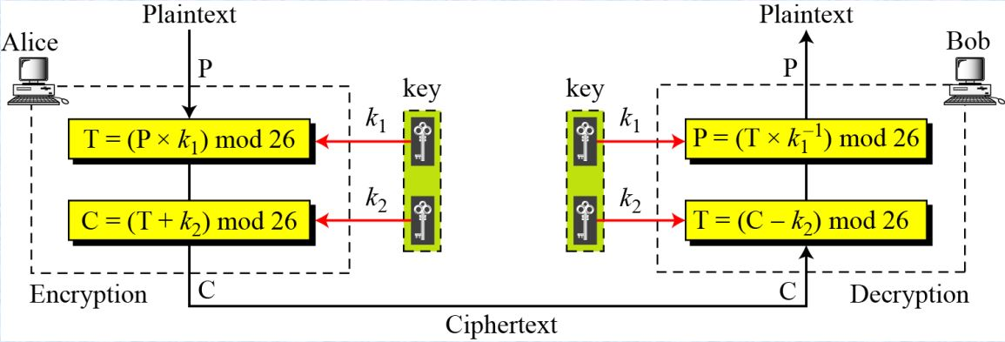
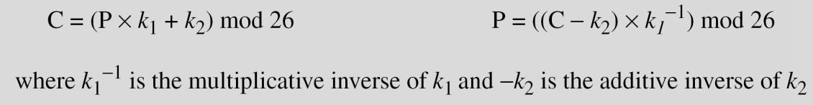
The Affine Cipher
Figure 4 : Affine Cipher

Slide 22
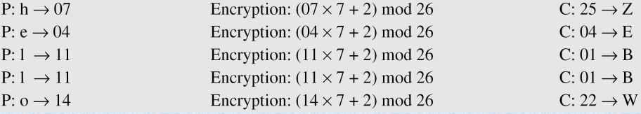

Example
The affine cipher uses a pair of keys in which the first key is from $Z_{26}$ * and the second is from $Z_{26}$. The size of the key domain is 25 × 11 = 275.
Example 1: Use an affine cipher to encrypt the message “hello” with the key pair (7, 2).

Slide 23
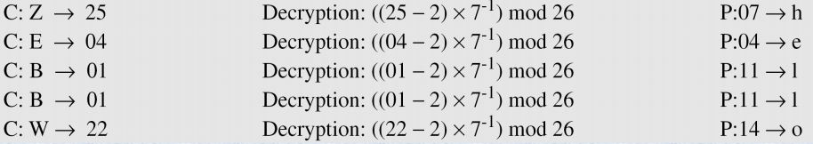
Example
Example 2: Use the affine cipher to decrypt the message “ZEBBW” with the key pair (7, 2) in modulus 26.
The additive cipher is a special case of an affine cipher in which k1 = 1. The multiplicative cipher is a special case of affine cipher in which k2 = 0.

Slide 24
Thank You

