Slide 1
Web Design Principles
Riyam k.Marjan
University Of Babylon – Faculty of Information Technology
Third Stage – 2019-2020
03/24/2020
MSc.Riyam K.Marjan
<number>

Slide 2
Outlines
Introduction
principles of Graphic Design
The elements of Graphic Design
03/24/2020
MSc.Riyam K.Marjan
<number>

Slide 3
principles of Graphic Design
03/24/2020
MSc.Riyam K.Marjan
<number>

Slide 4
Introduction
Good design, much like anything, starts with understanding the basics. Applying the following design principles will help you avoid design disasters and allow you to communicate your key theme.
03/24/2020
MSc.Riyam K.Marjan
<number>

Slide 5
Design Principles
Alignment
Alignment creates a sharper, more ordered design. Aligning elements allows them to create a visual connection with each other. It tightens the design and eliminates the haphazard, messy effect which comes when items are placed randomly.
Aligning elements which are not in close proximity with each other, helps to provide an invisible connection between them.
Alignment is one of the most basic and important principles of design. It allows us to create order and organisation among elements.
03/24/2020
MSc.Riyam K.Marjan
<number>

Slide 6
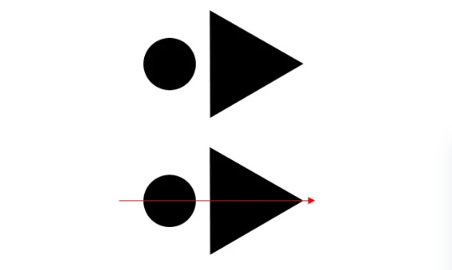
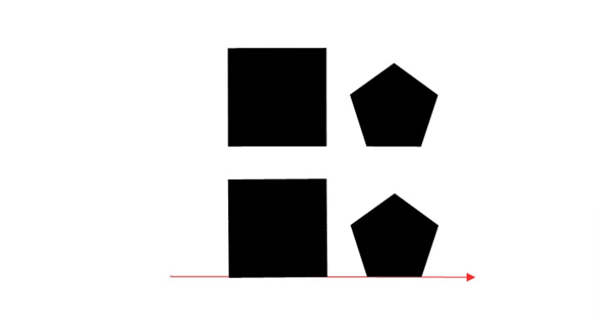
03/24/2020
MSc.Riyam K.Marjan
<number>

Slide 7
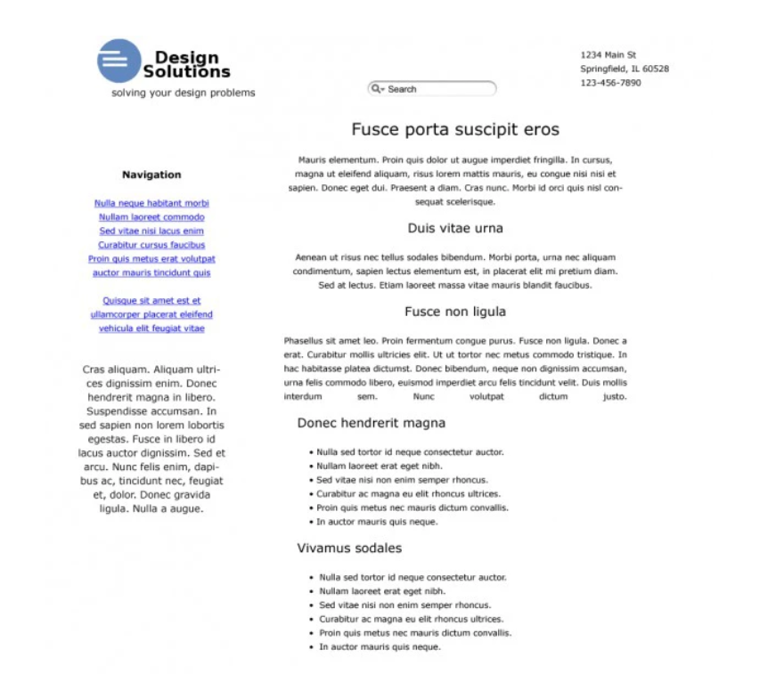
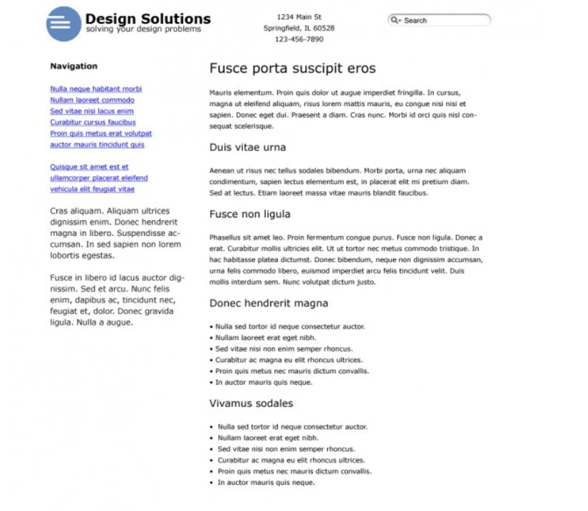
03/24/2020
MSc.Riyam K.Marjan
<number>

Slide 8
Design Principles
Repetition
Repetition strengthens a design by tying together individual elements. It helps to create association and consistency.
The consistent repetition of an element is widely used in multi-page documents & websites. Elements can be as simple as colour, shapes, typefaces or even texture.
03/24/2020
MSc.Riyam K.Marjan
<number>

Slide 9
Design Principles
Contrast التباين
Contrast allows you to emphasize or highlight key elements within your design. Contrast is created when two elements are total opposites.
This doesn’t necessarily have to be colours either. It can be achieved with fonts (classic/contemporary), lines (thick/thin) and shapes (big/small), just to name a few.
Contrast plays a crucial part in the organisation of information on a page. It will guide the reader to where they should look first or to the most important element. For it to work successfully though, it must be strong and obvious. It needs to make an impact.
03/24/2020
MSc.Riyam K.Marjan
<number>

Slide 10

03/24/2020
MSc.Riyam K.Marjan
<number>

Slide 11
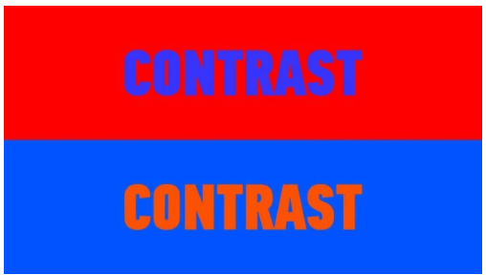
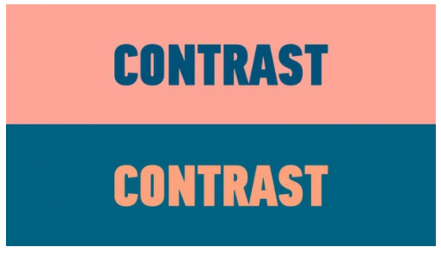
03/24/2020
MSc.Riyam K.Marjan
<number>

Slide 12

Design Principles
Proximity
The principle of proximity states that elements that are associated with each other should be placed closely (grouped together), and vice versa.
The application of proximity, especially in web design, can lead to better user experience.
03/24/2020
MSc.Riyam K.Marjan
<number>

Slide 13
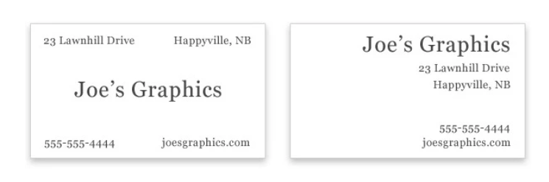
03/24/2020
MSc.Riyam K.Marjan
<number>

Slide 14
Design Principles
Balance
Balance provides stability and structure to a design. It’s the weight distributed in the design by the placement of your elements. The elements don’t necessarily need to be of the same size. Balance can be achieved by placing a large element on one side of your design and several small elements on the other side.
There are three main types of balance;
Symmetrical Balance (formal)
Asymmetrical Balance (informal)
Radial Balance
03/24/2020
MSc.Riyam K.Marjan
<number>

Slide 15
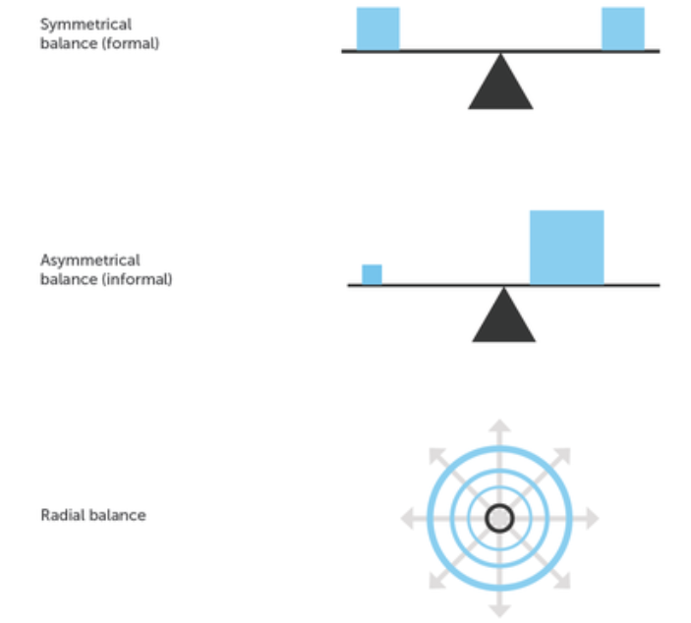
03/24/2020
MSc.Riyam K.Marjan
<number>

Slide 16
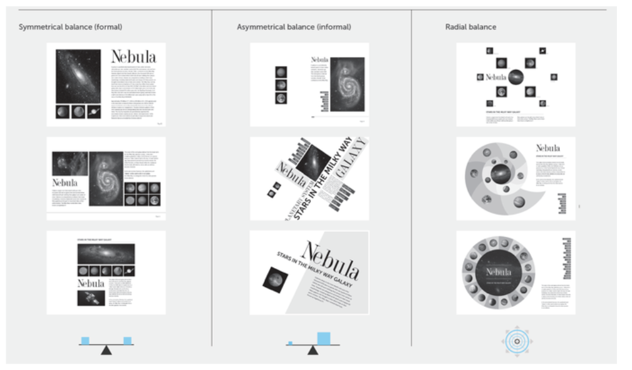
03/24/2020
MSc.Riyam K.Marjan
<number>

Slide 17
Elements of Graphic Design
03/24/2020
MSc.Riyam K.Marjan
<number>

Slide 18
The elements of graphic design are the things that make up a design which are:
Line
Shape
Direction
Size
Texture
Color
03/24/2020
MSc.Riyam K.Marjan
<number>

Slide 19
Thank you
03/24/2020
MSc.Riyam K.Marjan
<number>

