Slide 1
Color Theory
Riyam k.Marjan
University Of Babylon – Faculty of Information Technology
Third Stage – 2019-2020

Slide 2
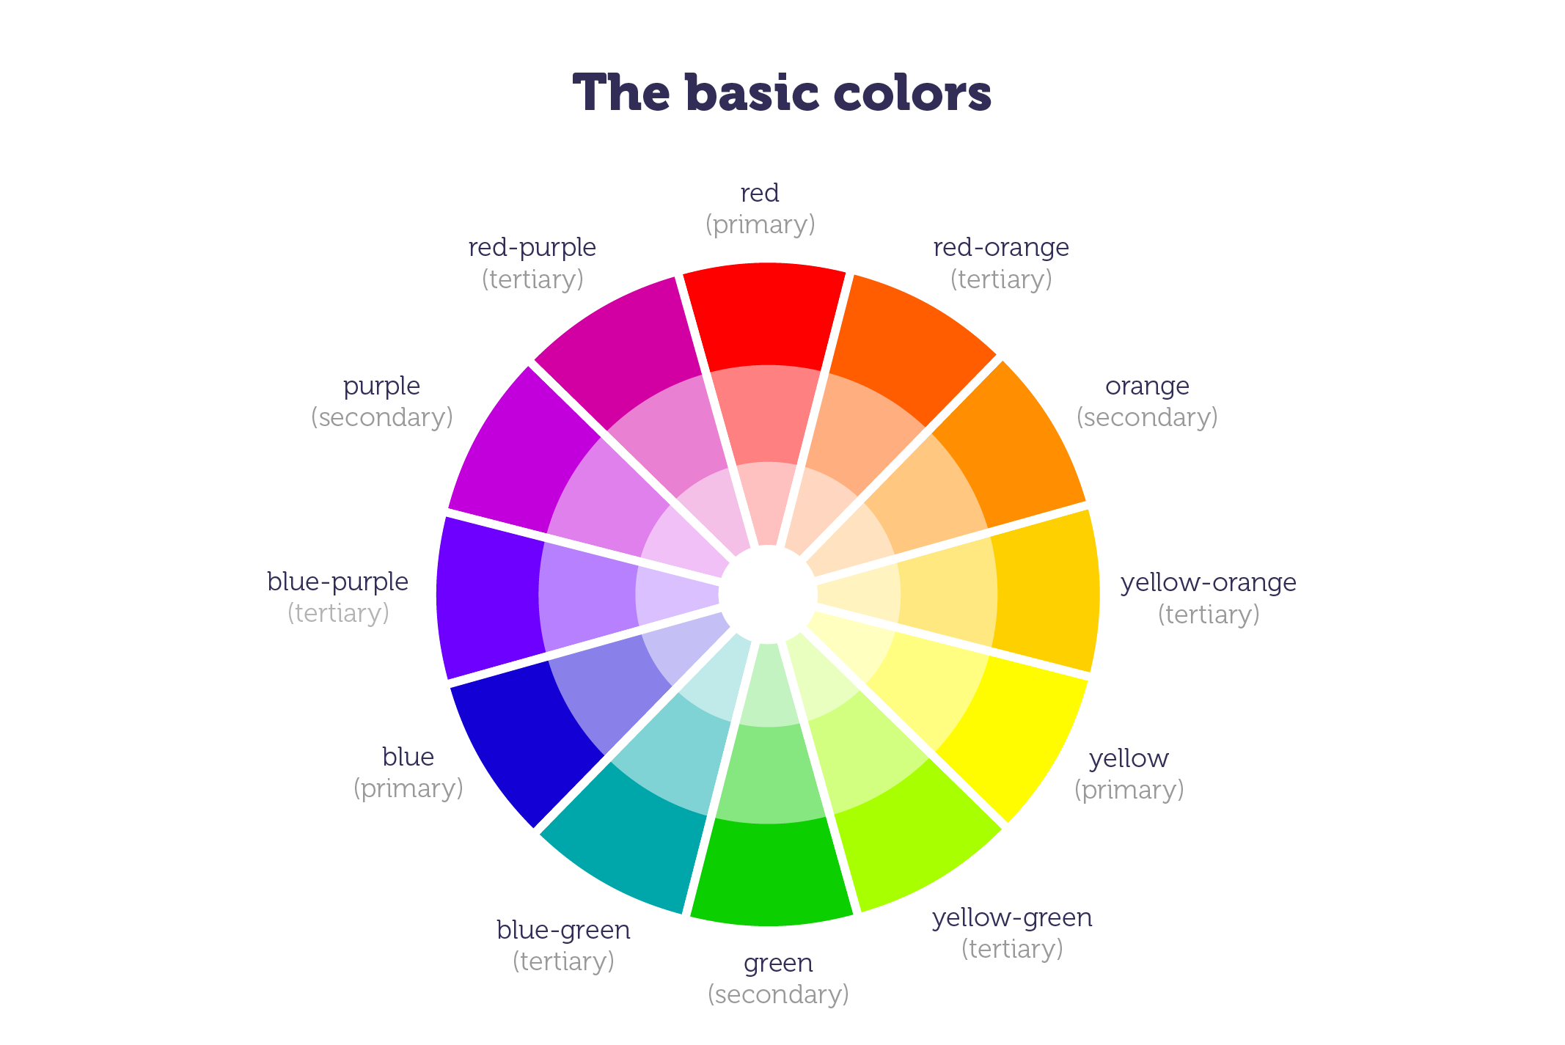
Introduction
A primary color is a color that cannot be made from a combination of any other colors.
A secondary color is a color created by combination of two primary colors.
Tertiary color is a combination of three colors primary or secondary.

Slide 3
Color’s System
Colors systems could be different based on the function it does.
In print
CMYK(cyan,magenta,yellow and black)
Subtractive or Reflective colors.
In screen Display
RGB(Red,Green,Blue)

Slide 4
Web colors
Screen Display
Pixel(Picture Element)
X & y coordinates
Color depth
1-bit ➔ 2 colors (black and white)
8-bit ➔ 256 colors
16-bit➔thousands of colors
24-bit➔millions of colors

Slide 5
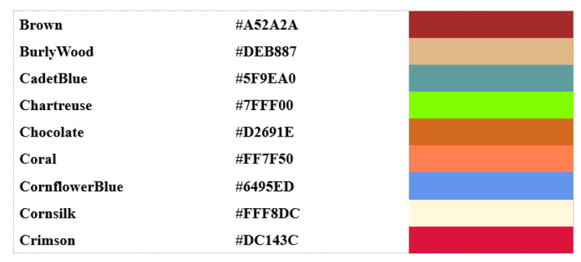
Web colors
HTML
Hexadecimal notation

Slide 6
Importance of colors and Typography for the web
Build hierarchy, Structure and organization
Create context
Enhance content
Draw attention
Provoke Emotions
Convey meaning
Visual Communication
Aid to metaphor , navigation, label, logo, graphics…

Slide 7
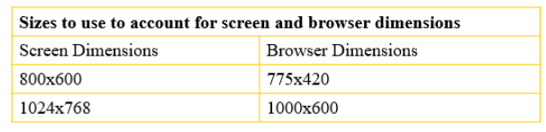
Web Canvas
As a web designer , you’ll always need to keep image dimention in mind. Your canvas( the computer monitor) contains fixed display dimensions ranging from 640x480 to 1280x1024. Most people keep their monitors all 1024x768 or more.
Examples:

Slide 8
Web Typography Short History about web Typography
1990:HTML
1995:INLINE TAGS
1998-FONT DOWNLOADING
1999:CSS3
2004:SIFR
2008:SUBSCRIPTION HOSTING
TODAY:BROWSER EMBEDDING

Slide 9












Example: Google’s typography

Slide 10
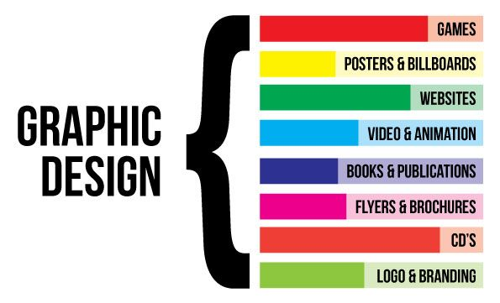
Graphic design applications
It shares aspects of engineering, but with aesthetic, communicative aspects and consumer appeal. As a practice, it has been around for thousands of years

Slide 11
Web design
Web design is the creation of a new solution to a problem in the web medium. It includes some or all of the following:
Logo design
User interface design
Copywriting
On-site SEO
Social media promotion
Information architecture
Navigation design
Design for accessibility
HTML/CSS mark-up
Design for ease-of-use (usability)
Selecting content imagery
Flash animation
JavaScript coding of UI elements
Pay-per-click advertising

Slide 12
Web design & graphic
What you need for web graphic design?
You will need a source for graphics or be able to create your own. The flexibility of knowing how to design your own graphics is preferable. Adobe Fireworks, Adobe PhotoShop, Adobe Illustrator, Adobe InDesign or any other graphic design application are great programs for creating graphics, retouching photographs, designing text and building animated GIFs.
To create the individual pages of a web site you need to be familiar with a web authoring program, or be knowledgeable in HTML and CSS.
Although it’s useful to know HTML and CSS, it’s not a necessity for web design. With the tools and software programs today (such as Adobe Dreamweaver) you can create a web page or add pictures and text to a page without typing a single line of code.

Slide 13
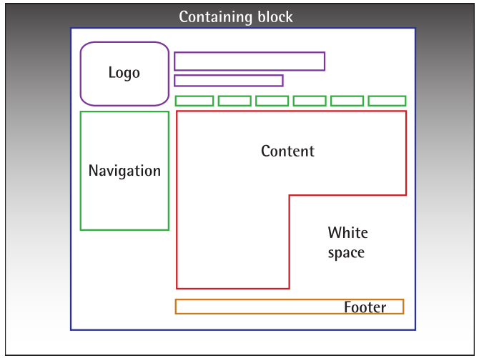
Web Page Anatomy
Containing Block
Logo
Navigation
Content
Footer
Space

Slide 14

Content
content is king. A typical web site visitor will enter and leave a web site in a matter of seconds. If visitors can’t find what they’re looking for, they will undoubtedly close the browser or move on to another site. It’s important to keep the main content block as the main point of a design so that precious seconds aren’t wasted as visitors scan the page for the information they need.

Slide 15
Footer
located at the bottom of the page, the footer usually contains copyright, contact, and legal information, as well as a few links to the main sections of the site. By separating the end content from the bottom of the browser window, the footer should indicate to users that they’re at the bottom of the page.

Slide 16
Space
The graphic design term space (or negative space) literally refers to any area of a page that’s not covered by type or illustrations. While many novice web designers (and most clients) feel a need to fill every inch of a web page with photos, text, tables, and data, having empty space on a page is every bit as important as having content. Without carefully planned Space, a design will feel closed in, like a crowded room. Space helps a design to “breathe” by guiding the user’s eye around a page.

Slide 17
Thank you

