Slide 1
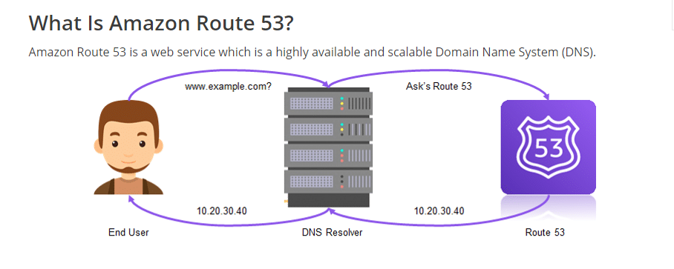
AWS Route 53 lets developers and organizations to route end users to their web applications in a very reliable and cost-effective manner. It is a Domain Name System (DNS) which translates domain names into IP addresses to direct traffic to your website. In simple terms, it converts World Wide Web addresses like www.example.com to IP addresses like 10.20.30.40.

Slide 2
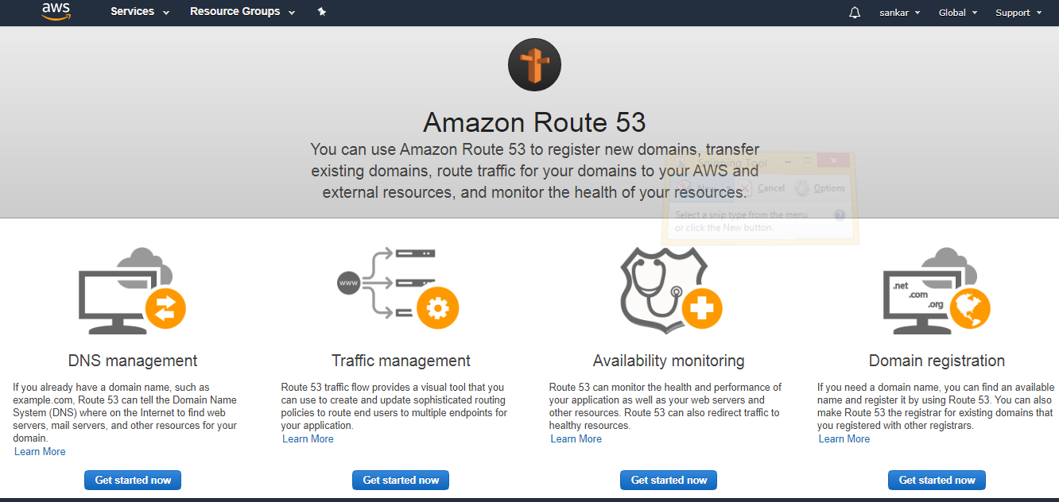
Amazon Route 53 Creation

Slide 3
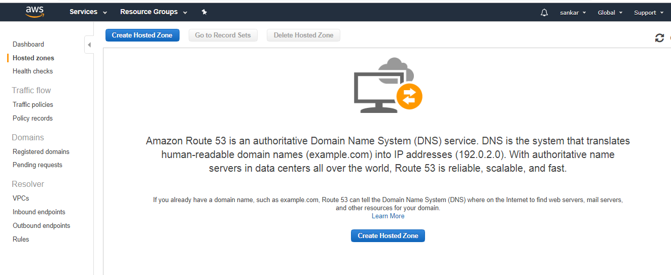
DNS Management

Slide 4
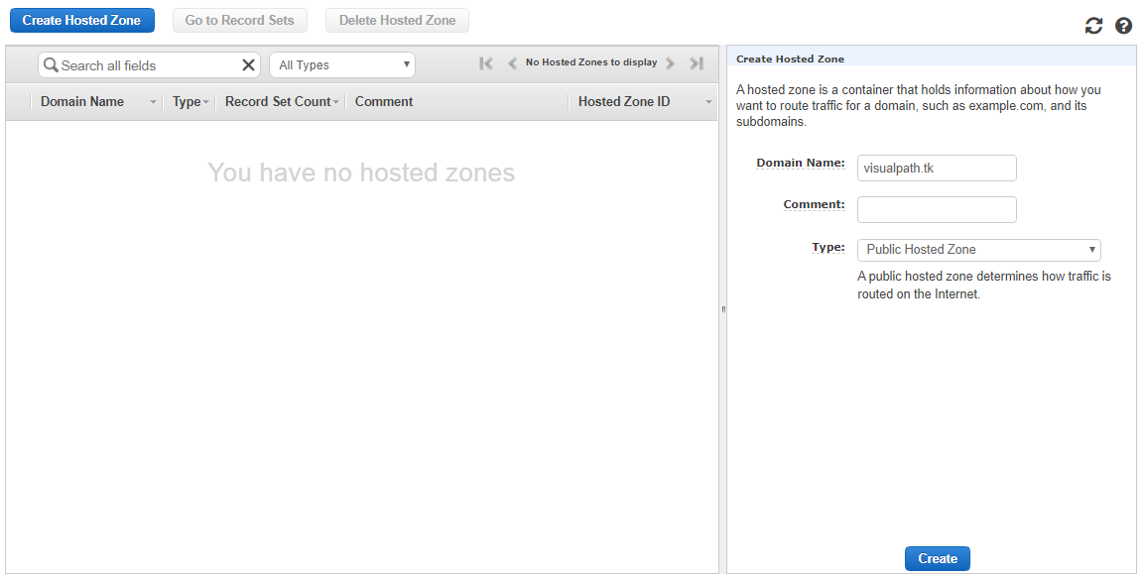
Click on Create Hosted Zone , then provide the domain name and click on create
Free Domain name : www.freenom.com

Slide 5
https://medium.com/front-end-weekly/connecting-a-domain-to-an-aws-ec2-instance-using-route53-69faffddda39

