Slide 1
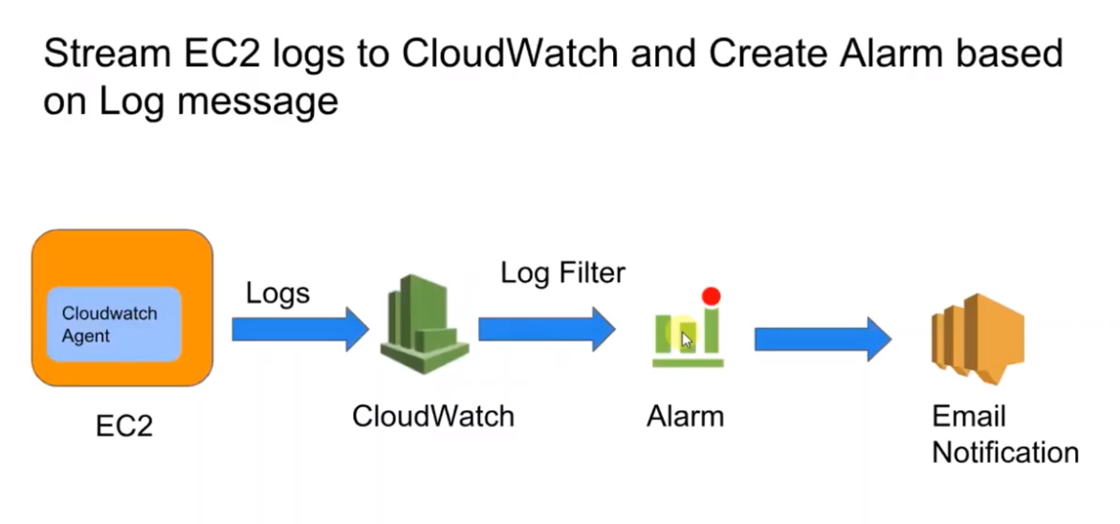
CLOUDWATCH-LOGS

Slide 2
Step 1 : Create Policy (IAM→ Policy→ modify JSON and paste the below code and give name to the policy
{
"Version": "2012-10-17",
"Statement": [
{
"Effect": "Allow",
"Action": [
"logs:CreateLogGroup",
"logs:CreateLogStream",
"logs:PutLogEvents",
"logs:DescribeLogStreams"
],
"Resource": [
"arn:aws:logs:*:*:*"
]
}
]
}

Slide 3
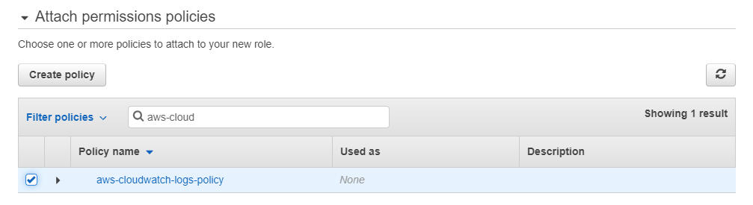
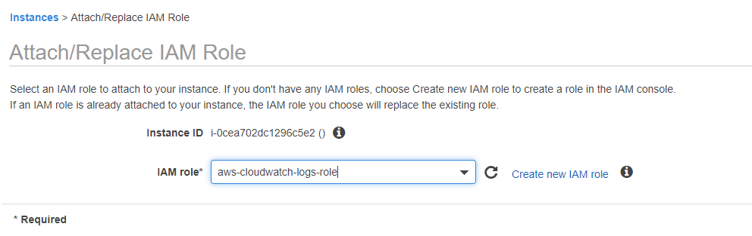
Step 2: Create IAM Role for EC2 instance and attach the policy (Role→ create role → select EC2 -→permissions → select the created policy
Step 3 : attach role to EC2 instance (Instance settings → select attach/replace role → select the role from drop down list

Slide 4

Step 4: Install cloud watch agent on the node (yum install awslogs )
Step 5: update aws logs configuration files (change the region of yours)
vi /etc/awslogs/awscli.conf
[plugins]
cwlogs = cwlogs
[default]
region = us-east-2
vi /etc/awslogs/awslogs.conf (remove the existing code and paste the below)
[general]
state_file = /var/lib/awslogs/agent-state
[application_logs]
region = ap-south-1
datetime_format = %b %d %H:%M:%S
file = /var/log/application.log
buffer_duration = 5000
log_stream_name = {instance_id}
initial_position = start_of_file
log_group_name = application_logs
Step 6: Start the logs agent
service awslogsd start

Slide 5
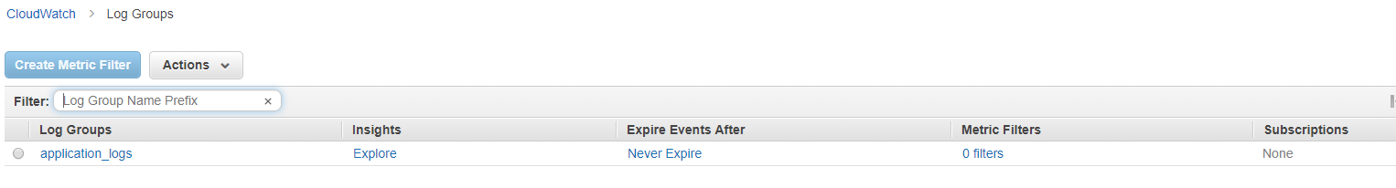
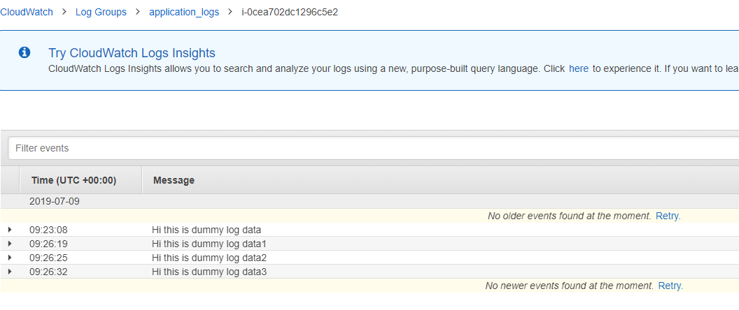
Step 7 : Create application.log file under /var/log with some data, then we can observe log will be generated under cloud watch logs
Step 8 : Append some more content to the file and observe in the logs

Slide 6
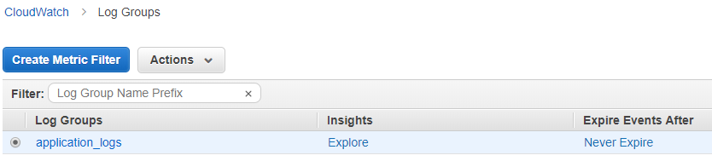
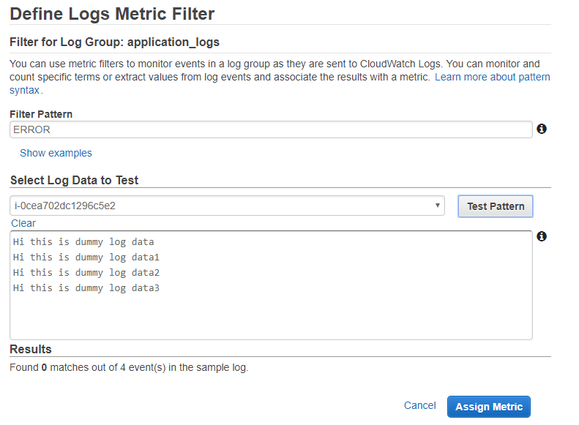
Step 9 : Apply Filter on the logs
Go to the log group and click on create metric filter
Provide the filter pattern and click on assign metric

Slide 7
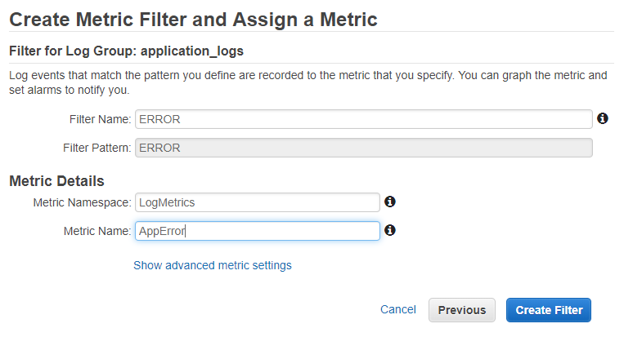
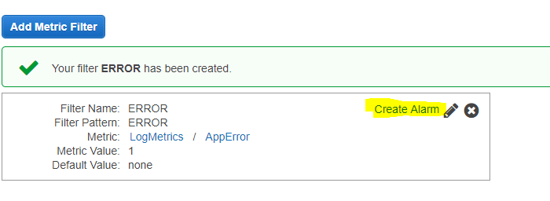
Step 10 : Create Alarm

Slide 8
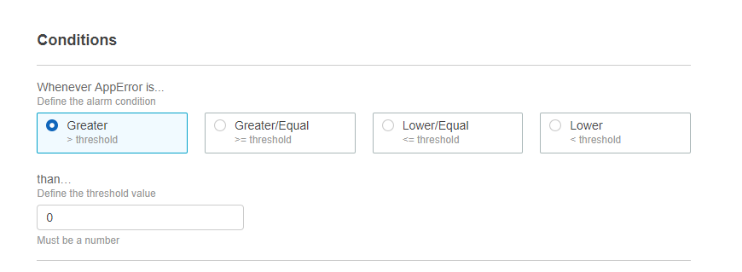
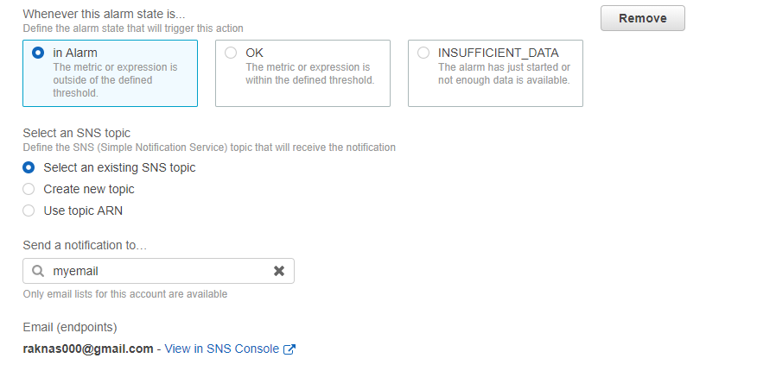
Configure the threshold condition then click on next
Configure Alarm and SNS topic, if topic exist choose the existing one or else create new one

Slide 9
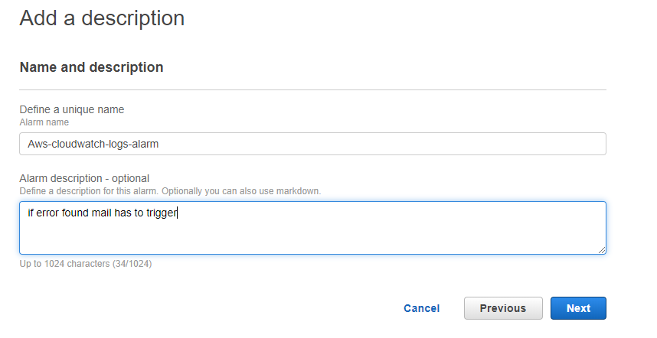
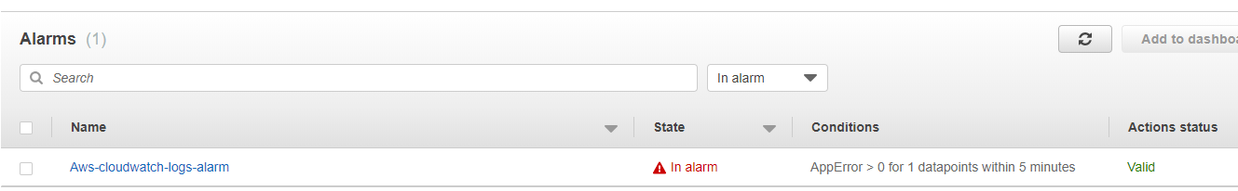
Now add some date with ERROR message into application.log file and check alarm will be triggered
We can observe email will be triggered when the state in Alarm

