Slide 1
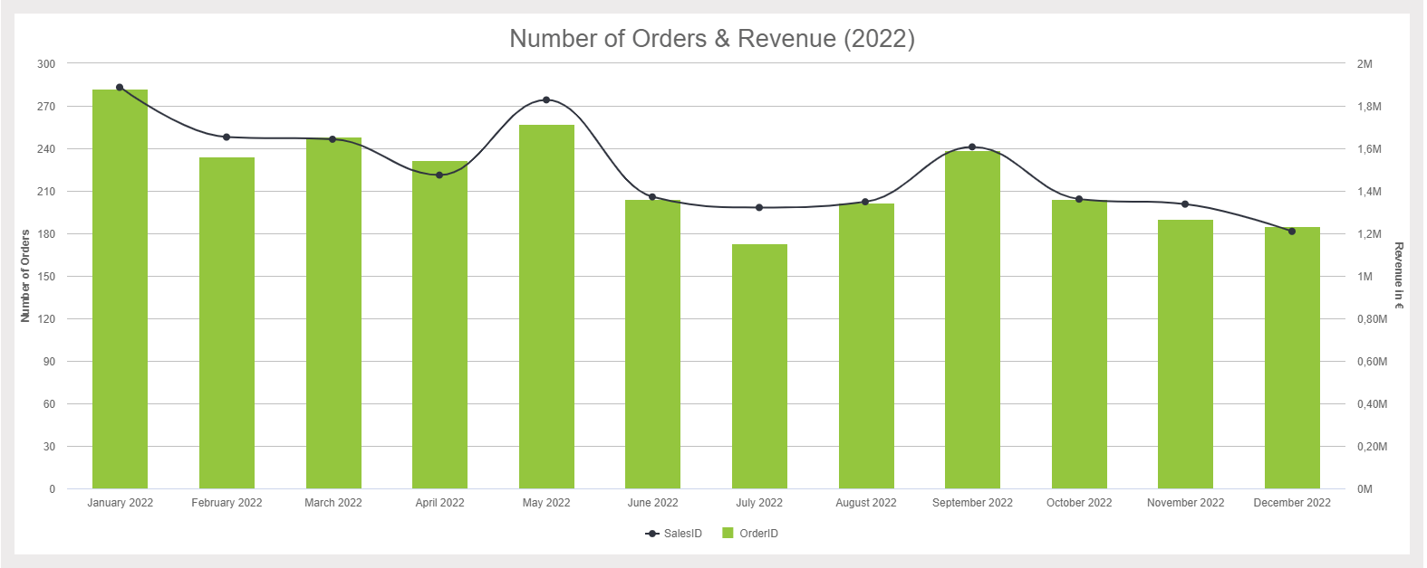
This is an amazing title!
And this is an incredible subtitle

Slide 2
This is an amazing title!
And this is an incredible subtitle

