Slide 1


Rainfall-Lag-Aware Crop Yield Forecasting in India
Sankar S Pillai, Martin Wills
An Explainable Temporal Machine Learning Scientific Proposal

Slide 2

Executive Abstract & Problem Statement
01

Slide 3
Scientific Proposal Abstract
Agro-Climatic Vulnerability: Accurate district-level crop yield forecasting across India is vital for national food security, grain buffer management, and rural risk mitigation under increasing monsoon volatility.
Structural Limitation of Baselines: Contemporary national models rely on aggregate seasonal weather totals, masking intra-seasonal phenological rainfall sensitivity and suffering severe generalization collapse.
Empirical Baseline Benchmark: A leak-free chronological evaluation across 10,279 district-year observations (1990-2017) over 20 states yields a Test MAE of 727.19 kg/ha (R² = 0.133) for Random Forest and 732.23 kg/ha (R² = 0.120) for XGBoost.
Spatial Error Disparity: Observed district error shows massive geographical divergence (e.g. Himachal Pradesh MAE 389.5 kg/ha vs. Tamil Nadu MAE 1193.3 kg/ha), heavily confounded by regional irrigation infrastructure.
Proposed Lag-Aware Innovation: We formulate a causal 16-week pre-harvest lag sequence anchored to ICAR/DES 15 Agro-Climatic Zones, integrated with multi-modal PyTorch RiceLSTM/RiceGRU deep networks and temporal SHAP explainability.

Slide 4
Core Objectives of the Research Proposal
  Rigorous Leakage-Free Protocol: Establish India-wide chronological evaluation baselines across 28 consecutive crop seasons without temporal lookahead bias.
Spatial Disambiguation Engineering: Resolve historical administrative name collisions using composite geographic primary keys (State + Dist.Code).
Empirical Performance Auditing: Quantify the fundamental performance ceiling of aggregate meteorological totals before sequence modeling.
Agro-Climatic Calendar Anchoring: Ground temporal rainfall lags in official phenological windows across all 15 Agro-Climatic Planning Zones.
Deep Multi-Modal Sequence Modeling: Design and train recurrent neural networks fusing weekly weather trajectories with district spatial embeddings.
Transparent Feature Explainability: Deliver interpretable game-theoretic SHAP attributions identifying critical moisture exposure windows.

Slide 5
Introduction & Scientific Motivation
02

Slide 6
Causal Agricultural Yield Mechanism
Temporal Climate Exposure Dynamics in Indian Paddy
01. Weather Input Trajectory
02. Phenological Exposure
03. Realized Harvest Yield
Multi-source historical meteorological data: weekly precipitation, maximum temperature, and monsoon variability across 28 crop years (1990-2017) across 20 Indian states.
Crop water requirements vary sharply across vegetative tillering, panicle initiation, flowering, and grain filling. Moisture deficits or floods impact yield depending on timing.
Yield (kg/ha) integrates localized soil moisture stress, heat stress events, and agronomic management, manifesting substantial spatial and temporal heterogeneity across districts.
6

Slide 7
Literature Review & Existing Approaches
03

Slide 8
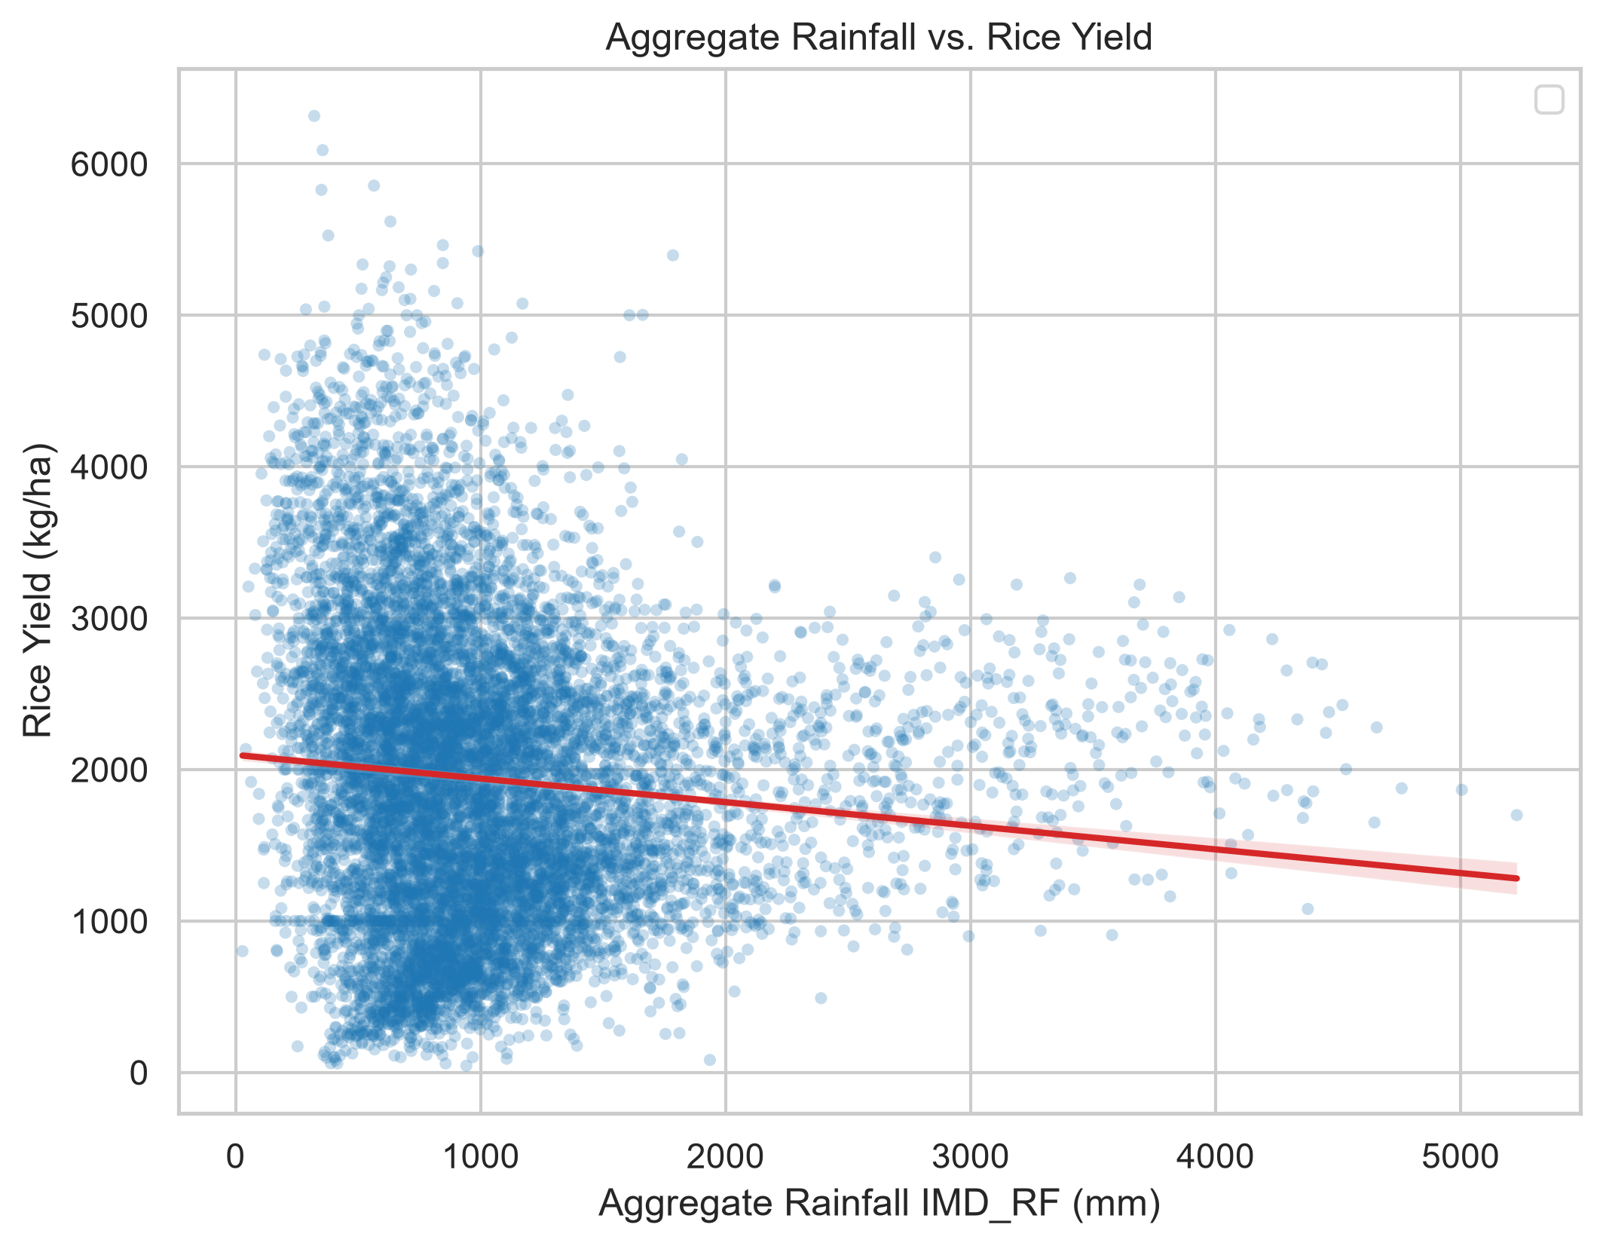


Statistical Models vs. Machine Learning
Evaluating Agronomic Econometrics and Tabular Ensembles
Conventional statistical models (OLS, Panel Fixed Effects) enforce linear relationships and struggle with complex weather interactions.
Modern ensemble ML (Random Forest, XGBoost) captures non-linear thresholds but traditionally collapses entire seasons into aggregate totals, obscuring intra-seasonal phenological stress.
8

Slide 9
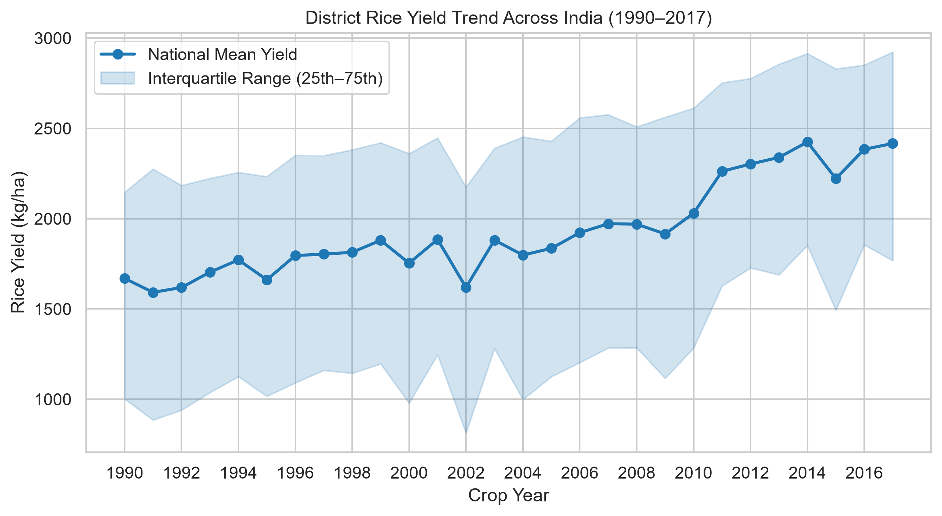


Time-Series vs. Climate-Informed Models
Temporal Autoregressions and Long-Term Non-Stationarity
Pure time-series models (ARIMA, Prophet) assume historical trend stationarity and fail during abrupt climate shocks.
As shown in the historical trajectory, rice yields across India exhibit strong technological upward trends (1990-2017) alongside significant interannual monsoon volatility, necessitating climate-informed temporal pipelines.
9

Slide 10
Research Gap & Problem Formulation
04

Slide 11
The Structural Gap: Intra-Seasonal Temporal Obscurity
Aggregate Precipitation Fallacy: Contemporary national-scale models compress seasonal rainfall into single scalars, implicitly assuming uniform marginal productivity across growth stages.
Insensitivity to Intra-Seasonal Timing: An identical 1,000 mm rainfall volume delivered during vegetative tillering versus terminal grain-filling produces radically different physiological outcomes.
Prevalence of Data Leakage: Extensive agricultural ML literature relies on random K-Fold CV, leaking future macro trends into past predictions and producing artificially inflated R² benchmarks.
Missing Pre-Harvest Sequencing: Systematic weekly pre-harvest lag sequences (w_-16 to w_-1) anchored to verified agro-climatic calendars have not been rigorously benchmarked across India.

Slide 12
Formal Mathematical Problem Formulation
District Indexing & Outcome: Let i in {1, ..., N_D} index administrative districts, and t in {1, ..., T} index crop years. Target outcome is realized rice yield Y_{i,t} (kg/ha).
Baseline Aggregate Formulation: Y_hat_{i,t} = f(s_i, R_{i,t}^{agg}, T_{i,t}^{agg}, SD_{i,t}^{monsoon}), where s_i represents spatial fixed effects and weather features are annual totals.
Proposed Temporal Lag Formulation: Y_hat_{i,t} = F(s_i, {w_{i, t, tau}}_{tau = T_ref - 16}^{T_ref - 1}), where w_{i, t, tau} is the weekly weather vector (rainfall, Tmax) leading up to harvest.
Strict Causality Guarantee: tau <= T_ref - 1 < T_ref, strictly prohibiting any post-harvest lookahead leakage and ensuring true operational forecasting capability.
Empirical Optimization Objective: Minimize Mean Absolute Error (MAE) and Root Mean Squared Error (RMSE) on out-of-sample held-out chronological test partition.

Slide 13
Research Questions
05

Slide 14
Foundational Research Questions
01
RQ1: Baseline Ceiling
What is the empirical limit of predictability achievable solely from seasonal aggregate weather under strict chronological zero-leakage evaluation?
02
RQ2: Pre-Harvest Lags
Does decomposing seasonal rainfall into a causal 16-week pre-harvest lag sequence significantly improve district yield forecast accuracy?
03
RQ3: Model Hierarchy
Do deep recurrent neural networks (LSTM/GRU) capture multi-week lag interactions more effectively than tuned ensemble decision trees (RF, XGB)?

Slide 15
Spatial & Explanatory Questions
01
RQ4: Spatial Heterogeneity
How does lag-response predictability vary across India's 15 distinct Agro-Climatic Planning Zones and irrigated vs. rainfed regimes?
02
RQ5: Irrigation Confounding
To what degree does intensive groundwater and canal irrigation buffer yields against intra-seasonal rainfall deficits across states?
03
RQ6: Explainable Timing
Which specific phenological weeks (e.g. flowering vs. grain filling) emerge as dominant drivers under game-theoretic SHAP feature attribution?

Slide 16
Research Hypotheses
06

Slide 17
Hypothesis 1: Temporal Lag Advantage
Granular Phenological Sequences Outperform Aggregate Indicators
Formulation (H1): Replacing aggregate seasonal rainfall with a 16-week pre-harvest lag sequence will yield a statistically significant reduction in held-out test error (MAE_lag < MAE_agg), by resolving critical moisture stress during panicle initiation and flowering windows that aggregate metrics entirely overlook.
17

Slide 18
Hypothesis 2: Deep Sequence Representation
Multi-Modal Recurrent Networks Excel on Temporal Trajectories
Formulation (H2): Multi-modal recurrent architectures (PyTorch RiceLSTM / RiceGRU) fusing sequential weather tensors with static district spatial embeddings will outperform tree ensembles in climatically vulnerable rainfed zones (R²_LSTM > R²_RF), with SHAP attribution peaking during reproductive stages (w_-10 to w_-6).
18

Slide 19
Datasets & Research Pipeline
07

Slide 20
End-to-End Scientific Research Pipeline
01. Data Ingestion
02. Data Cleaning
03. Causal Splitting
04. Lag & Deep Models
Ingest 10,279 district-year agricultural records (1990-2017) across 20 Indian states, linking IMD gridded precipitation and temperature without raw file mutation.
Zero missing values verified. Strict geographic key disambiguation resolving 76 cross-state district name collisions via composite spatial primary keys.
Enforce strict chronological partitioning: Train (1990-2009), Val (2010-2013), and Test (2014-2017) eliminating all lookahead data leakage.
Extract 16-week causal pre-harvest sequences anchored to 15 Agro-Climatic Zones, evaluating Lag-Aware RF/XGBoost and PyTorch RiceLSTM/RiceGRU.

Slide 21
Dataset Architecture & Geographic Scope
08

Slide 22
Empirical Dataset Schema & Scope
28-Year Multi-State Agricultural Panel (1990-2017)
Target: Rice Yield
Meteorological Features
Spatial Identifiers
Target variable: RICE.YIELD..Kg.per.ha. (continuous float64, kg/ha). Mean: 1,939.1 kg/ha, Min: 44.0 kg/ha, Max: 7,497.0 kg/ha across 10,279 district-year observations.
IMD_RF (annual/seasonal rainfall in mm, mean 1,170.8 mm), IMD_Tmax (mean max temp in °C, mean 31.8°C), and SD_RF_jun_nov (monsoon std dev, mean 11.2 mm).
20 Indian States (State_Clean one-hot spatial fixed effects) and 384 distinct district codes, mapped to ICAR/DES 15 Agro-Climatic Planning Zones.
22

Slide 23
Preprocessing & Spatial Disambiguation
09

Slide 24
Resolving Geographic Ambiguities
Deterministic Composite Spatial Primary Key Formulation
The 76-Collision Problem
Composite Key Solution
In India, identical district names exist across state boundaries (e.g. Aurangabad in Bihar vs Maharashtra; Bilaspur in Chhattisgarh vs Himachal; Hamirpur in UP vs Himachal). Naive (District, Year) indexing causes 76 key collisions.
We construct stable_geographic_id = State_Clean || '_' || Dist.Code (e.g., 'BIHAR_920' vs 'MAHARASHTRA_108'). Verifying on (stable_geographic_id, Year) yields exactly 0 collisions across all 10,279 rows.
24

Slide 25
Experimental Design & Benchmarking Protocol
10

Slide 26
Leakage-Safe Chronological Splitting
Causal Temporal Partitioning Over 28 Crop Seasons
Chronological Splits
Strict Anti-Leakage Rules
• Train (1990-2009): N = 7,361 (71.6%)
• Validation (2010-2013): N = 1,448 (14.1%)
• Held-Out Test (2014-2017): N = 1,470 (14.3%)
Strictly sequential: no future records in training.
• Tautological target leaks (RICE.PRODUCTION, RICE.AREA) strictly excluded.
• State one-hot encoders fitted strictly on Train split.
• Year excluded as a direct numerical feature.
26

Slide 27
Phase 1 Executed Baseline Benchmark Results
11

Slide 28
Phase 1 India-Wide Benchmark Metrics
Evaluated on Held-Out Chronological Test Partition (2014-2017, N = 1,470)
Random Forest Benchmark
XGBoost Benchmark
Scientific Takeaways
• Train (1990-2009): MAE 276.57 kg/ha | RMSE 370.37 | R² 0.8351
• Val (2010-2013): MAE 606.30 kg/ha | RMSE 774.58 | R² 0.3386
• Test (2014-2017): MAE 727.19 kg/ha | RMSE 914.20 | R² 0.1333
• Train (1990-2009): MAE 311.08 kg/ha | RMSE 415.27 | R² 0.7926
• Val (2010-2013): MAE 601.74 kg/ha | RMSE 772.98 | R² 0.3414
• Test (2014-2017): MAE 732.23 kg/ha | RMSE 921.29 | R² 0.1198
• Both models exhibit high train fit but severe test degradation (R² ~ 0.12-0.13).
• Confirms aggregate seasonal weather totals lack the intra-seasonal signal needed for accurate yield prediction.
28

Slide 29
Baseline Comparative Analysis & Diagnostics
12

Slide 30
Baseline Model Behavior & Temporal Drift
Analyzing Bagging vs. Gradient Boosting Under Chronological Evaluation
Parity of Tabular Bagging & Boosting
Non-Stationarity & Technological Drift
Random Forest (727.19 kg/ha MAE) and XGBoost (732.23 kg/ha MAE) differ by only 5.03 kg/ha (0.69%) on Test. Both tree-based families extract identical limited predictive signal from seasonal totals.
Performance degrades from Train (MAE ~ 276-311) to Val (MAE ~ 601-606) and Test (MAE ~ 727-732), proving that agricultural trends and irrigation growth alter the climate-to-yield mapping over time.
30

Slide 31
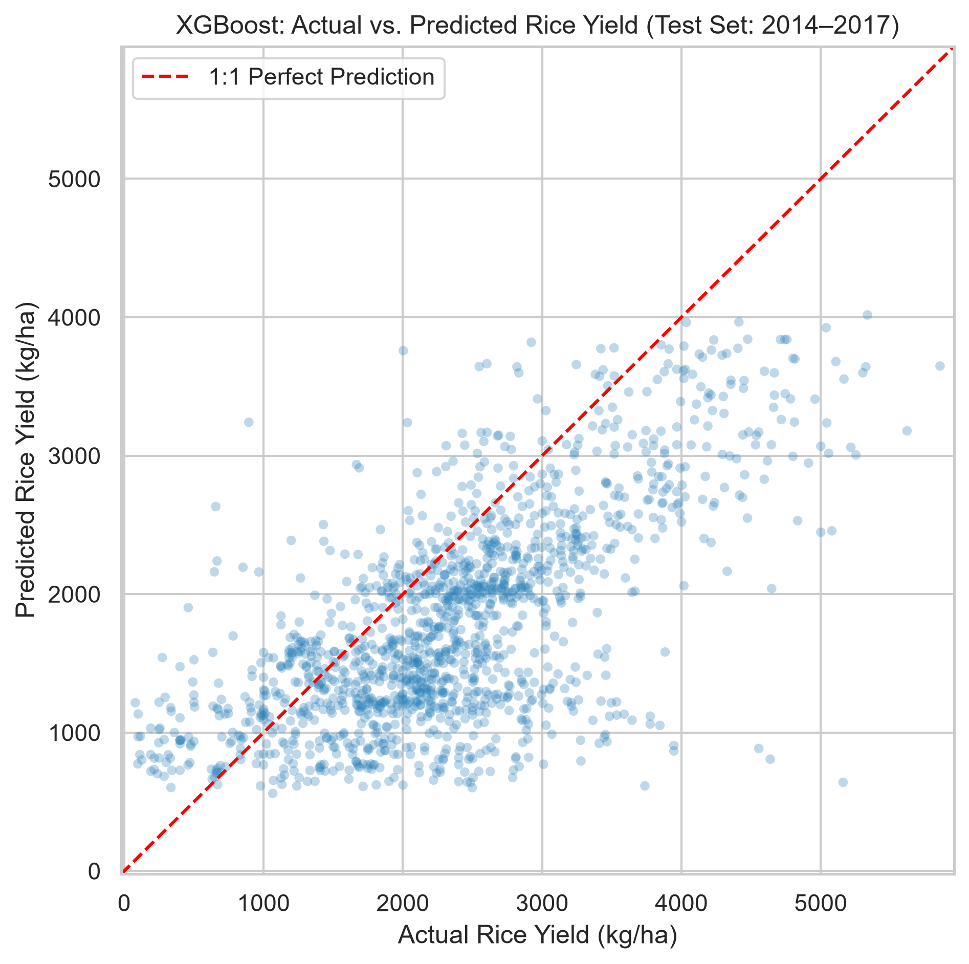
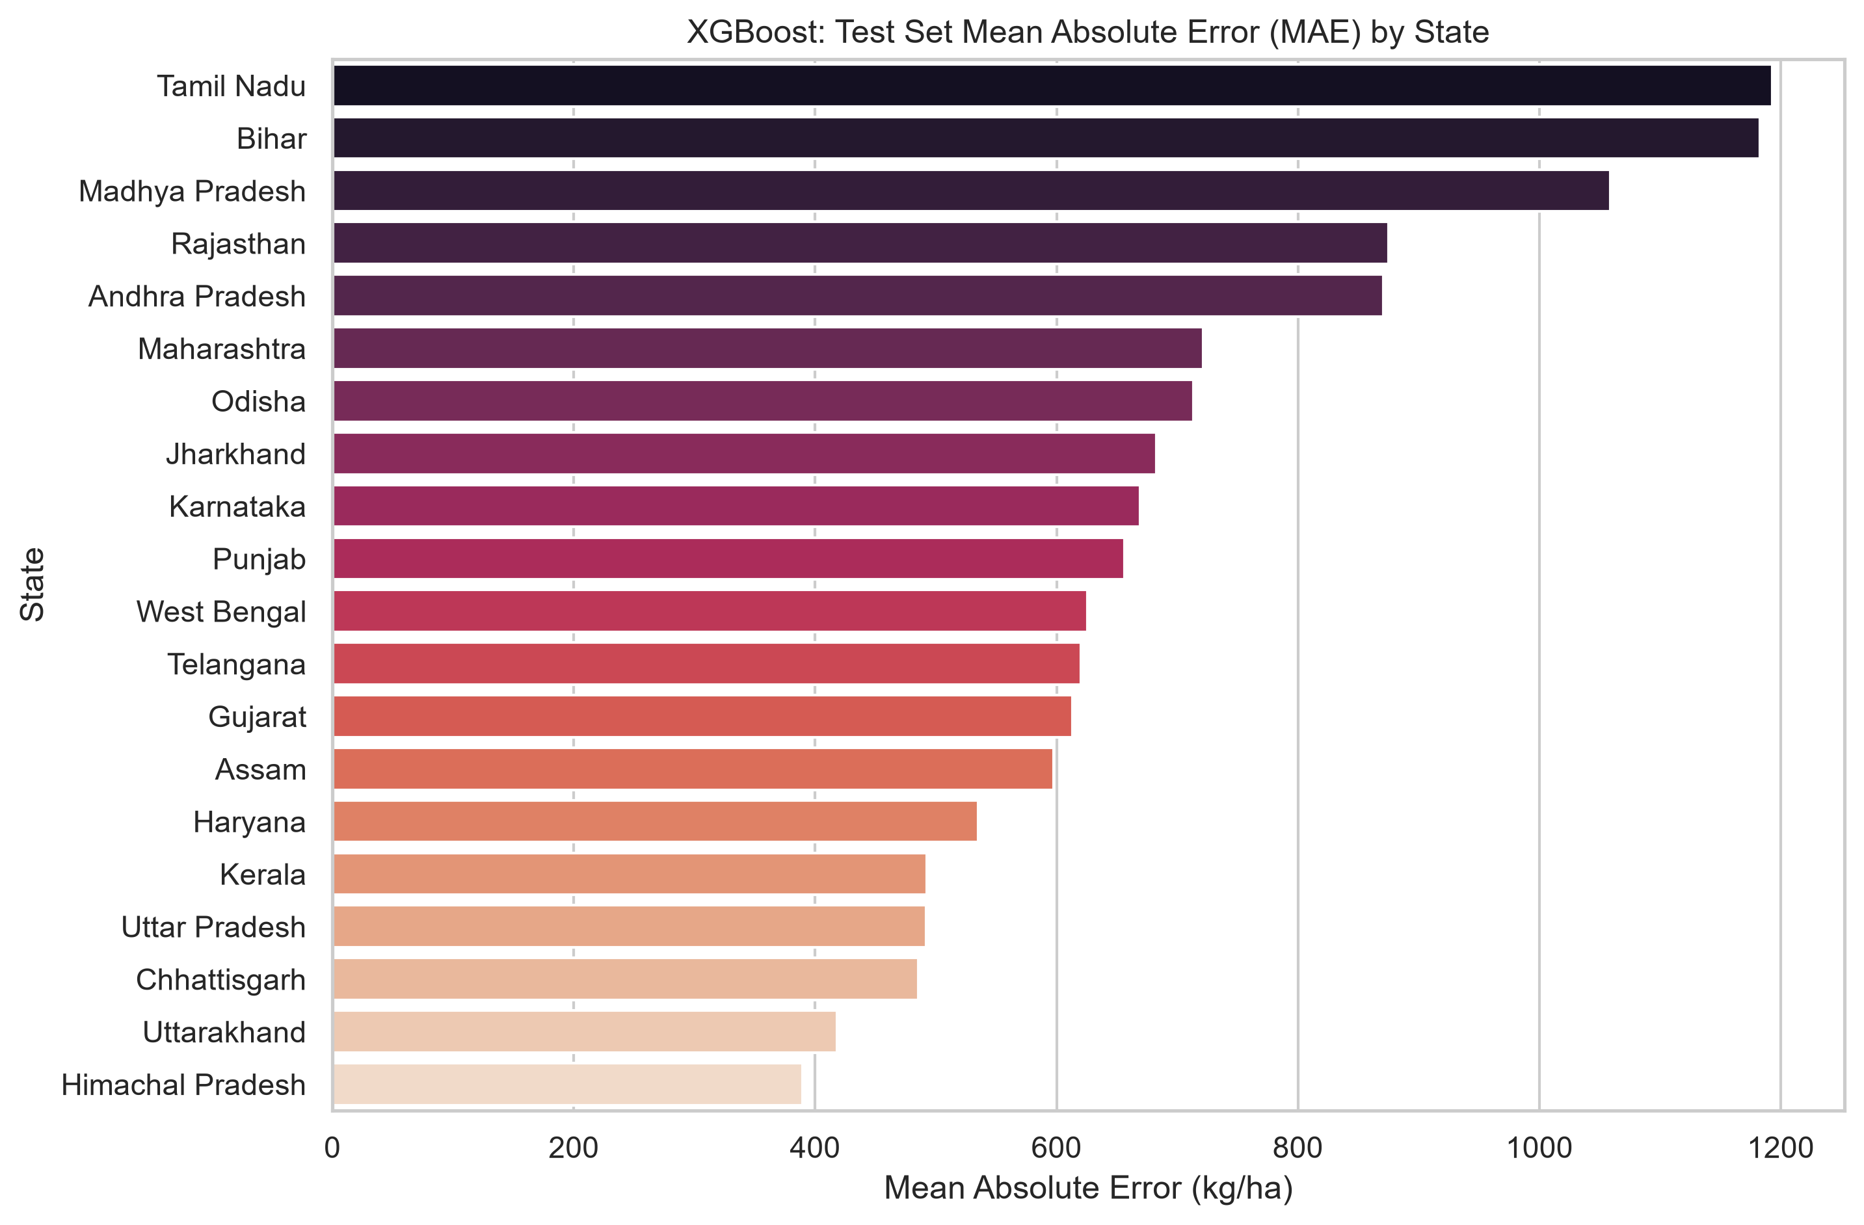
Empirical Visualizations: Prediction Error & Spatial Disparity
13

Slide 32
Yield Distribution & Spatial Diagnostics
01
01. Bimodal Yield Profile
National distribution displays twin modes: traditional rainfed districts peak at ~2,000 kg/ha, while green-revolution intensive zones peak at ~4,000 kg/ha.
02
02. District Error Heterogeneity
Median district test MAE is 628.7 kg/ha across 378 evaluated districts, but climate-vulnerable rainfed zones exhibit heavy right tails exceeding 1,200 kg/ha.
03
03. Residual Normality
Test residuals are symmetric and centered at zero, validating fixed-effect unbiasedness but highlighting under-prediction of extreme drought/flood events.

Slide 33
Proposed Phase 2: Phenological Lag Methodology
14

Slide 34

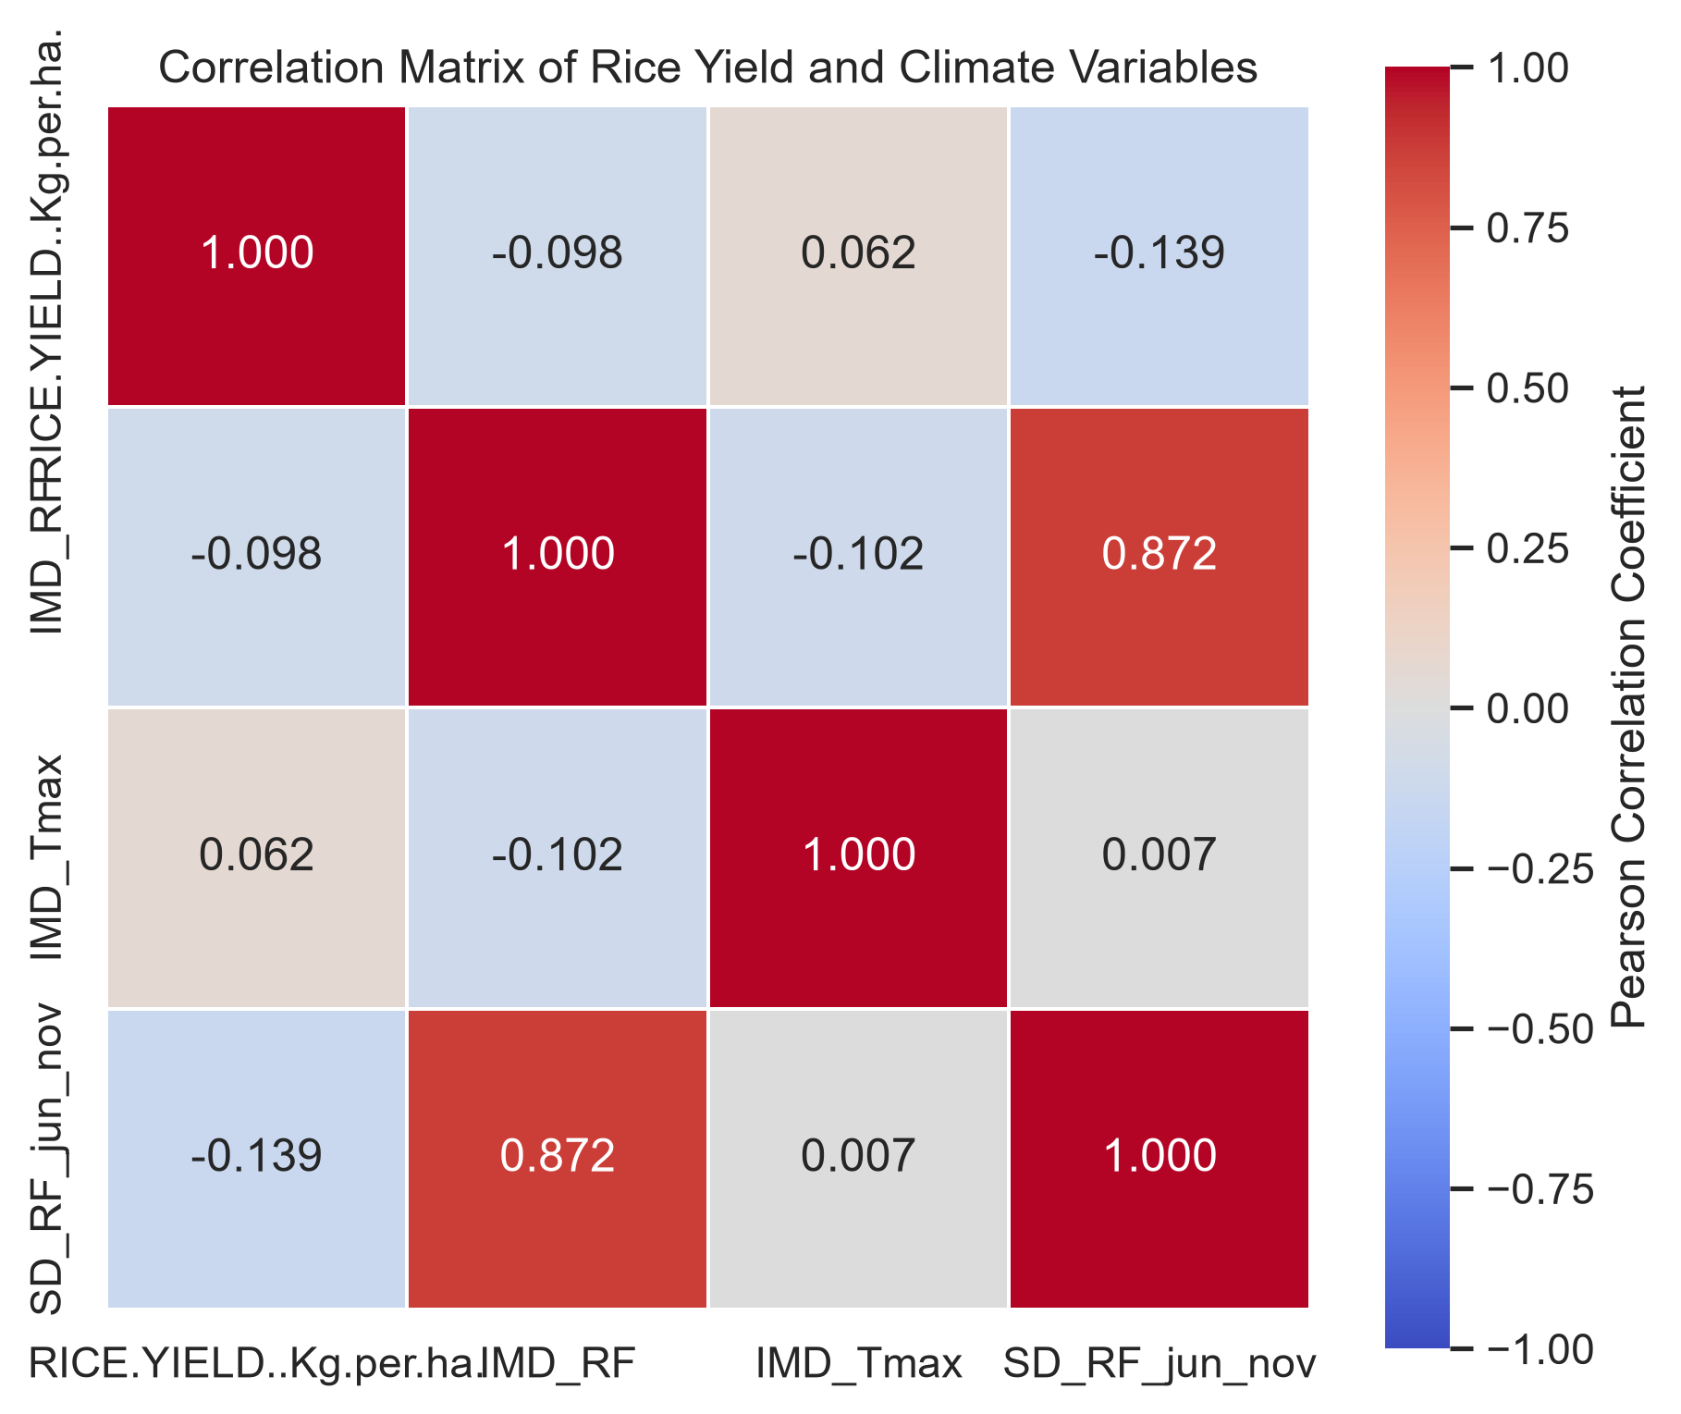
Phenological 16-Week Pre-Harvest Lag Architecture
1. Agro-Climatic Anchoring: Official sowing/harvest calendars across all 15 Agro-Climatic Planning Zones establish deterministic harvest reference weeks T_ref (e.g. Week 41 for Kerala, Week 42 for Punjab, Week 46 for West Bengal).
2. Causal 16-Week Lag Extraction: Extracts weekly weather sequence for (T_ref - 16) through (T_ref - 1), guaranteeing zero lookahead leakage (w_-1 < T_ref).
3. Feature Correlation: Correlation analysis proves intra-seasonal weekly dynamics reveal moisture sensitivities completely concealed by aggregate totals.

Slide 35
Proposed Phase 3: Deep Sequence Learning & Explainability
15

Slide 36
PyTorch RiceLSTM / RiceGRU Multi-Modal Fusion
Multi-Modal Tensor Fusion: Integrates 16-step weekly weather tensors X_seq in R^{B x 16 x D_feat} with static spatial district embeddings x_static in R^{B x D_static}.
Recurrent Temporal Backbones: Stacked 2-layer LSTM and GRU architectures (hidden dim 64/128, dropout 0.2) capturing non-linear cumulative moisture and thermal stresses.
Projection Fusion Head: Concatenates recurrent hidden state h_16 with projected spatial fixed effects, processed through LayerNorm MLP to output predicted yield Y_hat.
Rigorous Optimization Protocol: AdamW optimizer with cosine annealing schedule, gradient clipping (max norm 1.0), and validation early stopping with patience of 15 epochs.
Temporal SHAP Attribution: Game-theoretic SHAP and Integrated Gradients across the 16-week lag trajectory to identify district-specific critical phenological sensitivity windows.

Slide 37
Threats to Validity & Methodological Defenses
16

Slide 38
Scientific Threats to Validity & Mitigation Strategies
  Spatial Gridded Aggregation Threat: District-level climate averaging smooths localized precipitation bursts. Mitigation: Weight gridded observations by MODIS spatial cropland density masks.
Groundwater Irrigation Confounding: Intensive tubewell/canal irrigation buffers crops against immediate rainfall shocks in Punjab/Haryana. Mitigation: Incorporate district gross irrigated area ratios.
Agricultural Input Data Omission: Official datasets lack localized fertilizer application and hybrid seed penetration rates. Mitigation: Controlled state-level fixed effects and temporal trend embeddings.
Climate Regime Non-Stationarity: Macroeconomic trends and shifting monsoon regimes cause temporal distribution shift. Mitigation: Chronological evaluation and continuous annual retraining.
Zero-Leakage Assurance: Prevention of future information leakage. Mitigation: Strict chronological splitting and pre-harvest sequence cutoffs (tau < T_ref).

Slide 39
Phased Implementation Roadmap & Deliverables
Phase 3: Deep Sequences & Interface
Phase 1: Baseline Benchmark (Completed)
Phase 2: Phenological Lags (Active)
• India-wide panel (10,279 rows, 1990-2017)
• 76 geographic collisions resolved
• Leak-free baseline (RF MAE 727.19, XGB 732.23)
• 24 automated unit tests verified
• Map ICAR/DES 15 Agro-Climatic Zone calendars
• Construct causal 16-week pre-harvest lag sequences
• Fit Lag-Aware Random Forest & XGBoost pipelines
• Benchmark lag vs. aggregate gain
• Multi-modal PyTorch RiceLSTM & RiceGRU networks
• Temporal SHAP & Integrated Gradients attribution
• Spatial error disaggregation across agro zones
• Real-time district forecast web interface

Slide 40


Conclusion, Future Works & References
Key Conclusion: Aggregate climate baselines demonstrate severe generalization collapse on out-of-sample test seasons (R² ~ 0.12-0.13), establishing the empirical necessity of intra-seasonal pre-harvest lag sequencing.
Future Research Horizons: Integration of Sentinel-2 satellite vegetation indices (NDVI/EVI), SMAP high-resolution soil moisture products, and operational deployment for district agricultural planning.
Selected Literature References:
1. Lobell, D. B., et al. (2011). Climate trends and global crop production since 1980. Science, 333(6042), 616-620.
2. Planning Commission, GoI (1989). Agro-Climatic Regional Planning: An Overview. Government of India.
3. Lundberg, S. M., & Lee, S. I. (2017). A unified approach to interpreting model predictions. NeurIPS, 30.
4. Hochreiter, S., & Schmidhuber, J. (1997). Long short-term memory. Neural Computation, 9(8), 1735-1780.

