Slide 1


Rainfall-Lag-Aware Crop Yield Forecasting in India
Sankar S Pillai, Martin Wills

Slide 2

Research Context
2

Slide 3
Understanding Kerala's climate and agriculture
Kerala's agriculture is heavily reliant on seasonal rainfall, making it vulnerable to climatic variability. Key points include:
  Dependence on Monsoons: The southwest monsoon is critical for crop growth.
  Interannual Variability: Fluctuations in rainfall patterns can disrupt planting schedules.
  Crop Sensitivity: Varieties respond differently to moisture levels, impacting yield.
  Decision-Making Needs: Accurate forecasting is essential for planning and resource allocation.
  Understanding these factors is crucial for developing effective rainfall-lag-aware yield forecasting models tailored to the region's specific needs.

Slide 4
Key Insights into Agricultural Yield Forecasting
  Timely forecasts enable proactive measures for resource allocation.
  Accurate predictions enhance food security and economic stability.
  Supports farmers in optimizing planting and harvesting schedules.
  Facilitates effective risk management against adverse weather events.
  Empowers stakeholders to make informed decisions regarding crop selection.
  Contributes to sustainable agricultural practices by minimizing waste.
  Enhances overall productivity and profitability of farming operations.

Slide 5
Problem Formulation
5

Slide 6
Causal Chain Analysis
Temporal Lag Effects on Crop Yield
Input
Temporal Exposure
Crop Response
The model inputs historical rainfall and meteorological data to understand how previous precipitation affects crop yields, emphasizing the significance of data accuracy and relevance.
Rainfall exposure over multiple preceding time intervals is crucial in capturing delayed physiological responses, allowing for a more comprehensive understanding of crop yield dynamics.
The physiological and agronomic reactions of crops to varying rainfall lag structures illustrate the complexity of relationships influencing overall yield outcomes, necessitating robust analysis for predictions.
6

Slide 7
Existing Approaches Overview
7

Slide 8


Comparison of Statistical and Machine Learning Models
Evaluating Approaches to Crop Yield Forecasting
This page examines the strengths and limitations of conventional statistical models versus standard machine-learning approaches in crop yield forecasting, highlighting their different capabilities regarding temporal lag.
8

Slide 9

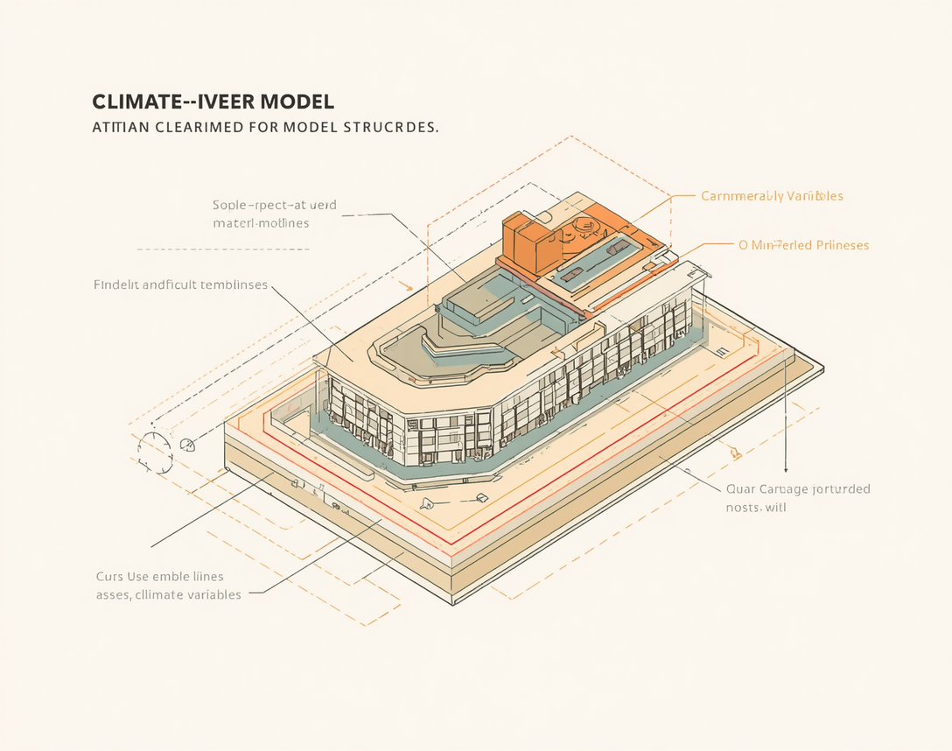
Comparison of Temporal Approaches
Examining Time-Series and Climate-Informed Models
This section outlines the distinctions between time-series approaches and climate-informed models, emphasizing their methodologies, strengths, and limitations in addressing rainfall-lag-aware crop yield forecasting.
9

Slide 10
Research Gap: Temporal Lag Structure
10

Slide 11
Understanding the limitations of existing models
Existing crop-yield prediction approaches frequently represent precipitation using contemporaneous or aggregated features. This methodology potentially obscures delayed and crop-specific rainfall responses. The contributions of rainfall at various time lags—such as t-1, t-2, t-4, and t-8—remain largely unknown. This lack of representation can lead to inaccurate yield forecasts, as it does not account for the complex physiological and agronomic responses of crops to delayed precipitation. A more nuanced approach that incorporates lagged rainfall data is crucial for improving the accuracy of yield predictions in Kerala's agricultural landscape.

Slide 12
Exploring the impact of rainfall lag
The research question addresses how lagged rainfall exposures contribute to yield prediction. This involves:
  Analyzing the effects of rainfall at various lag times (t-1, t-2, t-3, etc.)
  Determining if these lagged variables provide significant predictive power
  Identifying crop-specific responses to delayed rainfall
  Evaluating the influence of interannual climatic variability on lag effects
Understanding these aspects will enhance the accuracy of crop yield forecasts and offer actionable insights for agricultural planning in Kerala’s dynamic climate.

Slide 13
Research Questions
13

Slide 14
Research Questions Overview
01
Lag-Aware
Lag-aware features enhance predictive capabilities significantly.
02
Contemporaneous
Contemporaneous features may overlook critical rainfall impacts.
03
Informative Lags
Identifying specific lags optimizes forecasting accuracy effectively.

Slide 15
Optimal Lag Structures
01
Crops
Different crops respond uniquely to rainfall lags.
02
Climate
Climatic conditions influence lag contributions to yield.
03
Explainability
Machine learning can clarify rainfall-yield relationships.

Slide 16
Research Hypotheses
16

Slide 17
Lagged Rainfall Features
Improving Crop Yield Prediction Accuracy
Incorporating lagged rainfall features into models is expected to reduce prediction errors by capturing the delayed effects of precipitation, enhancing the accuracy of crop yield forecasts.
17

Slide 18
Rainfall Contributions
Crop-Specific Temporal Lag Structures
Understanding the unique temporal lag structures of rainfall can enhance crop yield prediction, offering tailored insights that improve model robustness under varying climatic conditions in Kerala.
18

Slide 19
Proposed Methodology
19

Slide 20
Research Pipeline
Data Acquisition
Data Cleaning
Temporal Alignment
Lag Feature Construction
This stage involves gathering comprehensive datasets, including historical rainfall and crop yield information, to build a robust foundation for subsequent analyses and model development.
In this phase, the collected data will be meticulously reviewed and cleaned to remove inconsistencies, missing values, and outliers, ensuring high-quality data for accurate forecasting.
Here, we will align the temporal datasets, synchronizing rainfall and crop yield data according to specific time intervals, thus establishing a coherent time-series for analysis.
This crucial step involves generating lagged rainfall features, allowing us to capture the delayed effects of precipitation on crop yield, thereby enhancing predictive model performance.

Slide 21
Dataset Construction Overview
21

Slide 22
Dataset Schema
Key Variables for Analysis
Rainfall
Temperature
Crop Yield
Rainfall is measured as a continuous variable, collected at daily or monthly temporal resolutions, serving as a primary predictor of crop yield in the analysis.
Temperature data is also treated as a continuous variable, collected at daily or monthly resolutions, influencing crop growth and yield outcomes alongside rainfall metrics.
Crop yield is recorded as a continuous variable, tracked on a seasonal or annual basis, representing the target outcome for the machine learning models used in forecasting.
22

Slide 23
Temporal Lag Construction
23

Slide 24
Rainfall Lag Dependency
Understanding Yield Relationships with Rainfall
Yield Function
Rain Lag Matrix
The function Yield_t = f(R(t-1), R(t-2), ..., R(t-k) illustrates how yield is influenced by precipitation across multiple lags, reflecting delayed crop responses to rainfall.
The notation X_rain = [R(t-1), R(t-2), ..., R(t-k)] organizes historical rainfall data into a structured matrix, aiding in the analysis of temporal effects on crop yield.
24

Slide 25
Analytical and Machine Learning Framework
25

Slide 26
Candidate Model Families
Approaches for Effective Crop Yield Forecasting
Baseline Models
Nonlinear Models
Baseline models such as Linear Regression and Random Forest provide foundational approaches, focusing on simplicity and interpretability while establishing initial benchmarks for yield predictions.
Nonlinear machine learning models like XGBoost leverage complex data patterns, allowing for better performance in capturing intricate relationships between rainfall data and crop yields.
26

Slide 27
Experimental Design Overview
27

Slide 28
Independent Variables
A Comprehensive Overview of Yield Factors
Rainfall Representation
Dependent Variable
Control and Baseline
The study considers multiple rainfall representations, including contemporaneous, cumulative, and lagged features, to assess their impact on crop yield prediction accuracy throughout the growing season.
Crop yield serves as the primary dependent variable, with measurements taken seasonally and annually, reflecting the overall agricultural productivity influenced by various climatic factors in Kerala.
The control model utilizes non-lagged climatic features, allowing for a comparative analysis against lag-aware models to evaluate the effectiveness of incorporating rainfall lag structures in predictions.
28

Slide 29
Baseline and Proposed Models
29

Slide 30
Baseline vs. Proposed
Comparing predictive modeling frameworks
Baseline Representation
Proposed Representation
The baseline model is formulated as Yield_t = f(R_t, T_t, ...), emphasizing contemporaneous rainfall and temperature without accounting for temporal lag effects on yield prediction.
The proposed model expands to Yield_t = f(R_t, R(t-1), R(t-2), ..., R(t-k), T_t, ...), integrating multiple rainfall lags to enhance predictive accuracy and better capture delayed responses.
30

Slide 31
Ablation Study Overview
31

Slide 32
Experiments Isolating Temporal Lag Contribution
01
Contemporaneous
Evaluates immediate rainfall impact on yield.
02
Cumulative
Assesses total rainfall effects over time.
03
Lagged
Analyzes short and long-term rainfall influences.

Slide 33
Explainability in Crop Yield Models
33

Slide 34

Rainfall Lag Contributions
This section visually represents how different rainfall lags contribute to yield predictions, using SHAP-based feature attribution to highlight the importance of temporal rainfall effects in crop forecasting.

Slide 35
Expected Research Contributions
35

Slide 36
Expected contributions to agricultural forecasting
The study aims to provide:
  A systematic representation of rainfall-yield temporal lag structures.
  An empirical evaluation of the impact of lag-aware precipitation features on yield prediction.
  A comparative analysis of crop-specific lag responses to weather variations.
  An explainable characterization of critical rainfall exposure windows influencing crop yield.
  A reproducible experimental framework for climate-aware crop forecasting, enabling further research and application within agricultural practices in Kerala.

Slide 37
Limitations and Threats
37

Slide 38
Key Limitations and Threats to Validity
  Data availability and completeness may hinder accurate predictions.
  Spatial aggregation across districts can obscure localized variations.
  Confounding agricultural factors such as crop management practices influence outcomes.
  Irrigation effects complicate the understanding of rainfall impacts.
  Variability in fertilizer and input usage can skew results.
  Extreme weather events may introduce unpredictability in yield responses.
  Non-stationarity under climate change raises questions about model stability.
  Potential temporal leakage between training and test datasets must be mitigated.

Slide 39
Research Timeline
Phase 3: Temporal Feature Construction
Phase 1: Data Acquisition
Phase 2: Preprocessing
In this phase, researchers will gather extensive historical data on rainfall, temperature, and crop yields across various districts in Kerala, ensuring comprehensive coverage for analysis.
The collected data will undergo rigorous cleaning and preprocessing to address missing values, standardize formats, and ensure alignment with the temporal resolution of interest.
Researchers will construct lagged rainfall features utilizing historical data, creating a structured temporal feature space that captures delayed precipitation effects for improved yield modeling.

Slide 40


Research Framework
Integrating insights for sustainable agriculture

