Slide 1
DATAQUEST 3.0
ROUND 1
PRISM ENGINE · PROBLEM STATEMENT DQNM · NANO MECH LABS
PROJECT DETAILS
TEAM & MEMBERS
PROJECT TITLE
PRISM Engine: Multi-Dimensional STEAM Career Guidance & Hyper-Local Innovation Platform
ONE-LINE PITCH
An AI engine that turns student psychometrics and parent finances into affordable, conflict-aware STEAM career pathways, computed with transparent math and explained by Gemini.
TRACK
DQNM · STEAM Career Guidance & Hyper-Local Innovation (Nano Mech Labs)
TEAM
Four Spades
PARTICIPANTS
• Palanivel Rajan S — 24BEC1005
• Sanjeev D — 24BEC1053
• PG Navin Kumar — 24BEC1055
• M Yashwant — 24BEC1096

Slide 2
DATAQUEST 3.0 · ROUND 1
02 Problem Definition
Who is impacted · Today's workarounds · Why current methods fail · Concrete proof
01 · AUDIENCE
02 · STATUS QUO
WHO & HOW OFTEN
Who: students (Grade 9–12, UG) and their parents across India; ~90% choose careers without structured guidance.
How often: every stream, course and college decision, for every child in every admission cycle.
Scale: one counsellor per ~15,000 students; parents, the real financiers, are left out.
CURRENT APPROACH
Hearsay, peer choices and narrow exam cut-offs drive decisions.
93% of youth know only 7–10 careers (medicine, engineering, law, civil services, IT) out of 250+ paths.
Static personality quizzes or generic chatbots; human counsellors are scarce and costly.
Parents decide on gut feel about cost and “safe” careers; scholarships are found late.
03 · DEFICIENCY
04 · VALIDATION
WHY IT FALLS SHORT
Isolated: ignores family budget, loan capacity and risk appetite, causing debt and conflict.
No yield view: no ROI, salary trajectory or regional demand; emerging STEAM fields stay invisible.
Doesn’t scale: 1:15,000 counsellor ratio; LLM chatbots hallucinate fees and careers.
Result: mismatched streams, dropouts, graduate underemployment.
EVIDENCE
90% choose blindly; engineering job-readiness only 20–25% (India Today, Sep 2025).
10% know real course costs; 81% report decision barriers (ETV Bharat, Sep 2025).
65% mismatched streams; 73% extreme stress at stream selection (UNESCO, 2025).
50%+ regret choices by 25; 85–86% of graduates feel unprepared (Dahiya, SSRN, 2025).

Slide 3
DATAQUEST 3.0 · ROUND 1
03 Proposed Solution
System identity · End-to-end user workflow · Competitive advantages
SOLUTION CORE
PRISM ENGINE: Multi-Stakeholder Career Intelligence
PRISM vectorizes a student’s psychometric profile and a parent’s financial constraints, solves feasibility with deterministic math, and returns ranked, affordable STEAM pathways with a Parent-Student Conflict Index (PSCI) and an explainable roadmap. Gemini only explains verified numbers.
USER FLOW
1. USER INPUT
Student: RIASEC, aptitude, marks. Parent: budget, loan cap, risk, radius
➔
2. PROCESSING
Vectorize → Fit + PSCI + Financial solver → MAUT ranker
➔
3. OUTPUT
Top-3 pathways, PSCI gauge, EMI/payback, scholarships, SWOT roadmap
ADVANTAGE
INNOVATION
WHY IT IS BETTER
Replaces blind choice with a 10-D student match plus a 4-D family constraint vector.
Fit, EMI and payback are computed, not generated: no hallucinated fees.
Pipeline under 45 ms (1.2 s with Gemini); near-zero run cost.
WHAT IS DIFFERENT
PSCI: a quantified parent-student conflict score.
Solve before rank: scholarships bridge tuition gaps first.
Compromise pathways: MAUT blends fit, conflict, payback, ROI, demand.
LLM explains only; math fallback if the API fails.

Slide 4
DATAQUEST 3.0 · ROUND 1
04 System Architecture
System diagram is the primary visual · Engineering decisions · Validation
SYSTEM DIAGRAM
1 · PRESENTATION
React + Vite, Tailwind
Student portal: psychometrics, marks
Parent portal: budget, loan cap, risk, radius
PSCI gauges, cards, AI chat
2 · API GATEWAY
FastAPI + Pydantic
Schema validation
Vector encoder maps traits to 0–1
HTTP / REST JSON
3 · MATH ENGINE
NumPy / SciPy
Fit: cosine similarity
PSCI: weighted Euclidean
Financial solver: amortization, deficit
MAUT ranker
5 · AI & EXPLAINABILITY
Gemini 2.5 Flash
SWOT, mediation, exam schedule
Math-only fallback if API fails
4 · DATA & KNOWLEDGE (SQLite): career & skills benchmarks · regional demand & geo-clusters · scholarships (PM-Vidyalaxmi)
TECH 01
TECH 02
TECH 03
KEY TECHNICAL DECISION
Math first, LLM second. FastAPI + NumPy compute cosine fit, PSCI and amortization deterministically, so no hallucinated careers or fees. Gemini 2.5 Flash only explains verified JSON.
HARDEST PART
Aligning student and parent vectors without discarding ambitious careers. We built PSCI (weighted Euclidean distance) and a deficit solver that bridges tuition gaps with scholarships before ranking.
VALIDATION
Edge-case unit tests (zero capital vs private fees; 100% risk aversion vs startups). Numeric pipeline under 45 ms; under 1.2 s with Gemini. A mock API failure falls back to math cards.

Slide 5
DATAQUEST 3.0 · ROUND 1
05 Feasibility & Scope
Concrete boundaries · Operational run rate · Risk mitigation · Post-hackathon plans
01 · BOUNDARIES
02 · ECONOMICS
1. SCOPE
In: dual-stakeholder portal (student psychometrics + parent finances); real-time vectorization and PSCI; deficit & EMI solver with payback; regional STEAM and scholarship mapping; Gemini counselling chat.
Out (Round 1): live bank/credit APIs; live job-posting scrapers (curated regional demand index instead); native mobile apps.
2. RUNNING COST
Hosting: $0/month: FastAPI on Render free tier, React app on Vercel.
Data: $0: SQLite and version-tagged JSON.
AI: Gemini 2.5 Flash free tier for the MVP; a few thousand tokens per assessment, so well under ₹1 per student at scale (estimate).
Core math runs on CPU; no GPU.
03 · CONTINGENCY
04 · HORIZON
3. RISKS & FALLBACK
LLM outage or quota limit: graceful degradation. Top-3 pathways, EMI and PSCI are computed locally in Python; the UI shows math cards and rule-based insights.
Data drift: demand index and scholarship data are version-tagged JSON, updated offline with no schema migration.
4. AFTER THE HACKATHON
Maps integration: Google Maps Places API to find nearby engineering hubs, incubators and government colleges.
Live financial rails: Vidya Lakshmi portal and bank APIs for loan pre-qualification.
Voice in Indian languages: Hindi, Tamil, Telugu counselling for non-English-literate parents.

Slide 6
DATAQUEST 3.0 · ROUND 1
06 Impact & Metrics
Primary measurable impact · Transparent calculation · Stakeholder advantages
PRIMARY METRIC
85%
Reduction in Parent-Student Conflict (PSCI)
HOW IT WAS MEASURED
Test: synthetic suite of 50 multi-stakeholder profiles across income brackets and risk tolerances (real-family pilot is next).
Formula: ΔPSCI = (PSCI before − PSCI after mediation) ÷ PSCI before × 100, averaged over 50 profiles.
Context: 80%+ of students face decision confusion; 50%+ regret choices by 25 (UNESCO; Dahiya, SSRN).
IMPACT 01
IMPACT 02
IMPACT 03
WHAT IMPROVES
Blind choice → defensible path: a 10-D psychometric match replaces guessing (90% choose blindly today).
No financial surprises: EMI ceiling, 5-year payback and bridge-scholarship matching.
Skill gaps closed early: personal SWOT before admission.
WHO ELSE BENEFITS
Parents: financial clarity and risk mitigation, included in the decision.
Regional STEAM ecosystems & MSMEs: local talent flows into manufacturing, EV and tech clusters, reducing out-migration.
Colleges & banks: expected gains in completion and lower loan defaults via pre-verified course ROI.
RISKS / MISUSE
Pigeonholing: scores read as absolute. Fix: probabilistic pathways and sensitivity sliders that show how a new skill or aid unlocks tracks.
Data drift: stale fees or scholarship dates. Fix: version-controlled datasets aligned to official portal schemas.
Positioned as decision support alongside human counsellors.

Slide 7
DATAQUEST 3.0 · ROUND 1
07 Why This Project?
Direct contrast with today's alternatives · Unfair technical advantage
STATUS QUO
OUR SOLUTION
CURRENT APPROACH
Isolated silos: research tools (Cheng 2026, C3-IoC 2023, Lahoud 2023, Wahrini 2026) match skills or traits but ignore household finances, parental risk tolerance and loan burden.
Black boxes: generic LLM wrappers hallucinate fees and careers; static personality quizzes fail under real market constraints.
No mediation: Sarmurzin et al. (2026) flag automation bias and weak explainability; families are left with debt and conflict.
OUR APPROACH
Dual-stakeholder vectors: 10-D student trait vector (RIASEC + aptitude) with a 4-D parent vector (liquid budget, debt cap, risk, mobility).
Solvers before LLM: cosine similarity, Euclidean distance and reducing-balance amortization give feasibility, payback and PSCI.
Explainable synthesis: Gemini 2.5 Flash explains the JSON output as a roadmap and bridge scholarships, with a math-only fallback.
MOAT / DIFFERENTIATION
KEY DIFFERENCE
Research solves isolated psychological matching (Cheng 2026) or skill mapping (C3-IoC, Wahrini 2026). PRISM treats career guidance as a multi-stakeholder constraint-satisfaction problem: it quantifies the Parent-Student Conflict Index (PSCI), closes tuition deficits through automated financial-aid matching, and generates Compromise Pathways that balance student ambition with family financial solvency.

Slide 8
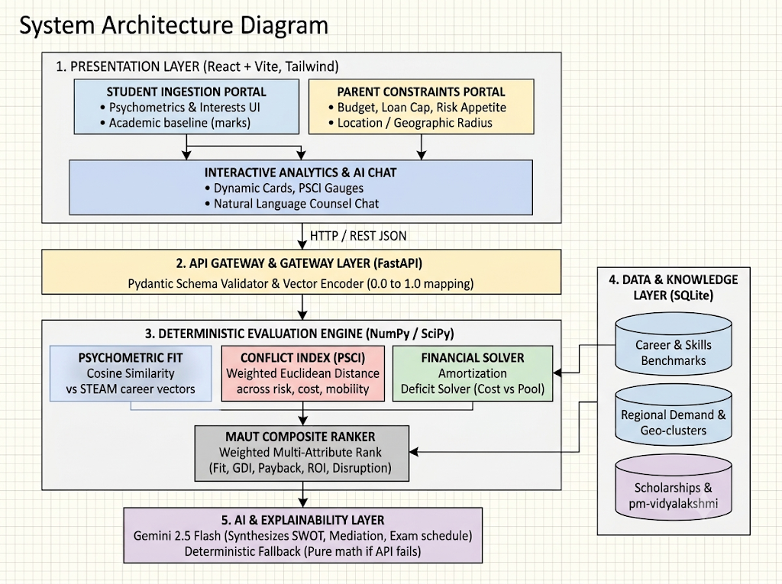
DATAQUEST 3.0 · ROUND 1
08 Architecture Deep-Dive
Appendix · Full layer-by-layer system architecture diagram
FULL ARCHITECTURE
HOW TO READ IT
LAYER BY LAYER
1 Presentation: two portals feed one analytics and chat view.
2 Gateway: validates inputs, encodes vectors to 0–1.
3 Engine: fit, PSCI and financial solver, then MAUT ranking.
4 Data: benchmarks, regional demand, scholarships.
5 AI: Gemini explains; pure math if the API fails.

