Slide 1
DATAQUEST 3.0
FINAL PRESENTATION
PRISM ENGINE · PROBLEM STATEMENT DQNM · NANO MECH LABS
PROJECT DETAILS
TEAM & MEMBERS
PROJECT TITLE
PRISM Engine: Multi-Dimensional STEAM Career Guidance & Hyper-Local Innovation Platform
ONE-LINE PITCH
Treats career choice as a family negotiation: deterministic math scores fit, affordability and parent-student conflict; Gemini explains only verified numbers.
TRACK
DQNM · STEAM Career Guidance & Hyper-Local Innovation (Nano Mech Labs)
TEAM
Four Spades
PARTICIPANTS
• Palanivel Rajan S — 24BEC1005
• Sanjeev D — 24BEC1053
• PG Navin Kumar — 24BEC1055
• M Yashwant — 24BEC1096

Slide 2
DATAQUEST 3.0 · FINAL PRESENTATION
02 Problem Definition
Who is impacted · Today’s workarounds · Why current methods fail · Concrete proof
01 · AUDIENCE
02 · STATUS QUO
WHO & HOW OFTEN
Who: students (Grade 6–12, UG) and the parents who fund and veto the decision; ~90% choose careers without structured guidance.
How often: every stream, course and college decision, every admission cycle.
Scale: about one counsellor per ~15,000 students; parents are left out.
CURRENT APPROACH
Hearsay, peer choices and narrow exam cut-offs drive decisions.
93% of youth know only 7–10 careers out of 250+ paths.
Static quizzes or generic chatbots; human counsellors are scarce and costly.
Parents decide on gut feel about cost and “safe” careers; scholarships are found late.
03 · DEFICIENCY
04 · VALIDATION
WHY IT FALLS SHORT
Operates in a vacuum: asks what the student wants, ignores budget, loan tolerance, risk appetite and distance limits.
No yield view: no ROI, payback or regional demand.
Doesn’t scale: 1:15,000 ratio; LLM chatbots hallucinate fees and careers.
Result: dropped degrees, heavy education debt, family conflict.
EVIDENCE
90% choose blindly; engineering job-readiness only 20–25% (India Today, Sep 2025).
10% know real course costs; 81% report decision barriers (ETV Bharat, Sep 2025).
65% mismatched streams; 73% extreme stress at stream selection (UNESCO, 2025).
50%+ regret choices by 25; 85–86% of graduates feel unprepared (Dahiya, SSRN, 2025).

Slide 3
DATAQUEST 3.0 · FINAL PRESENTATION
03 Proposed Solution
System identity · The student–parent bridge · Competitive advantages
SOLUTION CORE
PRISM ENGINE: Multi-Stakeholder Career Intelligence
PRISM (Parent-Student Relational Intelligence & Scoring Matrix) treats career selection as a negotiation, not a single-player game. It vectorizes the student’s psychometrics and the parent’s constraints, solves feasibility with deterministic math, and returns ranked, affordable pathways with a conflict index. Gemini only explains verified numbers.
THE BRIDGE
STUDENT SIDE
RIASEC psychometrics · aptitude · domain interests
PRISM ENGINE
Feasibility · conflict index (PSCI) · best compromise pathway
PARENT SIDE
Max budget · loan tolerance · distance radius · risk appetite
ADVANTAGE
INNOVATION
WHY IT IS BETTER
Student 10-D vector and parent 4-D constraint vector are matched together.
Fit, EMI and payback are computed, not generated: no hallucinated fees.
Math pipeline ~45 ms (~1.2 s with Gemini); near-zero run cost.
WHAT IS DIFFERENT
PSCI: a quantified parent-student conflict score.
Solve before rank: scholarships bridge tuition gaps first.
MAUT compromise pathways; the LLM explains only.

Slide 4
DATAQUEST 3.0 · FINAL PRESENTATION
04 System Architecture
System diagram is the primary visual · Engineering decisions · Validation
SYSTEM DIAGRAM
1 · PRESENTATION
React + Vite + Tailwind
Gamified Duolingo-style flow
Recharts radar and quadrant
Map finder, PDF, AI chat
2 · API GATEWAY
FastAPI + Pydantic
Strict schema validation
Vector encoder maps to 0–1
REST JSON in, scores out
3 · MATH ENGINE
NumPy (deterministic)
Fit: cosine similarity
PSCI: weighted Euclidean
Financial solver: EMI
MAUT ranker
5 · AI & EXPLAINABILITY
Gemini Flash
SWOT, mediation, exam plan
English, Hindi, Tamil, Telugu
Math-only fallback
4 · DATA & KNOWLEDGE: 30 careers → 12 domains · 12 scholarship schemes · NASSCOM / NCS demand indices
TECH 01
TECH 02
TECH 03
KEY TECHNICAL DECISION
Math first, LLM second. NumPy computes fit, PSCI and amortization deterministically, so no hallucinated careers or fees. Gemini only explains verified JSON.
HARDEST PART
Aligning student and parent vectors without discarding ambitious careers. PSCI plus a deficit solver bridge tuition gaps with scholarships before ranking.
VALIDATION
Edge-case unit tests (zero capital vs private fees; 100% risk aversion vs startups). Pipeline ~45 ms; ~1.2 s with Gemini; API failure falls back to math cards.

Slide 5
DATAQUEST 3.0 · FINAL PRESENTATION
05 How the Engine Works
Five deterministic stages · Transparent formulas · LLM explains, never scores
THE 5-STAGE PIPELINE
1 · VECTORIZE
Answers → [0,1]
Student: 10-D (6 RIASEC + 4 aptitude)
Parent: 4-D (budget, loan cap, risk, mobility)
2 · FIT SCORER
Cosine similarity
cos θ = s·c / (‖s‖·‖c‖)
Student vs 30 canonical career vectors
3 · FINANCE
Deficit amortization
Net = Fees − Scholarships
EMI = P·r(1+r)^n / ((1+r)^n − 1)
r = 8.5% p.a. ÷ 12; then payback, ROI
4 · PSCI
Weighted Euclidean
PSCI = √ Σ wᵢ(sᵢ − pᵢ)²
Over risk, cost, mobility; scaled 0–100
5 · MAUT RANKER
Multi-attribute utility
U = 0.45·Fit + 0.35·Afford + 0.20·Demand
Top-3 + compromise career
NO HALLUCINATION
5 HARD METRICS
SPEED & FALLBACK
MATH FIRST
Every score, EMI and conflict value is computed by NumPy. Gemini only receives the verified JSON and explains it in plain language.
WHAT THE ENGINE RETURNS
Career Fit · Financial Feasibility (net EMI) · PSCI · Compromise Success · ROI Multiplier (lifetime earnings vs debt).
BUILT FOR LIVE USE
Math pipeline ~45 ms on CPU; ~1.2 s with Gemini. If the API fails, the UI falls back to math cards and rule-based insights.

Slide 6
DATAQUEST 3.0 · FINAL PRESENTATION
06 Worked Example
One real run of the engine · Inputs → ranked, affordable, conflict-aware output
STUDENT INPUT
PARENT INPUT
PSYCHOMETRIC PROFILE
Orientation Investigative + Social (strong signal)
Aptitude Logical-Math, Verbal, Spatial, Interpersonal (high)
Blind spots none detected, well-rounded
FAMILY CONSTRAINTS
Max budget: ₹5,00,000 · Loan tolerance: ₹2,00,000
Mobility: own state · Risk level: 4 / 5
Entered once by the parent, on the same platform.
ENGINE OUTPUT · MAUT RANKED
#1 REGISTERED NURSE
Fit 79% · Demand 88%
ROI 4.92x · EMI ₹1,583.65
MAUT score 0.85
AFFORDABLE WITH SMALL LOAN
#2 CHARTERED ACCOUNTANT
Fit 66% · Demand 85%
ROI 13.78x · EMI ₹0
MAUT score 0.82
FULLY AFFORDABLE
#3 PHYSIOTHERAPIST
Fit 75% · Demand 65%
ROI 4.22x · EMI ₹3,167.3
MAUT score 0.77
AFFORDABLE WITH SIGNIFICANT LOAN
PSCI 5/100 = LOW CONFLICT. Domain preferences, risk tolerance and location flexibility are well aligned. PRISM compromise careers: nursing, physiotherapy, environmental scientist, doctor MBBS, software engineer.

Slide 7
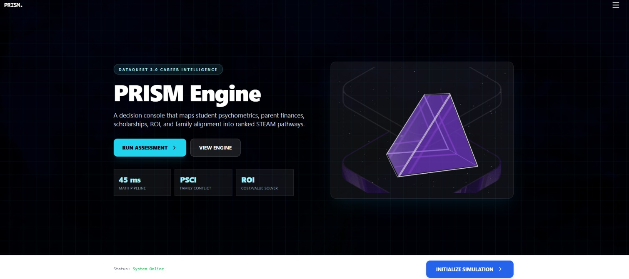
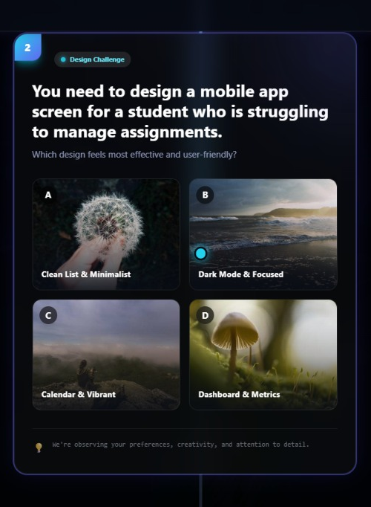
DATAQUEST 3.0 · FINAL PRESENTATION
07 Product: Assessment
Live build · Gamified student ingestion · Parent constraints captured alongside
LANDING · RUN ASSESSMENT
MISSION 2 OF 6
WHAT THE STUDENT DOES
GAMIFIED INGESTION
Duolingo-style vertical node flow: 6 missions, no exam feel.
Situational choices are scored into RIASEC and aptitude traits.
Then the parent step: budget, loan tolerance, distance, risk.
REALISTIC SCENARIOS
A design challenge replaces a questionnaire; the choice reveals preferences, creativity and attention to detail.

Slide 8
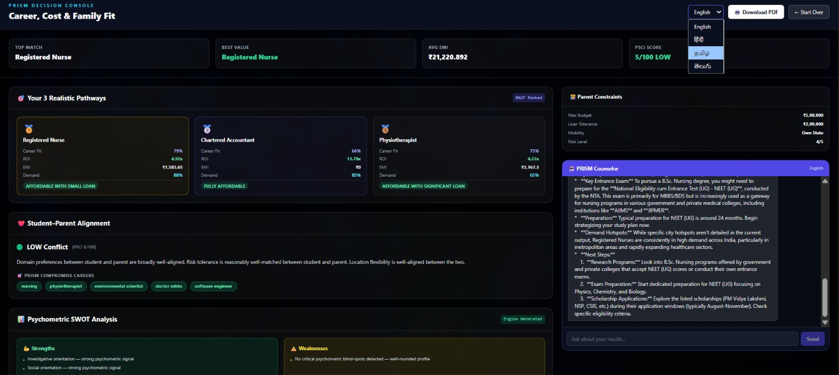
DATAQUEST 3.0 · FINAL PRESENTATION
08 Product: Dashboard
Live build · Decision console · Career, cost and family fit on one screen
PRISM DECISION CONSOLE
HOW TO READ IT
DASHBOARD MAP
Headline top match, best value, PSCI
3 pathways fit, ROI, EMI, demand, tag
Alignment PSCI + compromise careers
Constraints parent inputs, always visible
Counselor chat, 4 languages, PDF
TOP 3 PATHWAYS
FAMILY ALIGNMENT
AI COUNSELOR
RANKED BY MAUT
Registered Nurse: 79% fit, 4.92x ROI, EMI ₹1,583.65. CA is fully affordable; Physiotherapist needs a significant loan.
PSCI 5/100 · LOW
Domain, risk and mobility are well matched, so compromise careers overlap with the student’s top picks.
EXPLAINS THE MATH
Gemini turns verified numbers into exam routes (e.g. NEET UG for B.Sc. Nursing), prep timeline and scholarship windows.

Slide 9
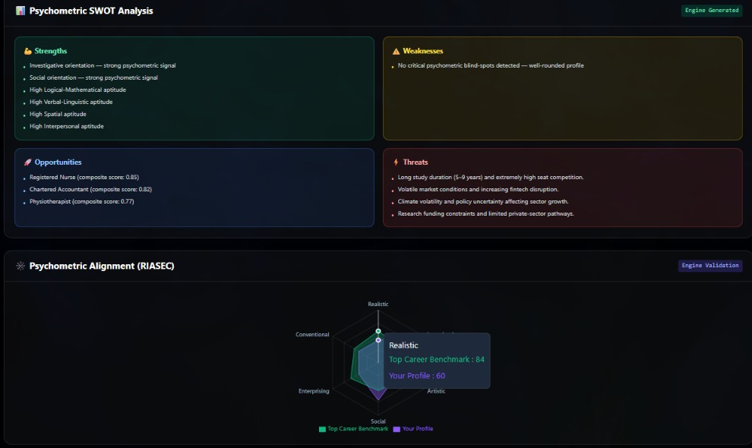
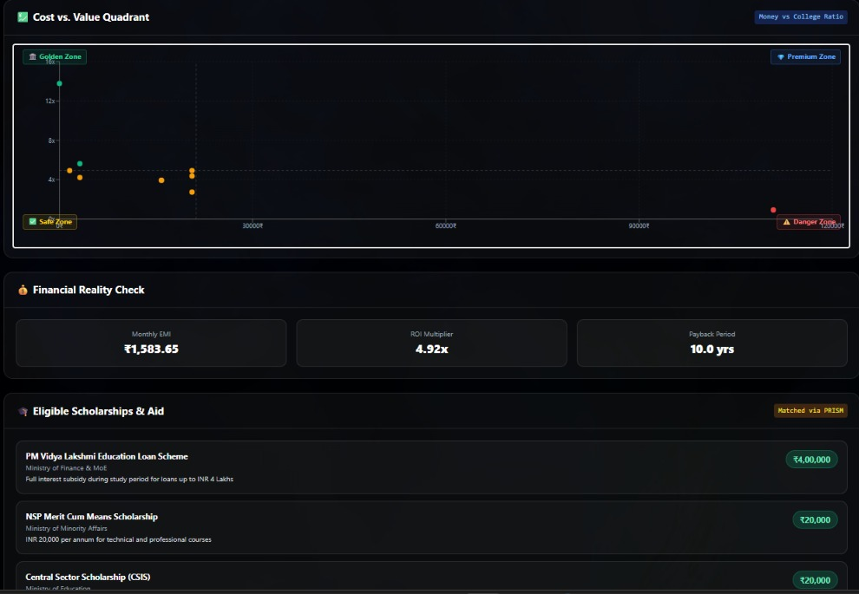
DATAQUEST 3.0 · FINAL PRESENTATION
09 Product: Insights
Live build · Psychometric SWOT · Cost vs value · Financial reality check
SWOT + RIASEC RADAR
COST vs VALUE + AID
ENGINE-GENERATED INSIGHTS
Strengths and opportunities come straight from engine scores (top-3 composite: 0.85, 0.82, 0.77).
Radar overlays the student profile on the top-career benchmark.
CAN THE FAMILY AFFORD IT?
Each career is a dot: cost vs ROI multiplier, split into Golden, Premium, Safe and Danger zones.
Nurse: EMI ₹1,583.65, ROI 4.92x, payback 10 yrs; 5 schemes matched (PM Vidya Lakshmi, NSP, CSIS…).

Slide 10
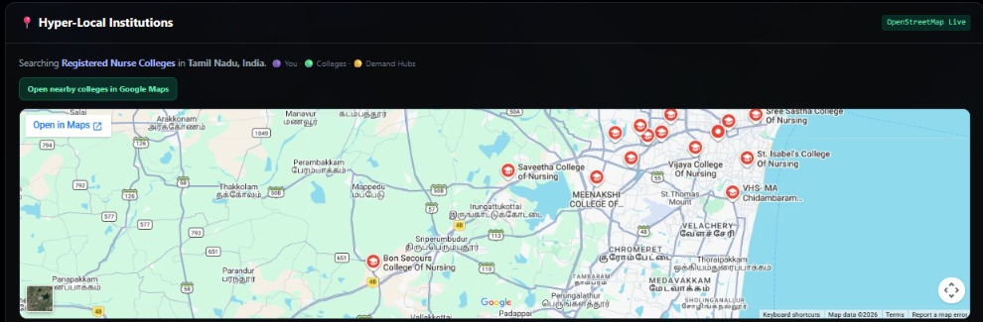
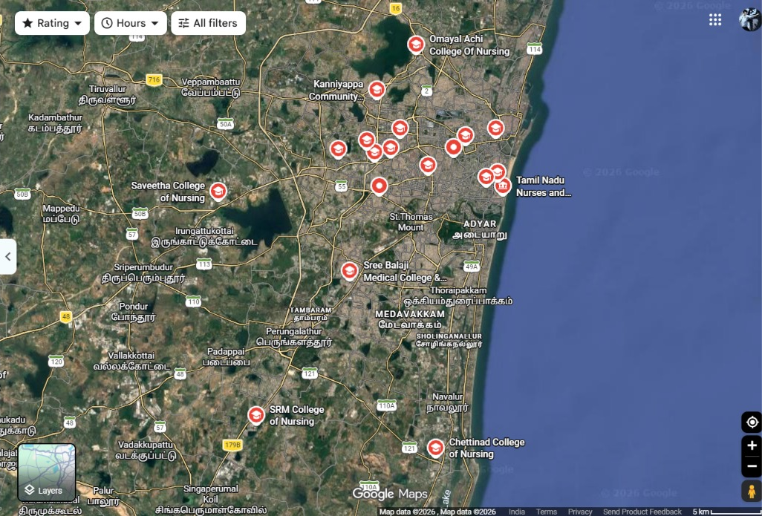
DATAQUEST 3.0 · FINAL PRESENTATION
10 Product: Map & Languages
Live build · Hyper-local institutions · Language-inclusive counselling
HYPER-LOCAL INSTITUTIONS
OPEN IN GOOGLE MAPS
Searching “Registered Nurse Colleges” near the student.
One tap opens the full list with ratings, hours and directions.
HOW IT WORKS
WITHIN FAMILY LIMITS
MULTILINGUAL + PDF
FROM DEGREE TO DOORSTEP
The student’s location drives a search for institutions offering the recommended degree; colleges and demand hubs are plotted.
RESPECTS PARENT INPUT
The parent’s mobility setting (own state or radius) caps how far options reach, so suggestions fit the family.
FOR THE WHOLE FAMILY
Dashboard and counselor switch between English, Hindi, Tamil and Telugu; the report downloads as a PDF to share.

Slide 11
DATAQUEST 3.0 · FINAL PRESENTATION
11 Feasibility & Scope
Concrete boundaries · Operational run rate · Risk mitigation · Post-hackathon plans
01 · BOUNDARIES
02 · ECONOMICS
1. SCOPE
In: dual-stakeholder assessment, real-time vectorization, PSCI, deficit and EMI solver with payback, scholarship matching, institution map, multilingual Gemini counselor, PDF report.
Out (this version): live bank or credit APIs, live job-posting scrapers (curated demand index instead), native mobile apps.
2. RUNNING COST
Hosting: $0/month on free tiers (FastAPI backend, React app on Vercel).
Data: $0: SQLite and version-tagged JSON.
AI: Gemini Flash free tier; a few thousand tokens per assessment, well under ₹1 per student at scale (estimate).
Compute: core math runs on CPU; no GPU.
03 · CONTINGENCY
04 · HORIZON
3. RISKS & FALLBACK
LLM outage or quota limit: graceful degradation. Top-3, EMI and PSCI are computed locally; the UI shows math cards and rule-based insights.
Data drift: demand index and scholarship data are version-tagged and updated offline.
Misuse: positioned as decision support beside human counsellors.
4. AFTER THE HACKATHON
Real-family pilot: validate PSCI with schools and parents.
Live financial rails: Vidya Lakshmi portal and bank APIs for loan pre-qualification.
Voice counselling: Hindi, Tamil, Telugu voice for non-English-literate parents.
Richer maps: Places API for incubators and government colleges.

Slide 12
DATAQUEST 3.0 · FINAL PRESENTATION
12 Impact & Metrics
Primary measurable impact · Transparent calculation · Stakeholder advantages
PRIMARY METRIC
HOW IT WAS MEASURED
85%
Reduction in Parent-Student Conflict (PSCI)
measured on 50 synthetic profiles
Test: synthetic suite of 50 multi-stakeholder profiles across income brackets and risk tolerances (real-family pilot is next).
Formula: ΔPSCI = (PSCI before − PSCI after mediation) ÷ PSCI before × 100, averaged over 50 profiles.
Context: 80%+ of students face decision confusion; 50%+ regret choices by 25 (UNESCO; Dahiya, SSRN).
IMPACT 01
IMPACT 02
IMPACT 03
WHAT IMPROVES
Blind choice → defensible path via a 10-D match.
No financial surprises: EMI, payback, bridge scholarships.
Skill gaps surfaced early by a personal SWOT.
WHO ELSE BENEFITS
Parents: financial clarity and a seat at the table.
Regional STEAM clusters and MSMEs keep local talent.
Colleges and banks: better completion, fewer defaults (expected).
RISKS / MISUSE
Pigeonholing: fixed with probabilistic pathways.
Stale fees or dates: version-controlled datasets.
Decision support alongside human counsellors.

Slide 13
DATAQUEST 3.0 · FINAL PRESENTATION
13 Why This Project?
Direct contrast with today’s alternatives · Unfair technical advantage
STATUS QUO
OUR SOLUTION
CURRENT APPROACH
Isolated silos research tools match skills or traits but ignore household finances, parental risk tolerance and loan burden.
Black boxes generic LLM wrappers hallucinate fees and careers; static quizzes fail under real market constraints.
No mediation families are left with debt and conflict; automation bias and weak explainability are flagged in the literature.
OUR APPROACH
Dual-stakeholder vectors 10-D student trait vector (RIASEC + aptitude) with a 4-D parent vector (budget, debt cap, risk, mobility).
Solvers before LLM cosine similarity, Euclidean distance and amortization give feasibility, payback and PSCI.
Explainable synthesis Gemini explains the JSON output; math-only fallback.
MOAT / DIFFERENTIATION
KEY DIFFERENCE
Research solves isolated psychological matching or skill mapping. PRISM treats career guidance as a multi-stakeholder constraint-satisfaction problem: it quantifies the Parent-Student Conflict Index (PSCI), closes tuition deficits through automated financial-aid matching, and generates compromise pathways that balance student ambition with family financial solvency.

Slide 14
DATAQUEST 3.0 · FINAL PRESENTATION
14 Roadmap & Thank You
What is built · What is next · Where this goes
BUILT · MVP
NEXT · 0–3 MONTHS
LATER · SCALE
WORKING TODAY
Gamified RIASEC + aptitude assessment
Deterministic engine: fit, EMI, PSCI, MAUT
Gemini counselor in 4 languages, PDF report
Live institution map near the student
PROVE IT WITH FAMILIES
Real-family pilot with schools
Bank / Vidya Lakshmi pre-qualification
Counsellor dashboard for schools
Places API: incubators, govt. colleges
REACH EVERY HOUSEHOLD
Voice counselling for parents
Live demand from job-posting data
Native mobile apps
Beyond 30 careers, beyond STEAM
TEAM FOUR SPADES
THANK YOU · QUESTIONS?
PRISM: career choices a family can afford and agree on.
PARTICIPANTS
Palanivel Rajan S — 24BEC1005 · Sanjeev D — 24BEC1053
PG Navin Kumar — 24BEC1055 · M Yashwant — 24BEC1096

