Slide 1

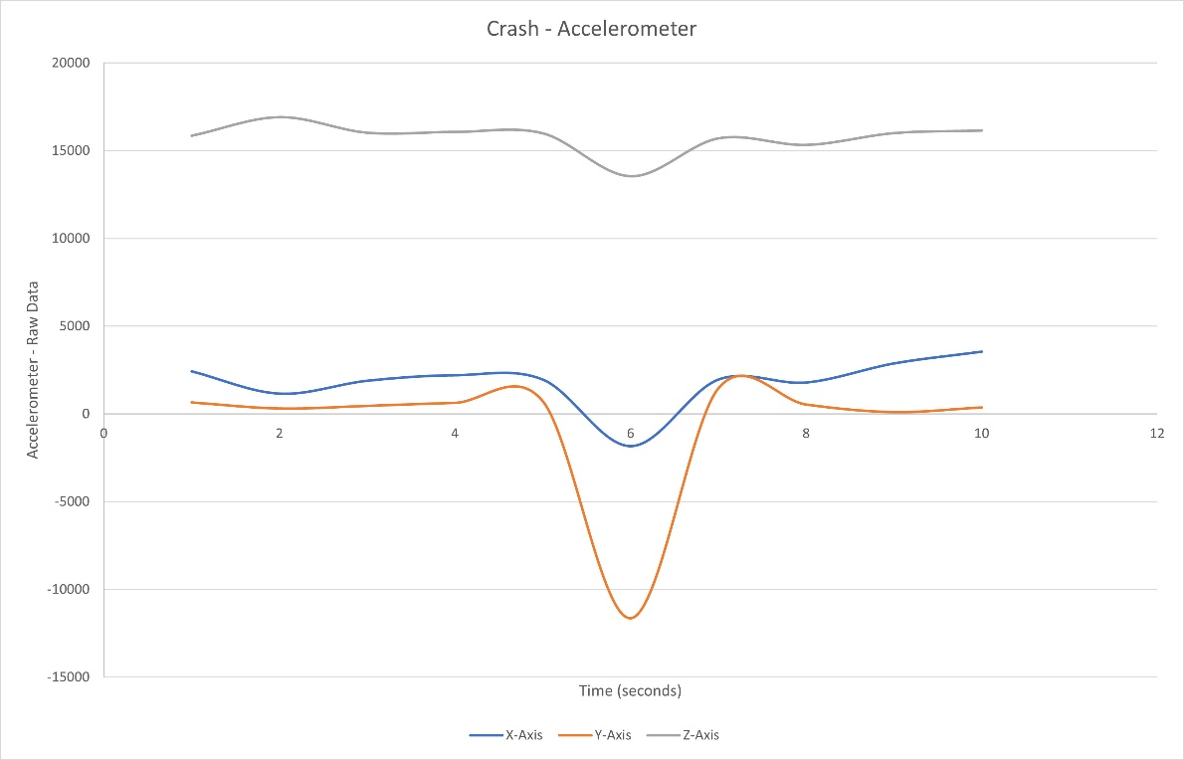
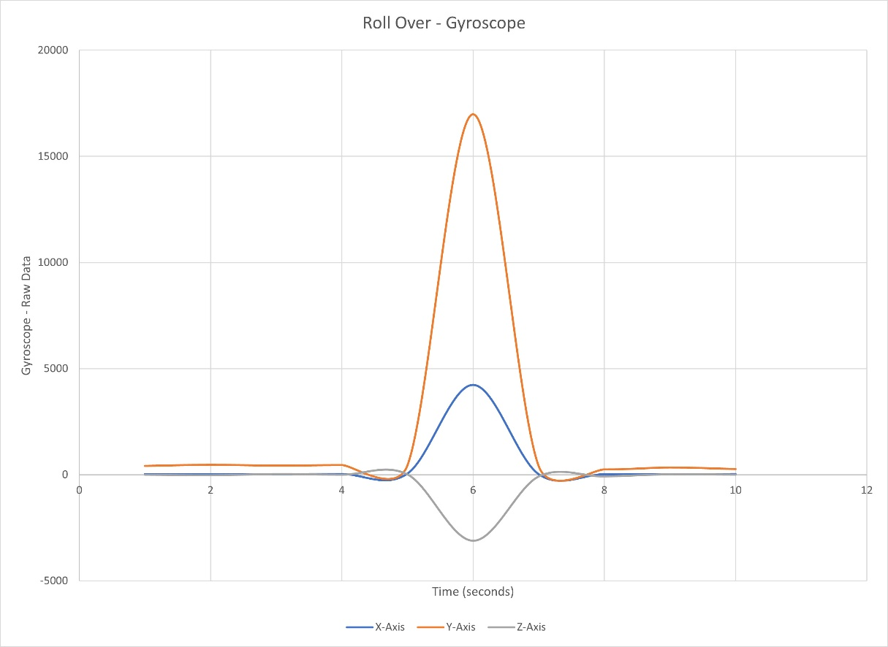

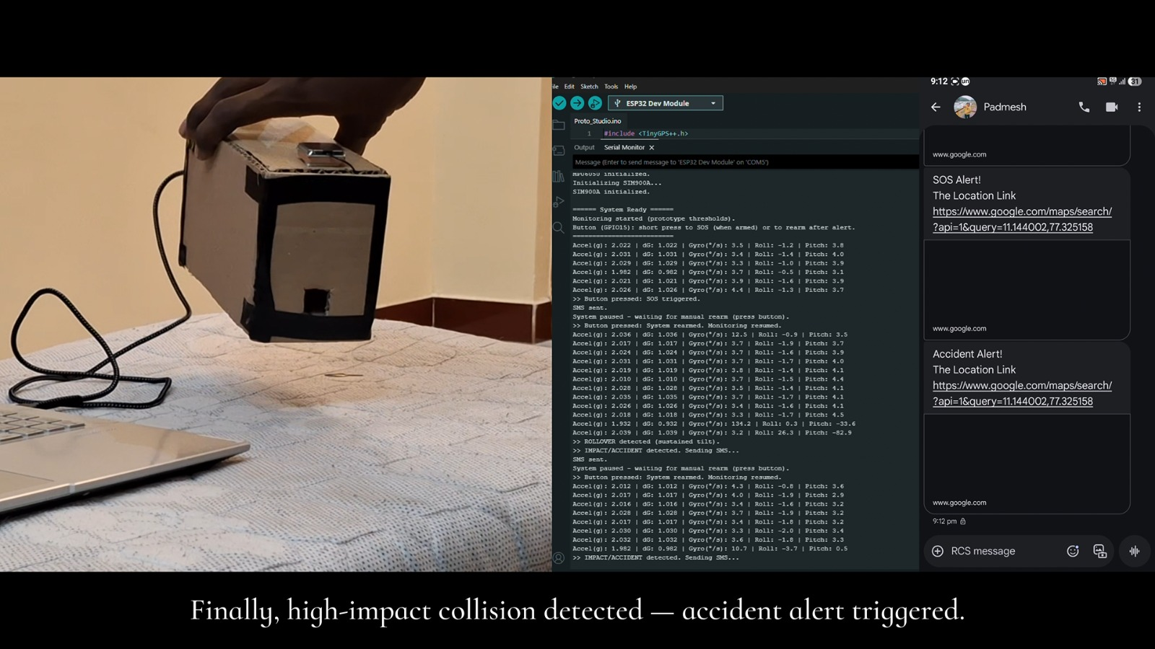
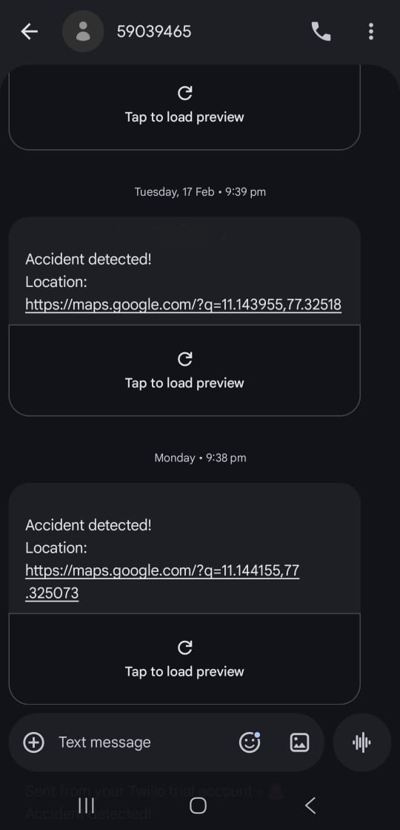
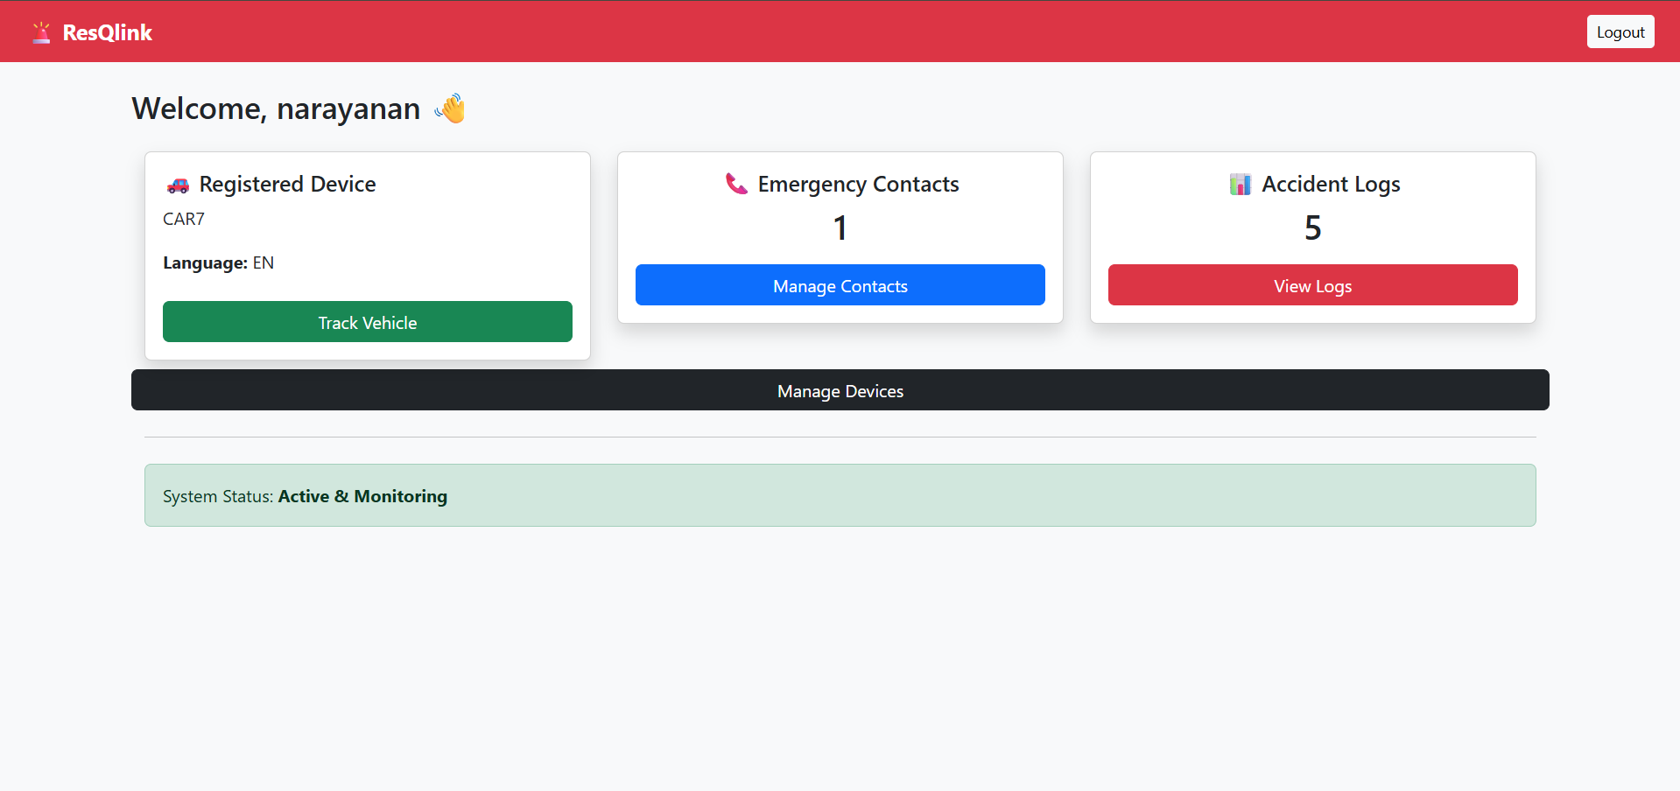
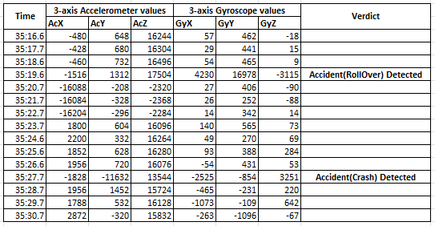
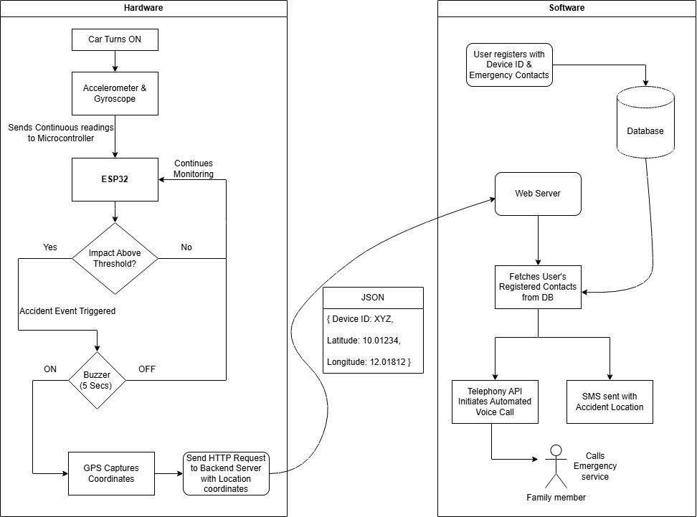



Intelligent Vehicular Emergency Communication System
Prawin V S| Dr. Himangshu Deka | Electronics and Communication Engineering
Motivation/ Introduction
Results
Road accidents cause over 1.19 million deaths globally each year, and timely emergency response during the “Golden Hour” is critical for saving lives. However, many existing accident alert systems rely on SMS notifications, which may fail as people do not check their SMS often. ResQLink proposes a hardware-based intelligent accident detection and emergency communication system that automatically detects collisions and alerts emergency contacts using multilingual voice calls, GPS location sharing, and GSM fallback communication to ensure reliable emergency response.
SCOPE of the Project
The ResQLink system aims to improve road safety by bringing accident detection and emergency communication features to all vehicles through an affordable and scalable solution. The system automatically detects collisions using embedded sensors and instantly shares the vehicle’s GPS location with emergency contacts. By integrating multilingual automated voice alerts and a hybrid communication architecture with GSM fallback, the system ensures reliable emergency notification even during network instability. In addition to accident alerting, the system includes a secure web dashboard where users can manage emergency contacts and view past accident records. It also supports future enhancements such as satellite-based emergency communication for remote areas.
Accelerometer readings during a simulated crash event showing sudden deviation in acceleration values.
Methodology
The proposed ResQLink system consists of an in-vehicle hardware module and a backend communication platform. The hardware module integrates an ESP32 microcontroller, MPU6050 accelerometer sensor, NEO-6M GPS module, and SIM900 GSM module to monitor vehicle motion and detect potential accidents. When abnormal motion is detected, the device captures the vehicle's location and transmits the information to the backend server, which automatically initiates emergency alerts.
Accident Detection Algorithm
Accident detection is performed using multi-axis acceleration analysis obtained from the MPU6050 sensor. The resultant acceleration magnitude is calculated using the Euclidean norm:
$$A=\sqrt{a_{x}^{2}+a_{y}^{2}+a_{z}^{2}}$$
$$Pitch={tan⁡}^{−1}\left(\frac{a_{x}}{\sqrt{a_{y}^{2}+a_{z}^{2}}}\right)×\frac{180}{π} \\ Roll={tan⁡}^{−1}\left(\frac{a_{y}}{\sqrt{a_{x}^{2}+a_{z}^{2}}}\right)×\frac{180}{π}$$
If the calculated acceleration exceeds a predefined impact threshold, the system identifies a potential collision event. Additional orientation analysis using pitch and roll helps reduce false triggers caused by sudden braking or road disturbances.
Automated emergency voice call triggered after accident detection.
ResQLink web dashboard displaying device information and accident records.
3-axis accelerometer and gyroscope data used to identify crash and rollover accidents.
Operational Workflow
The system continuously monitors vehicle motion using the accelerometer sensor. When a collision is detected, the device captures the latest GPS coordinates and sends them to the backend server. The backend retrieves registered emergency contacts and initiates automated multilingual voice alerts. If internet connectivity fails, the GSM module sends an SMS alert with the location link, ensuring reliable emergency communication.
Conclusion/ Summary
The proposed ResQLink system presents an affordable and reliable accident detection and emergency communication solution designed for deployment across a wide range of vehicles. By integrating real-time motion sensing, GPS-based location tracking, multilingual automated voice alerts, and GSM fallback communication, the system ensures rapid and dependable emergency notification during accident scenarios. Experimental testing demonstrates that the system can accurately detect high-impact events and trigger emergency alerts within a few seconds.
Unlike conventional SMS-based systems, ResQLink improves emergency response through automated voice alerts and hybrid communication. Its low-cost, scalable design supports wide deployment, with future enhancements including satellite-based emergency alerts using lightweight Iridium modules for completely network-less areas.
The graph illustrates raw accelerometer readings along the X, Y, and Z axes during a simulated crash event. Under normal conditions, acceleration values remain within a stable range.
User registration process where the user enters name, vehicle ID, preferred language, and emergency contact numbers.
Contact Details
23ec084@kpriet.ac.in, 23ec101@kpriet.ac.in, 23ec105@kpriet.ac.in, 23ec091@kpriet.ac.in, 23cs152@kpriet.ac.in
Acknowledgments/ References
We gratefully acknowledge the support of our project guide and the Department of ECE. KPRIET.
“An IoT-Based Automatic Vehicle Accident Detection and Visual Situation Reporting System ”, Wiley: Journal of Adv. Transportation. vol. 2024, May 2024.

